Slide 1
CS 3006 Parallel and Distributed Computing
Instructor: Dr. Hassan Jamil Syed
Email: hassan.jamil@nu.edu.pk

Slide 2
Textbook
• Introductin to Parallel Computing 2nd Ed. By Ananth Grama, Anshul Gupta, George Karypis, Vipin Kumar
Book reading is must.

Slide 3
Reference Book
Parallel and High Performance Computing by ROBERT ROBEY AND YULIANA ZAMORA

Slide 4
Google Classroom
All lectures and course material will be shared on google classroom.
Joining Google Classroom is must.
If you are not enrolled in google classroom, must email me as soon as possible.

Slide 5
Evaluation Criteria
Class Activities (5%)
Assignments (5%)
Projects (10%)
Mid Term (15+15=30%)
Final (50%)
• Plagiarized submissions will be marked as Zero.
• Late submissions are not allowed.

Slide 6
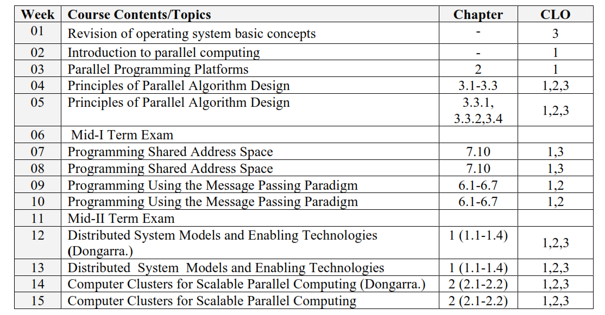
Tentative Course Outline

Slide 7
Introduction to Parallel Computing

Slide 8
Abstract
This presentation covers the basics of parallel computing. Beginning with a brief overview and some concepts and terminology associated with parallel computing, the topics of parallel memory architectures and programming models are then explored. These topics are followed by a discussion on a number of issues related to designing parallel programs. The last portion of the presentation is spent examining how to parallelize several different types of serial programs.
Level/Prerequisites: None

Slide 9
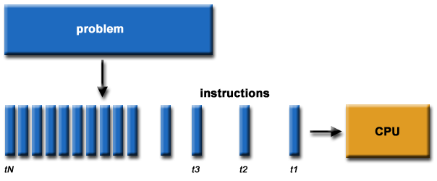
What is Parallel Computing? (1)
Traditionally, software has been written for serial computation:
To be run on a single computer having a single Central Processing Unit (CPU);
A problem is broken into a discrete series of instructions.
Instructions are executed one after another.
Only one instruction may execute at any moment in time.

Slide 10
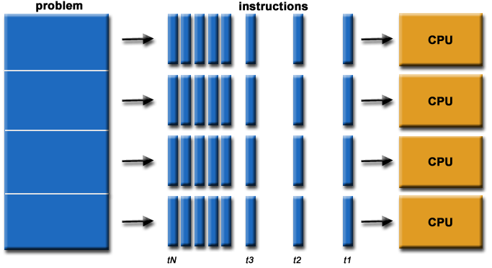
What is Parallel Computing? (2)
In the simplest sense, parallel computing is the simultaneous use of multiple compute resources to solve a computational problem.
To be run using multiple CPUs
A problem is broken into discrete parts that can be solved concurrently
Each part is further broken down to a series of instructions
Instructions from each part execute simultaneously on different CPUs

Slide 11
Parallel Computing: Resources
The compute resources can include:
A single computer with multiple processors;
A single computer with (multiple) processor(s) and some specialized computer resources (GPU, FPGA …)
An arbitrary number of computers connected by a network;
A combination of both.

Slide 12
Parallel Computing: The computational problem
The computational problem usually demonstrates characteristics such as the ability to be:
Broken apart into discrete pieces of work that can be solved simultaneously;
Execute multiple program instructions at any moment in time;
Solved in less time with multiple compute resources than with a single compute resource.

Slide 13
Parallel Computing: what for? (1)
Parallel computing is an evolution of serial computing that attempts to emulate what has always been the state of affairs in the natural world: many complex, interrelated events happening at the same time, yet within a sequence.
Some examples:
Planetary and galactic orbits
Weather and ocean patterns
Tectonic plate drift
Rush hour traffic in Paris
Automobile assembly line
Daily operations within a business
Building a shopping mall
Ordering a hamburger at the drive through.

Slide 14
Parallel Computing: what for? (2)
Traditionally, parallel computing has been considered to be "the high end of computing" and has been motivated by numerical simulations of complex systems and "Grand Challenge Problems" such as:
weather and climate
chemical and nuclear reactions
biological, human genome
geological, seismic activity
mechanical devices - from prosthetics to spacecraft
electronic circuits
manufacturing processes

Slide 15
Parallel Computing: what for? (3)
Today, commercial applications are providing an equal or greater driving force in the development of faster computers. These applications require the processing of large amounts of data in sophisticated ways. Example applications include:
parallel databases, data mining
oil exploration
web search engines, web based business services
computer-aided diagnosis in medicine
management of national and multi-national corporations
advanced graphics and virtual reality, particularly in the entertainment industry
networked video and multi-media technologies
collaborative work environments
Ultimately, parallel computing is an attempt to maximize the infinite but seemingly scarce commodity called time.

Slide 16
Why Parallel Computing? (1)
This is a legitime question! Parallel computing is complex on any aspect!
The primary reasons for using parallel computing:
Save time - wall clock time
Solve larger problems
Provide concurrency (do multiple things at the same time)

Slide 17
Why Parallel Computing? (2)
Other reasons might include:
Taking advantage of non-local resources - using available compute resources on a wide area network, or even the Internet when local compute resources are scarce.
Cost savings - using multiple "cheap" computing resources instead of paying for time on a supercomputer.
Overcoming memory constraints - single computers have very finite memory resources. For large problems, using the memories of multiple computers may overcome this obstacle.

Slide 18
Limitations of Serial Computing
Limits to serial computing - both physical and practical reasons pose significant constraints to simply building ever faster serial computers.
Transmission speeds - the speed of a serial computer is directly dependent upon how fast data can move through hardware. Absolute limits are the speed of light (30 cm/nanosecond) and the transmission limit of copper wire (9 cm/nanosecond). Increasing speeds necessitate increasing proximity of processing elements.
Limits to miniaturization - processor technology is allowing an increasing number of transistors to be placed on a chip. However, even with molecular or atomic-level components, a limit will be reached on how small components can be.
Economic limitations - it is increasingly expensive to make a single processor faster. Using a larger number of moderately fast commodity processors to achieve the same (or better) performance is less expensive.

Slide 19
The future
during the past 10 years, the trends indicated by ever faster networks, distributed systems, and multi-processor computer architectures (even at the desktop level) clearly show that parallelism is the future of computing.
It will be multi-forms, mixing general purpose solutions (your PC…) and very speciliazed solutions as IBM Cells, ClearSpeed, GPGPU from NVidia …

Slide 20
Who and What? (1)
Top500.org provides statistics on parallel computing users - the charts below are just a sample. Some things to note:
Sectors may overlap - for example, research may be classified research. Respondents have to choose between the two.
"Not Specified" is by far the largest application - probably means multiple applications.

Slide 21
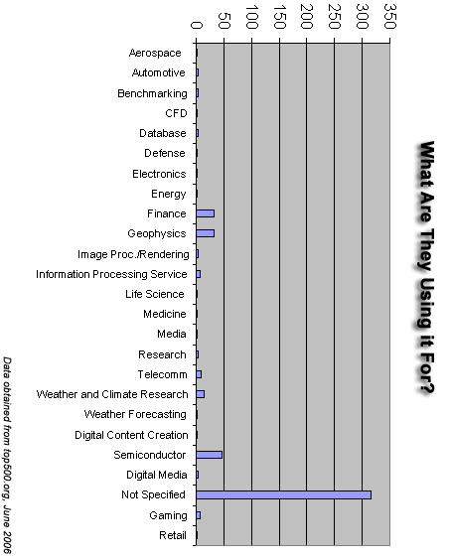
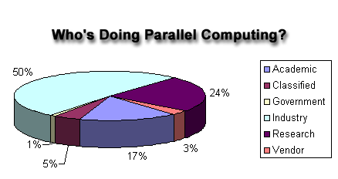
Who and What? (2)

Slide 22
Concepts and Terminology

Slide 23
Von Neumann Architecture
For over 40 years, virtually all computers have followed a common machine model known as the von Neumann computer. Named after the Hungarian mathematician John von Neumann.
A von Neumann computer uses the stored-program concept. The CPU executes a stored program that specifies a sequence of read and write operations on the memory.

Slide 24
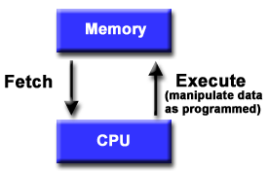
Basic Design
Basic design
Memory is used to store both program and data instructions
Program instructions are coded data which tell the computer to do something
Data is simply information to be used by the program
A central processing unit (CPU) gets instructions and/or data from memory, decodes the instructions and then sequentially performs them.

Slide 25
Flynn's Classical Taxonomy
There are different ways to classify parallel computers. One of the more widely used classifications, in use since 1966, is called Flynn's Taxonomy.
Flynn's taxonomy distinguishes multi-processor computer architectures according to how they can be classified along the two independent dimensions of Instruction and Data. Each of these dimensions can have only one of two possible states: Single or Multiple.

Slide 26
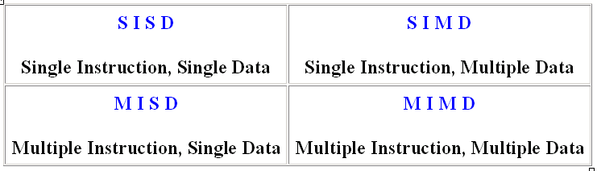
Flynn Matrix
The matrix below defines the 4 possible classifications according to Flynn

Slide 27
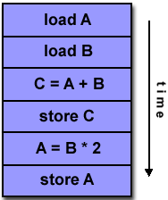
Single Instruction, Single Data (SISD)
A serial (non-parallel) computer
Single instruction: only one instruction stream is being acted on by the CPU during any one clock cycle
Single data: only one data stream is being used as input during any one clock cycle
Deterministic execution
This is the oldest and until recently, the most prevalent form of computer
Examples: most PCs, single CPU workstations and mainframes

Slide 28
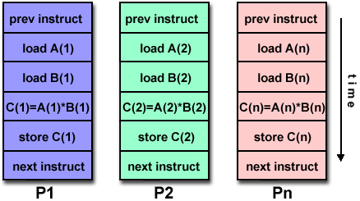
Single Instruction, Multiple Data (SIMD)
A type of parallel computer
Single instruction: All processing units execute the same instruction at any given clock cycle
Multiple data: Each processing unit can operate on a different data element
This type of machine typically has an instruction dispatcher, a very high-bandwidth internal network, and a very large array of very small-capacity instruction units.
Best suited for specialized problems characterized by a high degree of regularity,such as image processing.
Synchronous (lockstep) and deterministic execution
Two varieties: Processor Arrays and Vector Pipelines
Examples:
Processor Arrays: Connection Machine CM-2, Maspar MP-1, MP-2
Vector Pipelines: IBM 9000, Cray C90, Fujitsu VP, NEC SX-2, Hitachi S820

Slide 29
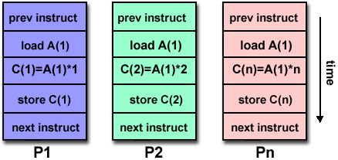
Multiple Instruction, Single Data (MISD)
A single data stream is fed into multiple processing units.
Each processing unit operates on the data independently via independent instruction streams.
Few actual examples of this class of parallel computer have ever existed. One is the experimental Carnegie-Mellon C.mmp computer (1971).
Some conceivable uses might be:
multiple frequency filters operating on a single signal stream
multiple cryptography algorithms attempting to crack a single coded message.

Slide 30
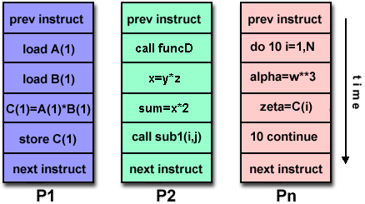
Multiple Instruction, Multiple Data (MIMD)
Currently, the most common type of parallel computer. Most modern computers fall into this category.
Multiple Instruction: every processor may be executing a different instruction stream
Multiple Data: every processor may be working with a different data stream
Execution can be synchronous or asynchronous, deterministic or non-deterministic
Examples: most current supercomputers, networked parallel computer "grids" and multi-processor SMP computers - including some types of PCs.

Slide 31
Some General Parallel Terminology
Like everything else, parallel computing has its own "jargon". Some of the more commonly used terms associated with parallel computing are listed below. Most of these will be discussed in more detail later.
Task
A logically discrete section of computational work. A task is typically a program or program-like set of instructions that is executed by a processor.
Parallel Task
A task that can be executed by multiple processors safely (yields correct results)
Serial Execution
Execution of a program sequentially, one statement at a time. In the simplest sense, this is what happens on a one processor machine. However, virtually all parallel tasks will have sections of a parallel program that must be executed serially.

Slide 32
Parallel Execution
Execution of a program by more than one task, with each task being able to execute the same or different statement at the same moment in time.
Shared Memory
From a strictly hardware point of view, describes a computer architecture where all processors have direct (usually bus based) access to common physical memory. In a programming sense, it describes a model where parallel tasks all have the same "picture" of memory and can directly address and access the same logical memory locations regardless of where the physical memory actually exists.
Distributed Memory
In hardware, refers to network based memory access for physical memory that is not common. As a programming model, tasks can only logically "see" local machine memory and must use communications to access memory on other machines where other tasks are executing.

Slide 33
Communications
Parallel tasks typically need to exchange data. There are several ways this can be accomplished, such as through a shared memory bus or over a network, however the actual event of data exchange is commonly referred to as communications regardless of the method employed.
Synchronization
The coordination of parallel tasks in real time, very often associated with communications. Often implemented by establishing a synchronization point within an application where a task may not proceed further until another task(s) reaches the same or logically equivalent point.
Synchronization usually involves waiting by at least one task, and can therefore cause a parallel application's wall clock execution time to increase.

Slide 34
Granularity
In parallel computing, granularity is a qualitative measure of the ratio of computation to communication.
Coarse: relatively large amounts of computational work are done between communication events
Fine: relatively small amounts of computational work are done between communication events
Observed Speedup
Observed speedup of a code which has been parallelized, defined as:
wall-clock time of serial execution
wall-clock time of parallel execution
One of the simplest and most widely used indicators for a parallel program's performance.

Slide 35
Parallel Overhead
The amount of time required to coordinate parallel tasks, as opposed to doing useful work. Parallel overhead can include factors such as:
Task start-up time
Synchronizations
Data communications
Software overhead imposed by parallel compilers, libraries, tools, operating system, etc.
Task termination time
Massively Parallel
Refers to the hardware that comprises a given parallel system - having many processors. The meaning of many keeps increasing, but currently BG/L* pushes this number to 6 digits.
*Blue Gene is an IBM project aimed at designing supercomputers that can reach operating
speeds in the petaFLOPS (PFLOPS) range, with low power consumption.

Slide 36
Scalability
Refers to a parallel system's (hardware and/or software) ability to demonstrate a proportionate increase in parallel speedup with the addition of more processors. Factors that contribute to scalability include:
Hardware - particularly memory-cpu bandwidths and network communications
Application algorithm
Parallel overhead related
Characteristics of your specific application and coding

Slide 37
Parallel Computer Memory Architectures

Slide 38
Memory architectures
Shared Memory
Distributed Memory
Hybrid Distributed-Shared Memory

Slide 39
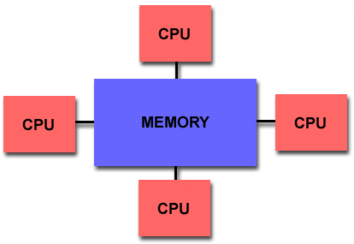
Shared Memory
Shared memory parallel computers vary widely, but generally have in common the ability for all processors to access all memory as global address space.
Multiple processors can operate independently but share the same memory resources.
Changes in a memory location effected by one processor are visible to all other processors.
Shared memory machines can be divided into two main classes based upon memory access times: UMA and NUMA.

Slide 40
Shared Memory : UMA vs. NUMA
Uniform Memory Access (UMA):
Most commonly represented today by Symmetric Multiprocessor (SMP) machines
Identical processors
Equal access and access times to memory
Sometimes called CC-UMA - Cache Coherent UMA. Cache coherent means if one processor updates a location in shared memory, all the other processors know about the update. Cache coherency is accomplished at the hardware level.
Non-Uniform Memory Access (NUMA):
Often made by physically linking two or more SMPs
One SMP can directly access memory of another SMP
Not all processors have equal access time to all memories
Memory access across link is slower
If cache coherency is maintained, then may also be called CC-NUMA - Cache Coherent NUMA

Slide 41
Shared Memory: Pro and Con
Advantages
Global address space provides a user-friendly programming perspective to memory
Data sharing between tasks is both fast and uniform due to the proximity of memory to CPUs
Disadvantages:
Primary disadvantage is the lack of scalability between memory and CPUs. Adding more CPUs can geometrically increases traffic on the shared memory-CPU path, and for cache coherent systems, geometrically increase traffic associated with cache/memory management.
Programmer responsibility for synchronization constructs that insure "correct" access of global memory.
Expense: it becomes increasingly difficult and expensive to design and produce shared memory machines with ever increasing numbers of processors.

Slide 42
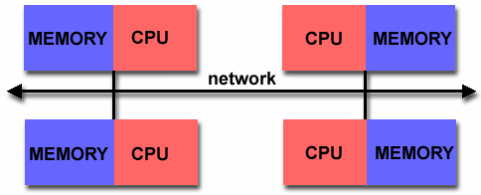
Distributed Memory
Like shared memory systems, distributed memory systems vary widely but share a common characteristic. Distributed memory systems require a communication network to connect inter-processor memory.
Processors have their own local memory. Memory addresses in one processor do not map to another processor, so there is no concept of global address space across all processors.
Because each processor has its own local memory, it operates independently. Changes it makes to its local memory have no effect on the memory of other processors. Hence, the concept of cache coherency does not apply.
When a processor needs access to data in another processor, it is usually the task of the programmer to explicitly define how and when data is communicated. Synchronization between tasks is likewise the programmer's responsibility.
The network "fabric" used for data transfer varies widely, though it can can be as simple as Ethernet.

Slide 43
Distributed Memory: Pro and Con
Advantages
Memory is scalable with number of processors. Increase the number of processors and the size of memory increases proportionately.
Each processor can rapidly access its own memory without interference and without the overhead incurred with trying to maintain cache coherency.
Cost effectiveness: can use commodity, off-the-shelf processors and networking.
Disadvantages
The programmer is responsible for many of the details associated with data communication between processors.
It may be difficult to map existing data structures, based on global memory, to this memory organization.
Non-uniform memory access (NUMA) times

Slide 44
Hybrid Distributed-Shared Memory
Summarizing a few of the key characteristics of shared and distributed memory machines
Comparison of Shared and Distributed Memory Architectures
Architecture | CC-UMA | CC-NUMA | Distributed
Examples | SMPs Sun Vexx DEC/Compaq SGI Challenge IBM POWER3 | Bull NovaScale SGI Origin Sequent HP Exemplar DEC/Compaq IBM POWER4 (MCM) | Cray T3E Maspar IBM SP2 IBM BlueGene
Communications | MPI Threads OpenMP shmem | MPI Threads OpenMP shmem | MPI
Scalability | to 10s of processors | to 100s of processors | to 1000s of processors
Draw Backs | Memory-CPU bandwidth | Memory-CPU bandwidth Non-uniform access times | System administration Programming is hard to develop and maintain
Software Availability | many 1000s ISVs | many 1000s ISVs | 100s ISVs

Slide 45
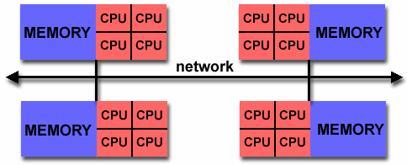
Hybrid Distributed-Shared Memory
The largest and fastest computers in the world today employ both shared and distributed memory architectures.
The shared memory component is usually a cache coherent SMP machine. Processors on a given SMP can address that machine's memory as global.
The distributed memory component is the networking of multiple SMPs. SMPs know only about their own memory - not the memory on another SMP. Therefore, network communications are required to move data from one SMP to another.
Current trends seem to indicate that this type of memory architecture will continue to prevail and increase at the high end of computing for the foreseeable future.
Advantages and Disadvantages: whatever is common to both shared and distributed memory architectures.

