Slide 1


Team “Chicago”

Slide 2
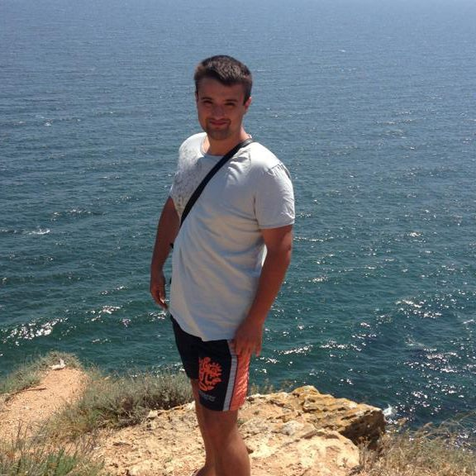
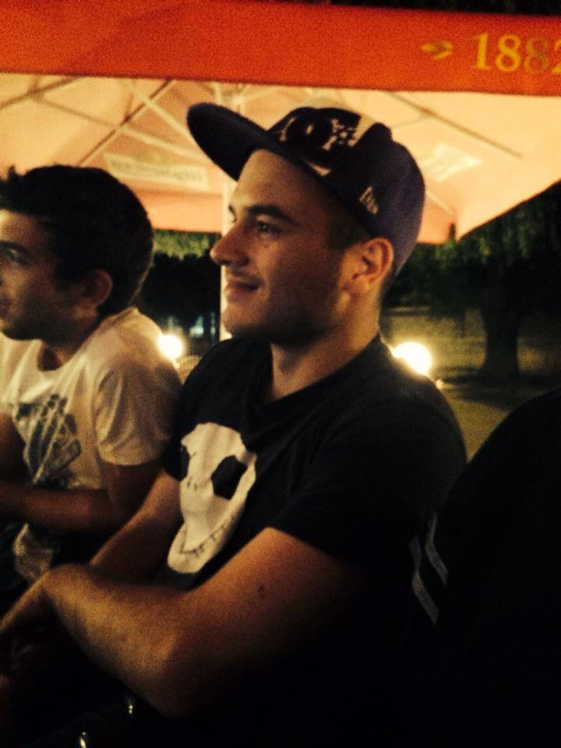
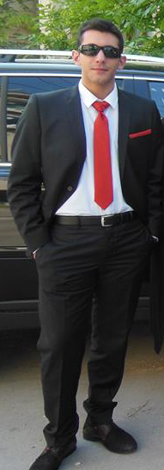
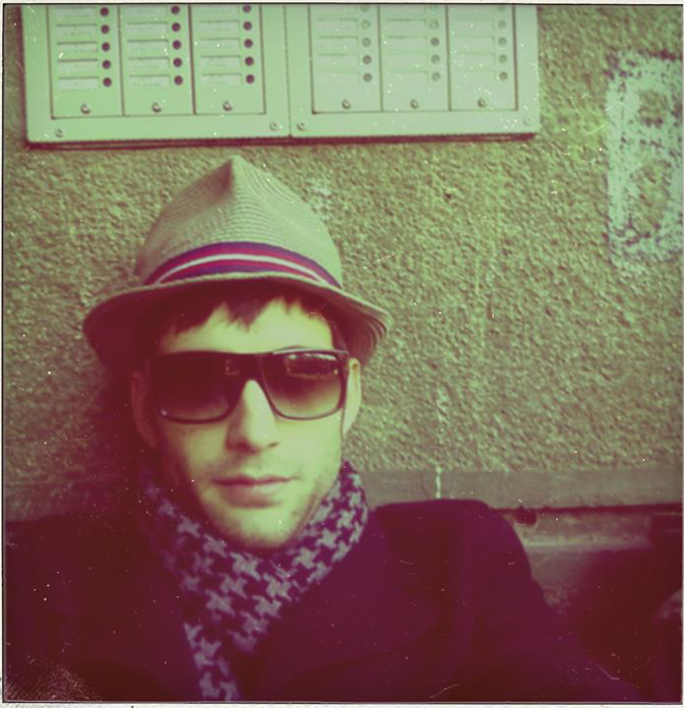
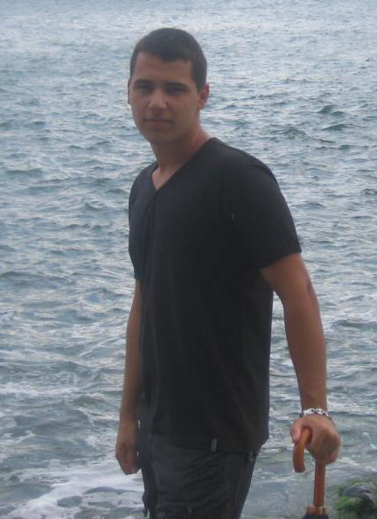
Team Members
Hristo Penchev
Plamen Grozdev
Iliq Bakyrdjiev
Alexandyr Bekya
Kristian Lubenov

Slide 3
The Project
“SportsMen” is a forum with sport articles about Bulgarian football, world football, volleyball, basketball and many other sports

