Slide 1


Mecanistic (compartmental) models in life science
Irene Balelli – irene.balelli@inria.fr

Slide 2
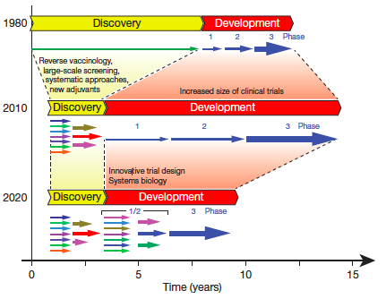
Motivation: All models are wrong, but some are useful!
Rappuoli R, Aderem A. A 2020 vision for vaccines against HIV, tuberculosis and malaria. Nature 2011;473:463–469.

Slide 3
Compartmental models: how
Delimit the problem of interest you want to study
Collect available data/Generate data
Identify the main actors contributing to the observed phenomena:
Cell types (e.g. in immunology…)
Subset of the population (e.g. in epidemiology…)
…
Clarify the interactions among the actors
Translate in equations
Observables
Compartments
ODE
Compartments → State variables
Interactions → Coefficients

Slide 4
Compartmental models ODE based: why
Use previous knowledge about the question of interest
Easily integrate additional knowledge when available to improve the model
Clearly understand the interactions, the biological meaning of parameters
Improved comprehension of the outputs
Longitudinal data → dynamical systems → ODE
Many powerful tools exist to analyze and solve ODE (R, Python, Matlab…)

Slide 5
What do we expect from a model?
Modeling imply high semplification of the mechanism underlying the case studyed → we could not include every variable in the model because it will be impossible to use in practice.
BUT
With a good balance between parsimony and exhaustiveness, models can be succesfully used to:
Improve the understanding of a phenomena
Test multiple hypotheses under different scenarios
Suggest experiments to better collect data to explain some outputs
Predict the evolution after the observed horizon
Personalized medicine

Slide 6
Class overview
In this class we are going to introduce mechanistic modeling in life science and talk about the forward problem:
Phenomena
Model
Observables
How to build a model starting from a case study:
What are the main actors and their interactions?
Which questions we want to answer?
Which structural problems should be taken into account before using the model
Model simulation to produce the outcome of some measurements: calibration

Slide 7
Examples from the literature: tumor growth
Tumor growth is the result of several complex biological processes (regulation of proliferation, angiogenesis,…).
But: all these processes together produce a macroscopic expansion of the tumor volume, which can be described with simple laws. Two main goals:
Testing growth hypotheses
Predict future course of tumor progression with or without therapy
Benzekry, Sébastien, et al. "Classical mathematical models for description and prediction of experimental tumor growth." PLoS Comput Biol 10.8 (2014): e1003800.
Brute data sets from lung breast experiments.
A. All animals' growth curves. B. Average curves.

Slide 8

Examples from the literature: tumor growth
Logistic model:
Exponential model:
$$⟹$$
Maximal volume or carrying capacity
Gompertz model:
Exponential decay of a
Ok for description of the first proliferation phase
But it has been observed that the relative growth rate decreases with time!
Initial proliferation rate

Slide 9
Examples from the literature: tumor growth
Representative examples of performances of varius models for the lung data set. Five data points were used to estimate the animal parameters and predict future growth.

Slide 10
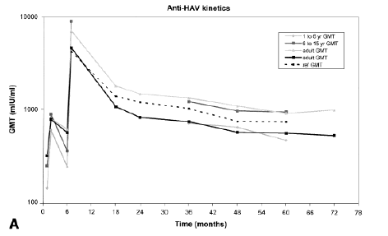
Examples from the literature: antibodies dynamic upon vaccination
Vaccine induced immunity is typically evaluated by means of the antibody titers, secreted by B-lymphocytes. It has been experimentally observed the existance of B-cells with an increased life span (bone marrow). Understanding and predicting the long-term persitance of humoral immunity after vaccination is crucial:
Immunology: quantitative research over time-scales+understanding epidemiology
Vaccinology: help in clinical trial for immunity conferred prediction
Health policy: make recommendations on booster vaccination
Van Damme, P., et al. "Long‐term persistence of antibodies induced by vaccination and safety follow‐up, with the first combined vaccine against hepatitis A and B in children and adults." Journal of medical virology 65.1 (2001): 6-13.
Long-term kinetics for anti HAV

Slide 11
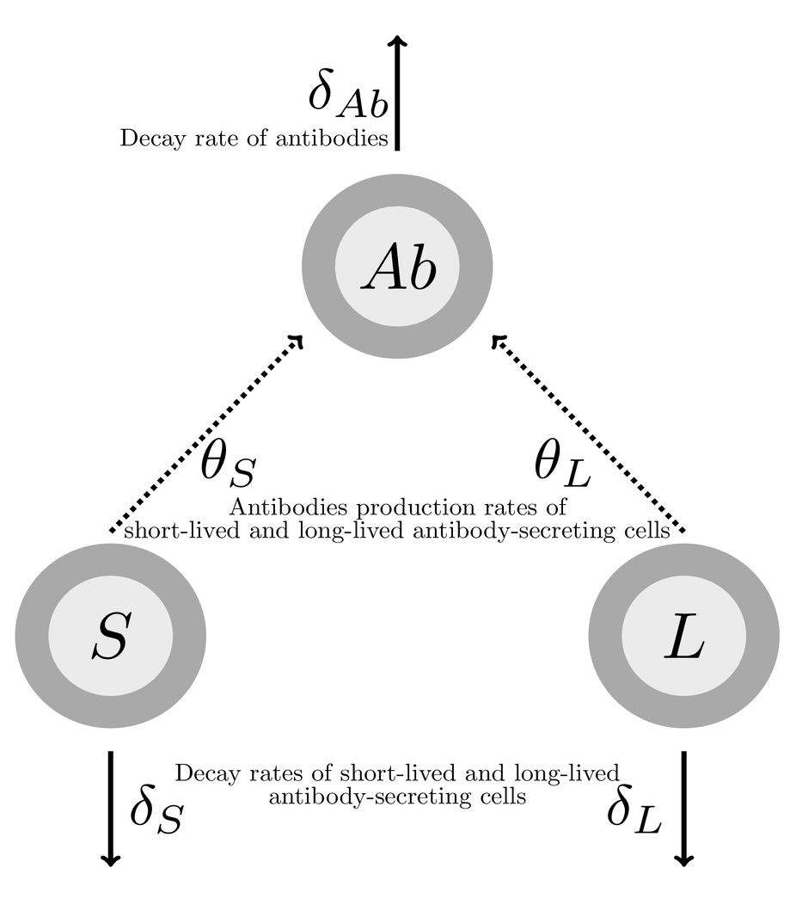
Examples from the literature: antibodies dynamic upon vaccination
Asymptotic model:
Andraud, Mathieu, et al. "Living on three time scales: the dynamics of plasma cell and antibody populations illustrated for hepatitis a virus." PLoS Comput Biol 8.3 (2012): e1002418.

Slide 12
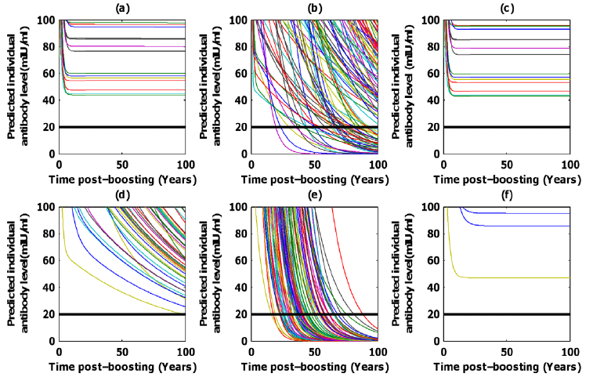
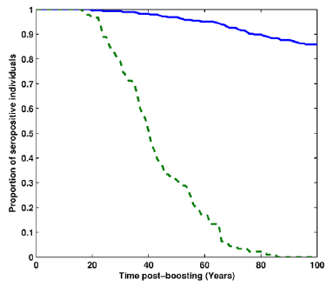
Examples from the literature: antibodies dynamic upon vaccination
Predicted proportion of seropositive patients according to time post vaccination from the plasma-cell driven kinetics model (full blue line: HavrixTM 1440 dataset , dashed green line: HavrixTM 720 dataset).
Individual prediction plots with a focus around the positivity threshold (20 mIU/ml, black line). (a,c,b) HavrixTM 1440 dataset,
(d,e,f) HavrixTM 720 dataset; (a,d) complete model, (b,e) plasma-cell driven kinetics model, (c,f) asymptotic model.

Slide 13
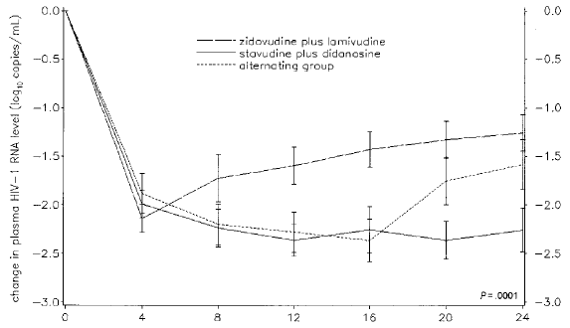
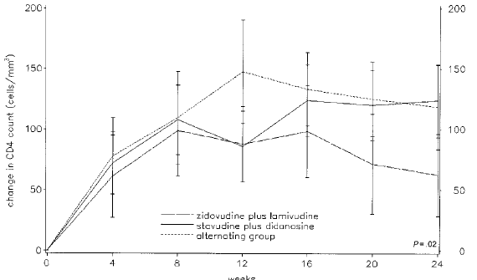
Examples from the literature: HIV and personalized medicine
HIV-infected patients can be treated but not cured with antiretroviral therapy, and guidelines for medical treatments are usually based on empirical results of clinical trials. Several biological processes should be considered: interactions of the viruses and the host immune system, mechanisms of action of the drugs, viral and host characteristics
Viral load
CD4+ T cells
Molina, Jean-Michel, et al. "The ALBI trial: a randomized controlled trial comparing stavudine plus didanosine with zidovudine plus lamivudine and a regimen alternating both combinations in previously untreated patients infected with human immunodeficiency virus." The Journal of infectious diseases 180.2 (1999): 351-358.

Slide 14
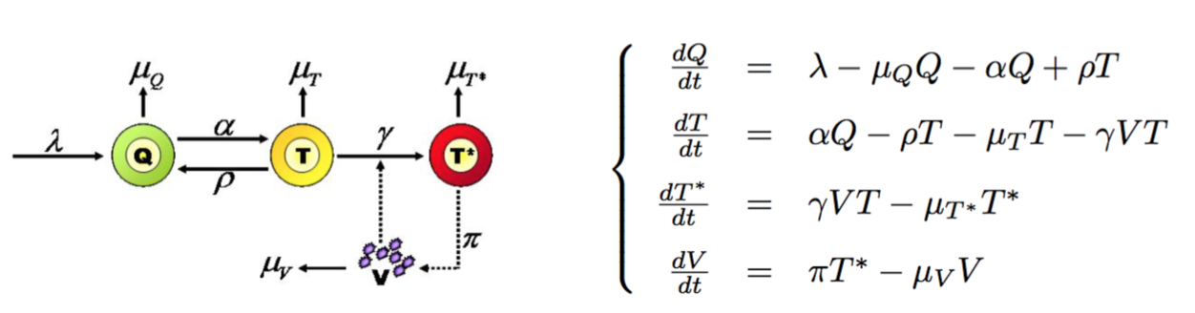
Examples from the literature: HIV and personalized medicine
Prague, Mélanie, Daniel Commenges, and Rodolphe Thiébaut. "Dynamical models of biomarkers and clinical progression for personalized medicine: The HIV context." Advanced drug delivery reviews 65.7 (2013): 954-965.

Slide 15
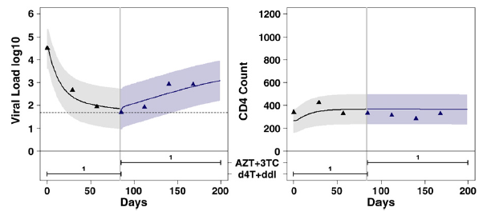
Examples from the literature: HIV and personalized medicine
Understand:
The effect of a specific drug, and more drugs when combined (synergism, antagonism…)
The reaction of each patient
The best posology, in a personalized manner
PK/PD
In silico trials
Viral load (log10 copies/ml) and CD4 count (cells/l) predictions for patients at median of the final HIV viral load distribution for patients in ALBI switch. Black lines are fits, blue line on the left of the horizontal line is prediction. Shaded zone represents the 95% measurement error predictive interval.

Slide 16
Is your model reliable?
We have identified a specific problem to study and decided how to model it as a compartmental model: can we really use this model? Can we rely on its outputs and predictions?
There are many assessments one can do to test the reliability of a model and our confidence. We will mainly discuss about the following topics:
Structural identifiability
Practical identifiability
Sensitivity analysis
Calibration

Slide 17
Structural identifiability analysis
ODE system: the model
With:
and
State variables
Unknown parameters

Slide 18
Structural identifiability analysis
System-Experiment model
With:
Observables
We want to answer the following question:
Assuming perfect experimental data (noise free and continuous in time), and an error-free model structure, are we able to recover unique values for unknown model parameters?

Slide 19
Structural identifiability analysis
3 possible answers:
The system-experiment model is structurally globally identifiable:
The system-experiment model is structurally locally identifiable
The system-experiment model is structurally not identifiable
Mathematically:

Slide 20
Structural identifiability analysis
Structural identifiability is a theoretical property of the model structure and a necessary condition for recovering the uniquely unknown model parameters:
If a system-experiment is not identifiable, then any parameter estimation would be random and not reliable!!!
In this case, one can:
Try to simplify the model (i.e. reduce k)
Fix some parameter values, for example from the literature (i.e. reduce p)
Design new experiments to measure additional quantities (i.e. improve n)

Slide 21
Structural identifiability analysis: some softwares
Identifiabilityanalysis package:
Implemented in Mathematica
Freely available at http://www.fcc.chalmers.se/software/other-software/identifiabilityanalysis/
Based on probabilistic semi-numerical algorithm
Fully authomatic, quick results, easy to use
DAISY package:
Implemented in REDUCE 3.8
Freely available at http://www.dei.unipd.it/~pia/
Based on a differential algebra algorithm
Completely automatized software

Slide 22
Practical identifiability analysis
Let us suppose that our model is structurally globally identifiable: are you sure that you will be able to correctly estimate the model parameters?

Slide 23
Sensitivity analysis
Sensitivity analysis is another theoretical approach to evaluate a model and understand if we can use it in practice to gain understanding of the problem it is supposed to model.
Sensitivity analysis aim at answering the following question:
How model parameters affect the output dynamics?
Question: can you see why answering that question can give additional information about practical identifiability?

Slide 24
Sensitivity analysis
Many methods exists to assess sensitivity analysis and, as for structural identifiability, we can talk about local and global sensitivity analysis.
In this class we are just going to discuss about local sensitivity analysis
The first step to perform a local sensitivity analysis of a model consists in identifying a reasonabe range for each parameter, i.e. reasonable lower and upper bounds of their values. For instance, this can come from the literature.

Slide 25
Local sensitivity analysis
A classical method for assessing local sensitivity analysis is to evaluate the normalized sensitivity coefficients, corresponding to the normalized partial derivatives of the observables with respect to the model parameters.
Mathematically:
Zi, Zhike. "Sensitivity analysis approaches applied to systems biology models." IET systems biology 5.6 (2011): 336-346.

Slide 26
Local sensitivity analysis
For example, Matlab function sens_ind:
https://fr.mathworks.com/matlabcentral/fileexchange/1480-sensitivity-analysis-for-odes-and-daes

Slide 27
Local sensitivity analysis
A more intuitive way to perform local sensitivity analysis is to plot the solution of the system given the parameters (i.e. from the model to the observables), then vary one parameter at a time in their reasonable range to see the effect over the solution.
In addition, understand how the variation of a single parameter affects the output, is one simple approach for model calibration.

Slide 28
Model calibration
Model calibration is the last step one could consider before trying a formal approach for proper parameter estimation (which is the content of the next lesson).
Model calibration is based on output simulation through the proposed model:
Is the model able to reproduce trajectories which are reasonable compared to the observed ones?
Question: what do you need and need to know to perform model calibration?

