Slide 1


Parameters Estimation through Mixed Effects Modeling
Irene Balelli – irene.balelli@inria.fr

Slide 2
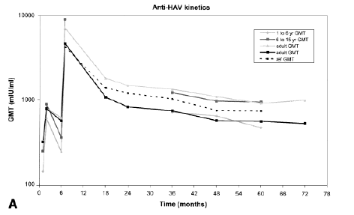
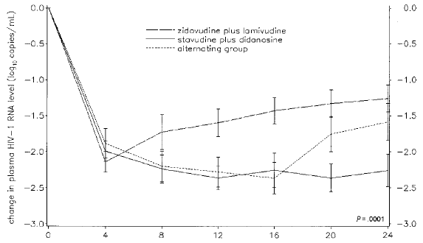
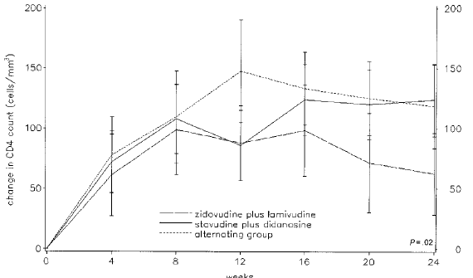
Objective: the inverse problem
e.g. tumor growth,
response to vaccination,
Viral load in HIV+ patients,…
EDO
Phenomena
Model
Observables
?

Slide 3
Longitudinal data: mean $±$ std & individual dynamics
Let us consider again examples from the previous lesson, and let us have a look to the observations
Tumor growth:
Viral load and CD4+ T cells:

Slide 4
Sources of variability
Two main sources of variability in the observations should be considered:
Inter-individual variability: each subject is unique, and this implies that two subjects will necessarily have a different dynamique, despite they have similar initial conditions with respect to model parameters (e.g. they have received exactly the same dose of a specific drug)
Covariance factors: we may know a priori some factors that could affect the observed dynamics (e.g. lung against breast cancer). These factors should be take into account

Slide 5
Which approach to estimate model parameters?
We can consider 2 main options:
We can estimate the specific model parameters for each subject in the study, then eventually consider a simple statistic such as their mean to infer the trend in the population
We can consider all subjects as being part of a whole population, and estimate parameters under the assumption that some of them could vary within a certain range depending on the subject specificity or on some known characteristic

Slide 6
Which approach to estimate model parameters?
We can consider 2 main options:
We can estimate the specific model parameters for each subject in the study, then eventually consider a simple statistic such as their mean to infer the trend in the population
We can consider all subjects as being part of a whole population, and estimate parameters under the assumption that some of them could vary within a certain range depending on the subject specificity or on some known characteristic

Slide 7
Non linear mixed effects models: assumptions
Let us recall the system-experiment model from the previous lesson:
Observables:

Slide 8
Non linear mixed effects models: the error model
Real-life observations are prone to error coming from different sources (systematic and random): this should be taken into account, i.e. in practice we can not suppose that our measurements are perfect.
We can define the error model in different ways. Let us consider this general formulation:
Obs id
Subj id
The error model
Constant:
Porportional:
Combined:

Slide 9
Non linear mixed effects models: fixed and random effects
As we said previously, all subjects are unique, and their variability depends either on intrinsic specificities or by known characteristics. Mixed-effects models allow to take into account both sources of variability.
In practice, we do not have a single parameter vector to estimate, but each parameter has a specific distribution and each individual parameter is sampled from this distribution:
Regression coefficient
Random
effect
Intercept
Explanatory variables

Slide 10
Non linear mixed effects models: fixed and random effects
Random effect
Fixed effects

Slide 11
Some considerations:
Data:
The number of observations and the time-point distribution may vary from one individual to another
It is convenient sometimes to consider transformation of the observations, hence the error model will be affected
In practice, we often consider transformations of parameters to improve their estimation: a common choice is to consider the logarithmic to avoid negative values. Hence the parameter distribution could change:
Normal,
Log-normal
…
Covariates: 2 different kinds
Conitnuous (eg BIM, age, …)
Categorical (eg sexe, study group)

Slide 12
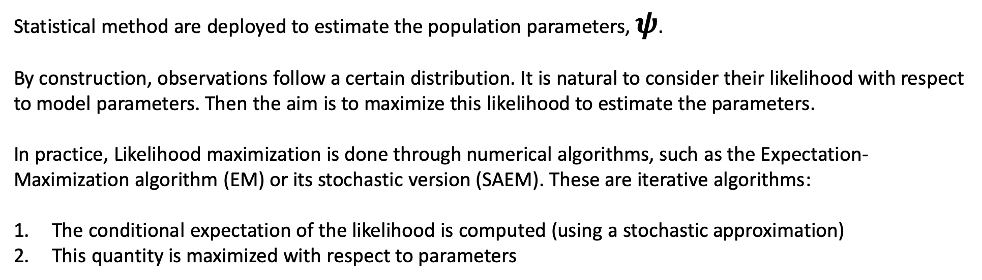
Parameter estimation: population parameters
Statistical method are deployed to estimate the population parameters, $ψ$.
By construction, observations follow a certain distribution. It is natural to consider their likelihood with respect to model parameters. Then the aim is to maximize this likelihood to estimate the parameters.
In practice, Likelihood maximization is done through numerical algorithms, such as the Expectation-Maximization algorithm (EM) or its stochastic version (SAEM). These are iterative algorithms:
The conditional expectation of the likelihood is computed (using a stochastic approximation)
This quantity is maximized with respect to parameters

Slide 13
Parameter estimation: individual parameters
Let us suppose that population parameters have been estimated: $\hat{ψ}$. The next step is to estimate each individual parameter, $ψ_{j}$. A natural way to do it is to maximize the conditional probabilities:
Question: what is the effect of having more or less observations for a given subject?

Slide 14
Are covariates improving the estimation?
While trying to fit a model and estimate its parameters with mixed effects models we use to make assumptions concerning the available covariates. In particular we try to add covariates effect on some parameters guided by some previous knowledge or simply intuition due to data analysis and knowledge about the sensitivity of the model with respect to its parameters. Nevertheless, we should always ask two questions:
Are the considered covariates adding useful information? Are they improving the estimation of a given parameter?
Do we have to check the effect of some covariates on other parameters?
To answer these questions we can use some statistical tests.

Slide 15
Tests
Pearson correlation test: the Pearson correlation coefficient measures the linear correlation between two variables. It is used to test wether continuous covariates should be removed from the model.
H0: the Person correlation coefficient between the individual parameters sampled from the conditional distribution and the covariate values is zero
ANOVA test: the ANOVA test measures weather the mean of two variables are equal. It is used as the Pearson test, but in the case of cathegorical covariates.
H0: the mean of the individual parameters sampled from the conditional distribution is the same for each category of the categorical covariate
In both cases, a small p-value indicates that the null hypothesis can be rejected → the correlation between the individual parameter values and the covariate values is significant → the covariate should be kept in the model.

Slide 16
Tests
The Pearson and ANOVA tests can also be used to test if a covariate should be added to the model
H0: the person correlation coefficient between the random effects (calculated from the individual parameters sampled from the conditional distribution) and the covariate values is zero
H0: the mean of the random effects (calculated from the individual parameters sampled from the conditional distribution) is the same for each category of the categorical covariate
In this case, a small p-value indicates that the null hypothesis can be rejected → the correlation between the random effects and the covariate values is significant → it is probably worth considering to add the covariate in the model (if this makes sense from a biological viewpoint).

Slide 17
Comparing models:
Some criteria exist to help choosing the «best» model. For instance:
AIC:=-2LL+2k, k being the total number of parameters to be estimated
BIC:=-2LL+log(N)k, N being the total number of subjects in the dataset
Both criteria gives an estimation of the relative quality of the model with respect to the dataset, taking into account both the complexity of the model and the goodness of its fits.

Slide 18
Softwares:
There exists several softwares allowing to numerically perform all or most functionalities discussed previously. For instance:
MONOLIX
R: nlme, saemix
NIMROD

Slide 19
Softwares:
There exists several softwares allowing to numerically perform all or most functionalities discussed previously. For instance:
MONOLIX
R: nlme, saemix
NIMROD
http://lixoft.com/products/monolix/

