Slide 1
Victorious VBA
Day 6
The Data Bootcamp |
May 12, 2017

Slide 2
Words of Advice

Slide 3
Advice #1: There Is No Cram…

Slide 4

Advice #2: Ask for Help!
If you’re ever spending more than 10 hours in a week and not seeing progress….
Get Help!!!

Slide 5
Advice #3: Be Sure to Study The Right Way

Slide 6
Advice #3: Be Sure to Study The Right Way
Syntax Recollection
Tool Familiarity
Technical Vocabulary
Pattern Recognition
Documentation Research
Pseudocoding
New Problem Solving
Debugging
Code Organization
Challenge Level

Slide 7
So…
Open Questions?

Slide 8
Refresher

Slide 9
Refresher
Explain to a baby:
What is a for-loop?

Slide 10
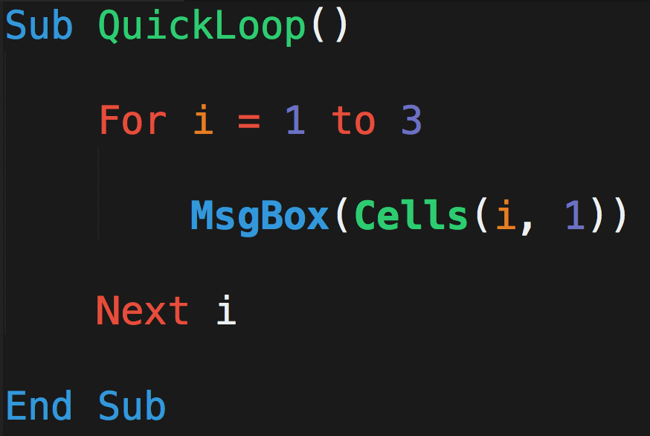
What Will This Code Do?
A
B
C
Michael | Luis | Ruchi
Evan | Mariah | Ricky
Jamie | Ron | Jeff
John | Lakshmi | Baskaran
1
2
3
4

Slide 11
What Will This Code Do?
A
B
C
Michael | Luis | Ruchi
Evan | Mariah | Ricky
Jamie | Ron | Jeff
John | Lakshmi | Baskaran
1
2
3
When i = 1…
4

Slide 12
What Will This Code Do?
A
B
C
Michael | Luis | Ruchi
Evan | Mariah | Ricky
Jamie | Ron | Jeff
John | Lakshmi | Baskaran
1
2
3
When i = 2…
4

Slide 13
What Will This Code Do?
A
B
C
Michael | Luis | Ruchi
Evan | Mariah | Ricky
Jamie | Ron | Jeff
John | Lakshmi | Baskaran
1
2
3
When i = 3…
4

Slide 14
What Will This Code Do?
A
B
C
Michael | Luis | Ruchi
Evan | Mariah | Ricky
Jamie | Ron | Jeff
John | Lakshmi | Baskaran
1
2
3
Nope….
Not going to i =4
4

Slide 15
Refresher
Explain to a baby:
What is a nested for-loop?

Slide 16
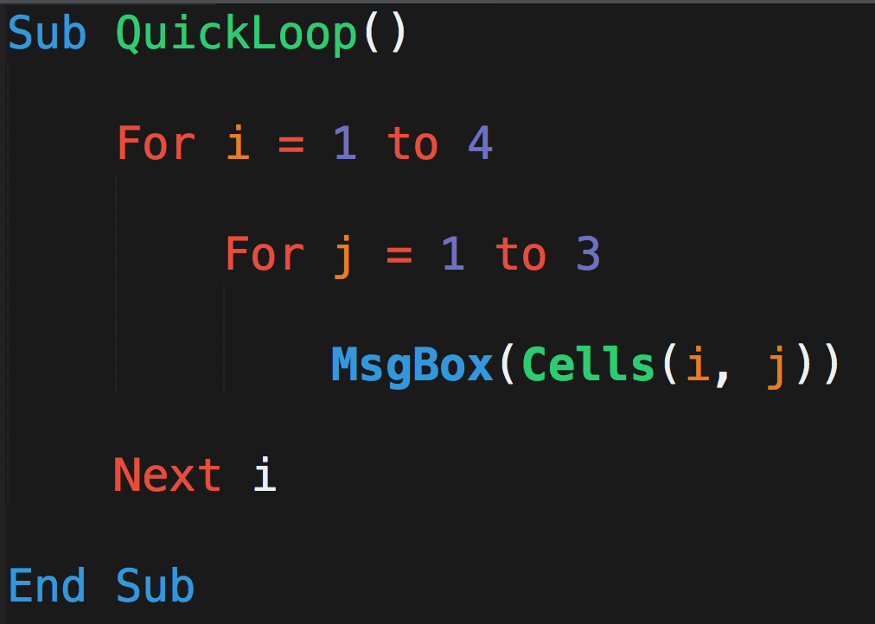
What Will This Code Do?
A
B
C
Michael | Luis | Ruchi
Evan | Mariah | Ricky
Jamie | Ron | Jeff
John | Lakshmi | Baskaran
1
2
3
4

Slide 17
What Will This Code Do?
A
B
C
Michael | Luis | Ruchi
Evan | Mariah | Ricky
Jamie | Ron | Jeff
John | Lakshmi | Baskaran
1
2
3
When…
i = 1
j = 1
4

Slide 18
What Will This Code Do?
A
B
C
Michael | Luis | Ruchi
Evan | Mariah | Ricky
Jamie | Ron | Jeff
John | Lakshmi | Baskaran
1
2
3
When…
i = 1
j = 2
4

Slide 19
What Will This Code Do?
A
B
C
Michael | Luis | Ruchi
Evan | Mariah | Ricky
Jamie | Ron | Jeff
John | Lakshmi | Baskaran
1
2
3
When…
i = 1
j = 3
4

Slide 20
What Will This Code Do?
A
B
C
Michael | Luis | Ruchi
Evan | Mariah | Ricky
Jamie | Ron | Jeff
John | Lakshmi | Baskaran
1
2
3
When…
i = 2
j = 1
4

Slide 21
What Will This Code Do?
A
B
C
Michael | Luis | Ruchi
Evan | Mariah | Ricky
Jamie | Ron | Jeff
John | Lakshmi | Baskaran
1
2
3
When…
i = 2
j = 2
4

Slide 22
What Will This Code Do?
A
B
C
Michael | Luis | Ruchi
Evan | Mariah | Ricky
Jamie | Ron | Jeff
John | Lakshmi | Baskaran
1
2
3
When…
i = 2
j = 3
4

Slide 23
What Will This Code Do?
A
B
C
Michael | Luis | Ruchi
Evan | Mariah | Ricky
Jamie | Ron | Jeff
John | Lakshmi | Baskaran
1
2
3
This continues…
4

Slide 24
So…
Open Questions?

Slide 25
Questions / Discussion
Notes:
It’s important to keep in mind why you joined this class. Let’s talk about your goals.

