Slide 1
Exploratory Data Analysis
MTA
Ibrahim Alzuhairi

Slide 2


Importing MTA Data
Local Microsoft SQL Instance
Azure Microsoft SQL Instance

Slide 3
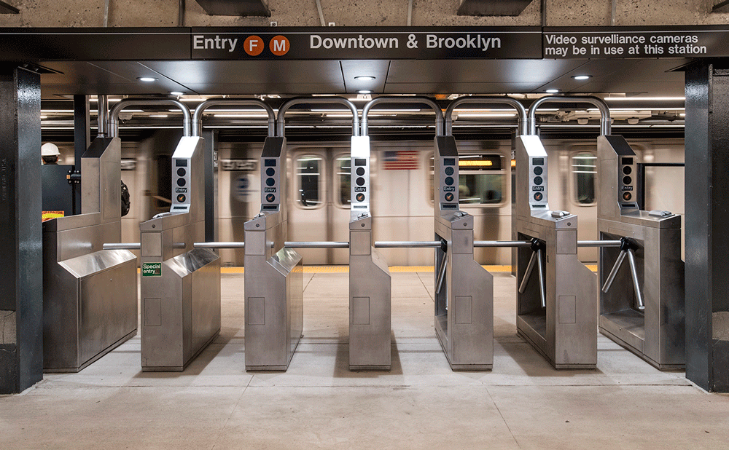
Problem
A lot of people are complaining about the ineffectiveness of NYC metro turnstiles.
Many claims that turnstiles slow people flow and the main cause of missing metro trips. *
* This is made up problem

Slide 4
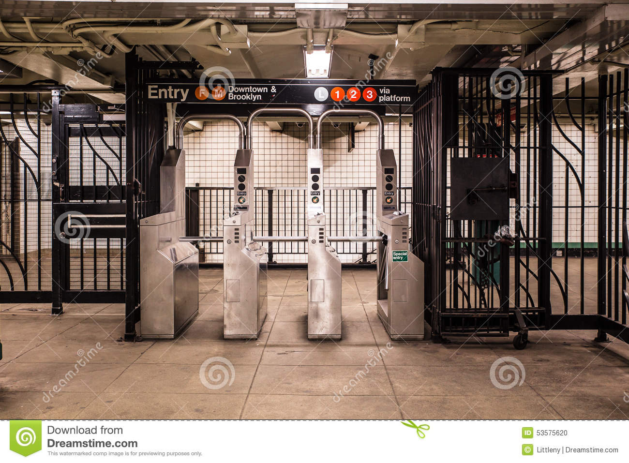
Question?
Is the flow of people distributed equally on turnstiles?
Is there a real need to change entry mechanism, or is it just flow distribution issue

Slide 5

Data Cleaning
Data collected from MTA website
From 05/18/2021 until 09/18/2021
107 duplicates removed
22k rows negative Entries and Exit.

Slide 6
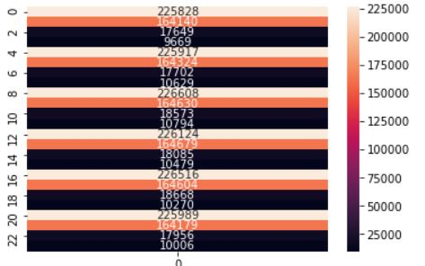
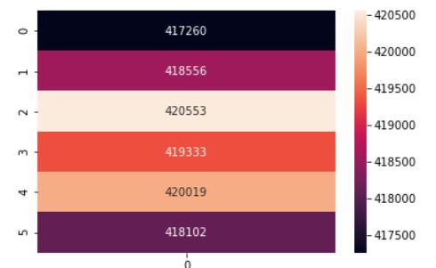
Data Cleaning
About 50% of data collection time does not follow 12AM- 4AM pattern.
Data points collected at 1 A.M. – 3 A.M. Were shifted to match 12AM- 4AM pattern
Distributed 4 hours blocks
Unified 4 hours blocks

Slide 7
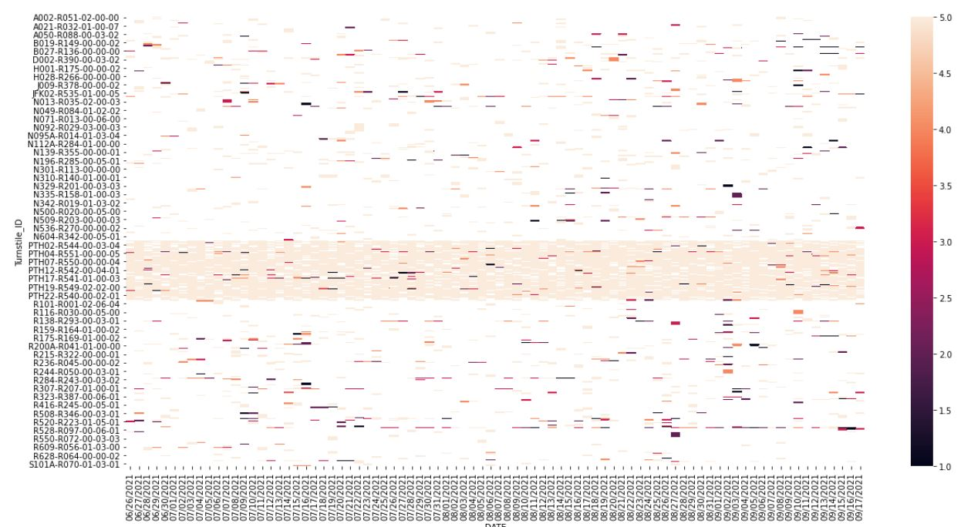
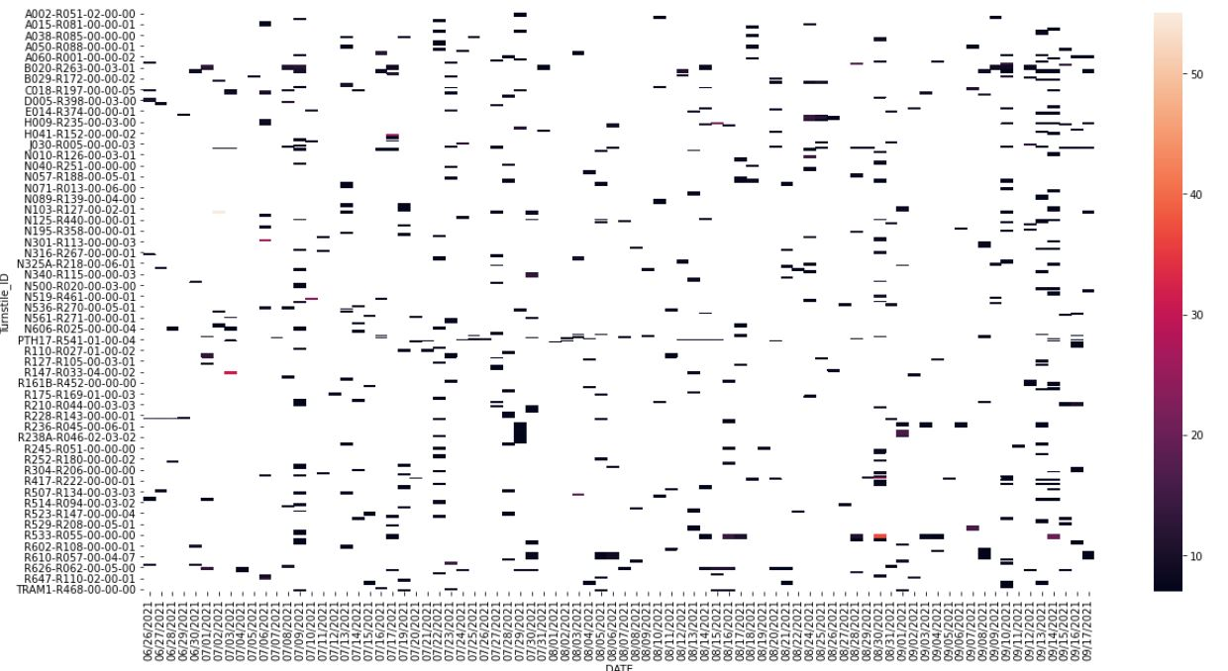
Data Cleaning
- Data collection was not systematic.
- Irregularities was fixed by interpolation.
Data collected less than 6 times a day
Data collected more than 6 times a day

Slide 8
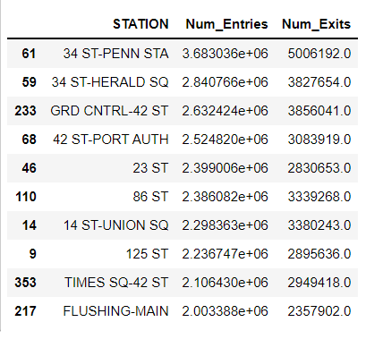
Results
Top 10 stations in terms of total entries.
Only 3 stations were chosen for analysis

Slide 9
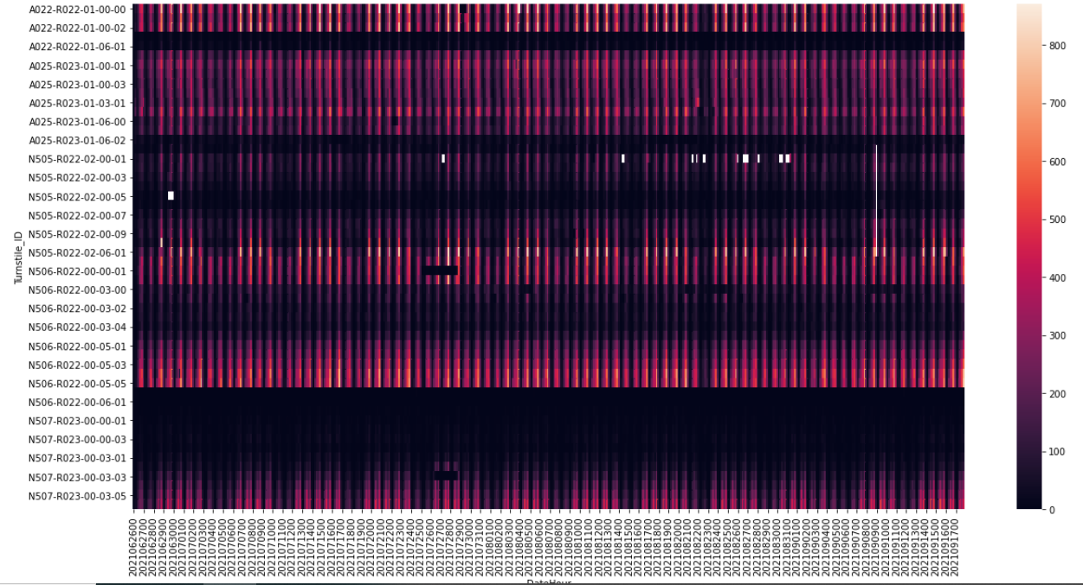
34 ST-HERALD SQ Station Heatmap
Turnstiles in 34 st Herald station across time blocks

Slide 10

34 ST-HERALD SQ Station Heatmap
Distributions across turnstiles were not equal.
Sample of one line Turnstiles in 34 st Herald station across time blocks

Slide 11
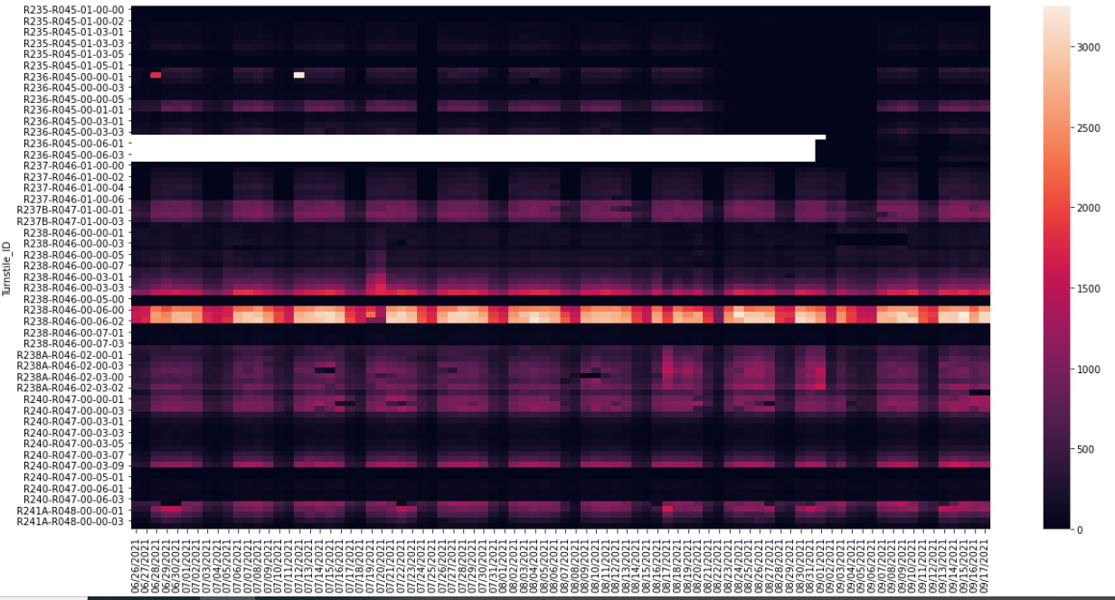
GRD CNTRL-42 ST
Turnstiles in GRD CNTRL-42 st station across time blocks
* White spaces represent missing days of data

Slide 12
Result
Congested gates on some days
Sample of one line Turnstiles in GRD CNTRL-42 station across time blocks

Slide 13
TIMES SQ-42 ST
Congested gates most of the time
Sample of one line’s Turnstiles in Times SQ-42 st station across time blocks

Slide 14
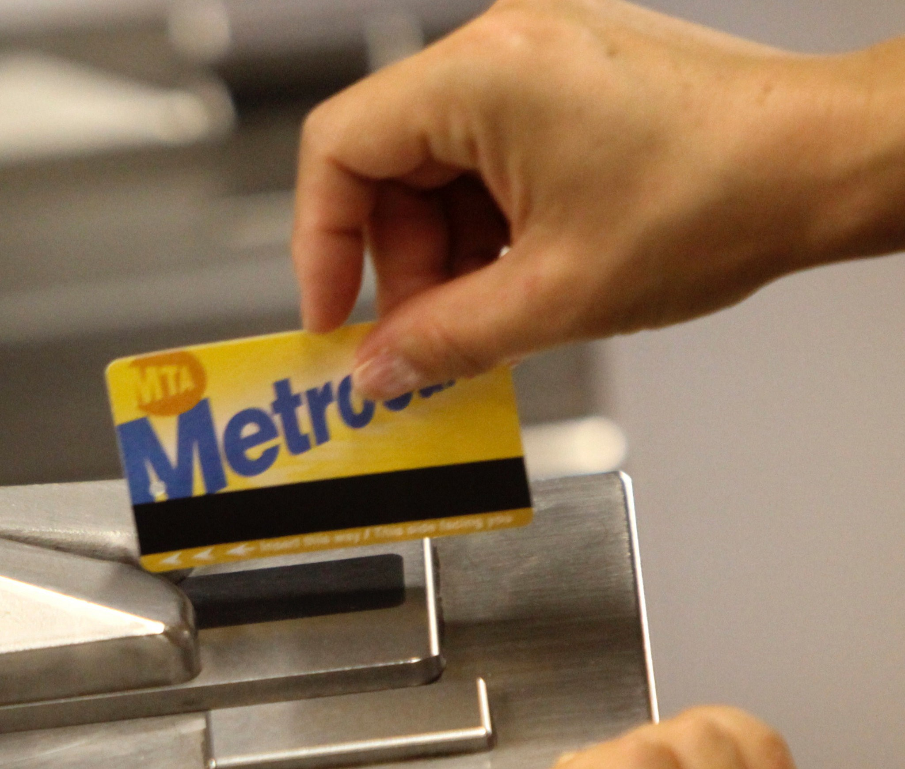
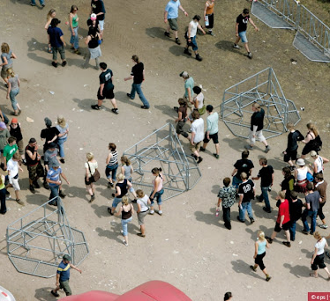
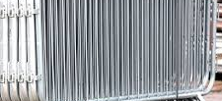
Recommendations
Install flow control to distribute people across gates.
Replace mechanism or add gates to TIMES SQ-42 ST stations.
Future work
Apply T-test to identify congested lines systematically.

Slide 15
Thank You

