Slide 1
Exploratory Data Analysis
MTA
Ibrahim Alzuhairi

Slide 2


Importing MTA Data
Local Microsoft SQL Instance
Azure Microsoft SQL Instance

Slide 3
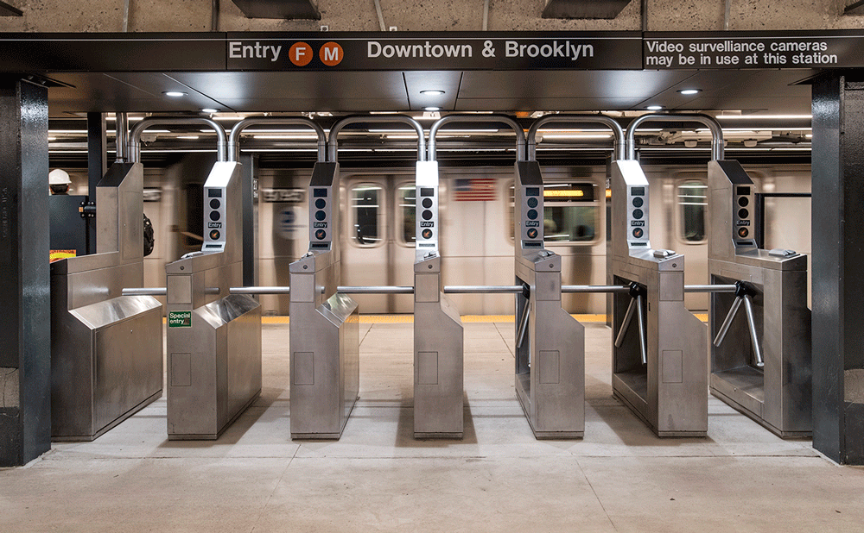
Problem
A lot of people are complaining about the ineffectiveness of NYC metro turnstiles.
Many claims that turnstiles slow people flow and the main cause of missing metro trips. *
* This is made up problem

Slide 4
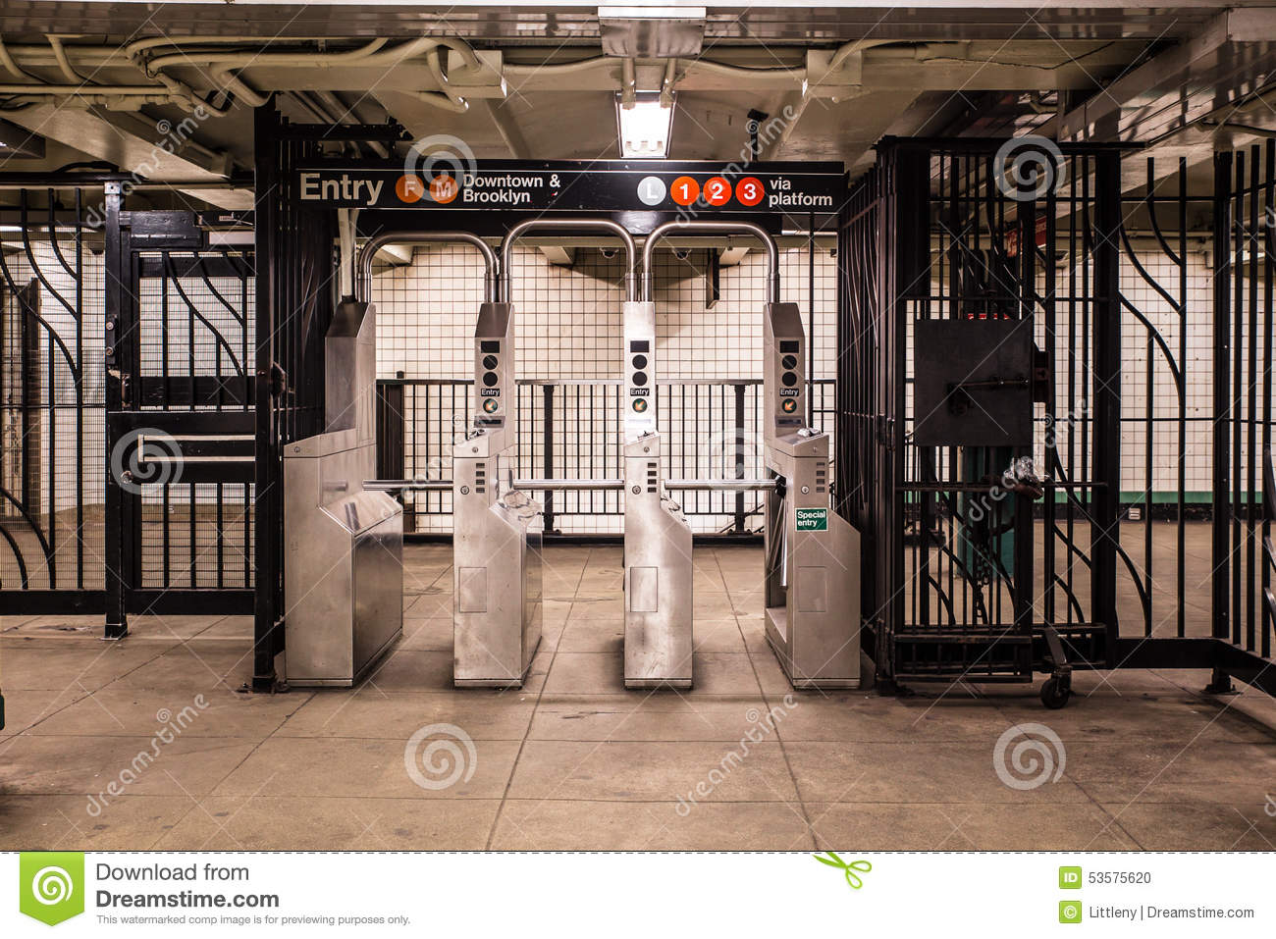
Question?
Is the flow of people distributed equally on turnstiles?
Is there a real need to change entry mechanism, or is it just flow distribution issue

Slide 5

Data Cleaning
Data collected from MTA website
From 05/18/2021 until 09/18/2021
107 duplicates removal
22k rows negative Entries and Exit.

Slide 6
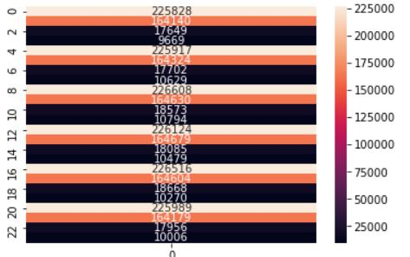
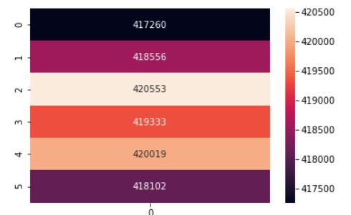
Data Cleaning
About 50% of data collection time does not follow 12AM- 4AM pattern.
Data points collected at 1 A.M. – 3 A.M. Were shifted to match 12AM- 4AM pattern

Slide 7
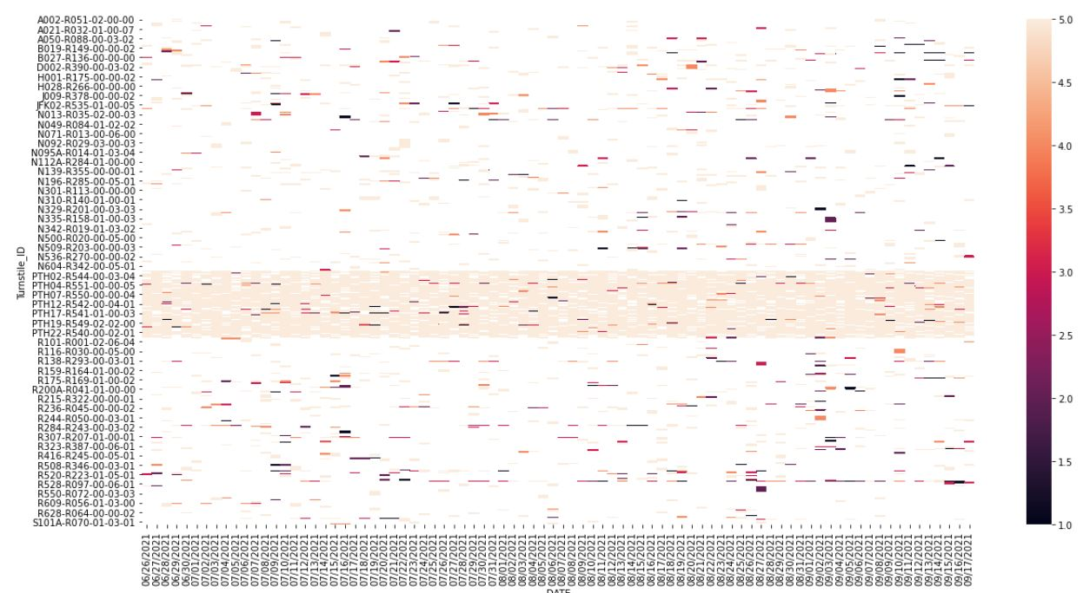
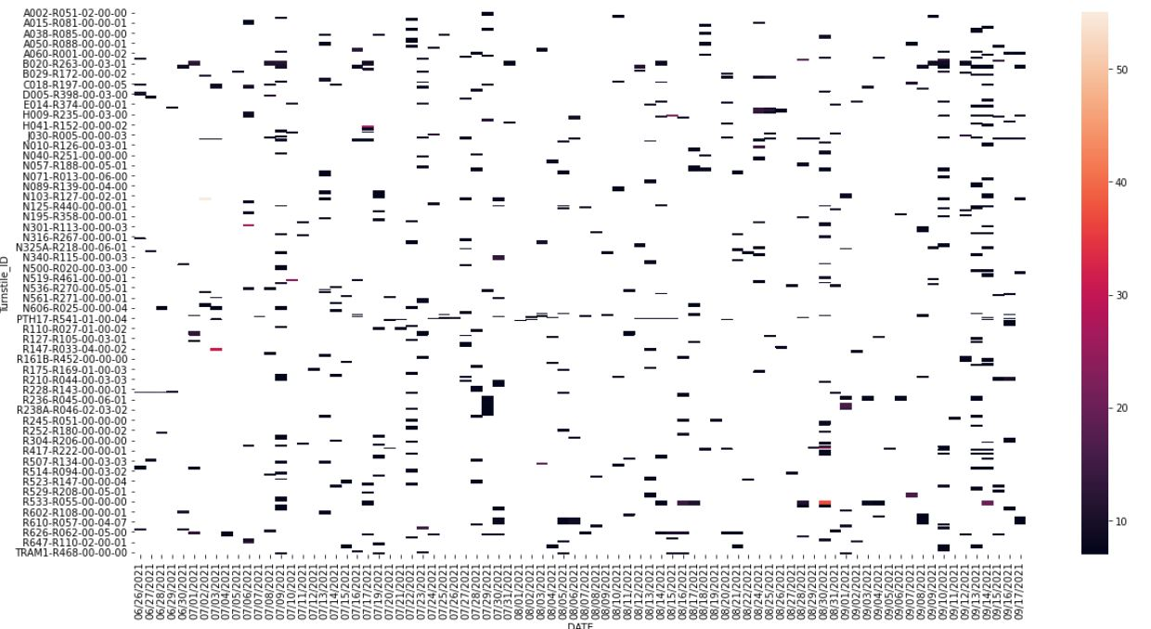
Data Cleaning
Data collection is not systematic
Data collected less than 6 times a day
Data collected more than 6 times a day

Slide 8
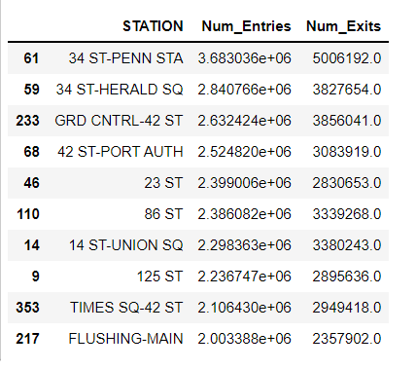
Results
Top 10 stations in terms of total entries.
Only 3 stations were chosen for analysis

Slide 9
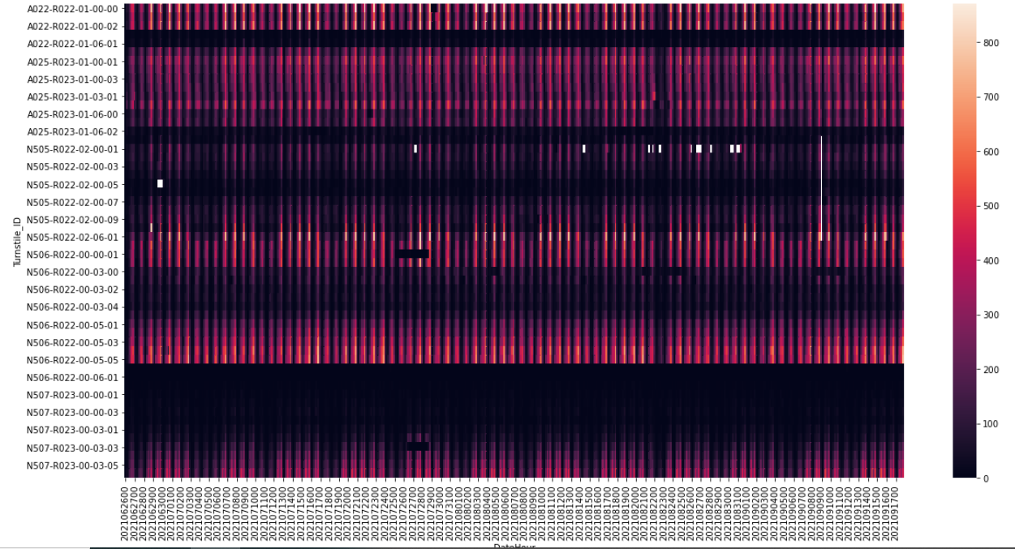
34 ST-HERALD SQ Station Heatmap
Turnstiles in 34 st Herald station across time blocks

Slide 10

Distributions across turnstiles are not equal.
Sample of one line Turnstiles in 34 st Herald station across time blocks

Slide 11
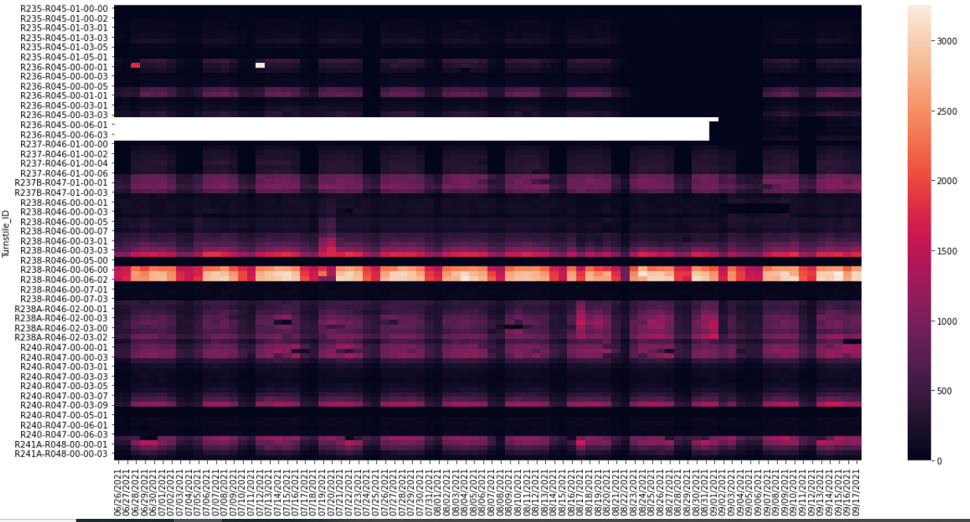
GRD CNTRL-42 ST
Turnstiles in GRD CNTRL-42 st station across time blocks
* White spaces represent missing days of data

Slide 12
Result
Congested gates on some days
Sample of one line Turnstiles in GRD CNTRL-42 station across time blocks

Slide 13
TIMES SQ-42 ST
Congested gates most of the time
Sample of one line Turnstiles in Times SQ-42 st station across time blocks

Slide 14
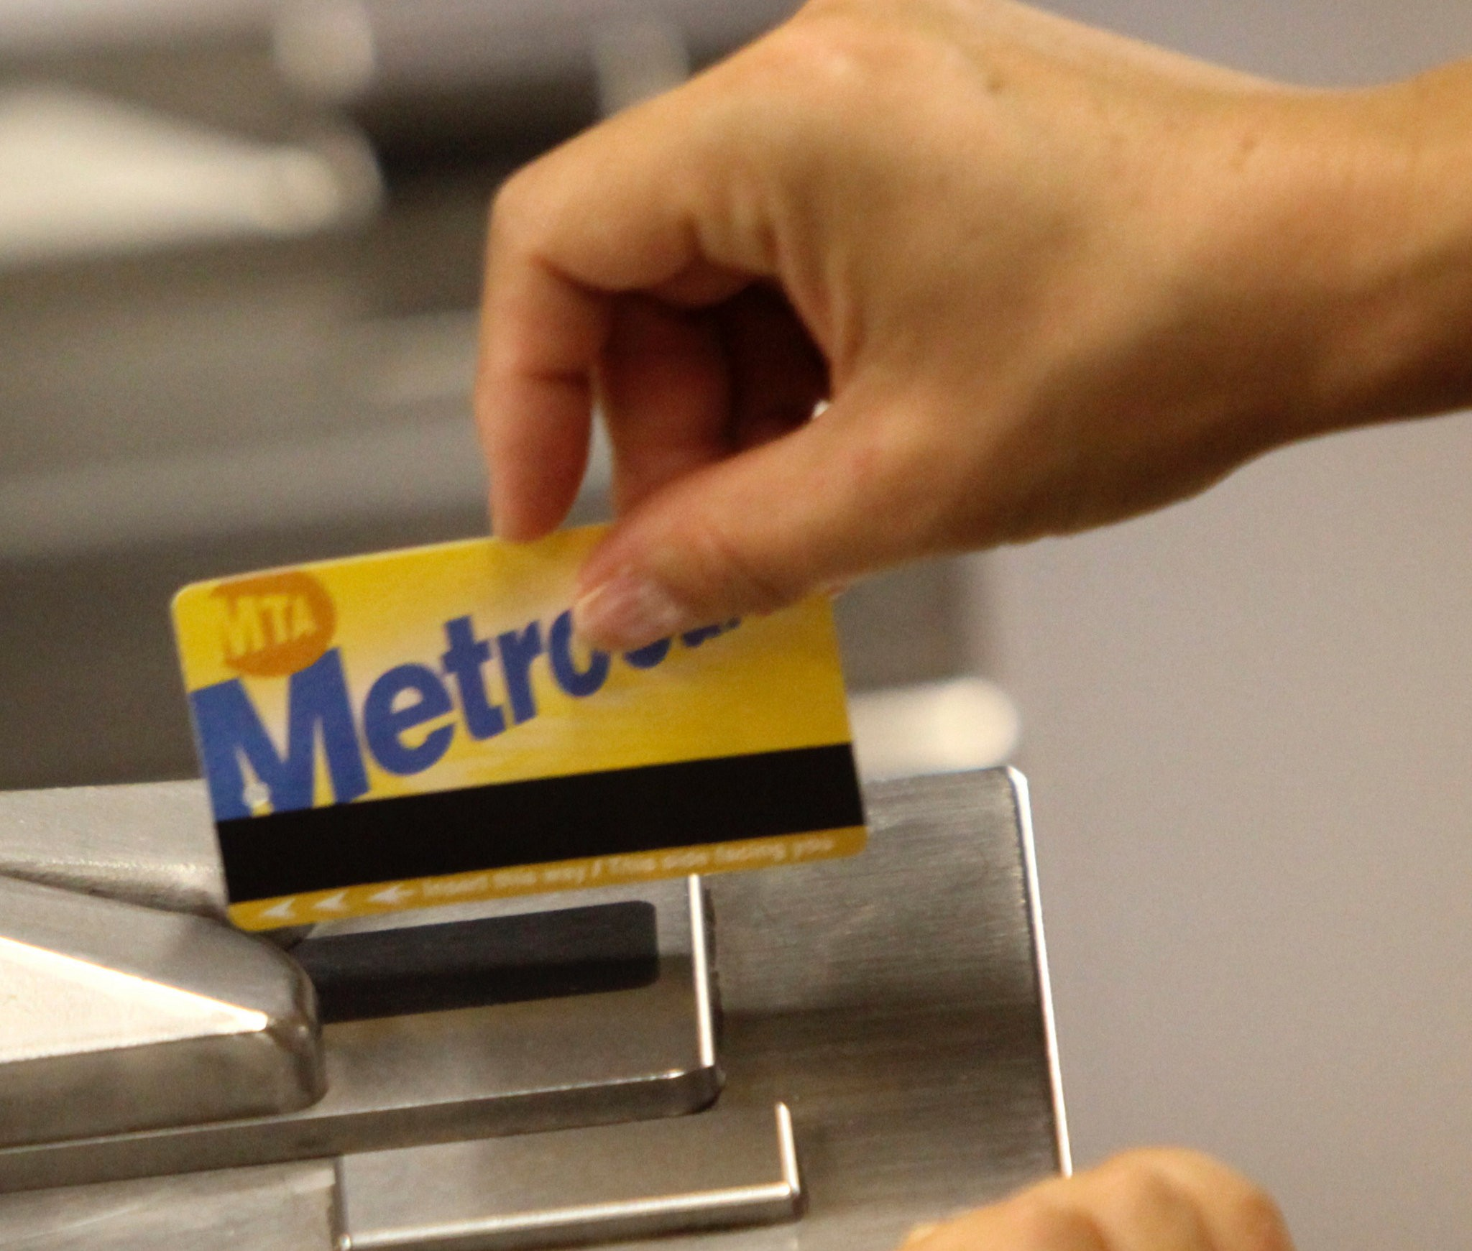
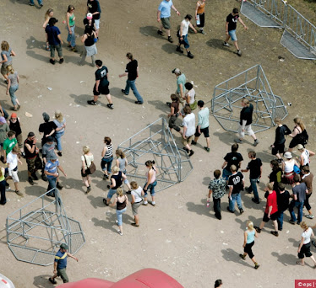
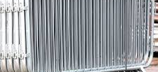
Recommendations
Install flow control.
Replace mechanism for over- crowded lines.

Slide 15
Thank You

