Slide 1
Puppet
Robert

Slide 2
Puppet Course Cover below topics
Puppet products
Puppet language(DSL)
Puppet master and Puppet Agent
Manifests, Classes and Modules
Users,groups and nodes
Resources
Templates and language
Puppet Forge
Puppet Hiera

Slide 3
What is Puppet
Puppet is IT automation software that helps system administration manage infrastructure throughout its lifecycle from provisioning and configuration to patch management and compliance.
Mean:
You can setup a server in minutes instead of hours time
You can be sure your server configurations are consistent.
You can easily deploy configuration changes to multiple servers
What happened
Puppet analyzed the scripts to build a picture or image what is should I like.
Puppet then compare the picture with what is right now.
Then it generates and execute scripts to make the server configuration match that is the puppet scripts.

Slide 4
How and What
Why it is better to describe what a system looks like rather than how to configure system
When you describe what a system it is, then you can easily rerun the process without fear of breaking the system.
Puppet is declarative language, focus on what needs to be done.

Slide 5
Overview:
Puppet is the leading open source configuration management tool.
Puppet uses a client/server Puppet deployment, where agent nodes fetch configurations from a central Puppet master.
PE includes distributed task orchestration features.
Puppet forge is open source and available for every one, but it is still young (not yet mature)
Puppet Enterprise comes with license and it will help you to monitor and control your infrastructure.

Slide 6
About the Puppet Enterprise Console
PE’s console is the web-based user interface for managing your systems. The console can:
Browse and compare resources on your nodes in real time
Analyze events and reports to help you visualize your infrastructure over time
Browse inventory data and backed-up file contents from your nodes
Group similar nodes and control the Puppet classes they receive in their catalogs
Manage user access, including integration with external user directories

Slide 7
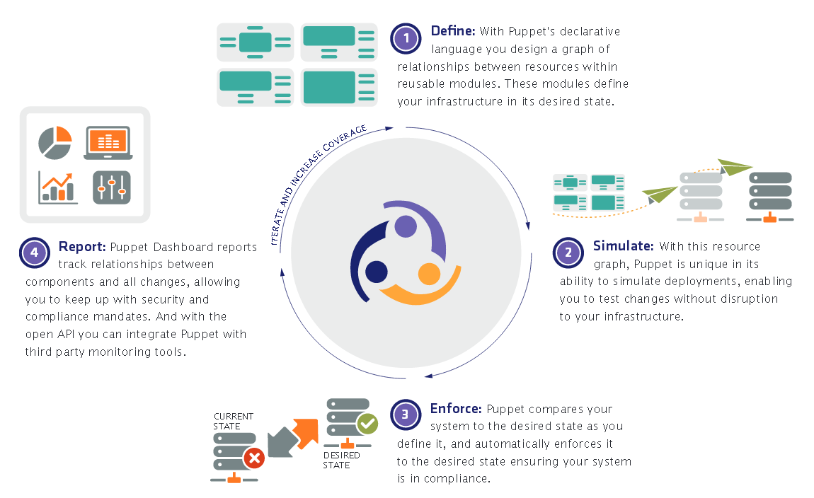
How Puppet Works

Slide 8
With Puppet you can:
Define Your Resources in Modules by node classifications, such as Web Server or Database, allowing you to define relationships between resources and configure thousands of servers at once.
Assign resource relationships automatically and deploy configurations via puppet dashboard, or with your own customized CMDB tools.
Re-use modules across multiple nodes, in whatever combination you need, reducing repetitive tasks and eliminating error-prone scripts.

Slide 9
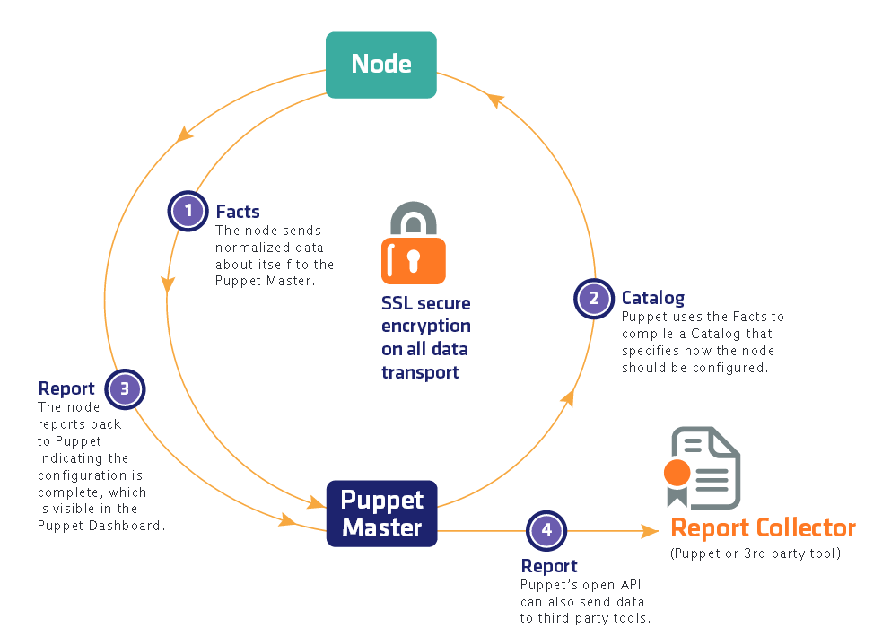
How Puppet manages Data flow

Slide 10
Installing Puppet Enterprise
Puppet Enterprise’s functions are spread across several different components which get installed and configured when you run the installer.
You can choose to install multiple components on a single node (a “monolithic install”) or spread the components across multiple nodes (a “split install”), but you should note that the “agent” component gets installed on every node.
For each node where you’ll install a PE component, you should know the fully qualified domain name where that node can be reached and you should ensure that firewall rules are set up to allow access to the required ports.

Slide 11
Installing Puppet Enterprise
The installation process will proceed in three stages:
You choose an installation method.
You install the main components of PE—the Puppet master, PuppetDB (and database support), and the PE console.
You install the Puppet agent on all the nodes you wish to manage with PE.

Slide 12
About Puppet Enterprise Components
The Puppet Agent:
The Puppet agent is most easily installed using a package manager. On platforms (Windows) that do not support remote package repos, use the installer script.
This component should be installed on every node in your deployment. When you install the Puppet master, PuppetDB, or console components, the Puppet agent component will be installed automatically on the machines assigned to those components.
Nodes with the puppet agent component can:
run the Puppet agent daemon, which receives and applies configurations from the Puppet master.
listen for orchestration messages and invoke orchestration actions.
send data to the master for use by PuppetDB.

Slide 13
About Puppet Enterprise Components
The Puppet Master:
In most deployments, you should install this component on one node. The Puppet master must be a robust, dedicated server.
The Puppet master server can:
compile and serve configuration catalogs to Puppet agent nodes.
route orchestration messages through its ActiveMQ server.
issue valid orchestration commands (from an administrator logged in as the peadmin user).

Slide 14
About Puppet Enterprise Components
PuppetDB and Database Support:
The PuppetDB component uses an instance of PostgreSQL that is either installed by PE or manually configured by you. In a monolithic installation, PuppetDB is installed on the same node as the console and Puppet master components. In a split install, PuppetDB is installed on its own server.
The PE Console:
For a split installation, you install the console on its own dedicated server, but if you have a monolithic installation, you install it on the same server as all of the other PE components.

Slide 15
Monitor and Analyze Infrastructure State
Introducing Configuration Management
Configuration Management leverages the data created and collected by Puppet Enterprise (PE) and provides insights into your infrastructure in the following ways:
Overview — Reports the state of your nodes after the most recent Puppet run so you can quickly find issues and diagnose the cause.
Node Graph — Provides a graphic representation of your node’s configuration so you can quickly spot the resources that are involved in issues. Visualizing relationships between resources helps you organize them and create more reliable deployments.

Slide 16
Why use Puppet?
Productivity / Efficiency - Most IT management solutions deliver efficiencies of 20-30 nodes per sysadmin. Puppet enables 100s and even 1000s of nodes per sysadmin!
Responsiveness To Business Needs - Using Puppet, customers have dramatically reduced the time it takes them to deliver applications into production, from weeks to days and even hours.
Eliminate Configuration Drift - With Puppet, your nodes (servers, desktops, etc.) remain in the state you set for them, dramatically improving service availability, reliability, scalability, and performance.

Slide 17
Monitor and Analyze Infrastructure State
Events — Enables you to drill into specific class, node, and resource events so you can find out what caused them to fail, change, skip, or run as no-op.
Reports — Provides reports on node activity so you can audit your system and perform root cause analysis over time.

Slide 18
Puppet Modules and Manifests
Summary:
Puppet uses its own domain-specific language (DSL) to describe machine configurations. Code in this language is saved in files called manifests.
The Puppet Language:
Puppet configurations are written in the Puppet language, a DSL built to declaratively model resources.
Manifests
Manifests are files containing Puppet code. They are standard text files saved with the .pp extension. Most manifests should be arranged into modules.

Slide 19
Puppet Modules and Manifests
Puppet Modules:
Modules are a convention for arranging Puppet manifests so that they can be automatically located and loaded by the Puppet master. They can also contain plugins, static files for nodes to download, and templates.
Modules can contain many Puppet classes. Generally, the classes in a given module are all somewhat related.
A module is:
A directory.
with a specific internal layout
It is self contained packages that describe an aspect of system
which is located in one of the Puppet master’s modulepath directories.
You can give new module path in puppet.conf

Slide 20
Why use Puppet?
Visibility - Puppet provides rich data sets not only of infrastructure configuration but also of any changes to that infrastructure, whether under direct control of Puppet or not. You have much more visibility into the changes occurring in your infrastructure over time and their impact to service levels
Some things that Puppet Can Do
Wipe and reinstall two servers in 40 minutes - that would have taken close to a full day of work without puppet
Set up 3 new database servers in 52 minutes completely from scratch - that would have taken well over a day without puppet

Slide 21
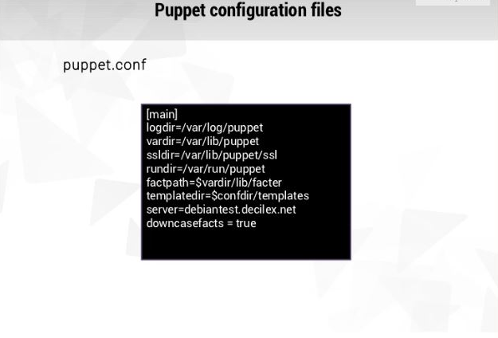

Slide 22
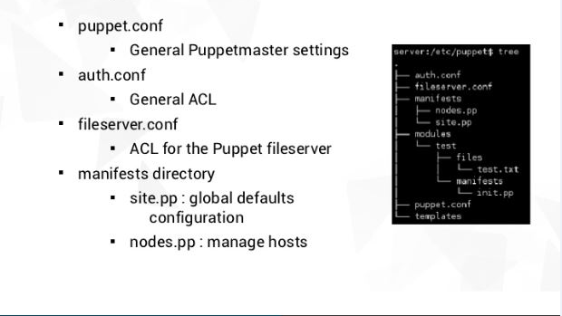
Puppet Configuration

Slide 23
Puppet configuration files
puppet.conf — Puppet’s main config file. (All nodes.)
auth.conf — access control rules for the Puppet master’s network services.
autosign.conf — a list of pre-approved certificate requests. (CA master only.)
csr_attributes.yaml — optional data to be inserted into new certificate requests. (All nodes.)
device.conf — configuration for network devices managed by the puppet device command. (All nodes.)
fileserver.conf — configuration for additional fileserver mount points. (Master only.)
hiera.yaml — configuration for the Hiera data lookup system. (Master only.)
routes.yaml — advanced configuration of indirector behavior. (Master only.)

Slide 24
Puppet variables and conditional statements
If $variable{
File{‘somefile’:ensure=>present}
}else {
File{‘some/other/file’:ensure=>present}
}
If $server==‘mysql’{
include mysql
Else {
Include postgress
Else {
Include oracle
}

Slide 25
Example of Manifest
Class DevOps
{
File { ‘/usr/local/sbin/puppetsimple.sh’
Owner=>root,
User=>root,
mode=>0755
Content=>”#!/bin/sh/npuppet agent –verbose –no odaemonize –onetime $1\n”,
}
}

Slide 26
Define a class
This is class definition which makes class available for later use
Class ntp {
Package {‘ntp’:
Ensure=>installed
}
}

Slide 27
Declaring a class
Declaring a class in 3 different ways
Include function
Require function
Resource like syntax
Include ntp
Require ntp
Class {‘ntp’:}
The declaring a class means the resource in it to be managed.

Slide 28
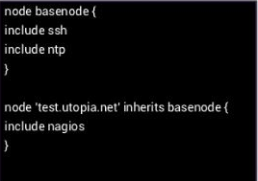
Class Inheritance
Node.pp file

Slide 29
Meta-parameter
Chaining arrows forming relationships between three resources
Before- Resource is applied before target resource
Require-Resource is applied after target resource
Notify-Like before the target resource will refresh if the notifying resource changes.
Subscribe- Like require+ the target resource will refresh if the target resource changes.
Relationship chaining
Package[‘ntp’]->file[‘ntp.conf’]->service[‘ntpd’]

Slide 30
Resource types
Puppet comes with wide range of resource types
Exec
Package
File
Service
notify

Slide 31
Puppet-Templates
Templates are files that use a simple markup language to insert dynamic content
Permit to have a personalized configuration per node
Use ERB language and retrieve and use facts.
ERB file placed in module template directory
Templates have an erb extension
Typically used with the file resource
Eg: file{‘ntp.conf’,Path=>’/etc/ntp.conf’,Ensure=>file,
Content=>template(‘ntp/ntp.conf.erb”),Owner=>root,
Mode=>0644,
}

Slide 32
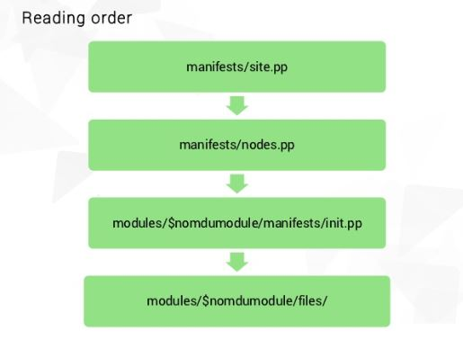
Puppet Reading order

Slide 33
Facter
What is the facts?
Global variables with information about the system that the scripts is running on
How do I see the available variables
Facter –p
How do I use them?
$::variable_name

Slide 34
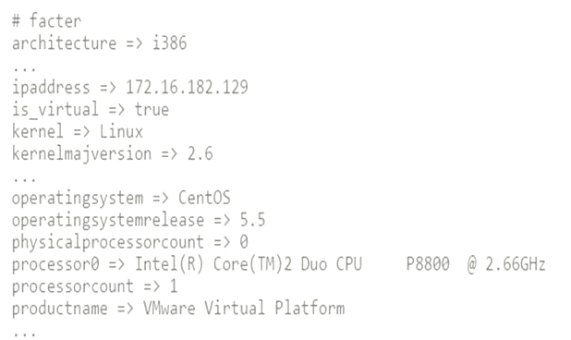
Factor example similar to ohai

Slide 35
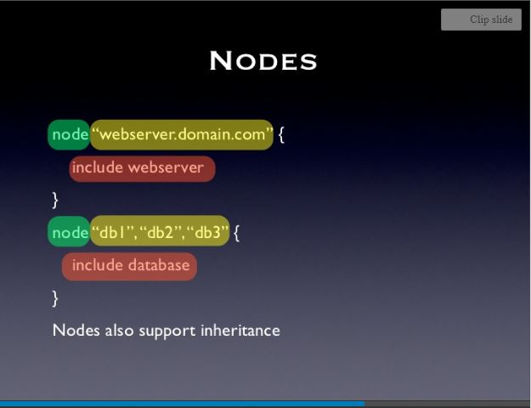
Puppet Nodes

Slide 36
Creating and using modules
Self contained packages that describe an aspect of the system.
Module is collection of manifests, templates, facts,specs,examples, files, lib etc.

Slide 37
Creating module
On the Puppet master, create the directory structure for a module named visualpath
cd /etc/puppet/modules sudo mkdir -p mymodule/manifests
sudo vi mymodule/manifests/init.pp
class mymodule{ }
Use module in main manifest
Sudo vi /etc/puppet/manifests/site.pp
node default { } node ‘hostname' { include mymodule}
Puppet agent –test
http://lamp_1_public_IP/info.php

Slide 38
Install and configure puppet server
Add Repositories and Install Software
Add Puppetlabs repository
rpm -ivh http://yum.puppetlabs.com/puppetlabs-release-el-6.noarch.rpm
Install Puppet Master software
yum install -y puppet-server This will install a load of dependencies including
These names must then be added to the Puppet configuration file
Open /etc/puppet/puppet.conf
Under the [main] section, add
dns_alt_names = puppet,puppet.cloud.local
Create the CA certificate and Puppet master certificate
puppet master --verbose --no-daemonize
End process once Puppet master version appears on the screen (in my case, version 3.6.1) by pressing 'ctrl + c'
This will also install a /etc/init.d/puppetmaster script
Start the Puppet Server
service puppetmaster start
Create and Configure Basic Environment Directories
The environment directories location needs to be set.
Add the following to /etc/puppet/puppet.conf, under the [main] section
environmentpath = $confdir/environmentsCreate the following directories to match with that:
mkdir /etc/puppet/environments/production mkdir /etc/puppet/environments/production/manifests mkdir /etc/puppet/environments/production/modules

Slide 39
Install and Configure a Puppet Client
yum update –y
Install and start ntp
yum install ntp
chkconfig ntpd on
service ntpd start
Ensure client can resolve puppet server via
'puppet' and 'puppet.cloud.local' via your chosen name resolution method
Add Puppet repository
​rpm -ivh http://yum.puppetlabs.com/puppetlabs-release-el-6.noarch.rpm​
Install Puppet agent software
yum install - y puppet
On the client, test and Resolve Any Issues
puppet agent --test

Slide 40
Puppet Module commands
puppet help module [...]
ACTIONS:
Build: Build a module release package.
Changes:Show modified files of an installed module
Generate: Generate boilerplate for a new module. Install:Install a module from the Puppet Forge or an archive.
List: List installed modules
Search: Search the Puppet Forge for a module.
Uninstall: Uninstall a puppet module.
Upgrade: Upgrade a puppet module.

Slide 41
Testing Puppet Modules
Puppet code testing can be done at different levels with different tools
puppet parser validate <manifest.pp> - Checks the syntax of a manifest
puppet-lint <manifest.pp> - A gem that checks the style of a manifest
puppet-rspec - A gem that runs rspec unit tests on a module (Based on compiled catalog)
cucumber-puppet - A gem that runs cucumber tests a module (Based on compiled catalog) OBSOLETE
puppet-rspec-system - A gem that creates Vagrant VM and check for the expected results of realPuppet runs
Beaker - A gem that runs acceptance tests on multiple Vagrant VM

Slide 42
Puppet-Hiera
Hiera is the key/value lookup tool of reference where to store Puppet user data.
It provides an highly customizable way to lookup for parameters values based on a custom hierarchy using many different backends for data storage.
It provides a command line tool hiera that we can use to interrogate direclty the Hiera data and functions to be used inside Puppet manifests: hiera() , hiera_array() , hiera_hash() ,hiera_include()
Hiera is installed by default with Puppet version 3 and is available as separated download on earlier version (Installation instructions).
We need Hiera only on the PuppetMaster (or on any node, if we have a masterless setup)

