Slide 1

Artificial Intelligence
KRISHTI Project

Slide 2
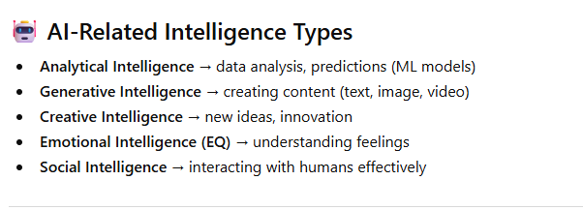
Module basic AI
What is Intelligence
Intelligence is the ability to understand a situation and make the
right decision.
Intelligence = thinking + creating + understanding+ decision
making + adapting

Slide 3
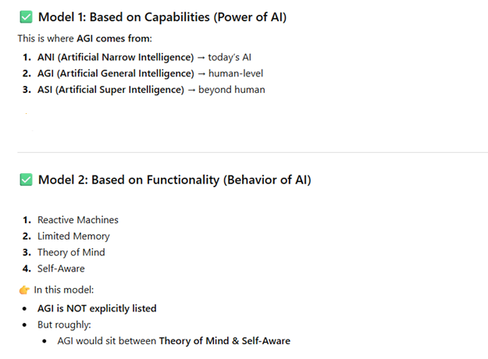
Module basic AI
AI models stage

Slide 4
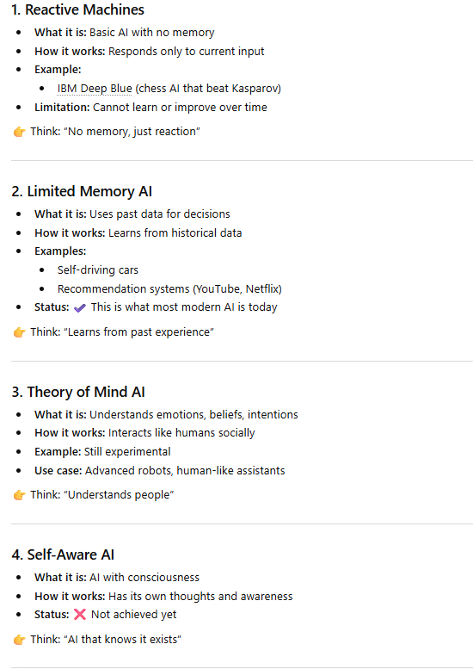
Module basic AI
Behavior of AI

Slide 5
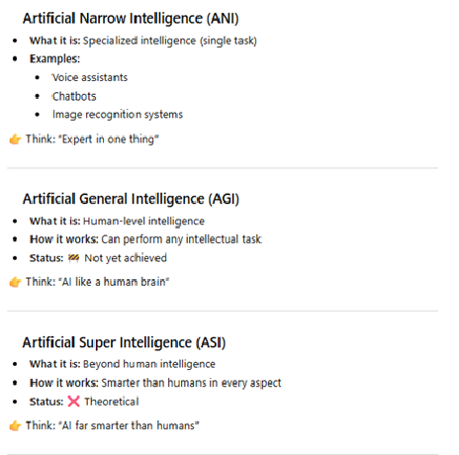
Module basic AI
Capability of AI

Slide 6
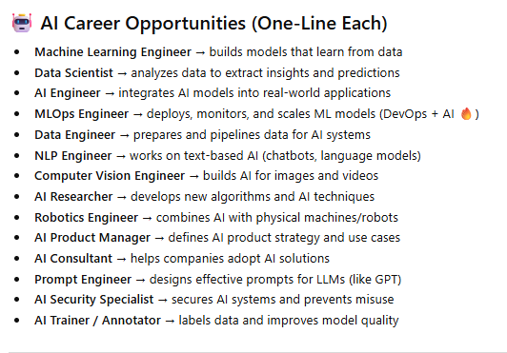
Module basic AI
Career Opportunity

Slide 7
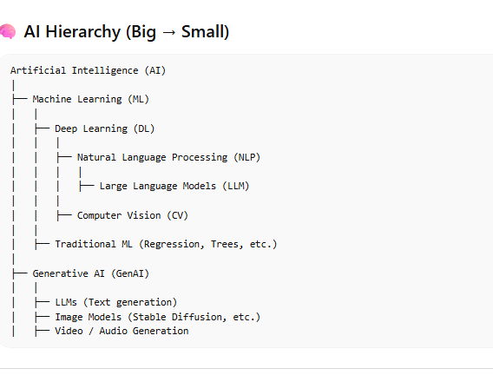
Module basic AI
AI Set & Subset

Slide 8
Module basic AI
AI Set & Subset

Slide 9
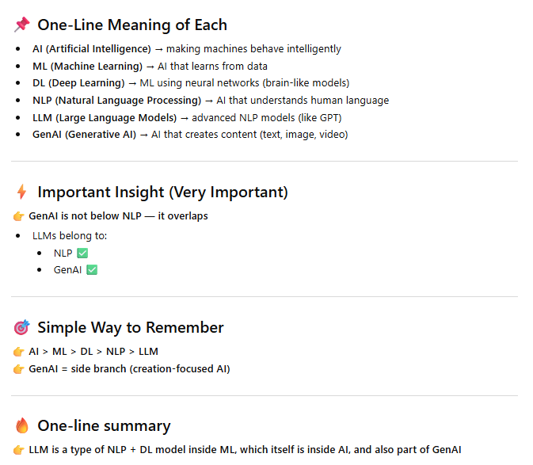
Module basic AI

