Slide 1

Web Scraping to Gain Company Insights
Scraping and analysing customer reviews to uncover customer’s views on BA trips.

Slide 2
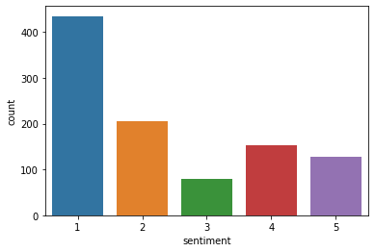
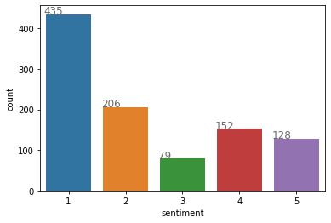


Findings:
At total of a 1000 reviews have been scraped from the given website. After creating a dataframe, a sentiment analysis has been performed using pre-trained model from Huggingface (https://huggingface.co/nlptown/bert-base-multilingual-uncased-sentiment) This is a bert-base multilingual model that predicts the sentiment of a review as a number of stars (From 1 to 5).
According to the sentiment analysis the reviews are pretty damming with more that 60% of those ranking at 1 or 2.
We have performed random checks on reviews and the model is pretty accurate at predicting sentiment, in line with the accuracy provided by Huggingface (95%).
Please see below for some summaries on the matter:
A couple of examples of reviews:
Random Forest Feature importance
XGBoost Feature importance and metrics
Dataset’s correlation matrix

