Slide 1

Predicting Customer Buying Behaviour
Building a predictive model to understand the factors the influence BA’s customers buying behaviour

Slide 2
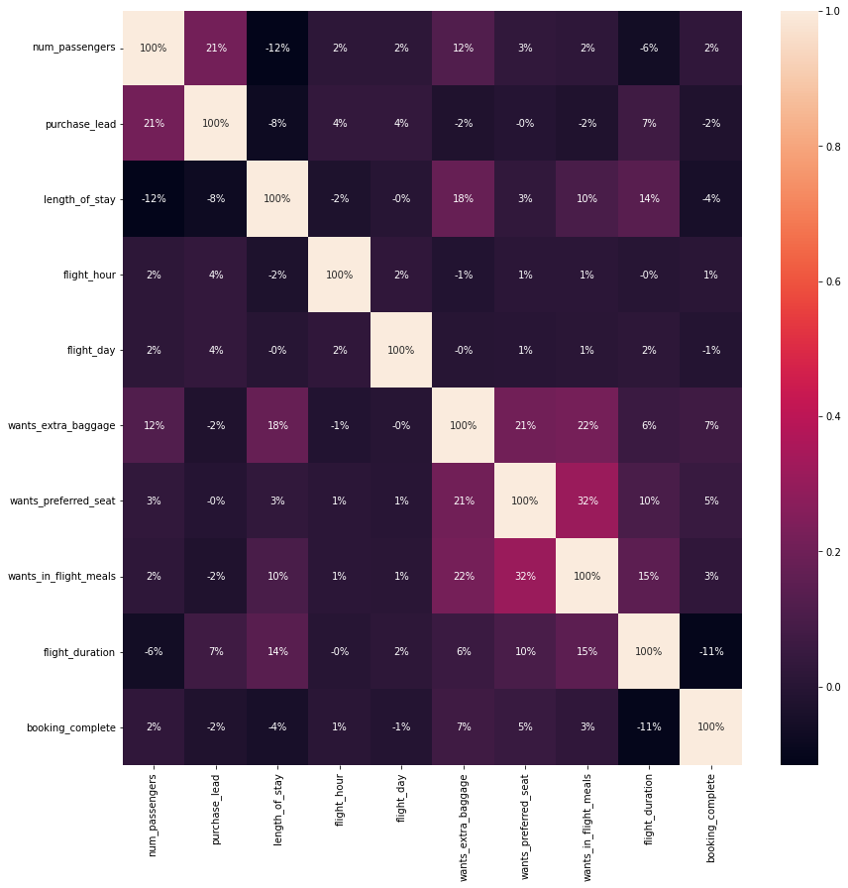
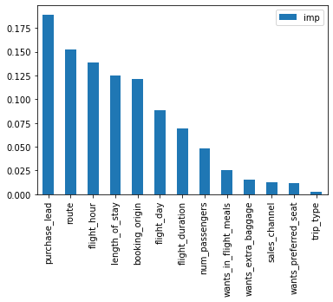
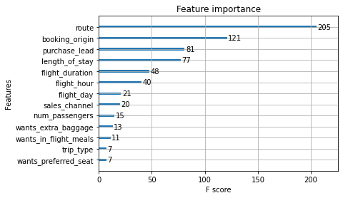
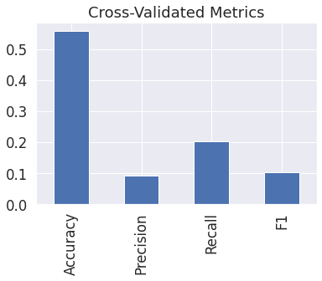
Findings:
Data provided is valid, we just need much more of it to make meaningful predictions. As per now the dataset is highly unbalanced and it is quite hard for modelling. Even using two quite good models (RF and XGBoost) we have not been able to obtain an accuracy of more than 85% after tuning. Cross validated metrics are quite poor as well. Maybe get more data until we get at least a 60/40 split if possible.
Based on the correlation matrix all the variables comprised on the dataset have very little correlation one with each other, again proving that all the features from the dataset are meaningful and valid.
We have tried some feature engineering and some of the newly created features have ranked high on the feature importance but in favour or interpretability we have decided to go with the existing features.
Although in different order, both RF and XGBoost highlight the same features as key contributors. Sales_channel is not one of them but it is worth mentioning that most of the bookings are done using a desktop or a laptop. Improving the mobile interface could be explored, given current trends.
Random Forest Feature importance
XGBoost Feature importance and metrics
Dataset’s correlation matrix

