Slide 1
Reclaim
Melissa W., Disney V., Igor B., Miles M.

Slide 2
Team Overview
Problem/Solution Overview
Name
As a buyer, finding someone in your community who’s selling what you need is hard—even if plenty of people would be willing to sell if asked. Reclaim is a reverse marketplace where buyers post what they need and anyone can fulfill their request. Reclaim unlocks hidden demand for buyers and reduces the burden on sellers to manually list everything they’re willing to part with.
Reclaim
Value Proposition
Everything is for sale.

Slide 3
Tasks
Simple
Medium
Complex
A buyer requesting an item.
A seller sending an offer to a buyer.
A seller setting up automatic alerts for when buyers are looking for a particular item.

Slide 4
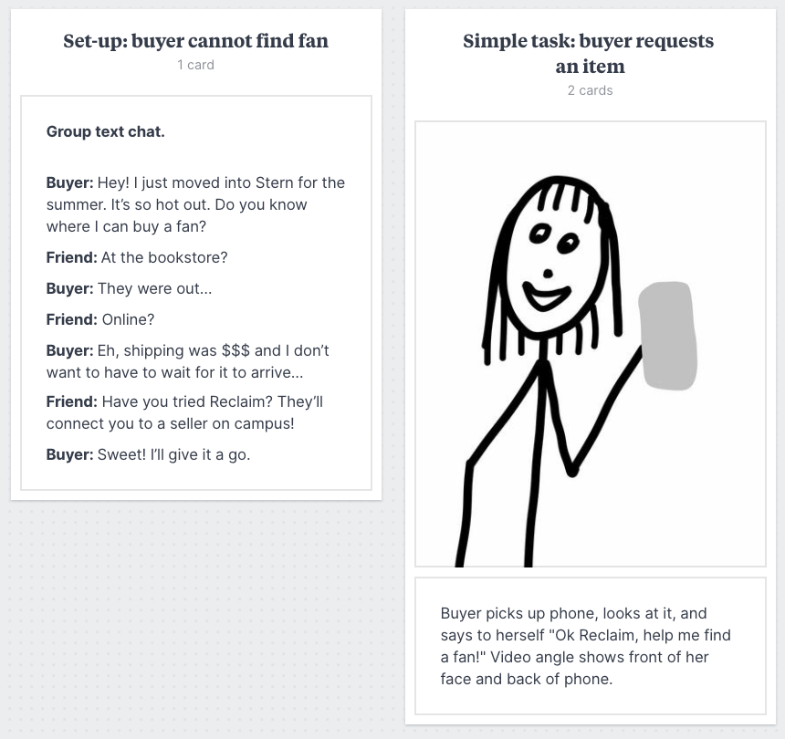
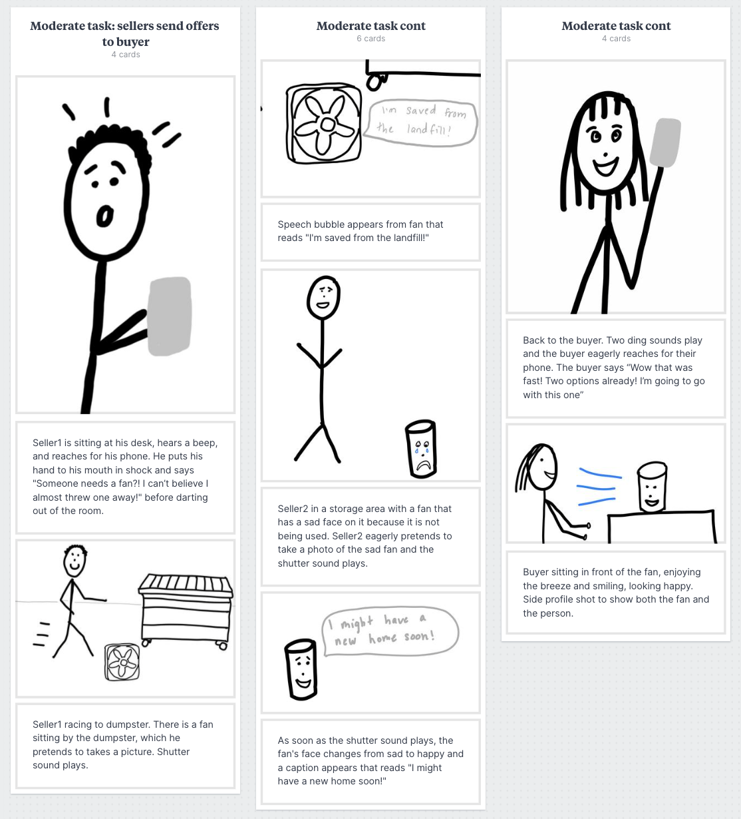
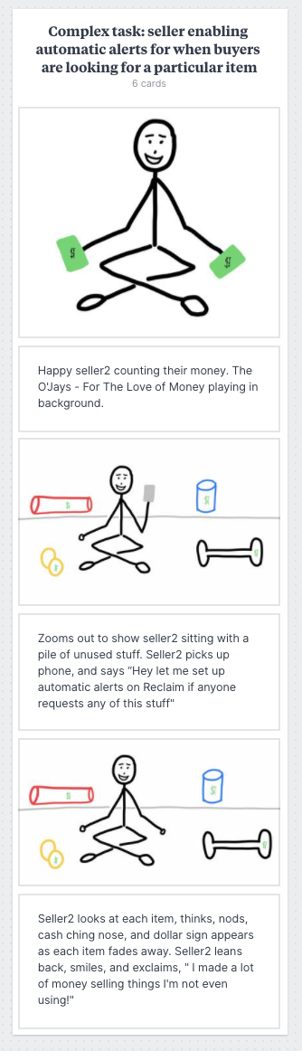
Video
Storyboard

