Slide 1
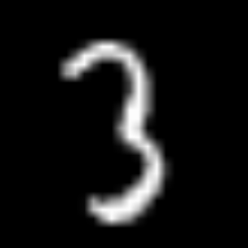
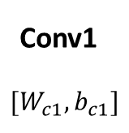
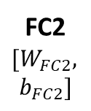

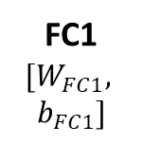

Conv + BN → Conv_{REP}
FC + BN → FC_{REP}
Conv1
$$[W_{c1}, b_{c1}]$$
FC1
$${[W}_{FC1},$$
$$b_{FC1}]$$
FC2
$${[W}_{FC2},$$
$$b_{FC2}]$$
BN $[γ, β, μ, σ^{2}]$
BN_1 $[γ, β, μ, σ^{2}]$
ReLU
Flatten
ReLU
Image
28x28
20 Maps
28x28
15684
values
1000
values
10
classes

Slide 2



Conv1
$$[W_{c1_REP},$$
$$b_{c1_REP}]$$
FC1
$${[W}_{FC1_REP}$$
$$b_{FC1_REP}]$$
FC2
$${[W}_{FC2},$$
$$b_{FC2}]$$
ReLU
Flatten
ReLU
Image
28x28
20 Maps
28x28
15684
values
1000
values
10
classes

