Slide 1

Bookworm Bear

Slide 2
Team Members
Isaba Ishrak - 190041223
Sabah Nushra - 190041227
Tasnim Hasan - 190041241

Slide 3
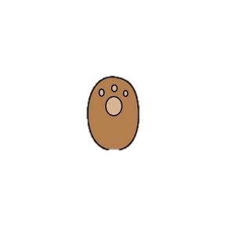
What is the Bookworm Bear?
The goal of this game is to collect a treasure. For this, the player has to successfully cross the jungle by helping the Bookworm Bear, who resides in the jungle, to fill up his dictionary. There are words spread across the jungle which needs to be collected by guessing each letters of that word.

Slide 4

Rules of the game
The game is set on multiple levels. In each level, the number words to add in the dictionary will increase.
Guessing all the required words correctly within the time limit will clear the level.
If the player is unable to guess the words but still has time left, he/she can choose to quit or start over the current level.
If the time runs out and the player is unable to collect the words, the Bear devours him and the game will be over.
In this way, the player can pass all the levels and obtain the treasure! :)
Clearing levels

Slide 5

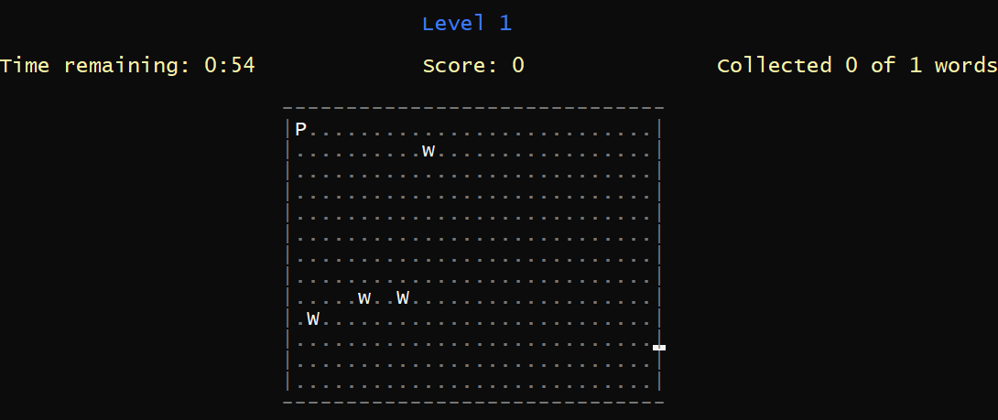
The player has to find and collect words by moving left, right, up or down and avoiding traps. Stepping on the traps will reduce the score.
Movement

Slide 6

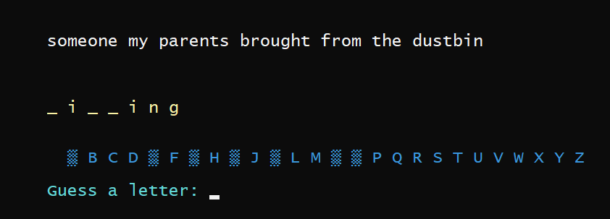
The player will be given blanks to fill whenever he stumbles across a word. By guessing the letters of the word, the player can collect the word as well as points. There will be six chances of error for each word. If all the guesses run out for a certain word, the player will have to find another word in the jungle.
Collecting words

Slide 7

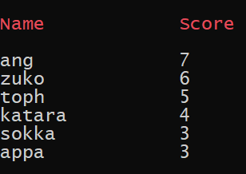
Each word will have value of 6 points. The more guesses the player needs, the less points he/she will get. Acquiring the treasure will earn the player 10 bonus points. The players can see their points in the leaderboard.
Earning points

Slide 8
Explanation of code
Main menu : The game has a main menu lobby which is implemented by simple if-else conditional statements.
Music on/off : To pause the background music, we used mciSendString(). In the command string of the function we have specified when to ‘play’ the audio file and when to ‘pause’ the audio file. We have also used PlaySound() to play other audio files throughout the game.
ASCII arts : We used ASCII arts and also animated some of them using pointers and setw().
We have also used user-defined functions like SetColor() and SetWindow() for colored text output and resizing the console window respectively.

Slide 9

The main game loop starts with creating the first level. We have defined level as a structure which has required number of words and a map to store the positions of the words and traps in the grid as members. The game loop is implemented by two nested while loops. The inner loop handles the current level gameplay i.e movements and wordgame. It breaks when the time for that level is over or the required amount of words is collected.
Then we proceed to the result of the current level. If the current level is cleared, a new level structure is created with different amount of words and the outer loop continues. If the current level is restarted, we again create a level structure but with same amount of words. The outer while loop breaks when the game is over or the user wants to quit
Levels

Slide 10

We have used a 30 X 15 grid to represent the jungle. In the grid, ‘P’ represents the player, ‘W’ represents the word to unlock and ‘w’ is the trap.
The player’s position is initially at the start i.e. at (1,1). The positions for W’s and w’s are defined in a structure position which are generated using rand() in each new level. The positions of the words and traps have been stored in a map with their coordinates.
The grid is rendered repeatedly within a while loop using another structure grid where we’ve used nested loops to position the player, words and the traps.
Grid

Slide 11
In a while loop for current level, using getch() we are taking the player input for by ‘w’/’a’/’s’/’d’. We update the player position according to the input before rendering the grid again.
We also check the player position using another nested loop. Whenever the player’s position coordinates match a word coordinate stored in map, that position in the map is omitted and the wordgame starts. The no. of plays and current level score increases. Again, when player’s coordinates match with a trap’s coordinates, scores are reduced.
Movement

Slide 12

The time resets with each new level and remains paused when the wordgame is executing. It can be paused manually as well.
We have implemented the timer with <ctime> header functions and a user defined function gotoxy(). The timer keeps reprinting in a while loop until the level is over.
The input for movement in the grid is handled by kbhit(). When the player gives an input, kbhit() detects it and the player position is then set according to the input.
Timer

Slide 13

We opened the text files containing the words and hints in read mode and stored all the words and hints in a vector of pairs as soon as the game started. We also made an array in which we stored unique random numbers using rand().
In each wordgame loop, we used these random numbers one by one as index of the vector to choose random words. We also made a vector of alphabets to track which letters the player has already used.
In an inner loop, the player is asked for letter inputs, this letter is checked with the word. If the player guesses it correctly, the blanks are updated using another loop. Otherwise, lives and points are decreased. This loop continues till lives>0 or filled blanks!=no. of letters in the word. The points are returned at the end of the function.
Wordgame

Slide 14
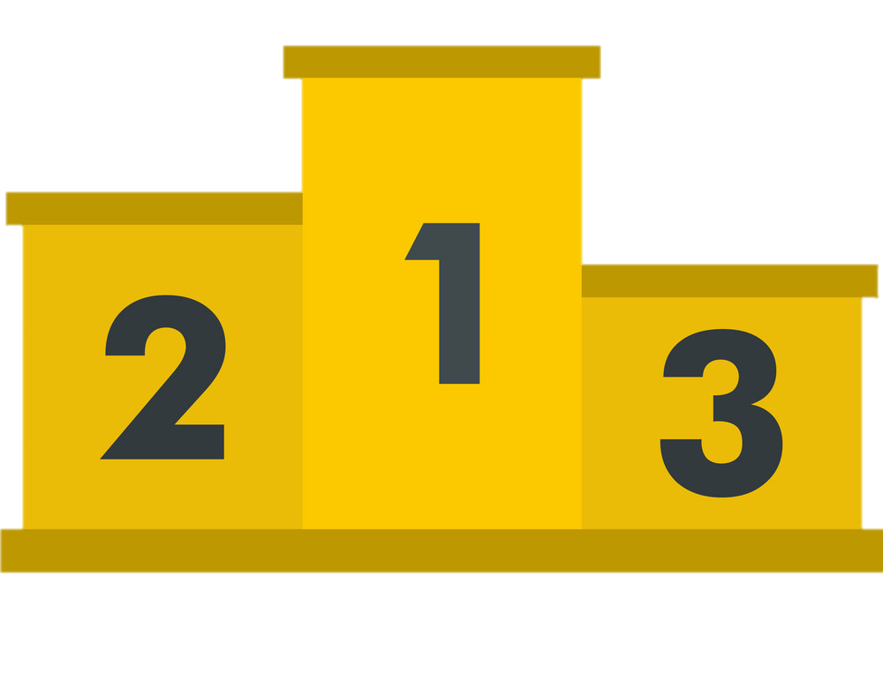
Leaderboard & save/load score
The leaderboard can be entered from the main menu. The scores are stored in a text file which is accessed using a file pointer. In this way, all the previous gameplay scores are also stored. We just read the file and print in the console to show the leaderboard.
After each game loop, the text file is updated with the new score.
We have used a separate user-defined compare() to sort the scores in descending order before printing.

Slide 15
It’s time to play the
GAME

