Slide 1
Puppet with vSphere Workshop
Install, configure and use Puppet on your laptop for vSphere DevOps
Billy Lieberman
August 1, 2015

Slide 2
Introduction
Billy Lieberman
Five years experience with Puppet
Puppet Certified Professional
Puppet Labs Certified Consultant
wlieberman@vmware.com
Proctors
Curtis Stewart
Eric Smalling

Slide 3
About Us: VMware DevOps Consulting Services
Developer friendly. Enterprise ready.
Our team of dedicated DevOps experts provide:
Strategy development
People, process & technology transformation for
Security & resilience optimization
Assessment
Continuous delivery
Configuration management
Cloud operations
Build and deliver applications sooner
Fuel innovation and accelerate time to market
Transform your enterprise to support high velocity, modern application development
Deploy an agile future-ready datacenter where any app can thrive

Slide 4
Agenda
Brief Overview of Puppet Components
Create Puppet Development Environment Using Vagrant
Create Puppet Master
Create Puppet Agent to test code
Create Puppet “Control” Repository
Puppetfile
environment.conf
Roles and Profiles
Dynamic Environments
Use r10k to deploy your puppet code to your Development Environment
Deploy all modules and environments
Testing New Code
Use the Node Classifier to test our new code on the Puppet Agent
Notes:
Mention that there is a lot to cover in a short period of time, but if there are any questions, will do best effort to answer them.

Slide 5
What’s Puppet?
What are the different components make up a Puppet Installation? What are some of the benefits to using Puppet?

Slide 6
Puppet
Puppet is one of many configuration management tools
Infrastructure as code
Composed of Several Components
Puppet Master
Puppet Console
Puppet Agent
Puppet Code
Modules (or classes)
Manifests
Hieradata

Slide 7
Benefits – Infrastructure as Code
Rebuild your entire system from a code repository, data backups, and compute resources
Programmatically provision and configure components
Limits the needs for full instance backups
Provides the ability to keep base images lightweight
Executable documentation

Slide 8
Create Development Environment
Using Vagrant, build virtual machines for a Puppet Master and a Puppet Agent.

Slide 9
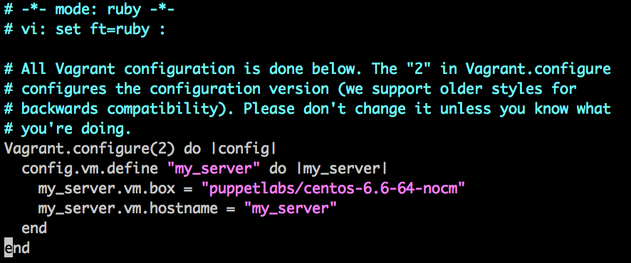
The Vagrantfile
Defines the instances that will be used. Below is a minimal Vagrantfile for one instance named “my_server”

Slide 10
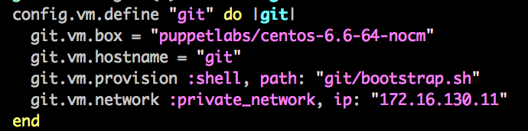
Setup Vagrant Environment
Below is a code block of the Vagrantfile that defines a git/yum repo server.

Slide 11
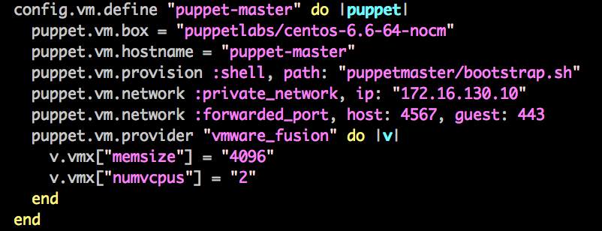
Setup Vagrant Environment
Below is the code block which defines the Puppet Master instance.

Slide 12
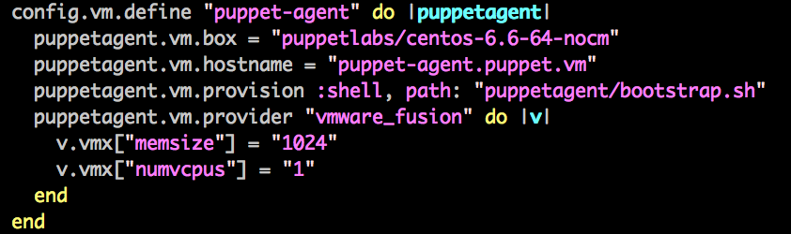
Setup Vagrant Environment
Below is the code block which defines the Puppet Agent instance.

Slide 13
Create Control Repository
Create a git repository containing a “Puppetfile” from which r10k will deploy Puppet Modules.

Slide 14
Contents of Control Repository
Puppetfile
environment.conf
site/ -- Directory for “roles” and “profiles” modules
hieradata/ -- Directory for Hiera. This can also be externalized into it’s own repository for r10k to deploy
manifests/ -- Directory which contains the site.pp file. This is not always required, however you may use it to take advantage of some site.pp configuration items (i.e. filebuckets)

Slide 15
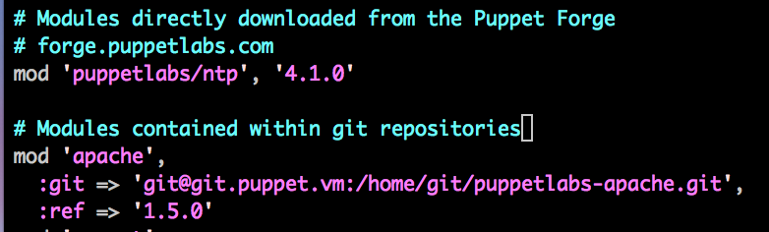
Puppetfile
Add all of your component modules here

Slide 16
environment.conf
Environment specific puppet configuration items
Use to specify the puppet “modulepath” in the specific environment
modulepath = site:dist:modules:$basemodulepath

Slide 17
Things to remember about the Control Repository
Each branch will be deployed by r10k as different environments. This is how we can achieve dynamic environments so easily.
The default branch should be named “production” to match up with Puppet’s default environment.
All files contained within each branch will be deployed into the environment directory named after the branch name.

Slide 18
Puppet “Roles” and “Profiles”
Create “Roles” and “Profiles” modules to use the component modules appropriately.

Slide 19
Let’s Create Some Profiles First
Let’s start with a “base” profile which will be applied in all roles
Next create a profile to manage a specific component of a system
Profiles may include other profiles
Profiles should make use of component modules

Slide 20
Create your first Role
One role per node
If a server would require two roles to be configured properly, then that requirement should define a new role. There can be only one!
Create a “roles” module by using only profiles that have been created. If something else needs to be added to the server, create a new profile or extend an existing one.
Notes:
Sorry for the Highlander reference…it’s not too often that you can use one in presentations!

Slide 21
Commit, Deploy, and Test
Use r10k to deploy all Puppet Code to your Development Puppet Master, and Test code by using Vagrant to create new instances.

Slide 22
Committing Your Work
For the most part, we follow the standard “Gitflow” workflow:
https://www.atlassian.com/git/tutorials/comparing-workflows/gitflow-workflow
New work should always be developed in “feature” branches
Test the “feature” branch to make sure that the feature works and nothing is broken
These should branch off of the “integration” branch
After testing is complete, merge to an “integration” branch
A “rebase” may be necessary if doing team development
Test the “integration” branch
Merge to “production” branch and tag an official release
It is recommended that tags follow Semantic Versioning: http://semver.org
Tagging is important for all sorts of reasons!
Notes:
Sorry for the Highlander reference…it’s not too often that you can use one in presentations!

Slide 23
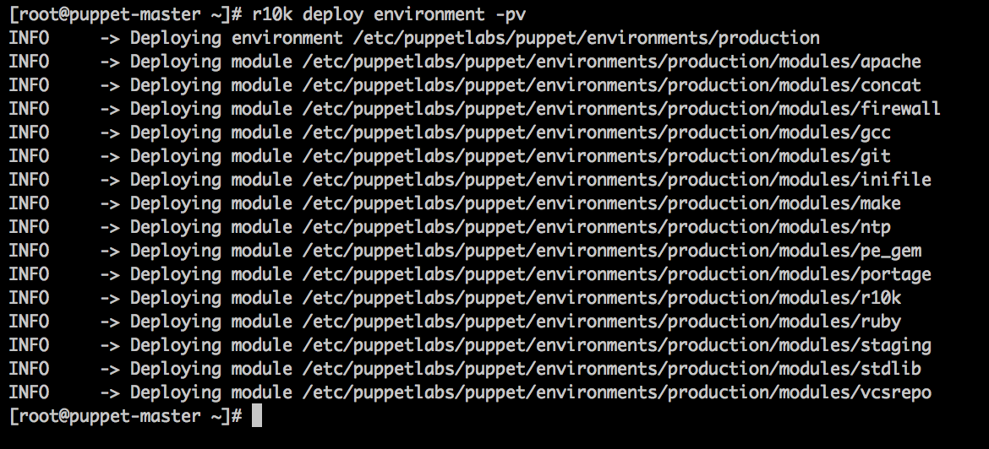
Deploy Your Code
Deploying becomes a simple process using r10k

Slide 24
Test Your Work!
Use Vagrant to spin up test instance(s)
Classify your new instance with the specific environment that matches your feature branch
Run the Puppet Agent on your test instance.
Perform required testing. Be sure to test idempotence!!!
Always ensure that you test your work before merging!
Notes:
Sorry for the Highlander reference…it’s not too often that you can use one in presentations!

Slide 25
Production in vSphere
Using the same repositories of tested code, use r10k to deploy on your Production Puppet Installation.

