Slide 1
Social-aware Hybrid Mobile Offloading
A contribution for edge and fog computing?
Huber Flores
huber.flores@ee.oulu.fi
Notes:
Hello, good day, my name is Huber Flores, I am postdoc at University of Oulu
I conduct research about mobile and cloud computing, specifically about mobile offloading.
Today I am glad to present you the results about a study we conducted to design a mobile offloading framework which unifies different offloading models
So the title of my presentations is
Social-aware Hybrid Mobile Offloading
And the discussion around it … is to know whether or not the approach can be exploited in practice

Slide 2
Roadmap
Background
  Mobile offloading
Problem statement
  Opportunistic spectrum
Studies towards the solution
  Hybrid system
Lessons learned and experiences
  Discussion
Conclusions
Notes:
I will talk briefly about mobile offloading and its multiple models. I will also highlight the opportunistic spectrum of each of them
Later, I will present the hybrid system along with the challenges that we overcome for building it.
Next, some results about the experimental evaluation in the wild.
Lastly, some conclusions and insights about the exploitation of the system in edge and fog computing

Slide 3
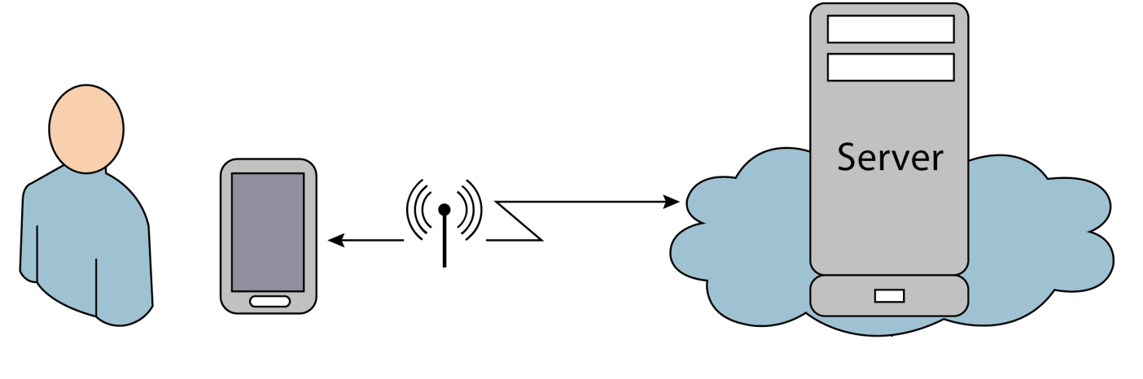


Mobile offloading
Opportunistic augmentation of resources
  Processing
  Storage
  etc…
[IEEE Communications 2015] Flores, H., Hui, P., Tarkoma, S., Li, Y., Srirama, S., & Buyya, R. (2015). Mobile code offloading: from concept to practice and beyond. IEEE Communications Magazine, 53(3), 80-88.
Notes:
It’s just the opportunistic process of moving one computational or storage task from one place to another.
Naturally, when the mobile context to offload the task is good enough, such that outsourcing the task represents less effort for the device rather than processing by itself.
Usually, low power rely on this approach to release the resources from computational processing, such that it is possible to improve performance and save energy.
The potential of mobile offloading is already well-known in the community. Thus, the effort is towards approaches that improve the availability of the offloading support.

Slide 4
Mobile offloading models
Cloudlet
  Scalability
Remote cloud
  Latency in the communication
Device-to-Device (D2D)
  Social participation
Notes:
There are different offloading models.
The opportunistic spectrum is influenced by many drawbacks.
Cloudlet
Rich and nearby servers
Remote cloud
Cloud infrastructure
Device to device communication
User’s device

Slide 5
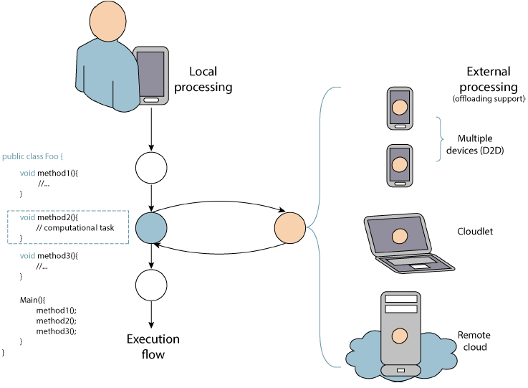
Hybrid offloading system
Increasing the offloading spectrum
Notes:
We propose a hybrid system that combines all the offloading models in order to augment the offloading spectrum
But the real question here is
Can this system be really exploited in the wild?
What are the considerations for this system to work?

Slide 6
Hybrid offloading system
Addressability of the user’s device
  Privacy
Stability based on user’s mobility
  Duration and frequency
Social participation
  How valuable is batterylife is for the user?
Notes:
Now you may think….
Why do we need to address this challenges within the system is communication is increasing….

Slide 7
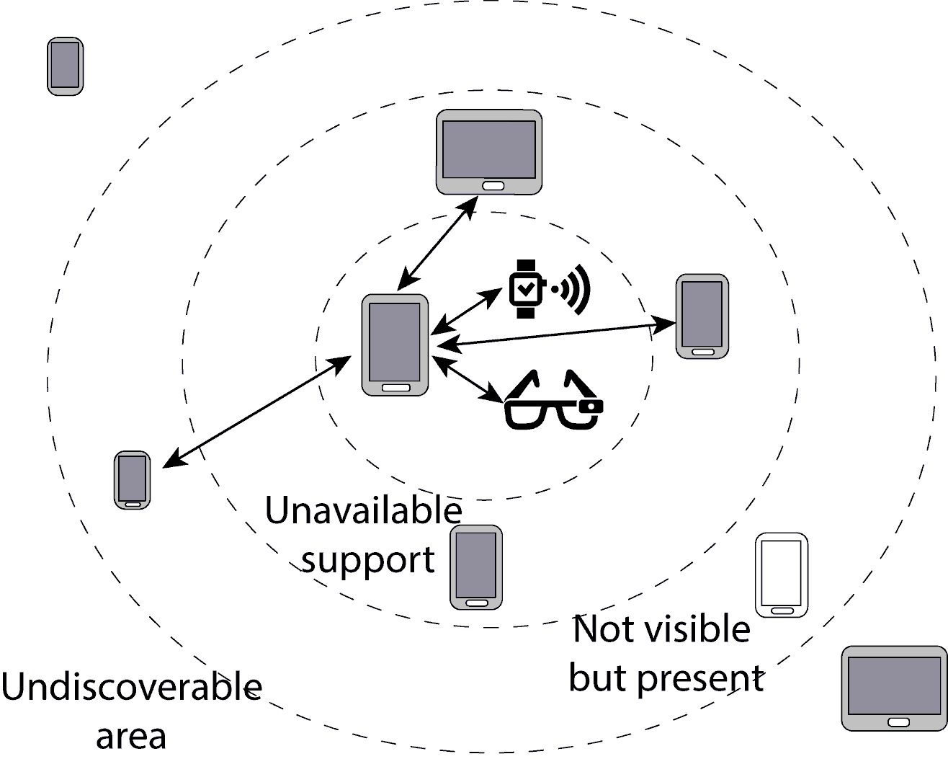

Study: proximal infrastructure
[WMSC-UbiComp 2016] Flores, H., Sharma, R., Ferreira D., Lou, C., Kostakos, V. Tarkoma, Hui, P., Li, Y. (2016) Social-aware Device-to-Device Communication: A contribution for edge and fog computing?, UbiComp Workshop on Mobile and Situated Crowdsourcing , 2016.
Notes:
Even the device is present, it is not discoverable, so how much really D2D can deliver?
If we let the mobile operator handle this, many concerns will arise
Who is the owner of the device?

Slide 8
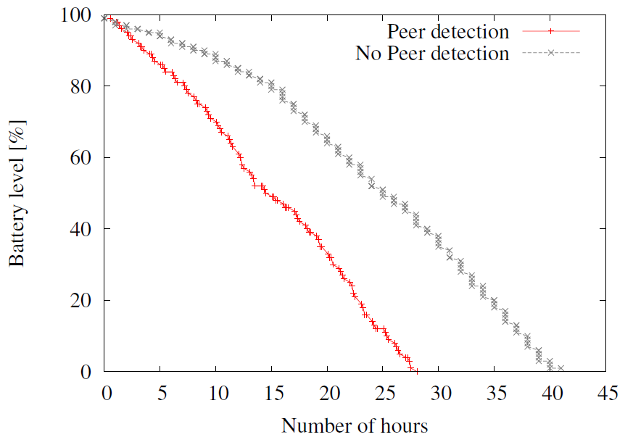
Results

Slide 9
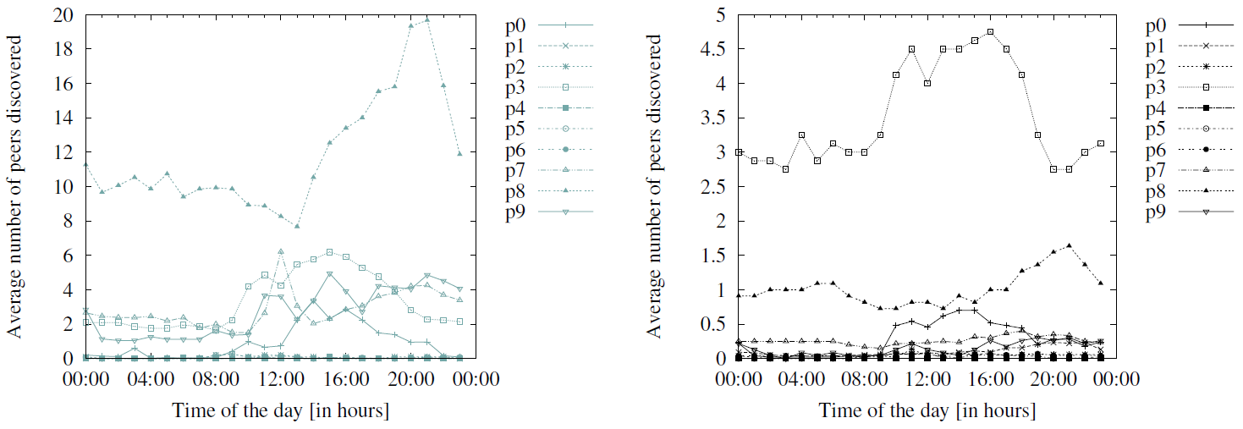
Results

Slide 10
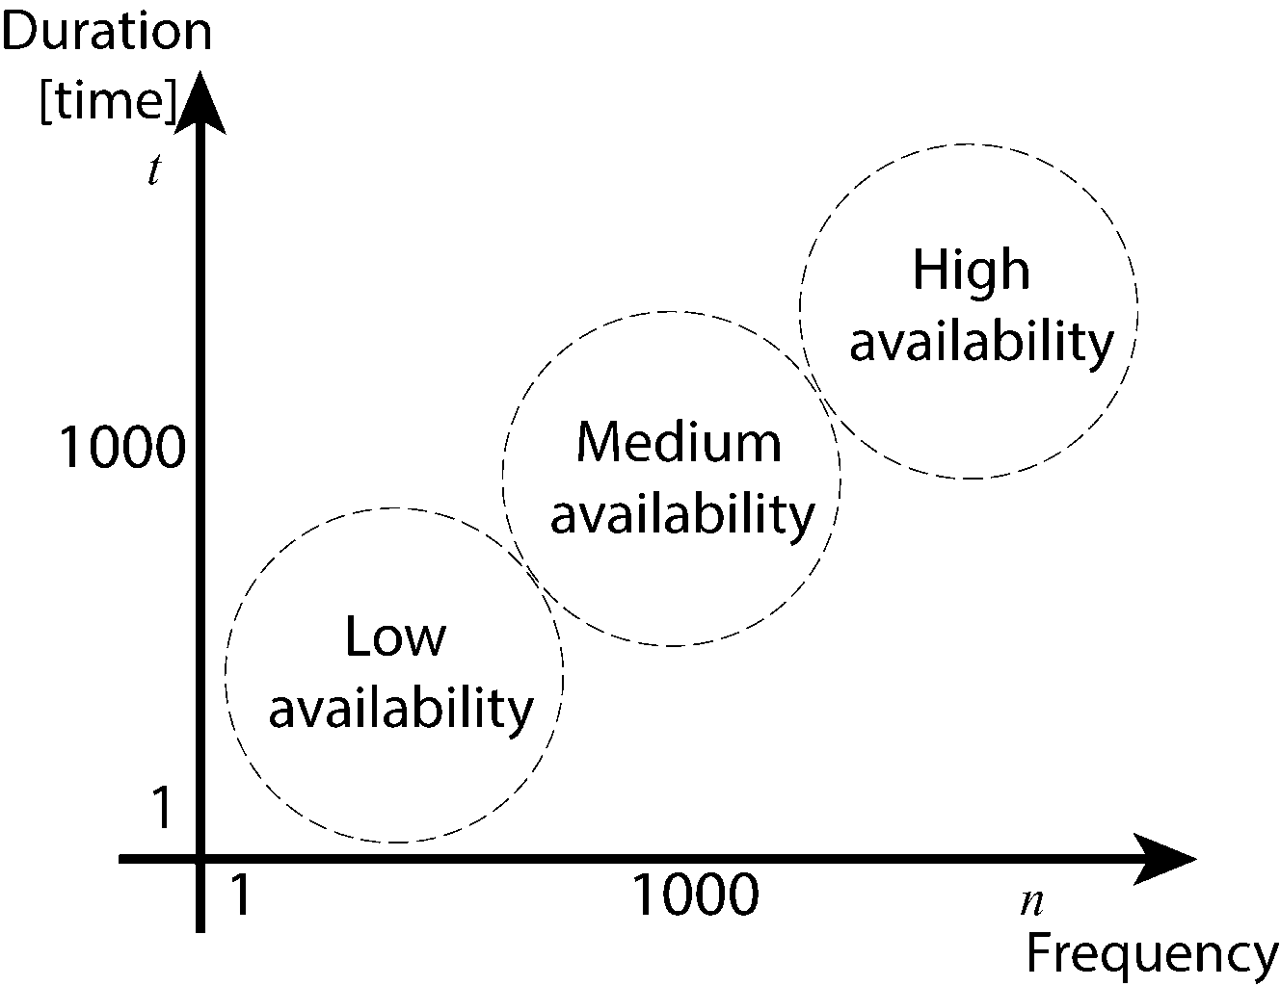
Study: stability region
[PMC 2016] Flores, H., Sharma, R., Ferreira D., Kostakos, V. Tarkoma, S. Manner, J., Hui, P., Li, Y. (2016) Social-aware Hybrid Mobile Offloading, Pervasive and Mobile Computing Journal, 2016.

Slide 11
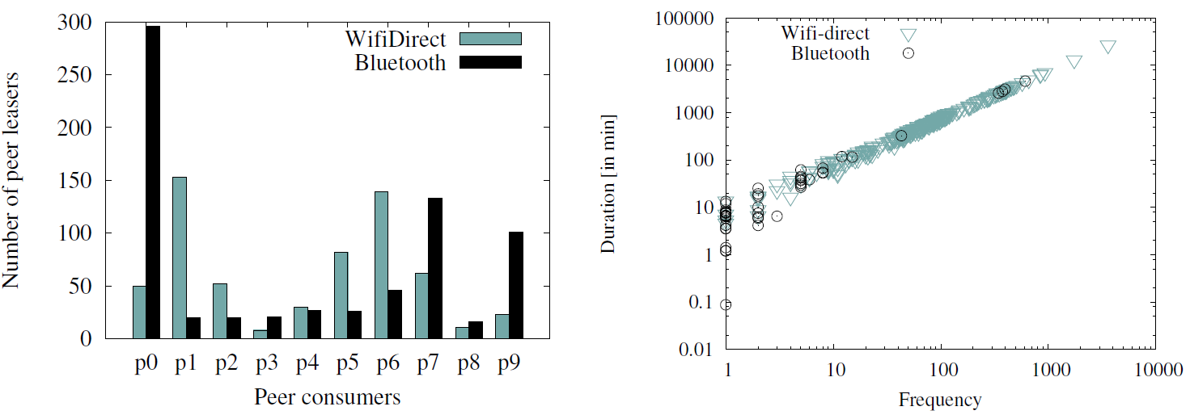
Results

Slide 12
Study: monetary assesment of battery life
Battery is money!

Slide 13
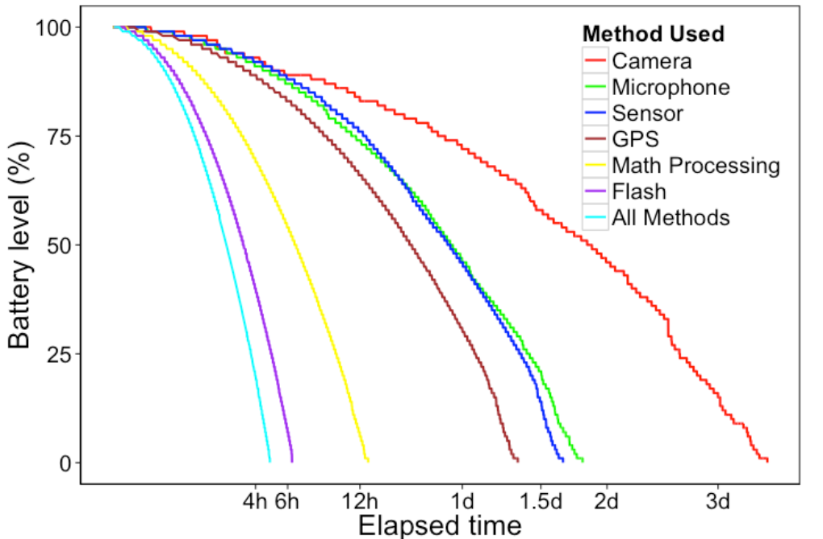
Monetary assesment of battery life
[CHI 2016] Hosio, S., Ferreira, D., Goncalves, J., van Berkel, Flores, H., ... & Kostakos, V. (2016). Monetary Assessment of Battery Life on Smartphones. In Proceedings of the 2016 CHI Conference on Human Factors in Computing Systems (pp. 1869-1880). ACM.

Slide 14
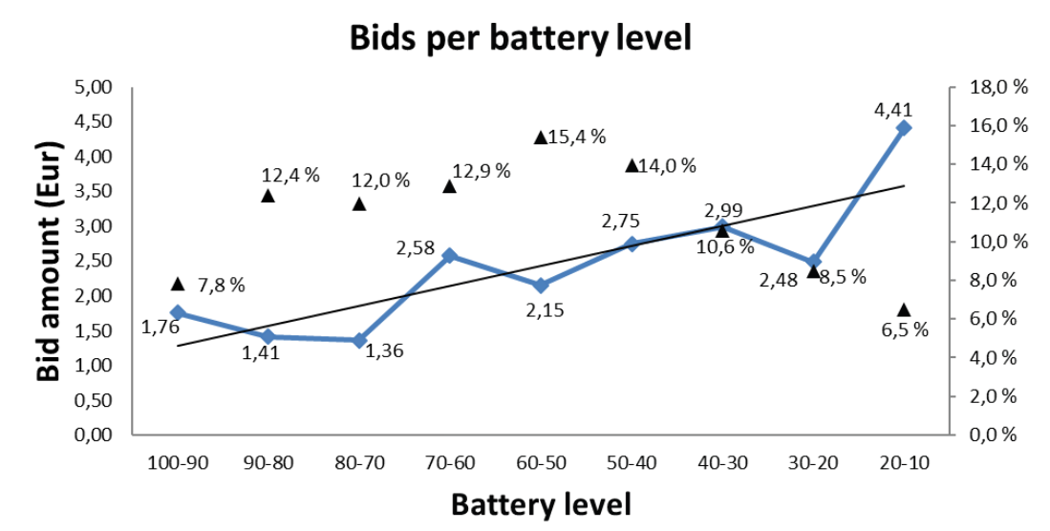
Monetary assesment of battery life

Slide 15
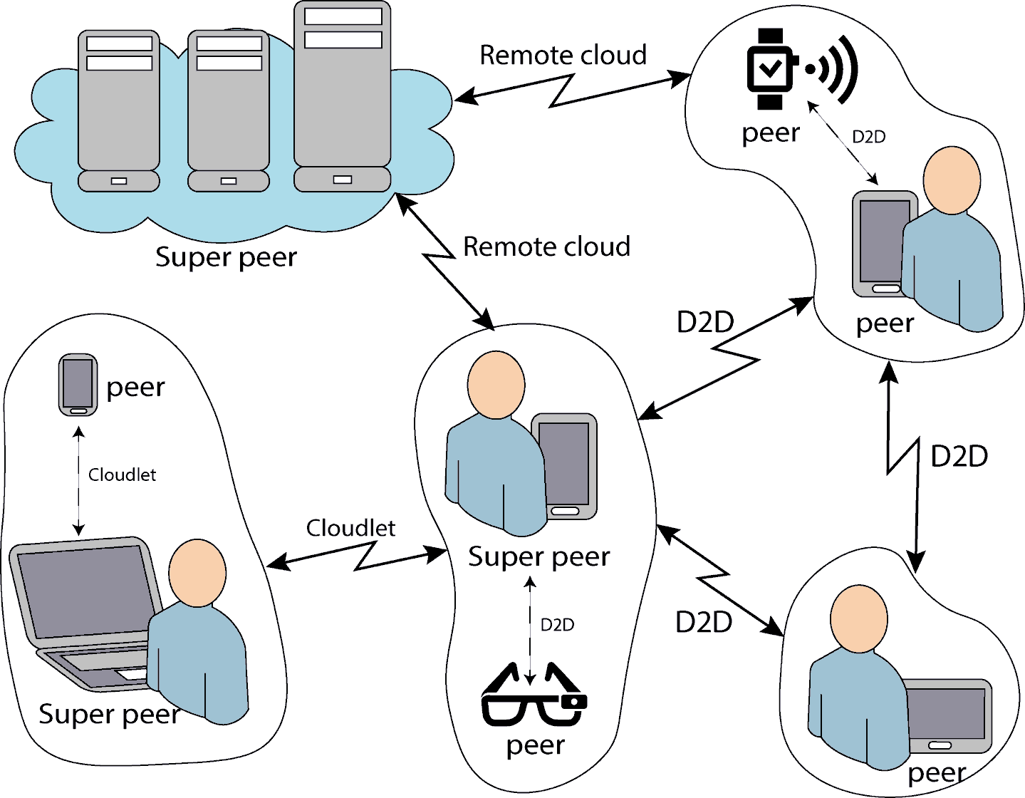
Social-aware hybrid offloading

Slide 16
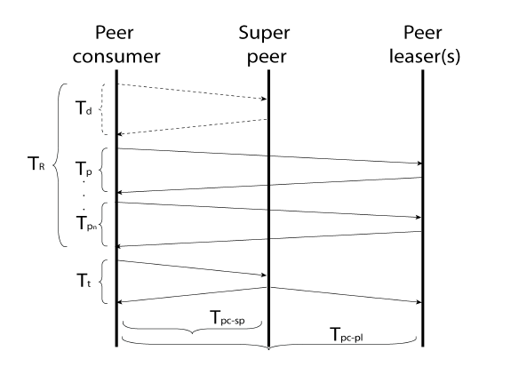
Social-aware hybrid offloading
Peers
Super-peers
  Credit and reputation
Notes:
Propagation of updates and consistency, which we need to explore further.

Slide 17
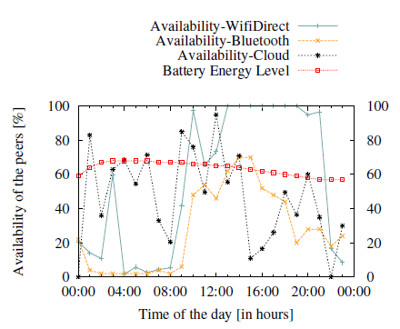
Social-aware hybrid offloading

Slide 18
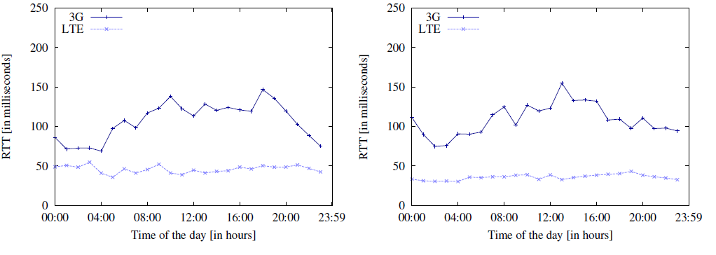
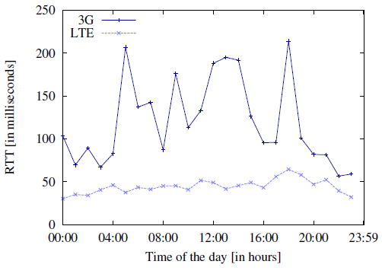
Mobile offloading (3G/3G LTE)
DNA
ELISA
SONERA
Notes:
1000 samples to characterize the average latency experienced by a user. Notice that I am showing average. I should be showing median because people is not measure in averages, but even though is the average, we can see relative low latency.

Slide 19
Conclusions
The offloading spectrum increases substancially
An extra layer of complexity and overhead is introduced when handling social participation.

Slide 20
QUESTIONS

