Slide 1
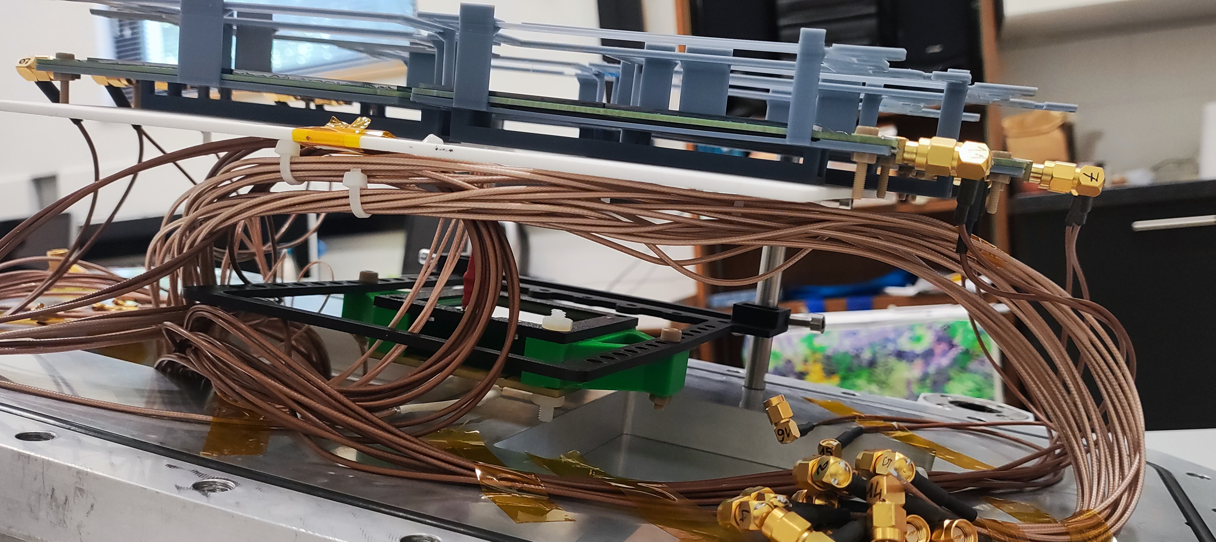
EXTRA FLENCH OF 2CM !!
25 mm
73.5 mm
71.5 mm
18 mm
11.5 mm
Medidas flench-Juan’sSil-65micras-Silicon f1 (distance to front and far, the plastic wall bend when the particles where horizontally, check if improves having it vertically)- f0

