Slide 1


Python Session 21

Slide 2


Today
Stiva/Stack
Lista Inlantuita/Linked List
IT School ©2022 Proprietary and Confidential. All Rights Reserved.

Slide 3
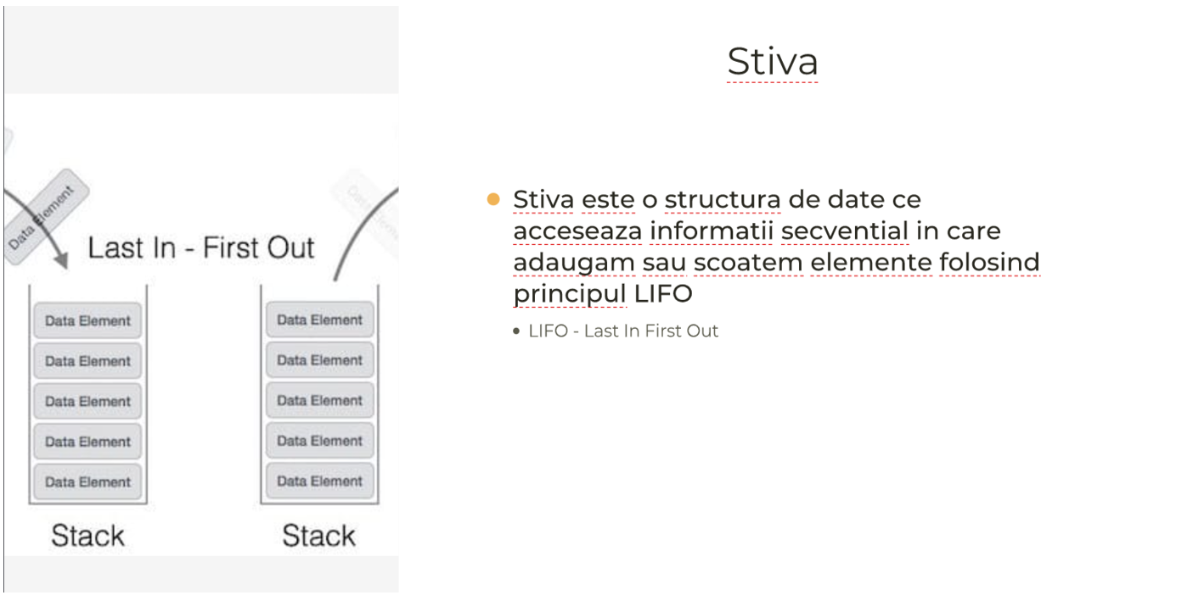
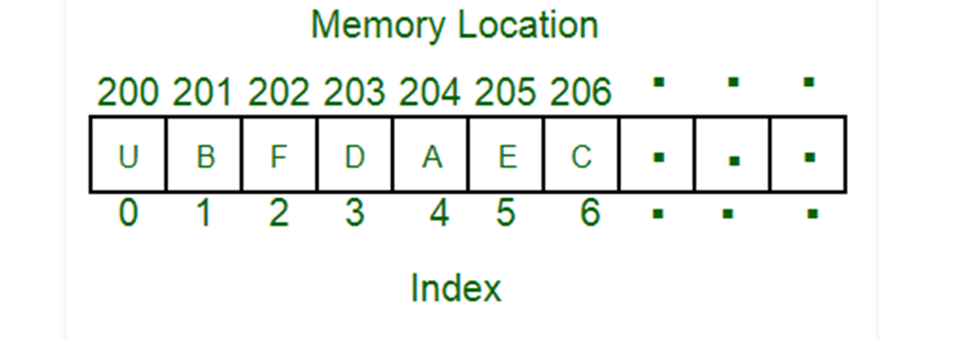
Stack/Stiva
IT School ©2022 Proprietary and Confidential. All Rights Reserved.

Slide 4
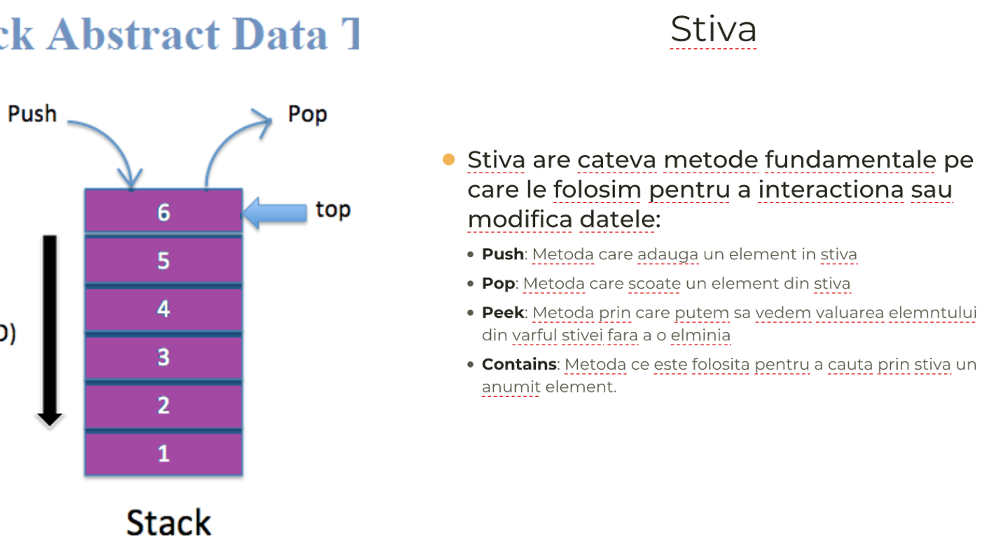
Stiva
IT School ©2022 Proprietary and Confidential. All Rights Reserved.

Slide 5
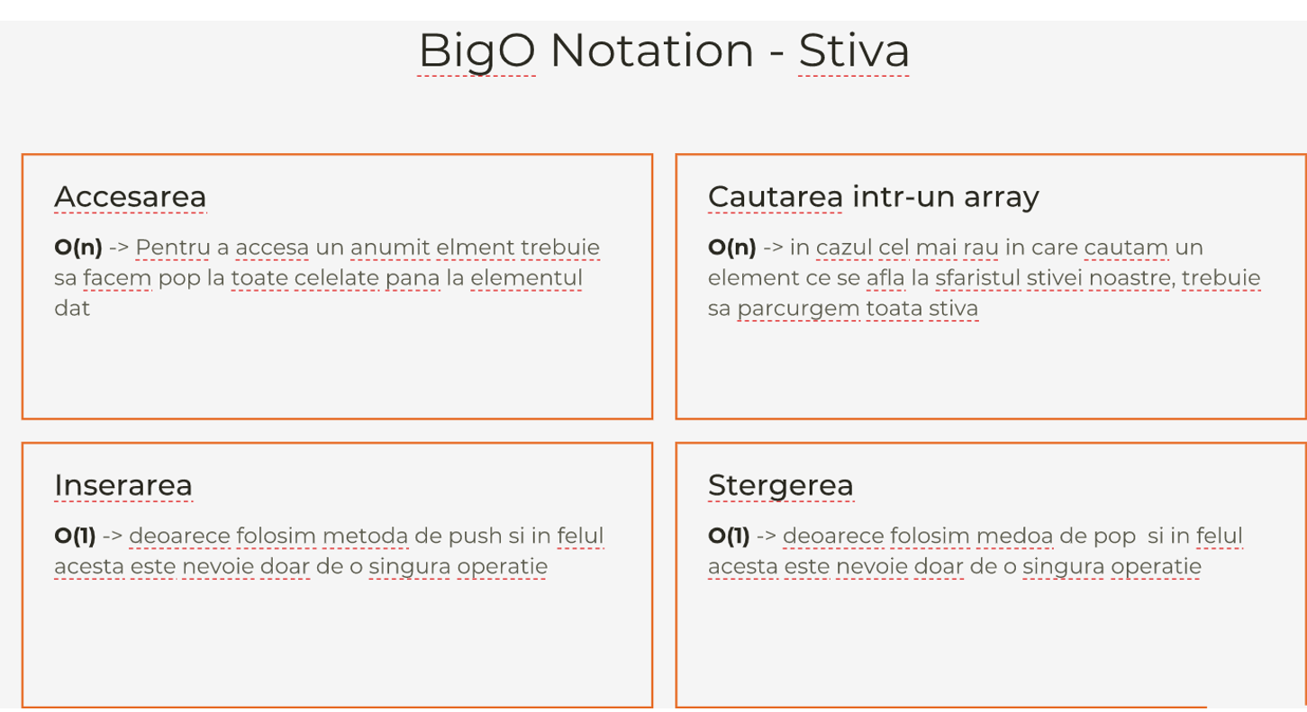
Stiva
IT School ©2022 Proprietary and Confidential. All Rights Reserved.

Slide 6
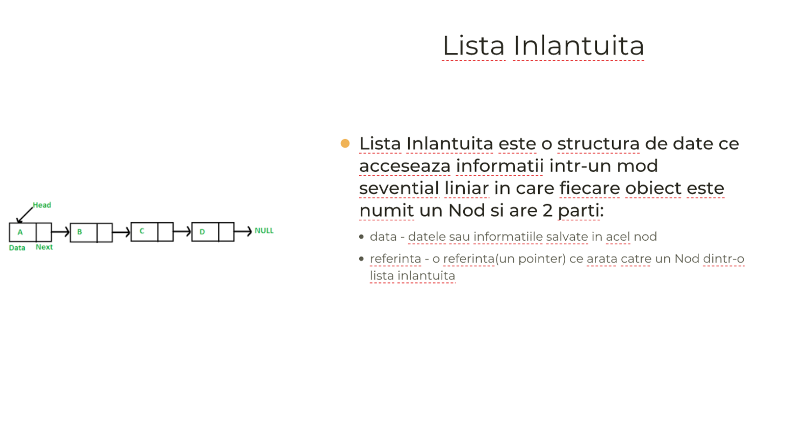
Lista Inlantuita:
IT School ©2022 Proprietary and Confidential. All Rights Reserved.

Slide 7
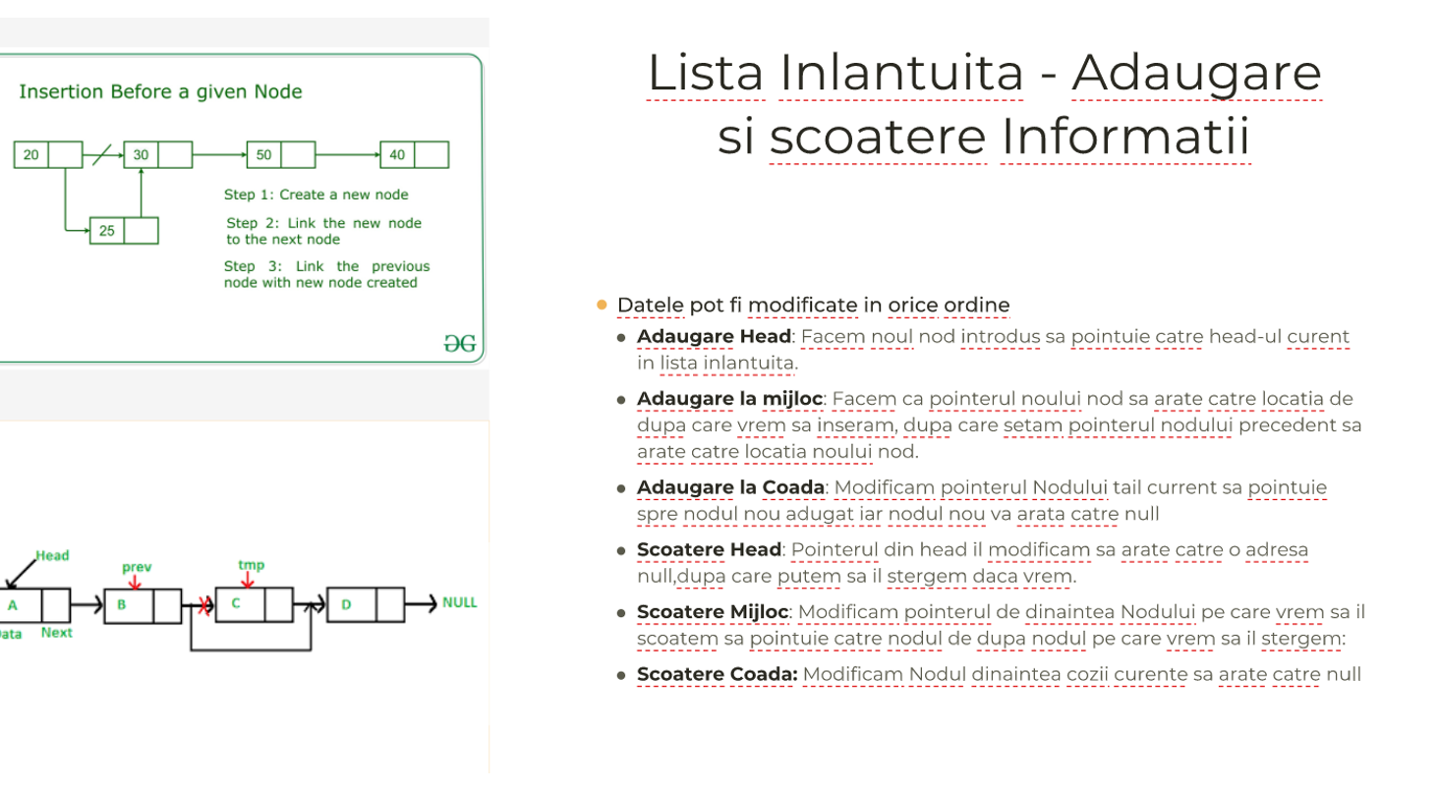
Lista Inlantuita
IT School ©2022 Proprietary and Confidential. All Rights Reserved.

Slide 8
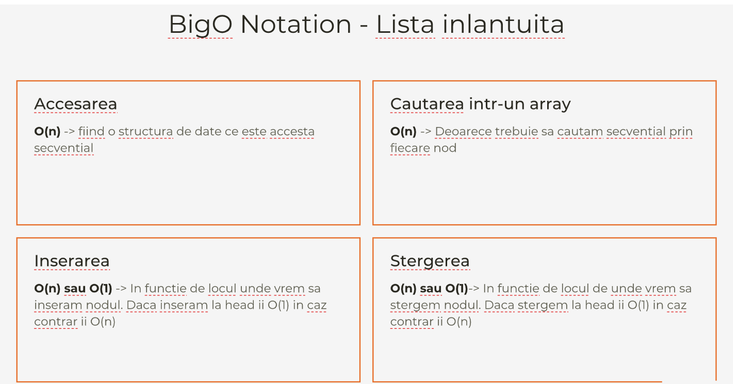
Lista Inlantuita
IT School ©2022 Proprietary and Confidential. All Rights Reserved.

