Slide 1

cBGE and WGS Merged QC Summary Statistics and Polygenic Risk Score
Kugathasan Lab
April 15th 2025
Ranjit Pelia and Dave Cutler
PhD Genetics & Molecular Biology (Y3)

Slide 2
Ancestry Amongst Datasets
WGS
cBGE
N=3610
N=1794
Ancestry | WGS | cBGE
African | 3401 | 1174
American | 35 | 503
European | 161 | 115
South Asian | 10 | 2
East Asian | 3 | 0

Slide 3
What exactly was wrong two weeks ago?
Multiallelic sites with differing representations of the reference allele were handled incorrectly!
An example
In the WGS dataset
:1 788841 rs372538724 GGAACGGAA AGAACGGAA,*,CGAACGGAA
In BGE
1 788841 rs372538724 G A
Incorrectly combined last time
1 788841 rs372538724 GGAACGGAA AGAACGGAA,*,CGAACGGAA,G,A
Correctly combined, this time
1 788841 rs372538724 GGAACGGAA AGAACGGAA,*,CGAACGGAA

Slide 4
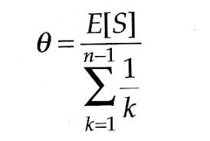
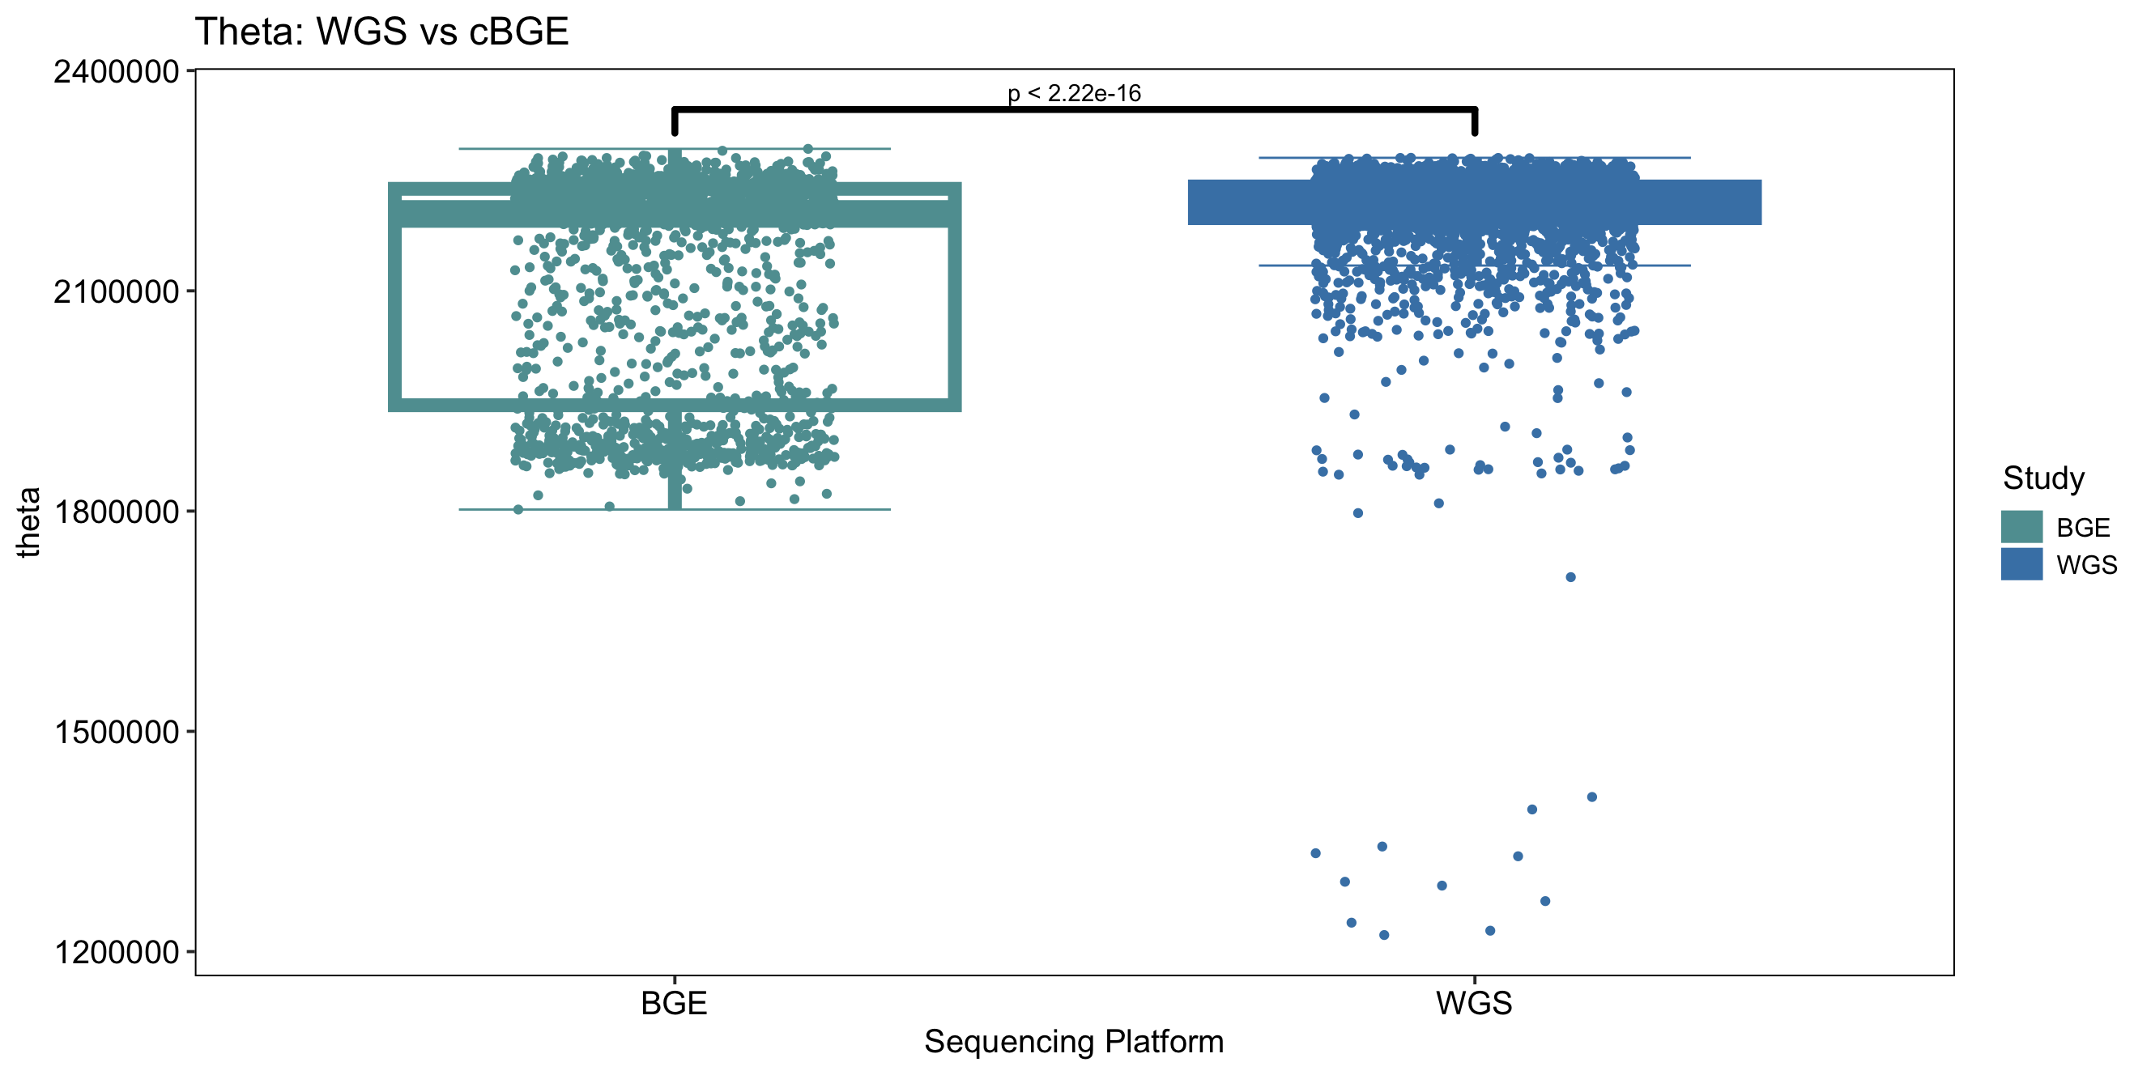
Theta
Theta is a measure of genetic diversity within a population based upon polymorphic sites
The higher the sample size, the greater the number of polymorphisms hence theta will be increased
Theta | cBGE | WGS
Minimum | 1802121 | 1222575
1st Quartile | 1944198 | 2198994
Median | 2204715 | 2225049
Mean | 2117041 | 2207967
3rd Quartile | 2238944 | 2242157
Maximum | 2293417 | 2281187

Slide 5
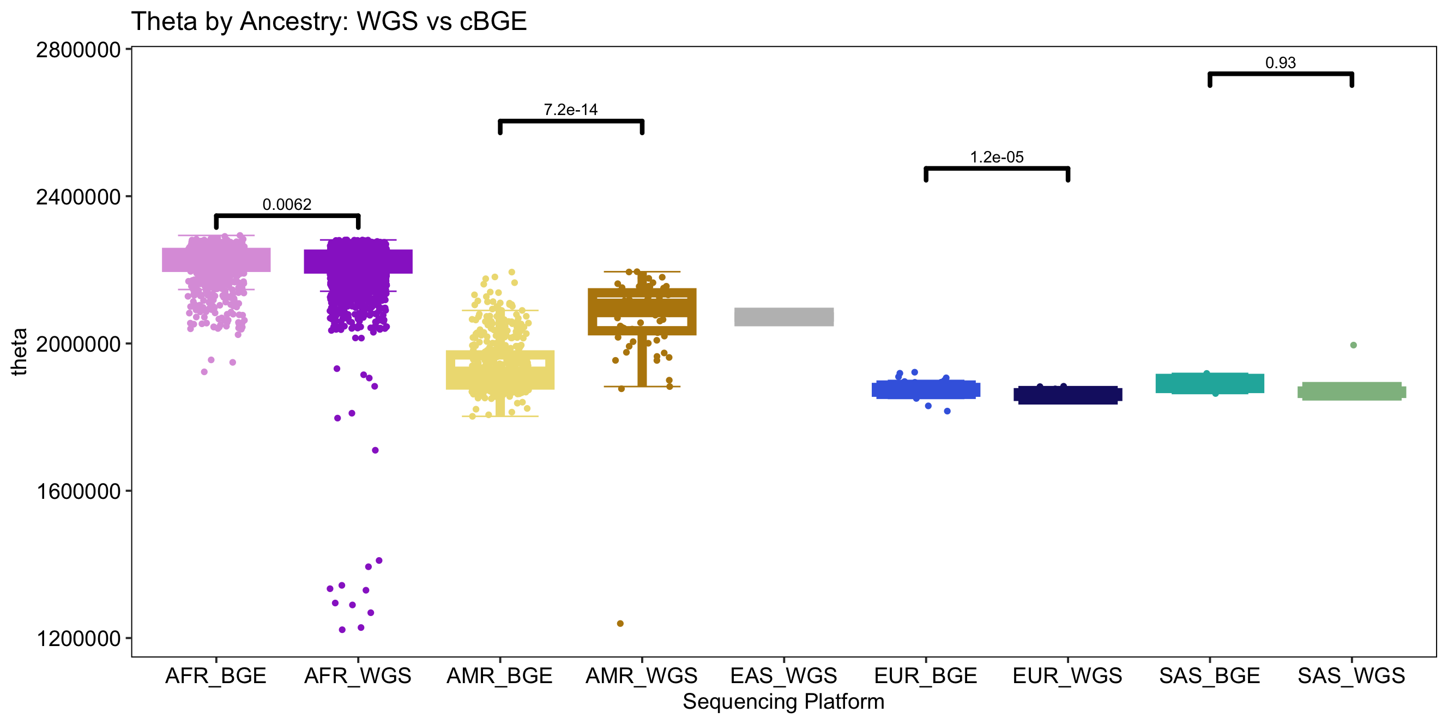
Theta by Ancestry

Slide 6
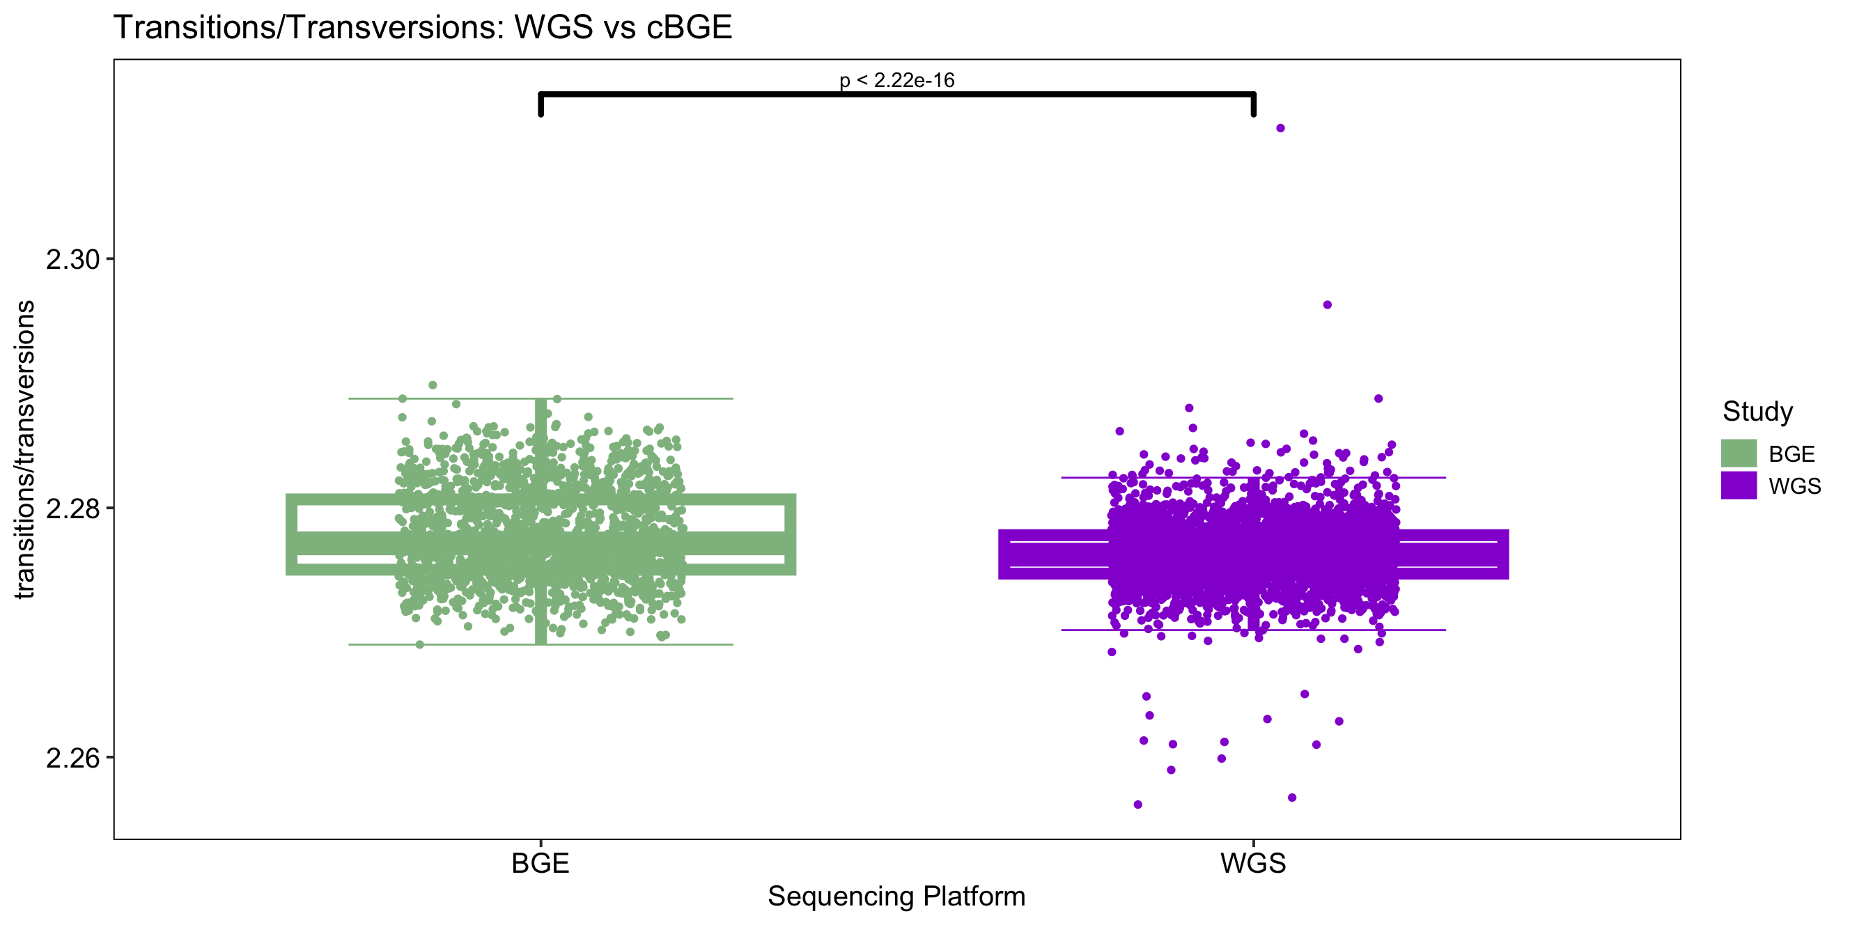
Transitions/Transversions Ratio
Transitions/ Transversions | cBGE | WGS
Minimum | 2.269 | 2.256
1st Quartile | 2.275 | 2.275
Median | 2.277 | 2.276
Mean | 2.278 | 2.276
3rd Quartile | 2.281 | 2.278
Maximum | 2.290 | 2.310

Slide 7
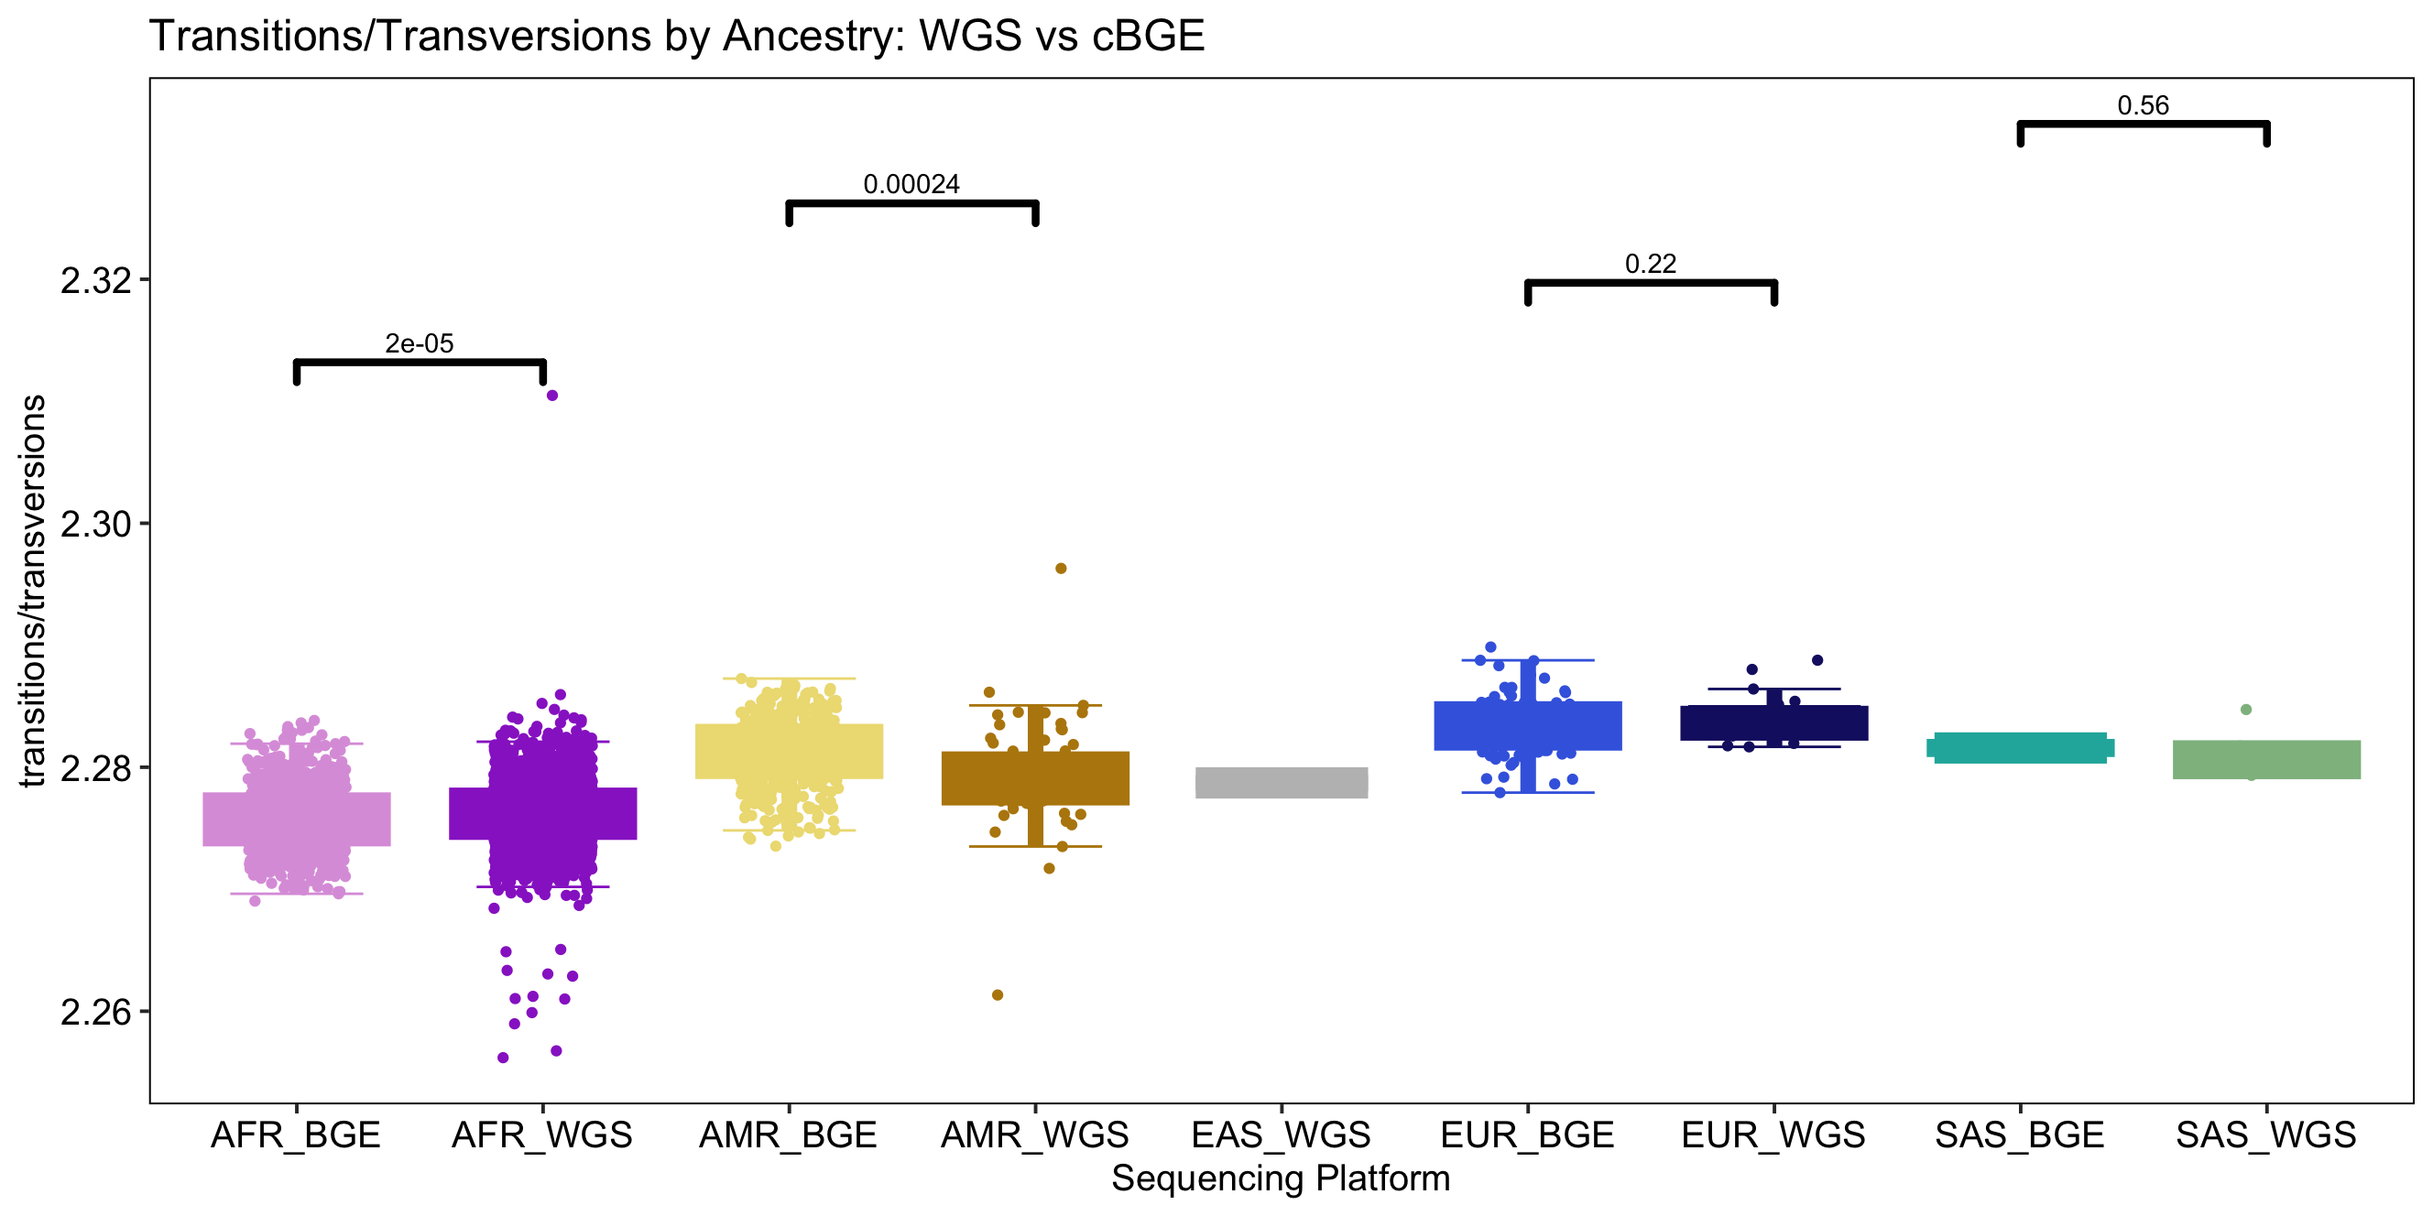
Transitions/Transversions Ratio by Ancestry

Slide 8
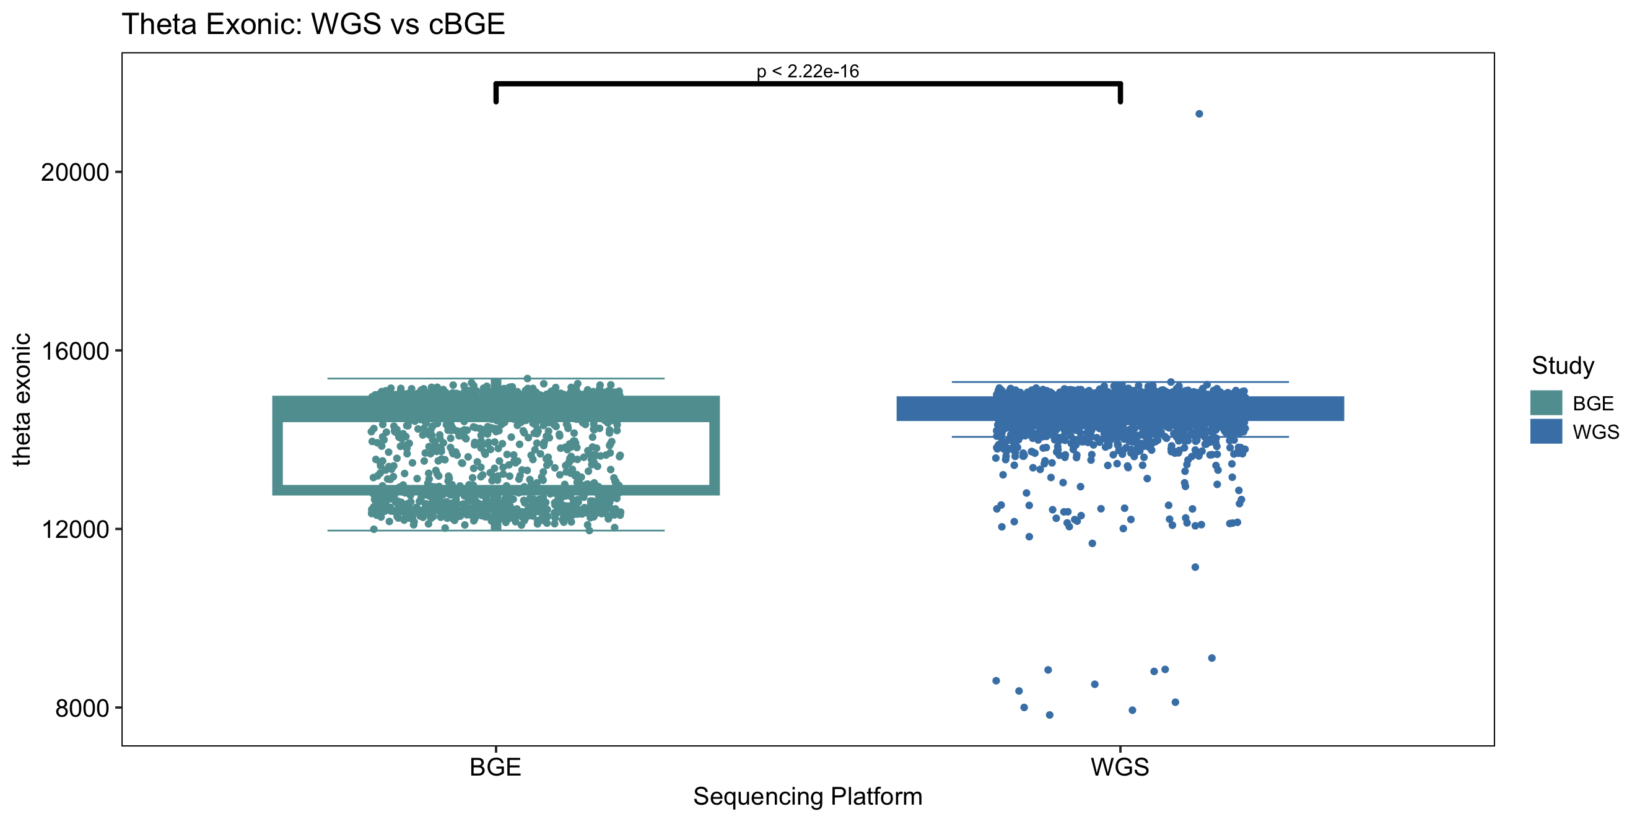
Theta Exonic
Theta Exonic | cBGE | WGS
Minimum | 11964 | 7833
1st Quartile | 12868 | 14536
Median | 14629 | 14723
Mean | 14041 | 14620
3rd Quartile | 14866 | 14853
Maximum | 15369 | 21300

Slide 9
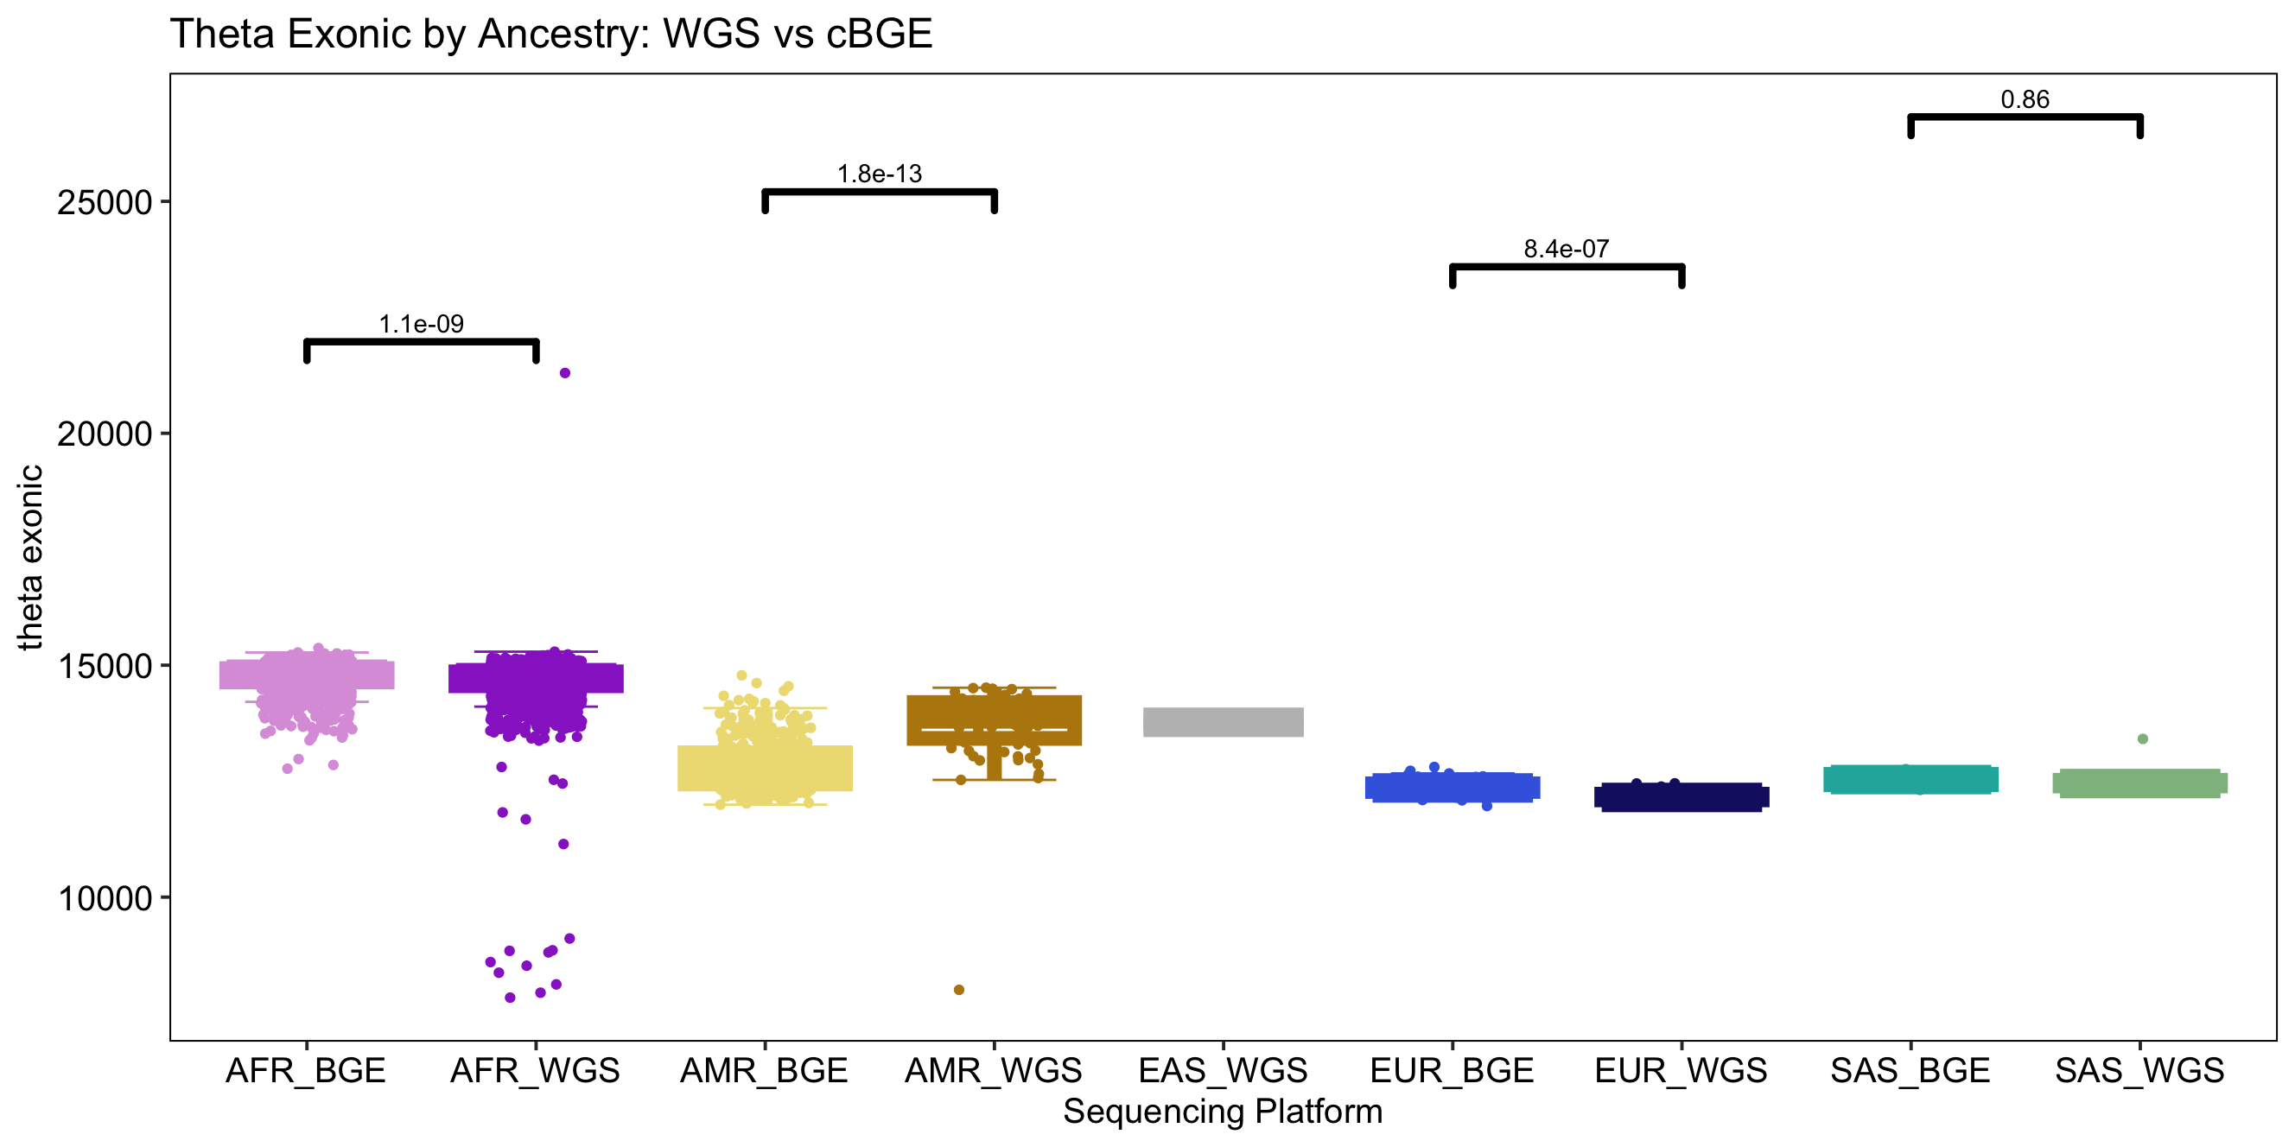
Theta Exonic by Ancestry

Slide 10
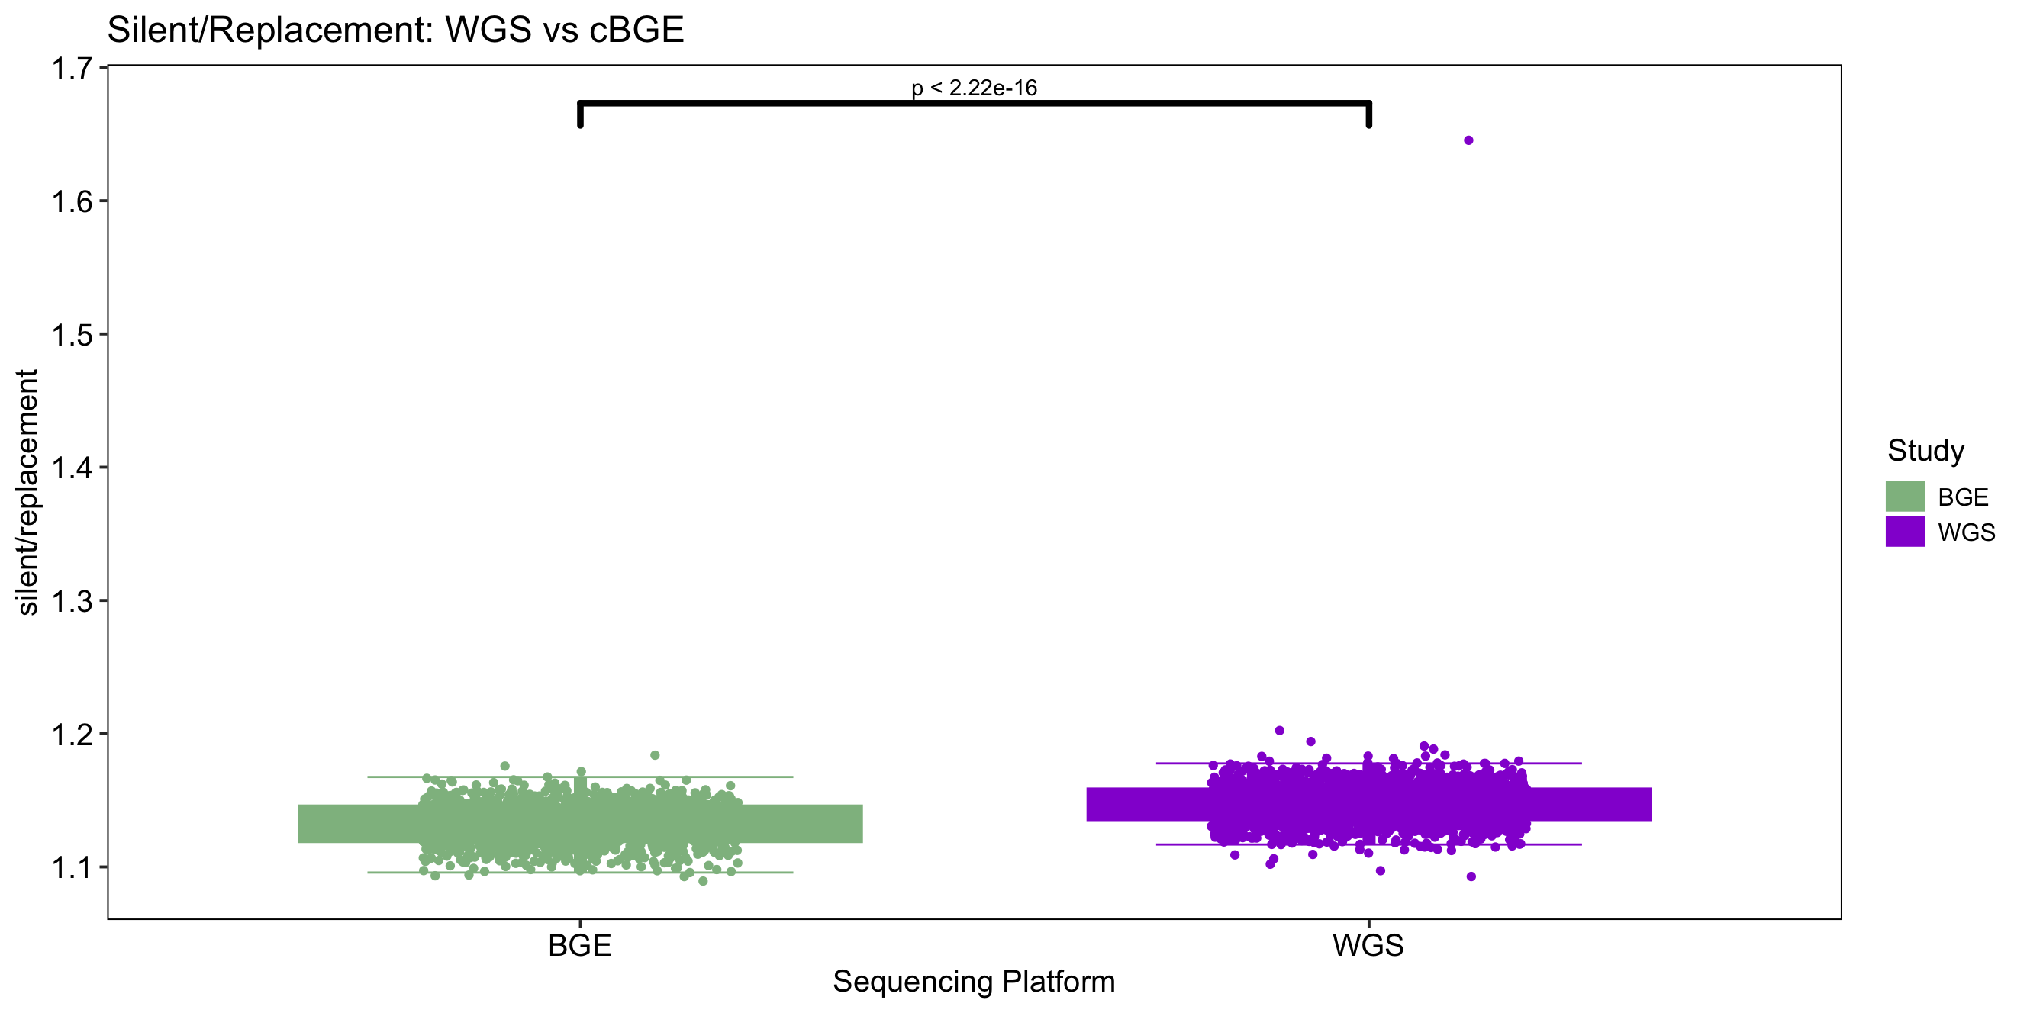
Silent/Replacement Ratio
Silent/ Replacement | cBGE | WGS
Minimum | 1.089 | 1.093
1st Quartile | 1.123 | 1.139
Median | 1.133 | 1.147
Mean | 1.132 | 1.147
3rd Quartile | 1.142 | 1.155
Maximum | 1.184 | 1.645

Slide 11
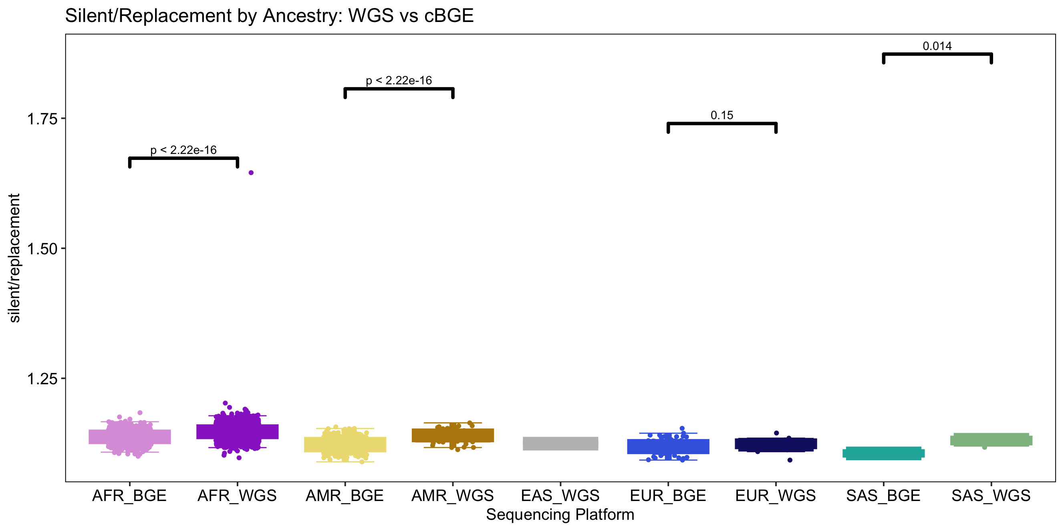
Silent/Replacement Ratio by Ancestry

Slide 12
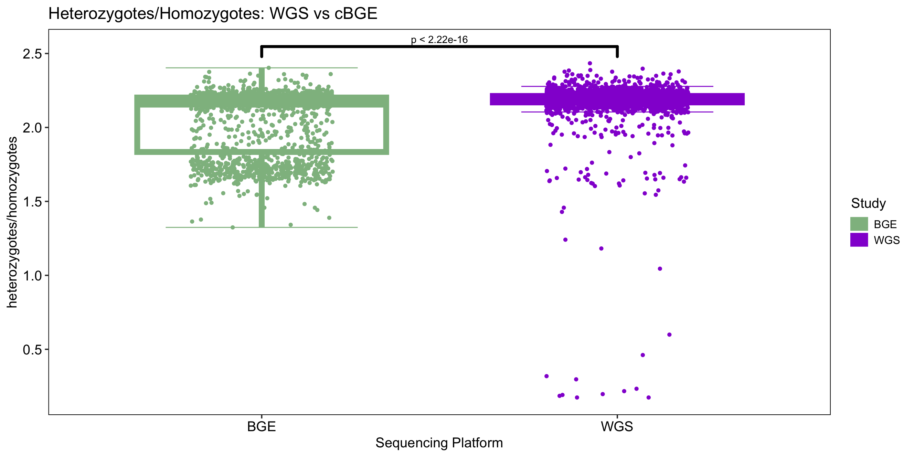
Heterozygotes/Homozygotes Ratio
Heterozygotes/Homozygotes | cBGE | WGS
Minimum | 1.324 | 0.174
1st Quartile | 1.830 | 2.169
Median | 2.174 | 2.191
Mean | 2.051 | 2.179
3rd Quartile | 2.202 | 2.213
Maximum | 2.403 | 2.434

Slide 13
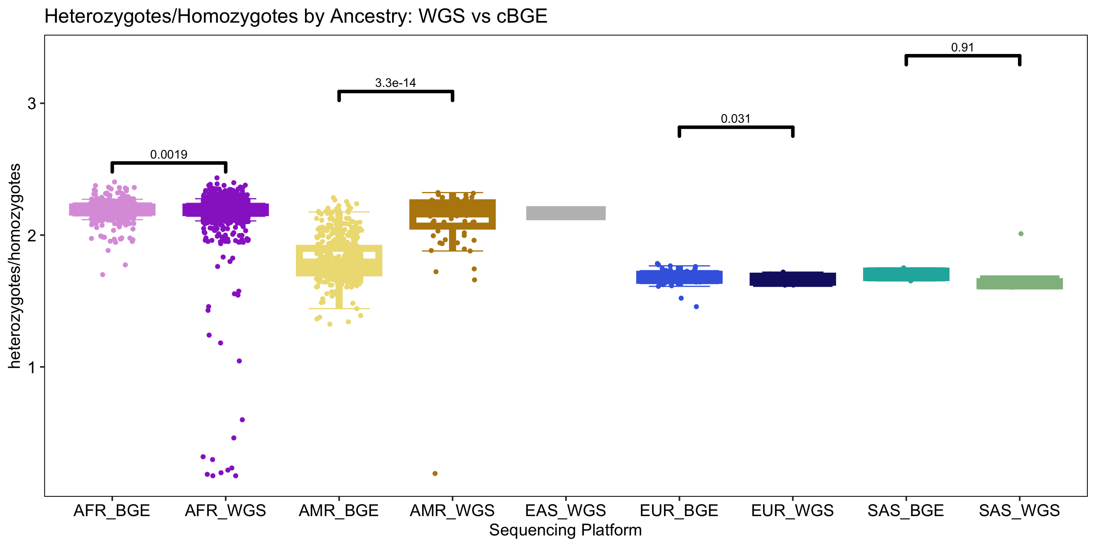
Heterozygotes/Homozygotes Ratio by Ancestry

Slide 14
Merger appears correct from a technical standpoint
In a fundamental sense there appears to be little difference in “quality” of the data related to source.
The ”same sites” with the “same alleles” seem called in both datasets.
Almost no QC has occurred yet (2 samples with more than 5% missing data were dropped, ~10,000 sites with more than 5% missing data dropped). Nothing else
This dataset is ready for final “standard QC” and actual genetic analysis.
But let’s do some actual analysis for fun, before QC.

Slide 15
Polygenic Risk Scores are far more portable between populations than you likely believe

Slide 16
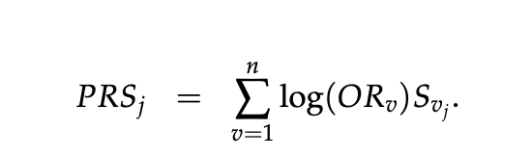

The way most people construct a PRS (i.e. the way the Broad has taught us to do it)
Estimate the OR for each SNP in the genome.
Pick a bunch of them.
Construct the PRS for individual j as the log of the OR for a SNP multiplied by the minor allele count.
Construct the OR for person j by taking e^(prs_j)
Kyle has shown you results for PRS calculated in this manner

Slide 17
PRS constructed in this fashion is notoriously “unportable” between study populations
Everyone on this call knows PRS constructed in this manner does very “poorly” in African ancestry populations (as Kyle showed).
Why is this?
Lots of reasons, but a truly significant fraction of the problem derives from the fact that a SNP’s OR is a function of the allele frequency in the population in which it was measured!
If populations have different allele frequencies they must have different OR’s.
Any SNP with allele frequency differences between ancestries will necessarily have differing OR’s across ancestries.
But, this is super easy to correct.

Slide 18
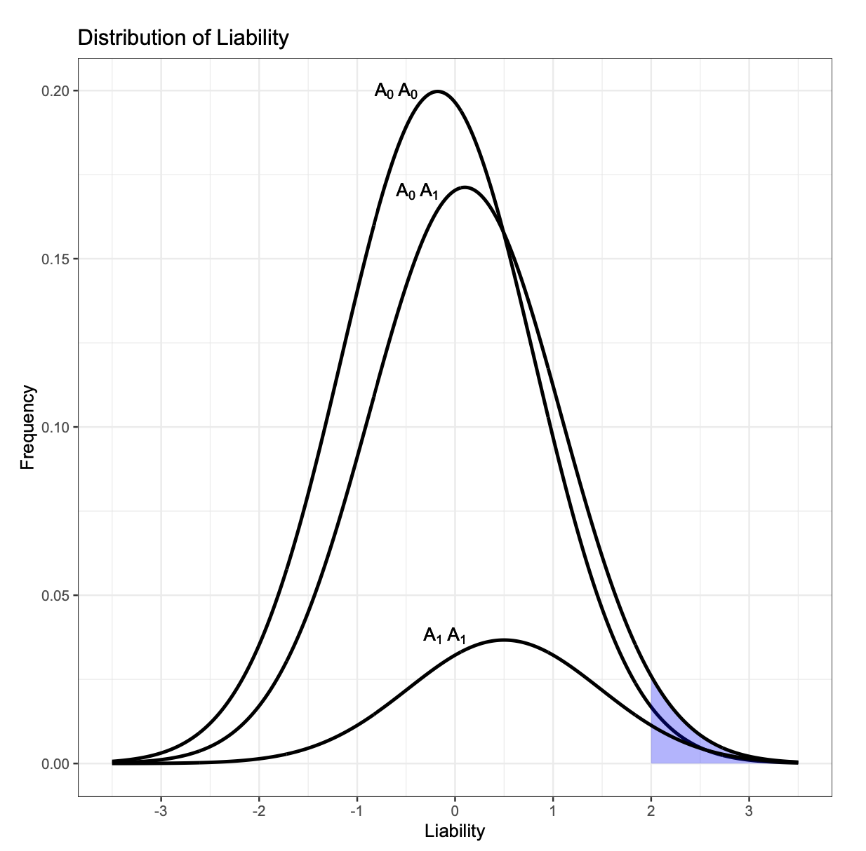
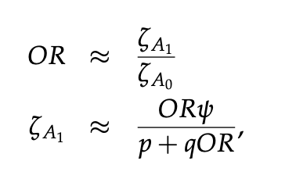
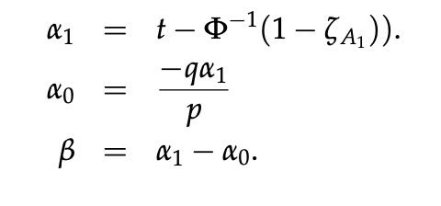
Convert effects from the OR scale to the liability scale
To do this, we need to know the overall prevalence of the disease, and the frequency of the allele in the population where effect sizes were estimated

Slide 19
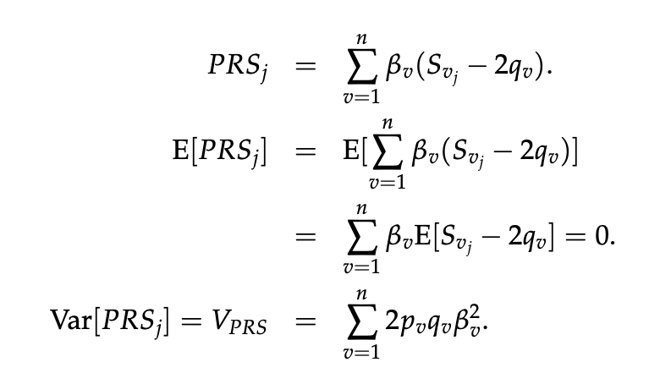
To apply a PRS to a new individual, j
Not
Convert effect sizes in the training study to the liability scale.
With those effects in hand, you can apply them to ~anyone~ with reasonable results just so long as you know the ”population” allele frequencies for the person you are applying it to.
The key idea: we need to use a minor allele frequency q_{v} that is “correct” for individual j, given j’s actual ancestry
Instead Use

Slide 20
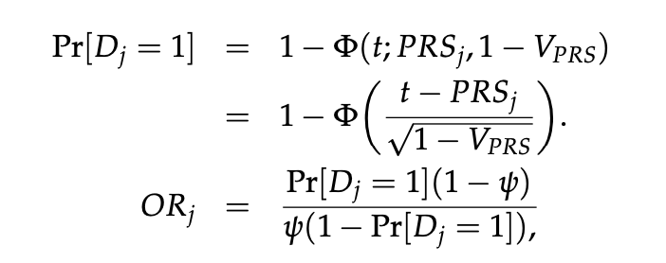
The annoying bit, solved by bystro
To apply a PRS to a new individual we need an estimate of that person’s ancestry, and knowledge of the allele frequencies in the populations that person’s ancestors came from.
Bystro provides an estimate of ancestry probabilities, which we use here as an estimate of the fraction of their ancestry that came from the given population.
Bystro also stores and reports all gnomad population allele frequencies.
Thus, we can calculate an individual allele frequency q_{vj} at every SNP v in every person j, by averaging the gnomad allele frequency weighted by the fraction of individual j’s ancestors that came from that population.
From the PRS for person j we can convert this back to a probability person j will eventually develop disease, and an OR for person j.

Slide 21
PRS constructed in this fashion is portable and ought to work well in just about anyone
Properties you expect from your PRS:
Cases: average PRS should be greater than 0.
Controls: average PRS should be less than 0.
Cases: average OR should be bigger than 1.
Controls: average OR should be less than 1.
Differences between cases and controls shouldn’t depend too much on ancestry.
This should certainly not depend on data source (BGE vs WGS).
Caveats:
Because the variance explained by the PRS is a function of allele frequencies and allele frequencies differ between populations, the PRS explanatory power will differ somewhat between populations, but this is “correct.” It should differ, but still lead to an interpretable result.
Because PRS is a function of the estimated effect sizes, if non-casual SNPs are included, LD differences between population estimated effects will be “wrong” in differing ways between individuals of differing ancestries.
Noise / inaccuracy in ancestry inference should lead to biases in the inferred PRS.

Slide 22
Applying Liu 2015 to the merged mega dataset
Let’s see how this works. I’m going to use effect sizes for CD from Liu 2015 for CD (mostly European with a small Asian fraction).
Apply this to the merged BGE / WGS dataset with…no real QC
Only 2 samples dropped with more than 5% missing data, and less than 10,000 variants dropped due to missing data.
I am going to pick SNPs to include in the simplest possible way.
For each megabase I pick the single SNP with the lowest p-value.
I include that SNP only if p < 5 x 10⁻⁸.

Slide 23
Everything looks good
”UC” is actually both proper UC together with IBD unspecified.
AFR is the only well powered ancestry but overall PRS scores look completely as expected.
We are using CD effect sizes, so these ought to predict UC to whatever extent UC and CD share allelic effect, i.e. UC PRS ought to be bigger than Control, but less than CD.
CD is highly significantly different from controls, UC less so, but sample size is a factor.

Slide 24
Adding more SNPs with less significant p-values
When you add more SNPs with less significant p-values, the PRS ought to get “better” by whatever extent you are including more “true” positives.
But it also gets “noisier” as more false positive SNPs are included, and true positive effects are less accurately estimated.
As long as the noise is unbiased, as we add more false positive SNPs the average PRS scores probably shouldn’t change much, but the variance should and therefore the significance of the difference between cases and controls might go down.

Slide 25
Controlling for “winner’s curse”
Fundamentally all effect sizes are inflated by a “winner’s curse.”
True positive beta’s are slightly inflated.
False positive SNPs have greatly inflated effect sizes (it should be zero).
Therefore we should be “shrinking” all the effect size estimates by a measure of this “winner’s curse”
Here we are using an empirical Bayes estimate of the false-positive probability, and shrinking beta’s accordingly.
This has virtually no impact on genome-wide significant loci, but if it is working as intended should help account for including “false positive” loci as we drop the p-value threshold for inclusion.

Slide 26
Portability of PRS
As we add more SNPs the difference between cases and controls appears to grow, but only slightly in the well powered subset (AFR)
Other ancestries bounce around more, but also have much smaller sample sizes
Samples with inferred European ancestry appear substantially inflated in both cases and controls at p<0.001 SNP inclusion. Might be small sample size or worse ancestry inference in this subset, or something more complex (LD?).

Slide 27
The OR scale is inherently noisier than the PRS scale as OR is a non-linear transformation.
OR is very asymmetrical, values bigger than 1 can get large, but are bounded below by 0.
So, mean is not necessarily a good measure of central tendency as it can be influenced by a few huge OR values.
Nevertheless, the results seem completely consistent with the PRS results. Average OR for controls largely less than 1.
Average OR bigger than 1 for CD cases, and in between for UC as we are using CD effect sizes.
Variation looks driven by sample size, and perhaps a somewhat different accuracies of ancestry inference.

Slide 28
Median OR better measure of central tendency
P< 0.00001 inclusion of SNPs
Best powered African ancestry shown
Notice the median for CD is bigger than 1.
Some what less than 1 for UC.
Even lower controls.
But there are long tails.

Slide 29
Everything looks very consistent across platforms
It certainly appears the bge and wgs datasets are behaving exceptionally consistently with one another.
So, let’s do the mega-analysis on this uncleaned data.
Here we are grouping all the AFR / AMR / and Eur samples together regardless of platform.
I show p < 0.001 SNP selection. Others are similar
For all the follows, Case is CD, Control is Control. UC dropped.

Slide 30
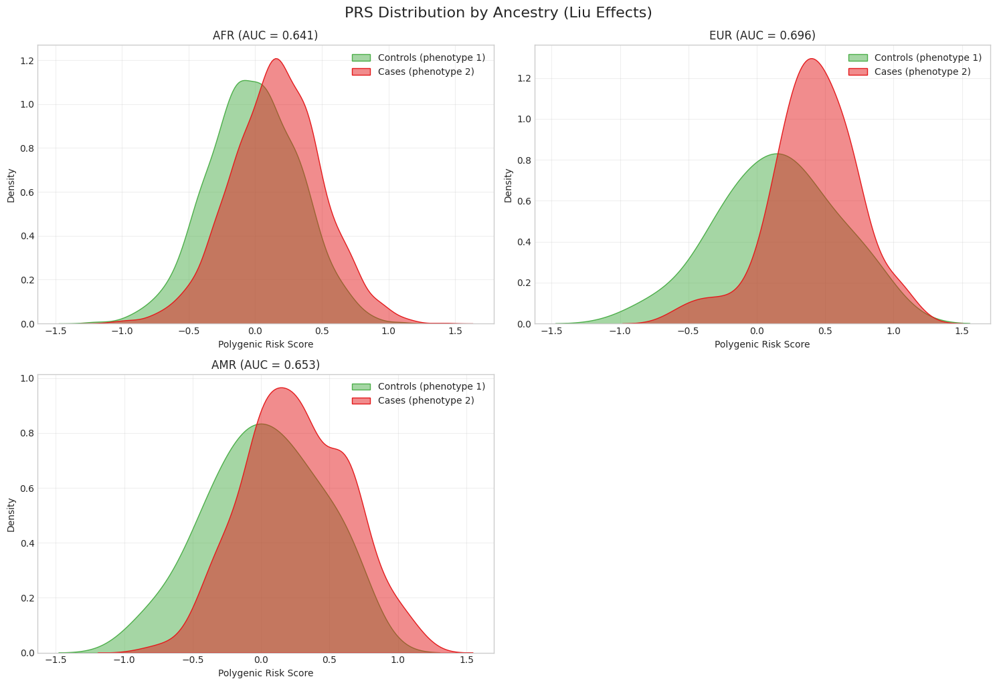
P < 0.001

Slide 31
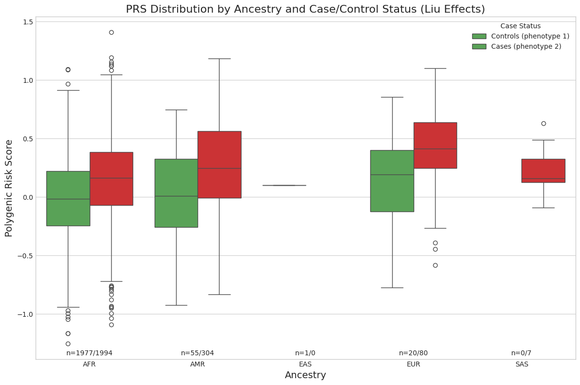

Slide 32
