Slide 1
Midterm Assignment
Submitted by:
Praneeth Krishna
Prateek Gangwal
Sakshi Arora

Slide 2
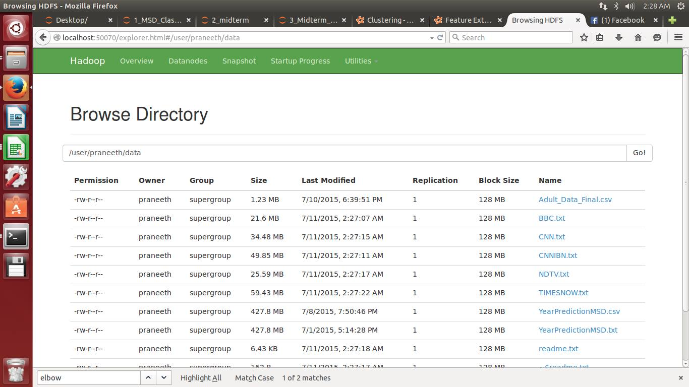
Integration of Hadoop & Spark

Slide 3
Regression & Classification
Loaded the dataset into a pseudo node Hadoop cluster.
Created a parse function, which parses through every line separated by delimiter (,) and written labeled points of features and labels.
Data Caching is done using .cache to increase the performance.
Data Exploration is done using mllib.stat library and performed function like mean, numberOfZeroes, variance, count etc among the data points.

Slide 4
Calculated the Max and Min year to shift the labels according to our data requirements using the following code:
parsedDataInit = rawData.map(parsePoint) onlyLabels = parsedDataInit.map(lambda a: a.label) minYear = onlyLabels.min() maxYear = onlyLabels.max() print maxYear, minYear
#Shifting labels
parsedData = NewData.map(lambda a: LabeledPoint((a[0] - 1922),a[1:]))
print type(parsedData.take(1)[0])
# View the first point
print '\n{0}'.format(parsedData.take(1))
Min -> 1922
Max -> 2011
Normalized the data using the normalizer in the mllib.feature using the following code:
from pyspark.mllib.feature
import VectorTransformer from pyspark.mllib.feature
import Normalizer

Slide 5
Parsed the map function and created a binary variable for <1965 as 0 and >=1965 as 1 using the following code:
parsedData = NewData.map(lambda a: LabeledPoint((1 if a[0] >=1922 else 0),a[1:]))

Slide 6
No Feature Reduction Regression
Data is spitted into training, validation and test data sets using randomSplit() using the following code.
weights = [.6, .2, .2]
seed = 42
parsedTrainData, parsedValData, parsedTestData = parsedData.randomSplit(weights,seed) parsedTrainData.cache()
parsedValData.cache()
parsedTestData.cache()
Created a baseline model by taking average from all the years.

Slide 7
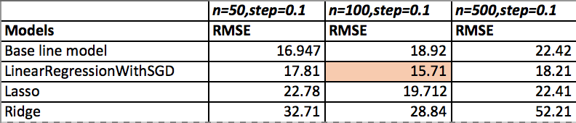
Evaluated baseline model using Evaluation matrix RMSE using the following code:
labelsAndPredsTrain = parsedTrainData.map(lambda x:(x.label,76.39463))
rmseTrainBase = calcRMSE(labelsAndPredsTrain)
Evaluated the model Base line Model, LinearRegressionwithSGD, RidgeRegressionwithSGD, LassowithSGD.
Compared the models using RMSE.
Analysis: LinearRegregressionwithSGD outperforms other models as it has the least RMSE of 15.71

Slide 8
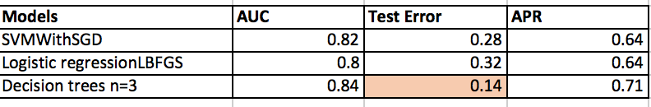
No Feature Reduction Classification
Evaluated the model SVMwithSGD, LogisticRegressionwithLBFGS, LogisticRegressionwithSGD.
Compared the models using following metrics:
AreaUnderCurver
ConfusionMatrix
Error Evaluation

Slide 9
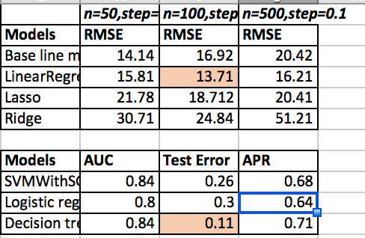
Feature Engineering PCA
Implemented PCA in scala as Pyspark doesn’t support PCA.
Top 15 and top 20 variables were generated as output from PCA analysis.
Applied the Regression and Classification models after doing feature engineering with PCA.
Analysis: Regression and Classification models after PCA outperforms other models without feature reduction.

Slide 10
Classification
The categorical variables were converted into numeric variables using the following steps:
Factorized the data using scala using the following code:
def cleanData(i : String): String = {
val a1 = i.split(",") val b1 : List[AnyVal] = List(a1(0).toDouble,convertCol1toInt(a1(1)),a1(2).toDouble,convertCol4toInt(a1(3)),a1(4).toDouble,convertCol6toInt(a1(5)),convertCol7toInt(a1(6)),convertCol8toInt(a1(7)),convertCol9toInt(a1(8)),convertCol10toInt(a1(9)),a1(10).toDouble,a1(11).toDouble,a1(12).toDouble, convertCol14toInt(a1(13)),convertCol15toInt(a1(14)))
b1.mkString(",")
}
The function convertColtoInt function is defined as follows:
def convertCol15toInt(s : String): Double =
{
val a2 = s match {
case " <=50K" => 0
case " >50K" => 1 } a2
}

Slide 11
The categorical missing values were replaced by Mode function.
Created dummy variables using the following code:
features_dummies = pd.get_dummies(features1)

Slide 12
Applying SVMwithSGD Classification
Applied the model using the following code:
from pyspark.mllib.classification
import SVMWithSGD, SVMModel
# Build the model model = SVMWithSGD.train(parsedTrainData, iterations=100,step=0.001,regParam=0.01)
Evaluated the model on training data using the following code.
# Evaluating the model on training data
labelsAndPreds = parsedTrainData.map(lambda p: (p.label, float(model.predict(p.features)))) trainErr = labelsAndPreds.filter(lambda (v, p): v != p).count() /
float(parsedTrainData.count()) print("Training Error = " + str(trainErr))

Slide 13
Performed model evaluation by observing area under curve, confusion matrix and validation error.
metrics = BinaryClassificationMetrics(labelsAndPreds) AUC = metrics.areaUnderROC APR = metrics.areaUnderPR print("train AreaUnderCurve = " + str(AUC))
p = np.array(labelsAndPredsval).collect() confusion_matrix(p[:,0],p[:,1])

Slide 14
LogicsticRegressionwithLBFGS Classification
Applied the model using the following code:
model = LogisticRegressionWithLBFGS.train(parsedTrainData,iterations=100,regParam=0.01)
Evaluated the model on training data using the following code.
# Evaluating the model on training data
labelsAndPreds = parsedTrainData.map(lambda p: (p.label, float(model.predict(p.features)))) trainErr = labelsAndPreds.filter(lambda (v, p): v != p).count() /
float(parsedTrainData.count())
print("Training Error = " + str(trainErr))
Performed model evaluation by observing area under curve, confusion matrix and validation error.
metrics = BinaryClassificationMetrics(labelsAndPreds)
AUC = metrics.areaUnderROC
APR = metrics.areaUnderPR
print("train AreaUnderCurve = " + str(AUC))
p = np.array(labelsAndPreds.collect()) confusion_matrix(p[:,0],p[:,1])

Slide 15
Applying Decision Tree Classification
Applied the model using the following code:
model = GradientBoostedTrees.trainClassifier(parsedTrainData, categoricalFeaturesInfo={}, numIterations=3)
Evaluated the model on training data using the following code.
# Evaluate model on train instances and compute test error predictions = model.predict(parsedTrainData.map(lambda x: x.features)) labelsAndPredictions = parsedTrainData.map(lambda lp: lp.label).zip(predictions) testErr = labelsAndPredictions.filter(lambda (v, p): v != p).count() / float(parsedTrainData.count()) print('Test Error = ' + str(testErr)) print('Learned classification GBT model:') print(model.toDebugString())
Performed model evaluation by observing area under curve, confusion matrix and validation error.
metrics = BinaryClassificationMetrics(labelsAndPredictions) AUC = metrics.areaUnderROC APR = metrics.areaUnderPR print("train AreaUnderCurve = " + str(AUC))
p = np.array(labelsAndPredictions.collect()) confusion_matrix(p[:,0],p[:,1])

Slide 16
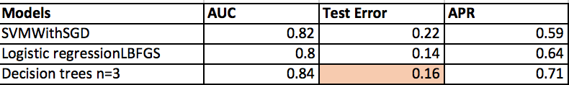
Analysis

Slide 17
Clustering – Pre Processing
Combining the 5 Lib svm files into 1 Lib svm file using the following code:
cnn = "/home/praneeth/Downloads/Case3_TvNews/CNN.txt"
cnn1 = MLUtils.loadLibSVMFile(sc, cnn) x = points.union(cnn1)
cnnibn = "/home/praneeth/Downloads/Case3_TvNews/CNNIBN.txt"
cnnibn1 = MLUtils.loadLibSVMFile(sc, cnnibn) y = x.union(cnnibn1)
ndtv = "/home/praneeth/Downloads/Case3_TvNews/NDTV.txt"
ndtv1 = MLUtils.loadLibSVMFile(sc, ndtv) z = y.union(ndtv1)
tn = "/home/praneeth/Downloads/Case3_TvNews/TIMESNOW.txt"
tn1 = MLUtils.loadLibSVMFile(sc, tn) data = z.union(tn1)
Normalized the data using the following code:
scaler2 = StandardScaler(withMean=True, withStd=True).fit(features)

Slide 18
Applying K means:
The model is built using the in-built k means algorithm by specifying the max iterations and run.
clusters = KMeans.train(data2, 2, maxIterations=10, runs=10, initializationMode="random”)
clusters = KMeans.train(data2, 4, maxIterations=10, runs=10, initializationMode="random”)
clusters = KMeans.train(data2, 6, maxIterations=10, runs=10, initializationMode="random”)
clusters = KMeans.train(data2, 8, maxIterations=10, runs=10, initializationMode="random”
clusters = KMeans.train(data2, 10, maxIterations=10, runs=10, initializationMode="random”
Evaluating the cluster by computing within set sum of squared errors.
from math import sqrt
from numpy import array
def error(point): center = clusters.centers[clusters.predict(point)]
return sqrt(sum([x**2 for x in (point - center)])) WSSSE = data2.map(lambda point: error(point)).reduce(lambda x, y: x + y)
print("Within Set Sum of Squared Error = " + str(WSSSE))

Slide 19
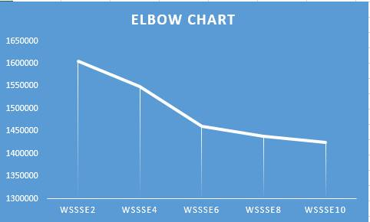
Analysis
Within Set Sum of Squared Error (2) = 1605485.841
Within Set Sum of Squared Error (4) = 1549285.453
Within Set Sum of Squared Error (6) = 1460567.116
Within Set Sum of Squared Error (8) = 1438714.297
Within Set Sum of Squared Error (10) = 1425614.813

Slide 20
Thank You!
Questions?

