Slide 1

Project Presentation: Data Preparation and Integration / Data Profiling
Student: Samuele Ceol
Academic year: 2022 / 2023 (Winter semester)
Date: 7th February 2023
University: Free University of Bozen-Bolzano

Slide 2
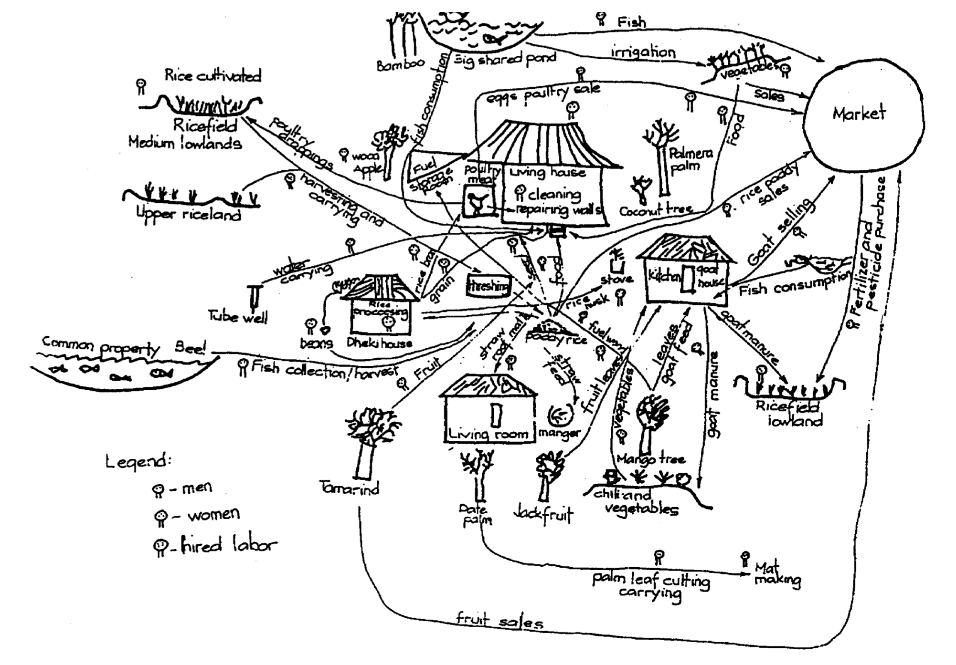
Introduction - Domain of interest
Underlying data collected in the context of the CRISP project.
Seeks to describe Farming Systems belonging to different macro regions.
“Farming systems are […] populations of farms that have broadly similar resource bases, enterprise patterns, household livelihoods and constraints, and for which similar development strategies and interventions would be appropriate.”
Notes:
Eurac Climate and Disaster Research Group

Slide 3
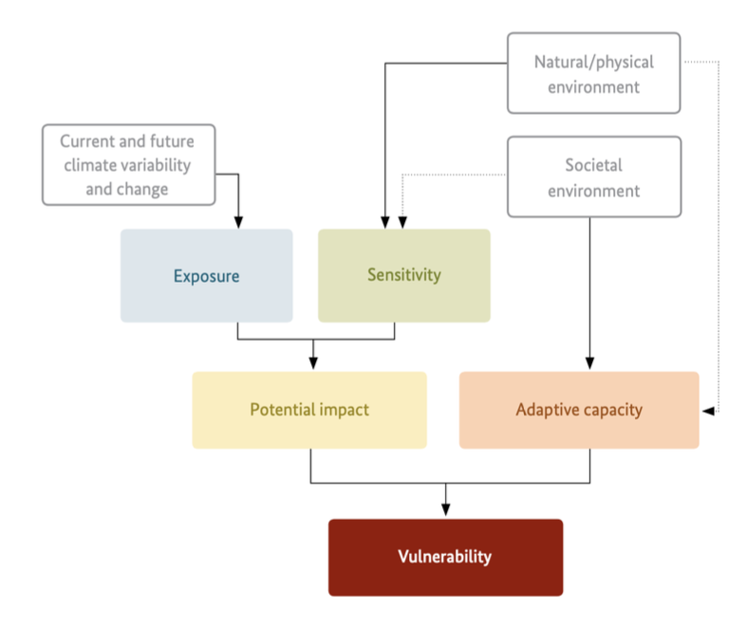
Introduction - Domain of interest
Much of the data is described using concepts related to the impact chain method.
In this context, an impact chain model is:
“an analytical tool that helps you better understand, systemise and prioritise the factors that drive vulnerability in the system under review”
Each farming system is associated with relevant factors and connections.

Slide 4
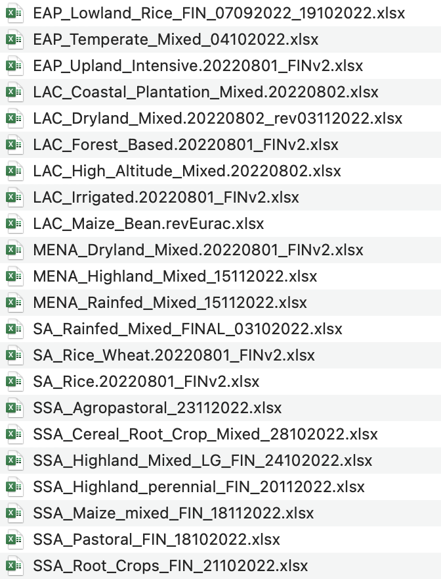
Introduction – Shape of the dataset
The initial dataset is made up o a set of 22 .xlsx files.
Each .xlsx file contains data related to an individual Farming System.
Data is organised into a set of (up to) 10 different sheets.
Each sheet represents a different category of information.

Slide 5
Data Profiling

Slide 6
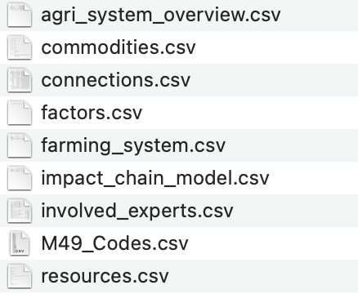
First data reformulation
The original sources are organised into a set of 8 .csv files.
Each file (roughly) correspond to the corresponding .xlsx sheet.
Data coming from different sources files and belonging to the same sheet is stacked.
For some files an ID attribute is added.
Additional geographical location data is imported from the UN website.

Slide 7
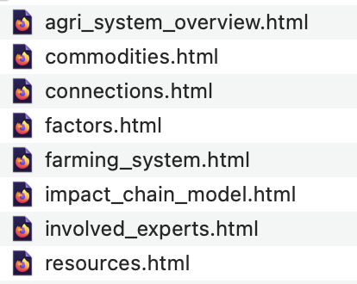
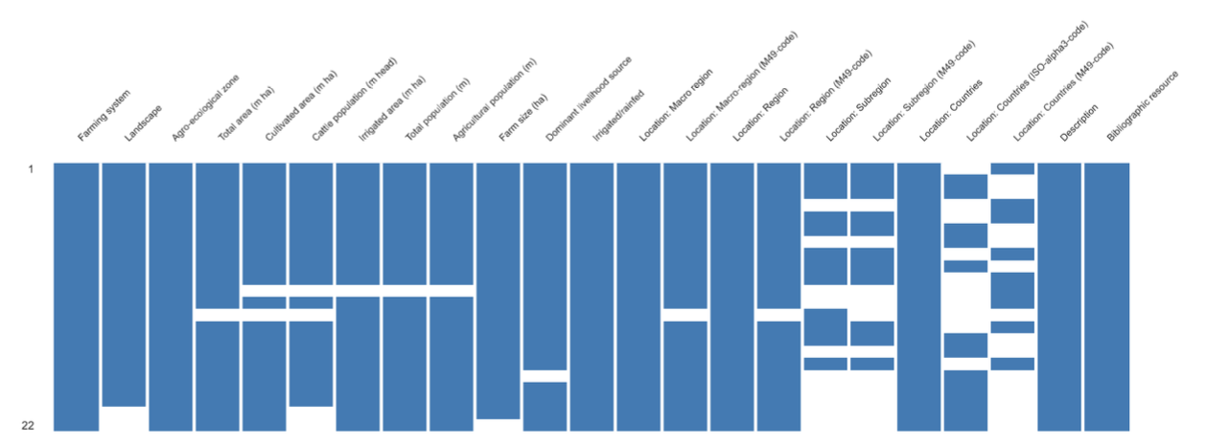

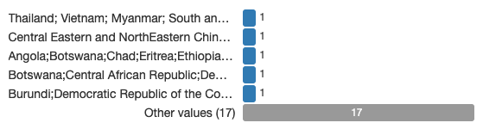


Exploratory Data Analysis
The Pandas profiling library is used to generate a set of profiling reports.
This step allows to make initial observation on:
The overall shape of the source files.
The degree of completeness of the underlying data.
Some characteristics of the data useful at DB design time:
Fields containing value lists.
Uniques / Non-Uniques.
…

Slide 8
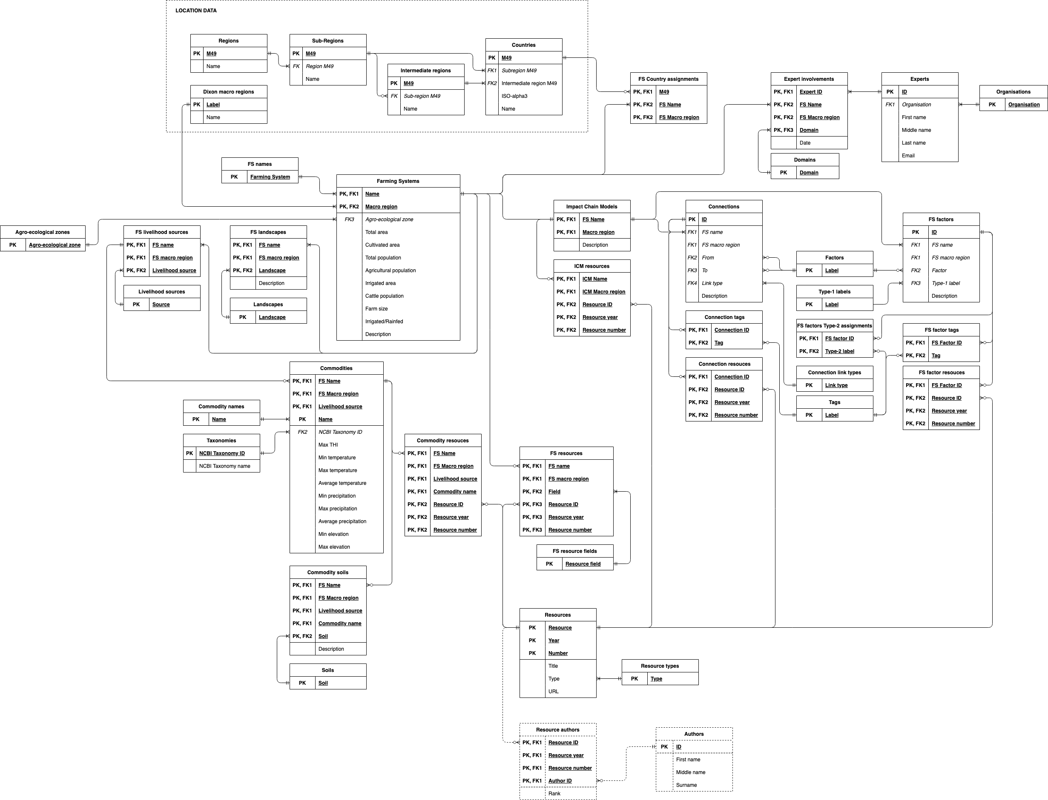
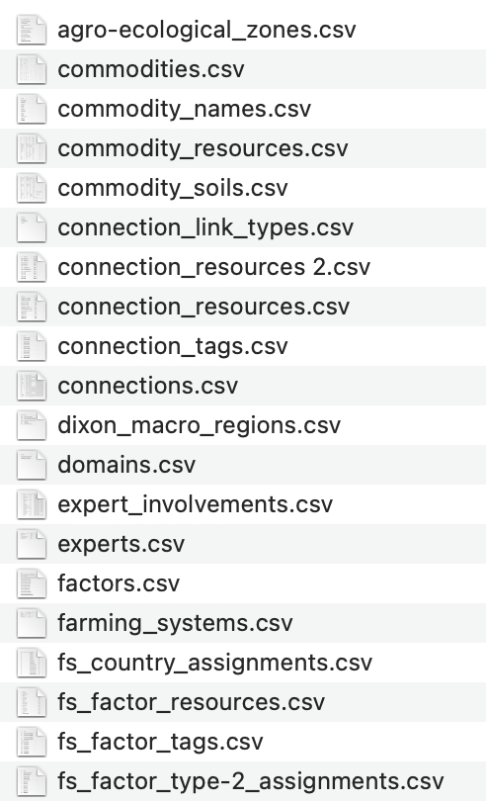
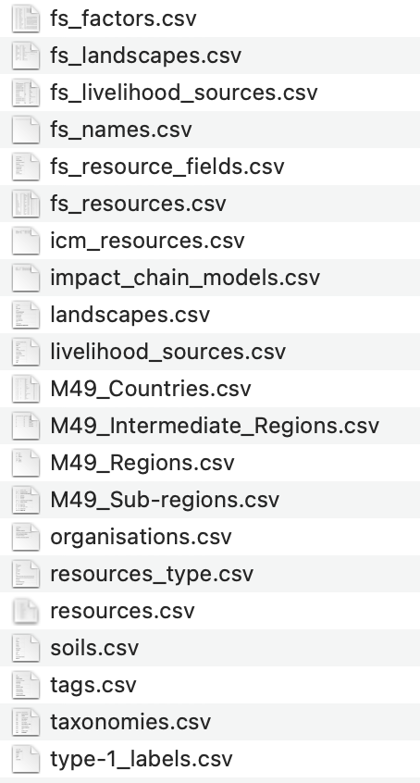
Database architecture (and second data reformulation)
An initial DB architecture is proposed.
Structured around 40 tables.
A new set of .csv files is created to mirror the proposed design.

Slide 9
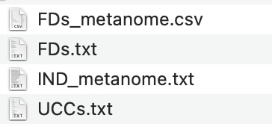
IC discovery
Executed after the DB design phase.
Performed to verify that the created .csv files complied with the proposed DB design.
Implemented:
UCC discovery algorithm based on the bottom-up Apriori approach.
FD discovery algorithm based on the principles of TANE.
Compared the results with the Metanome implementation.
Two simple implementation of 1-ary IND discovery.
Metanome implementation of Binder for n-ary INDs.

Slide 10
Data Preparation and Integration

Slide 11
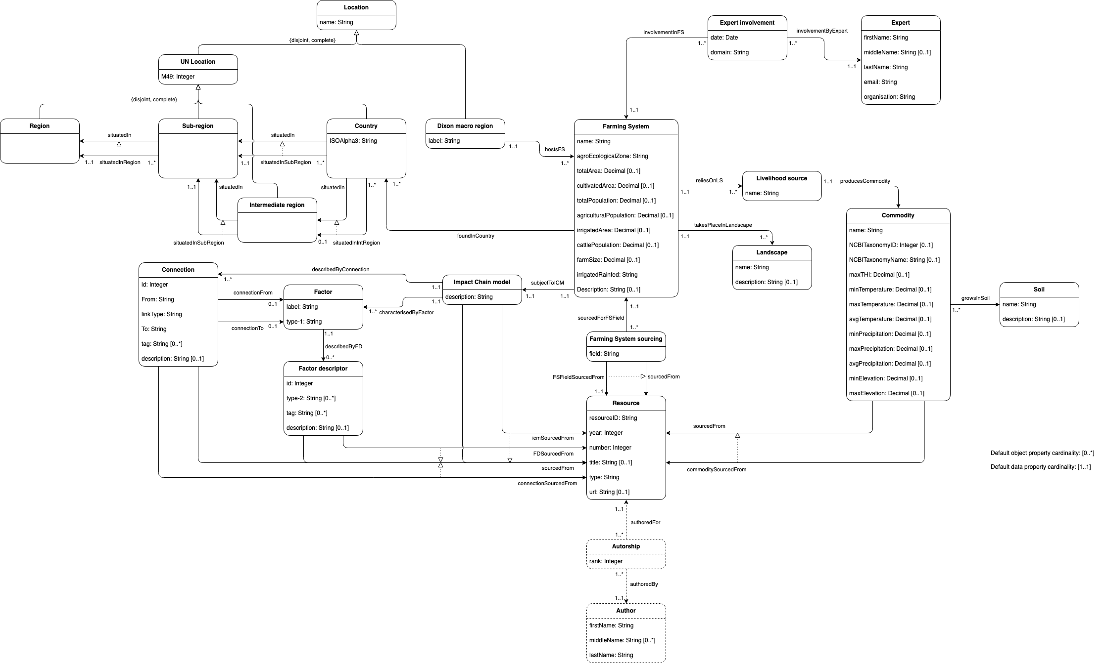
Ontology
Made up of:
20 classes.
26 object properties.
59 data properties.
Follows, for the most part, the structure of the DB.
Notable exceptions:
Factor and Factor descriptor classes.
Class hierarchy for location data.

Slide 12
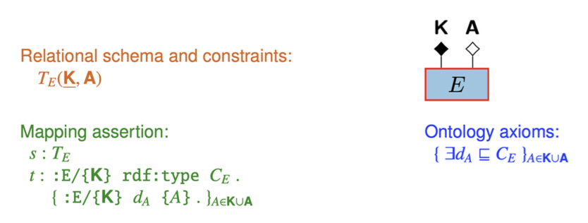
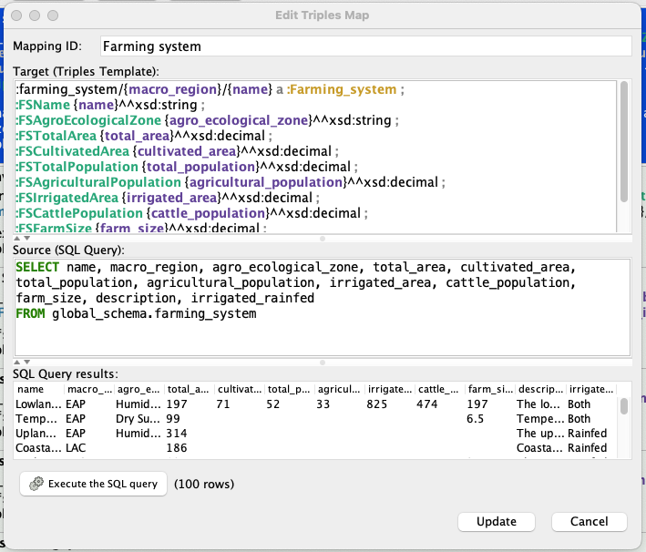
Mapping patterns - Entity
An underlying DB table is mapped to a corresponing class.
The table’s PK attributes are used to build instances of the class.
Table attributes are mapped to data properties.

Slide 13
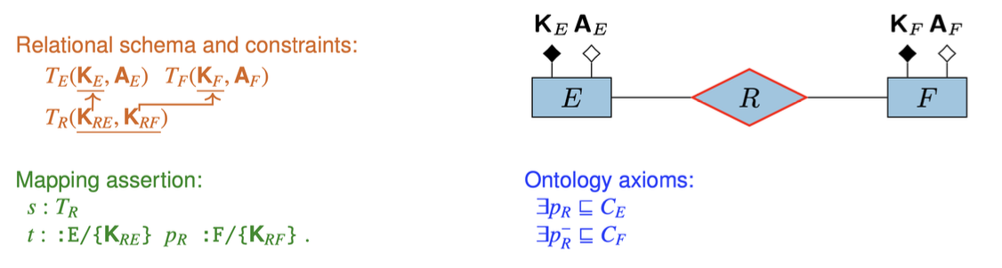
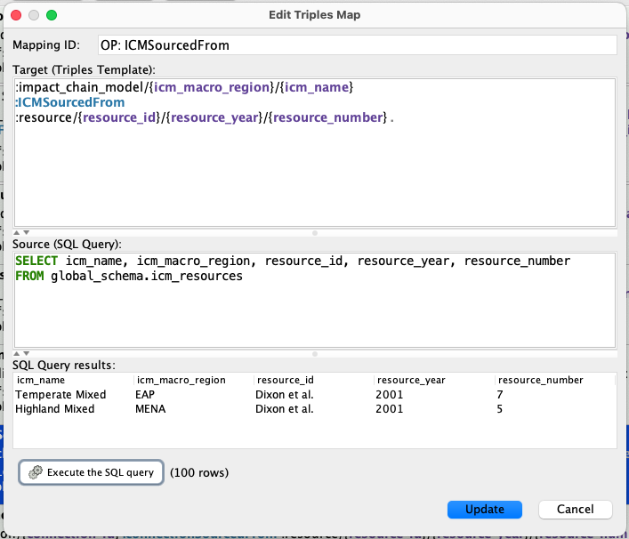
Mapping patterns - Relationship
The source table has a PK partitioned into two FKs.
Used to model the object properties stemming for some of the DB’s junction tables.

Slide 14
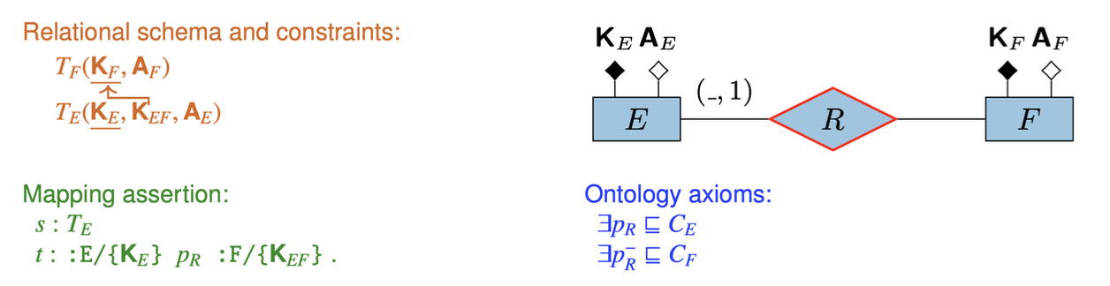
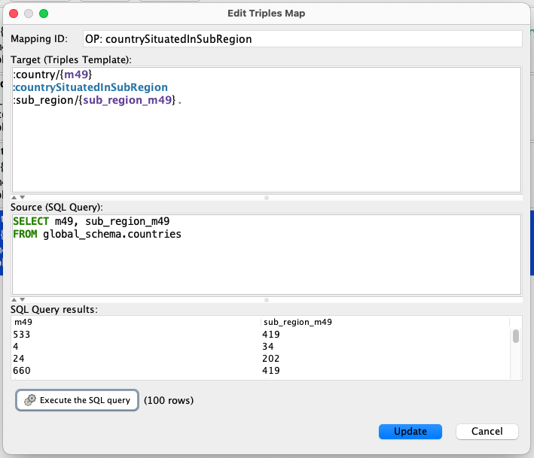
Mapping patterns - Relationship with Merging
Used to model those object properties represented by FKs in the underlying DB.
Some mappings are just loosely associated with this pattern.

Slide 15
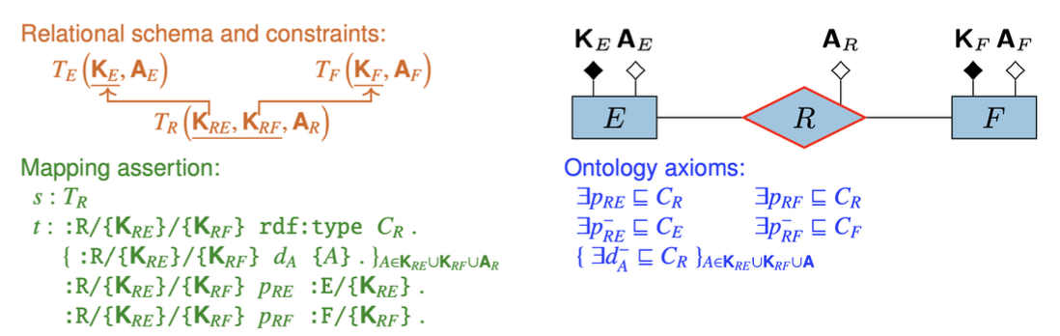
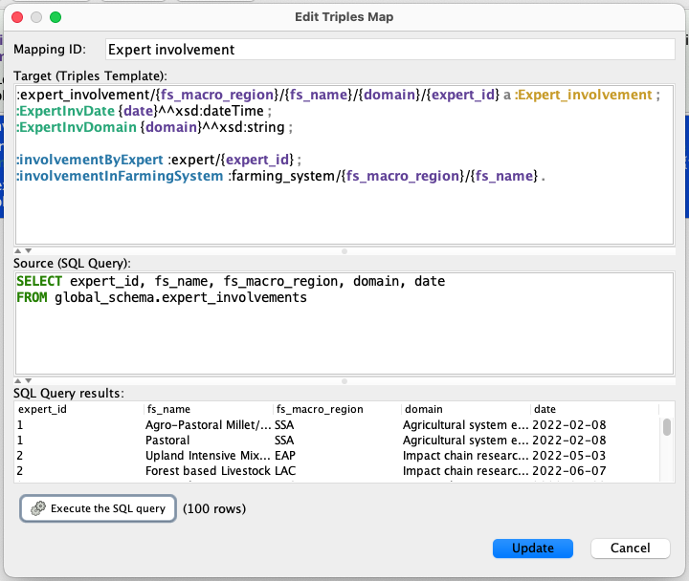
Mapping patterns – Reified Relationship
Models classes that underwent a reification transformation in the ontology.
The related data and object properties appear as part of the mapping.

Slide 16
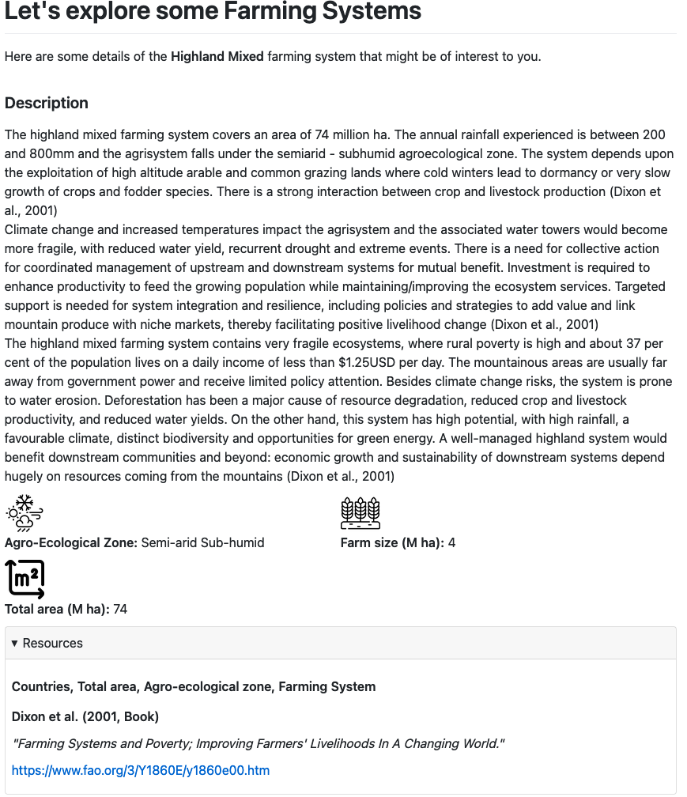
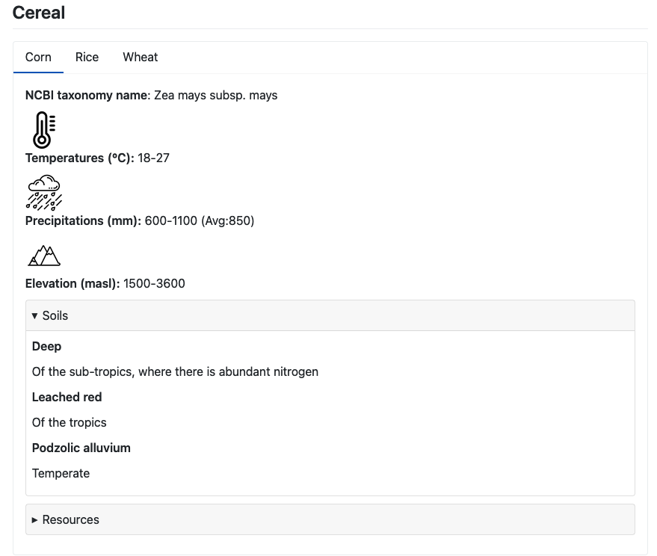
Application
Web app written in Python (using the PyWebIO library).
Can be seen as an interactive markdown document.
Allows to explore functionally all data stored in the underlying DB.

Slide 17
Let’s move to the application

