Slide 1

Project Presentation: Data Preparation and Integration / Data Profiling
Student: Samuele Ceol
Academic year: 2022 / 2023 (Winter semester)
Date: 7th February 2023
University: Free University of Bozen-Bolzano

Slide 2
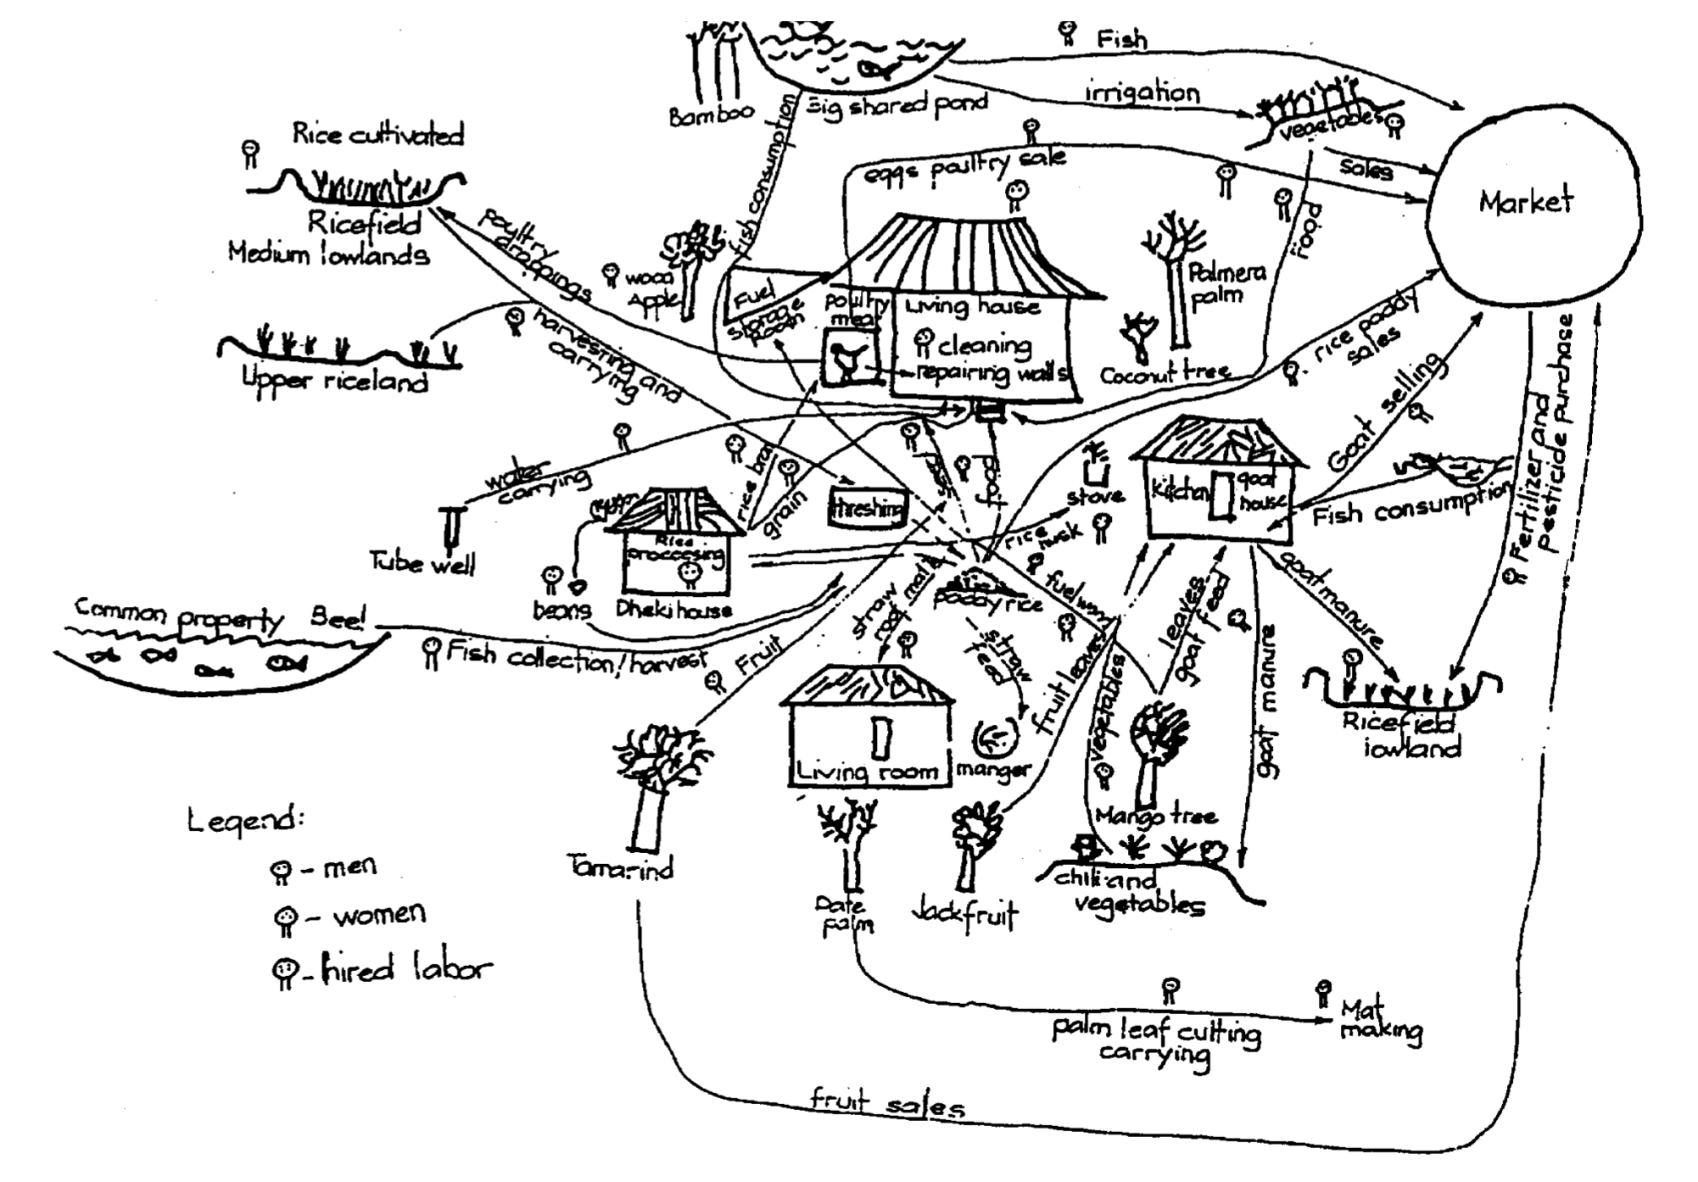
Introduction - Domain of interest
Underlying data collected in the context of the CRISP project.
Seeks to describe Farming Systems belonging to different macro regions.
“Farming systems are […] populations of farms that have broadly similar resource bases, enterprise patterns, household livelihoods and constraints, and for which similar development strategies and interventions would be appropriate. ”
Notes:
Lack of adaptability to real-world live networks (no ability to process traffic flows that can be split across multiple capture time windows)

Slide 3
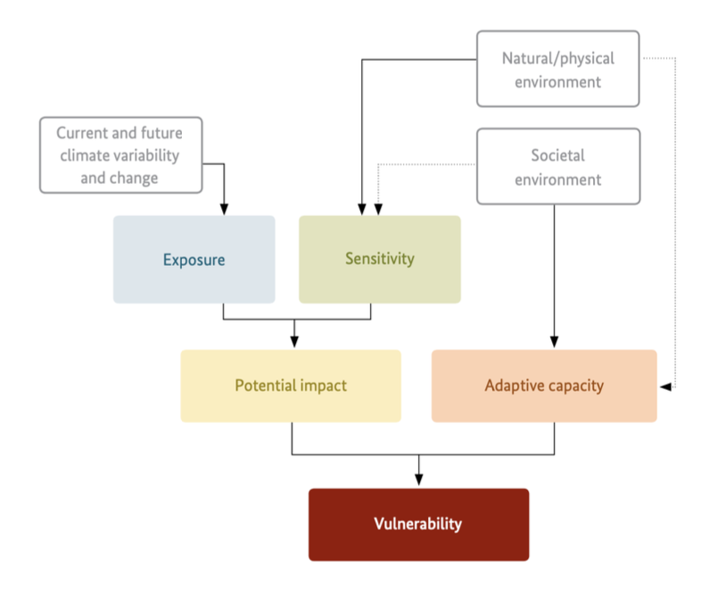
Introduction - Domain of interest
Much of the data is described using concepts related to the impact chain method.
In this context, an impact chain model is:
“an analytical tool that helps you better understand, systemise and prioritise the factors that drive vulnerability in the system under review”
Each farming system is associated with relevant factors and connections.
Notes:
Lack of adaptability to real-world live networks (no ability to process traffic flows that can be split across multiple capture time windows)

Slide 4
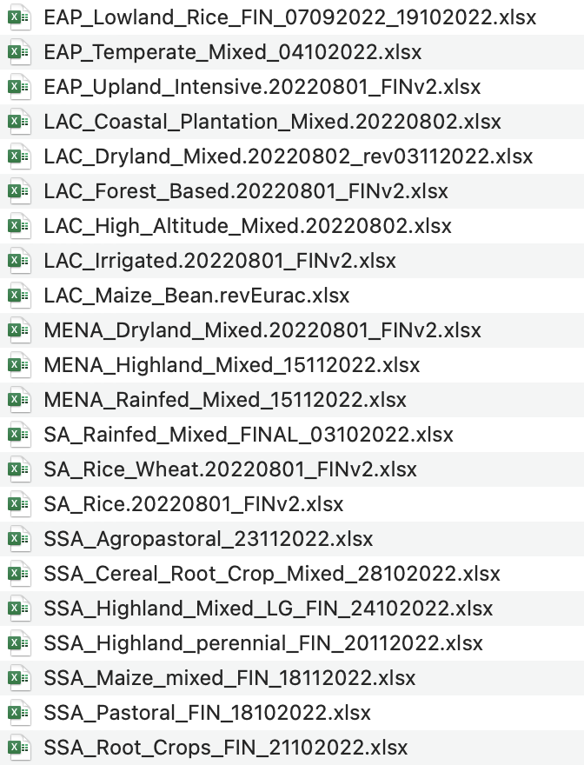
Introduction – Shape of the dataset
The initial dataset is made up o a set of 22 .xlsx files.
Each .xlsx file contains data related to an individual Farming System.
Data is organised into a set of (up to) 10 different sheets.
Each sheet represents a different category of information.
Notes:
Lack of adaptability to real-world live networks (no ability to process traffic flows that can be split across multiple capture time windows)

Slide 5
Data Profiling

Slide 6
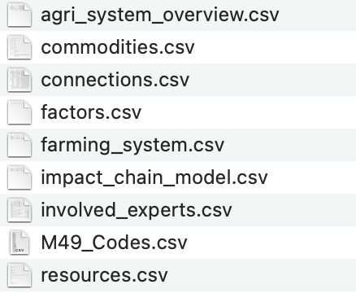
First data reformulation
The original sources are organised into a set of 8 .csv files.
Each file (roughly) correspond to the corresponding .xlsx sheet.
Data coming from different sources files and belonging to the same sheet is stacked.
For some files an ID attribute is added.
Additional geographical location data is imported from the UN website.
Notes:
Lack of adaptability to real-world live networks (no ability to process traffic flows that can be split across multiple capture time windows)

Slide 7
Exploratory Data Analysis
The Pandas profiling library is used to generate a set of profiling reports.
Notes:
Lack of adaptability to real-world live networks (no ability to process traffic flows that can be split across multiple capture time windows)

Slide 8
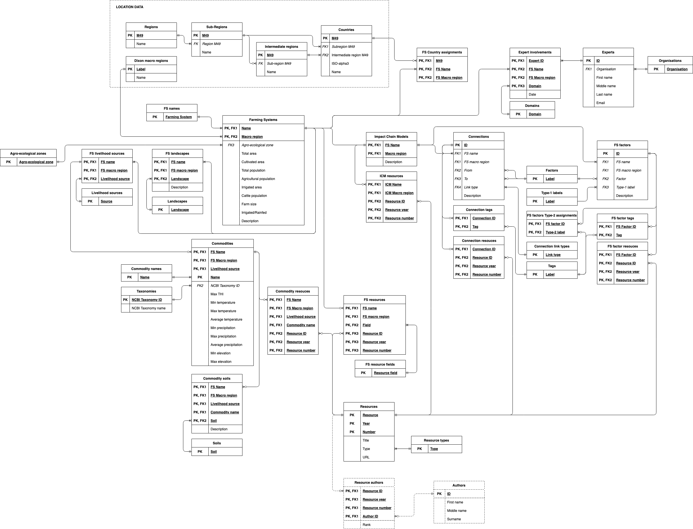
Database architecture
An initial DB architecture is proposed.
The proposed architecture is structured around 40 tables.
A new set of .csv files is created to mirror the proposed design.
Notes:
Lack of adaptability to real-world live networks (no ability to process traffic flows that can be split across multiple capture time windows)

Slide 9
IC discovery – Unique
…
Notes:
Lack of adaptability to real-world live networks (no ability to process traffic flows that can be split across multiple capture time windows)

Slide 10
Data Preparation and Integration

Slide 11
Ontology
Made up of:
20 classes
26 object properties
59 data properties
Notes:
Lack of adaptability to real-world live networks (no ability to process traffic flows that can be split across multiple capture time windows)

Slide 12
Mappings
…
Notes:
Lack of adaptability to real-world live networks (no ability to process traffic flows that can be split across multiple capture time windows)

Slide 13
Application
…
Notes:
Lack of adaptability to real-world live networks (no ability to process traffic flows that can be split across multiple capture time windows)

Slide 14
Thank you!

