Slide 1

Master in Computational Data Science
Enhancing the methodological approach to Systematic Literature Reviews: A practical application on Topic Labeling research
Candidate: Samuele Ceol
Supervisor: Barbara Russo
July 2023

Slide 2
Rationale & Research questions
Addressing the lack of SLRs on topic labeling
By reviewing the relevant primary studies in the period 2017-2022
Providing a (novel) set of methodological contributions
Stemming from observations made throughout the review process
Capable of enhancing (parts of) existing guidelines for secondary studies
Believed to be generally applicable outside of the investigated domain
The research questions explore the research in terms of:
The identified cateogories of labeling approaches and the techniques by which they are implemented
The topic modeling techniques generating the distributions
The observed label structures and the conducted label selection and quality evaluation procedures
The characteristics of the underlying corpora

Slide 3
Definitions
Topic modeling:
Topic:
Topic labeling: Task of pairing each topic with a label capable of concisely summarising its content
Topic label: “a sequence of words which is semantically meaningful and covers the latent meaning of the topic. Words, phrases, and sentences are all valid labels under this definition” - Mei et al. (2007)
Example:
Topic terms: vote, house, election, poll, bill, republican, party, voter, candidate, senate
Label: election

Slide 4
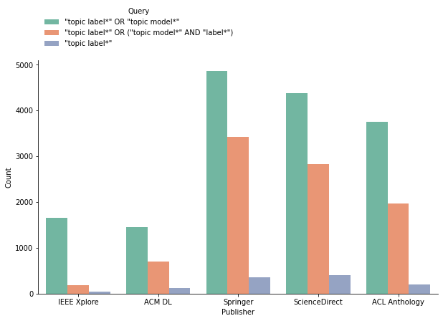
Venue selection process
An exploratory search is conducted on 5 repositories:
IEEE Xplore, ACM Digital Library, SpringerLink, ScienceDirect & ACL Anthology
Three queries are proposed for this purpose:
The selected query is used to gather the relevant venues

Slide 5
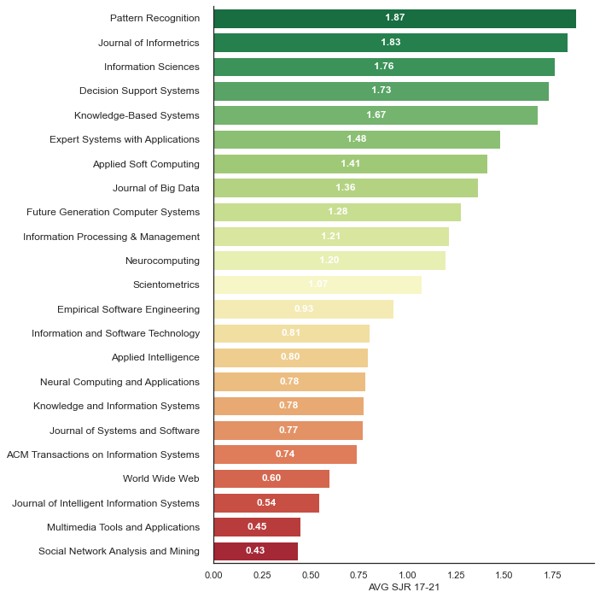
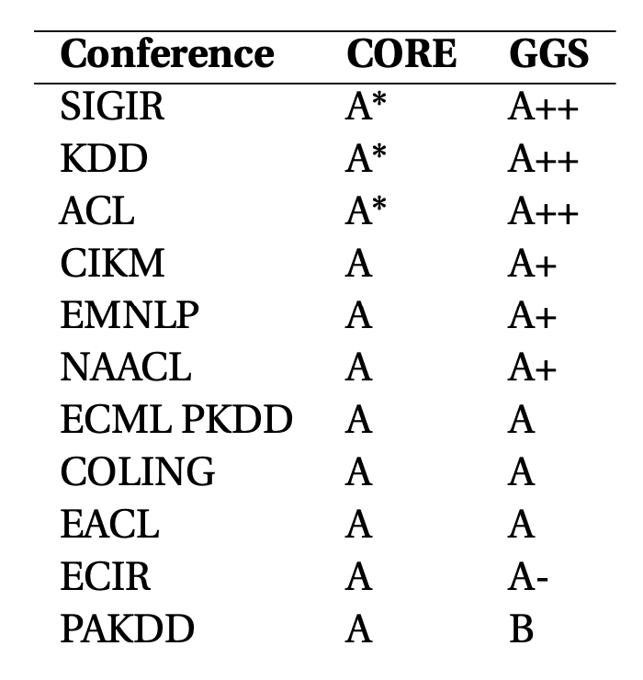
Venue selection process
From the selected query:
A first set of candidate venues is identified based on the number of associated documents.
Cut-off values are set at:
30 articles for journals
20 articles for conferences…
…10 in the case of ACL
Results:
23 candidate journals
11 candidate conferences

Slide 6
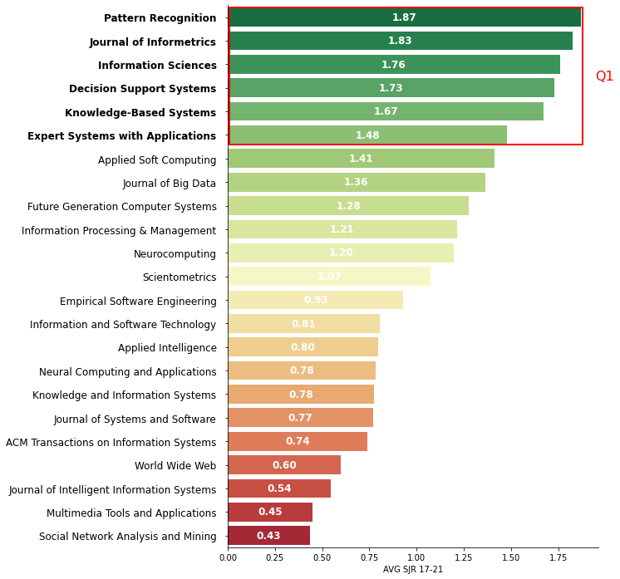
Venue selection process
Candidates are filtered based on values tied to selected quality metrics:
Scimago Journal & Country Rank (SJR(2)) score
Computing Research and Education Association of Australasia (CORE) rankings
GII-GRIN-SCIE (GGS) rankings
Final venues are obtained by retaining:
25% of best scoring journals
All conferences with an “A” rating
Results:
6 journals
10 conferences

Slide 7

Search strategy
The query used in the venue selection is extended by means of a proximity operator:
The proximity constraint is set to 20 terms:
“The average length of sentences in scientific writing is only about 12-17 words” - Griffies et al. (2013)
Examples of captured sentences:
”Topics can be more readily interpretable when they are assigned semantically meaningful labels” - Hosseiny Marani et al., 2022
“Various methods have been proposed to assign concise labels to topics to improve interpretability” - Zosa et al., 2022
“An interpretable topic is one that can be easily labeled. How easily a topic could be labeled . . .” - Doogan and Buntine, 2021

Slide 8
(Initial) Study selection
937 primary studies
388 conference and 549 journal papers
Inclusion\exclusion criteria are applied by means of manual inspection
Only studies actively applying topic labeling are kept
Secondary & tertiary studies are filtered out
…
A core selection of 55 papers is obtained

Slide 9
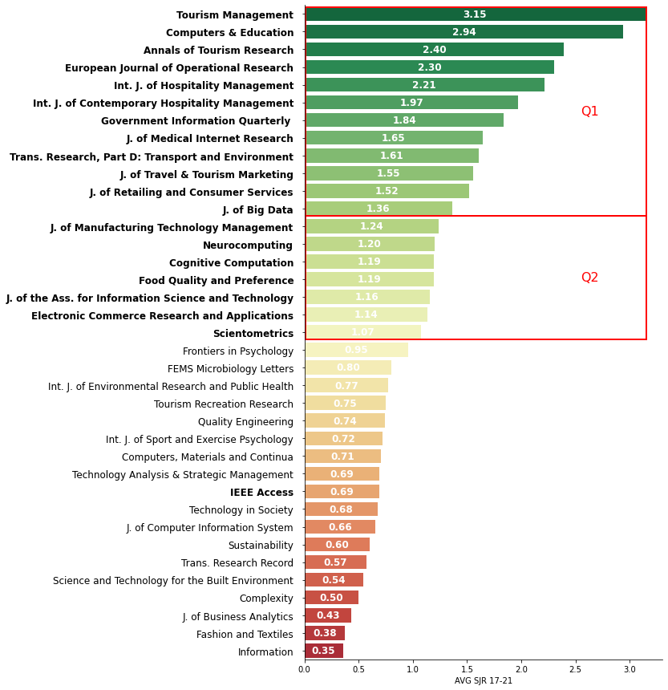
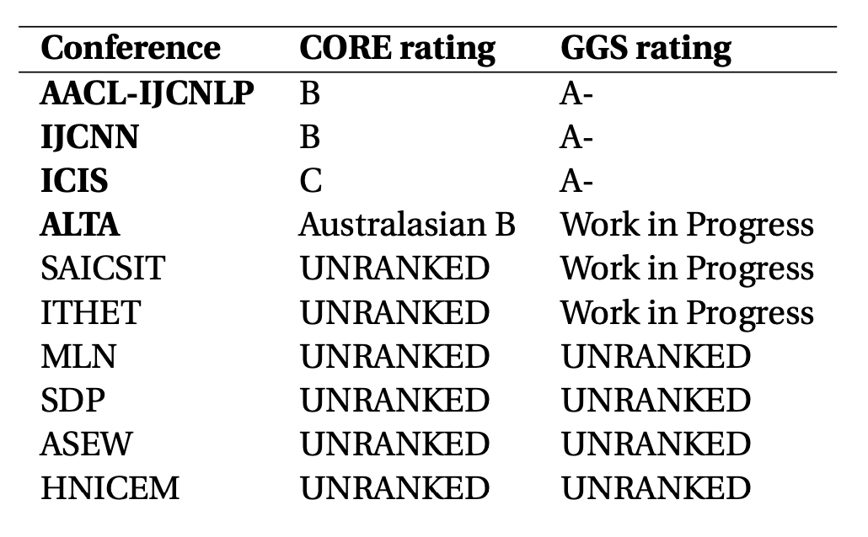
Snowballing activities

Slide 10
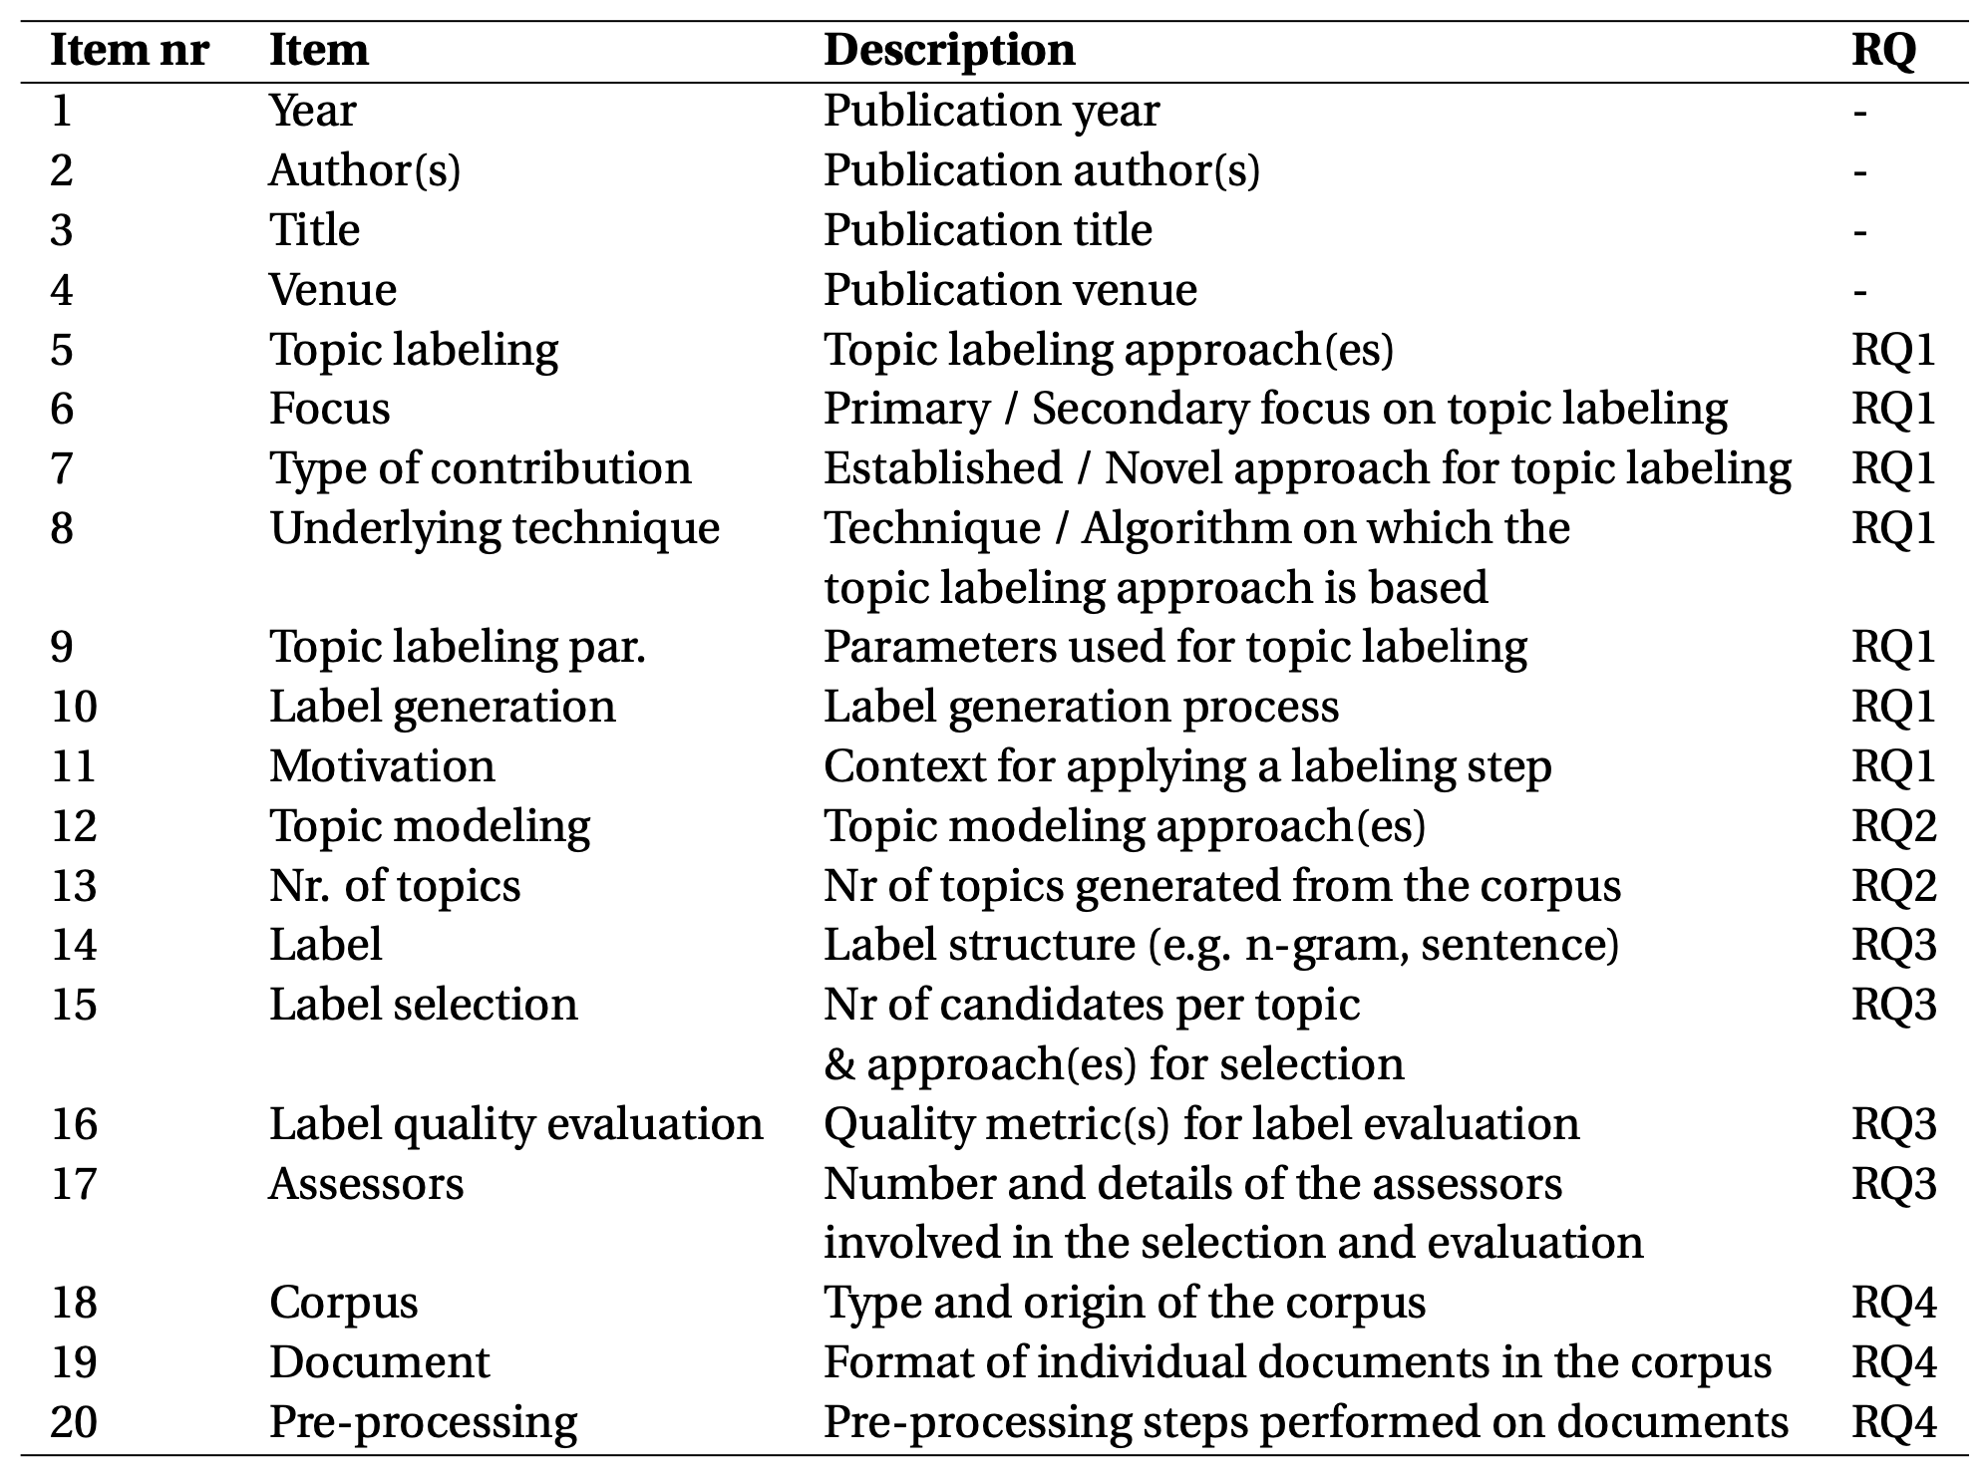
Data items

Slide 11
Structure of the analysis and synthesis

Slide 12
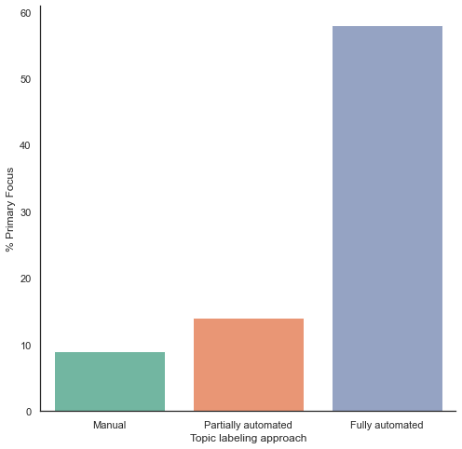
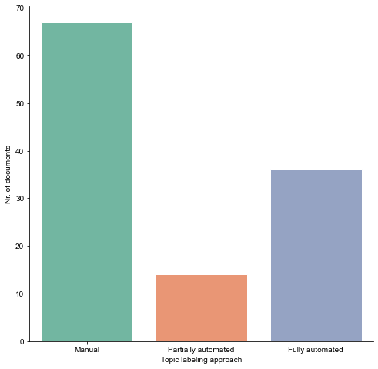
RQ1 – Topic labeling approaches

Slide 13
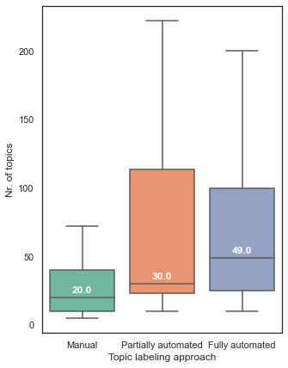
RQ2 – Underlying topic modeling approaches

Slide 14
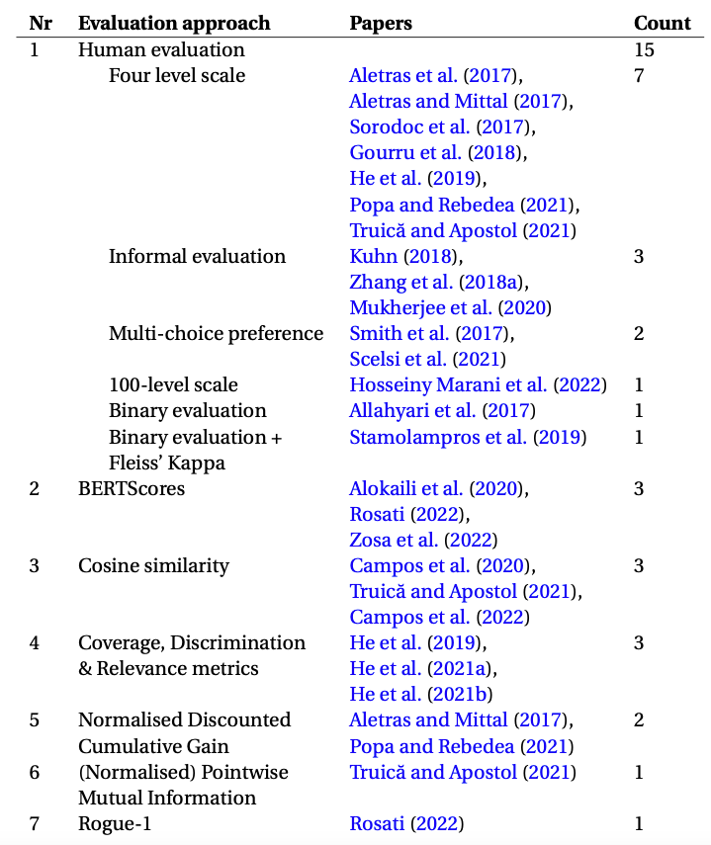
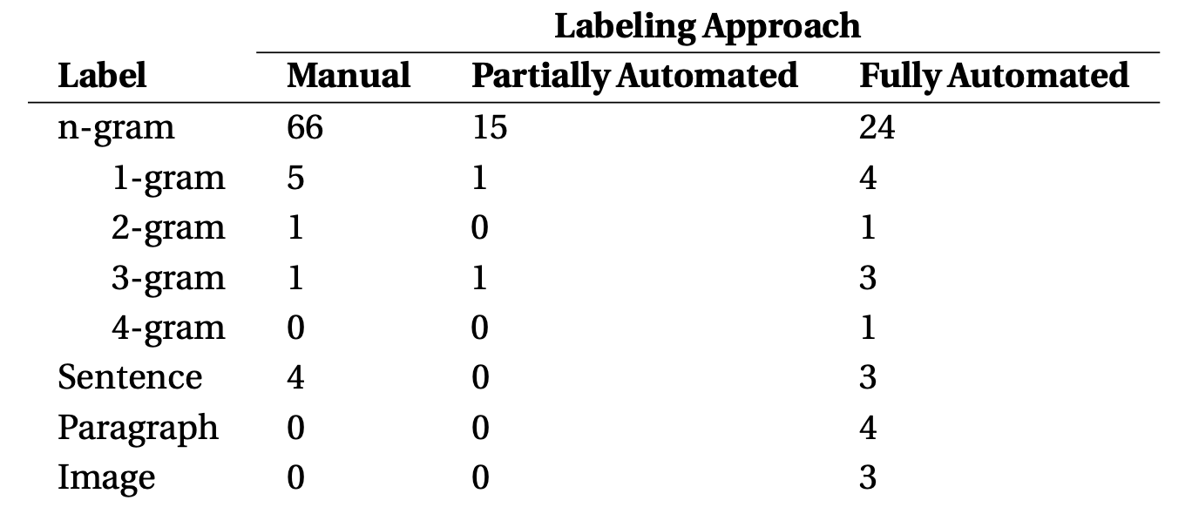
RQ3 – Label structures

Slide 15
RQ4 – Categories of corpora

Slide 16
Research gap 1 -

Slide 17
Additional Slides

Slide 18
Summary of methodological contributions

Slide 19
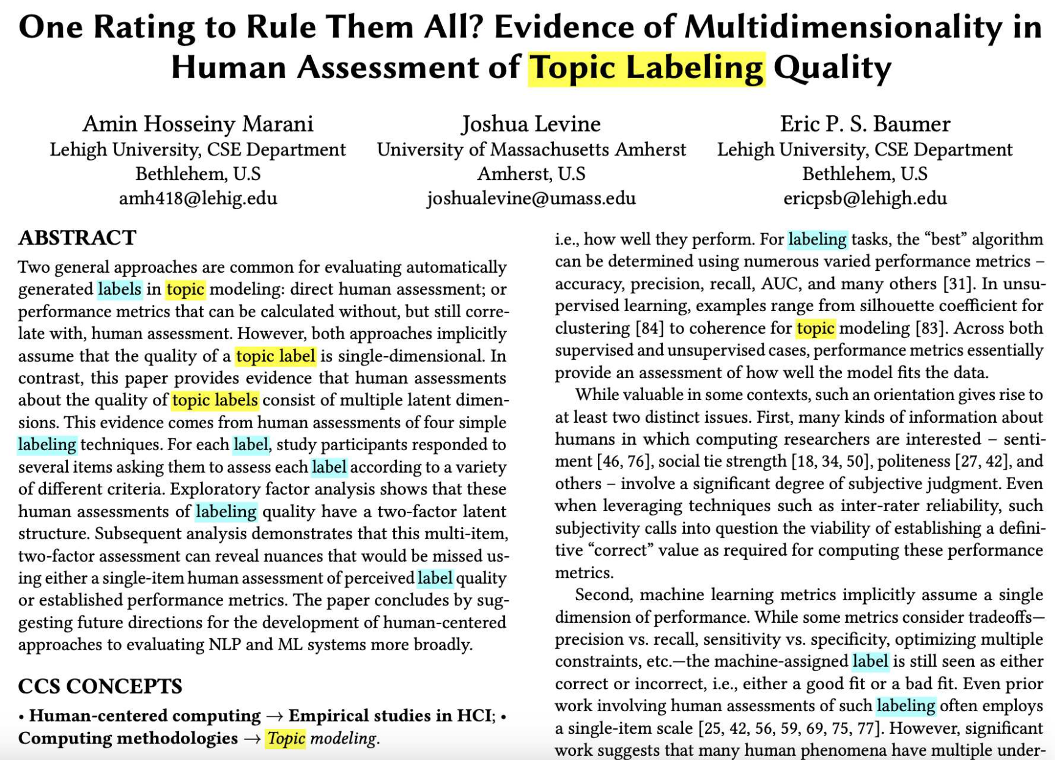

Data collection process

