Slide 1

Master in Computational Data Science
Enhancing the methodological approach to Systematic Literature Reviews: A practical application on Topic Labeling research
Candidate: Samuele Ceol
Supervisor: Barbara Russo
July 2023

Slide 2
Rationale & Research questions
Addressing the lack of SLRs on topic labeling
Reviewing the relevant primary studies in the period 2017-2022
Providing a set of methodological contributions
Stemming from observations made throughout the review process
Enhancing (parts of) existing guidelines for secondary studies
Believed to be generally applicable outside of the investigated domain
Research questions seek to explore the domain of interest in terms of:
Identified cateogories of labeling approaches and techniques by which they are implemented
Topic modeling methods used to generate the distributions
Observed label structures and conducted label selection and quality evaluation procedures
Characteristics of the underlying corpora

Slide 3
Definitions
Topic modeling:
Topic:
Topic labeling: Task of pairing each topic with a label capable of concisely summarising its content
Topic label: “a sequence of words which is semantically meaningful and covers the latent meaning of the topic. Words, phrases, and sentences are all valid labels under this definition” - Mei et al. (2007)
Example:
Topic terms: vote, house, election, poll, bill, republican, party, voter, candidate, senate
Label: election

Slide 4
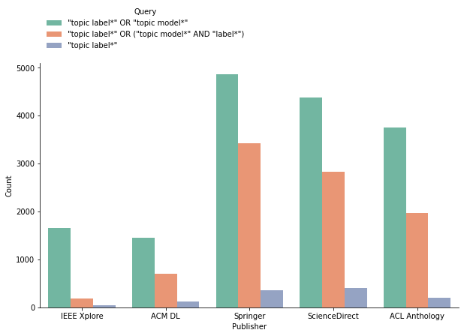
Venue selection process
Exploratory search is conducted on 5 repositories:
IEEE Xplore, ACM Digital Library, SpringerLink, ScienceDirect & ACL Anthology
Three queries proposed for this purpose
Ultimately, one is selected to gather the relevant venues
, each yielding a set of numerical results

Slide 5
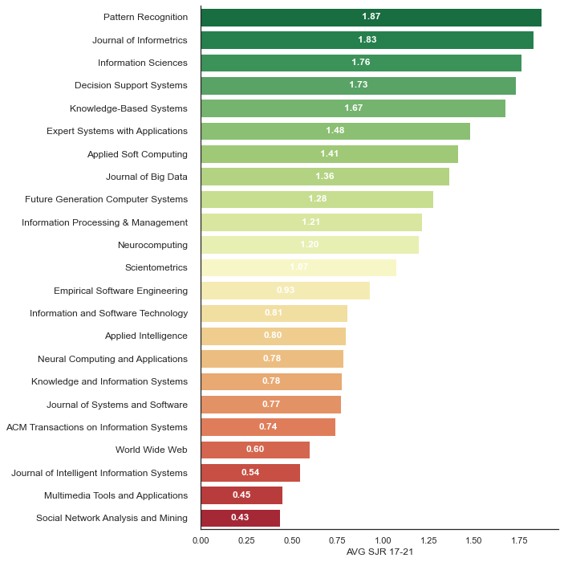
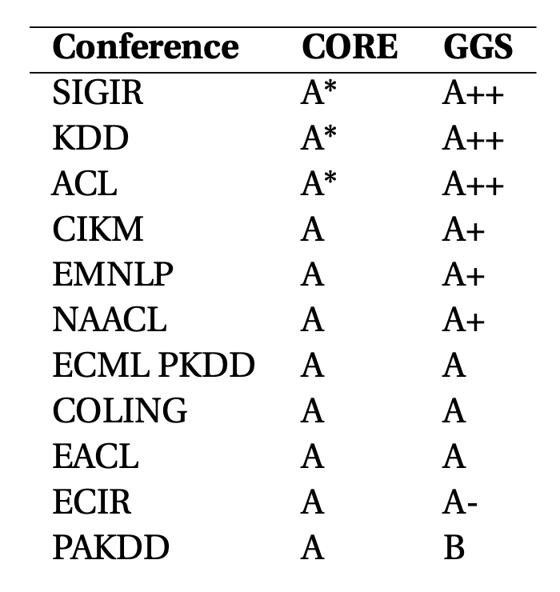
Venue selection process
From the selected query:
A first set of candidate venues is identified based on the number of associated documents.
Cut-off values set at:
30 articles for journals
20 articles for conferences…
…10 in the case of ACL
Results:
23 candidate journals
11 candidate conferences

Slide 6
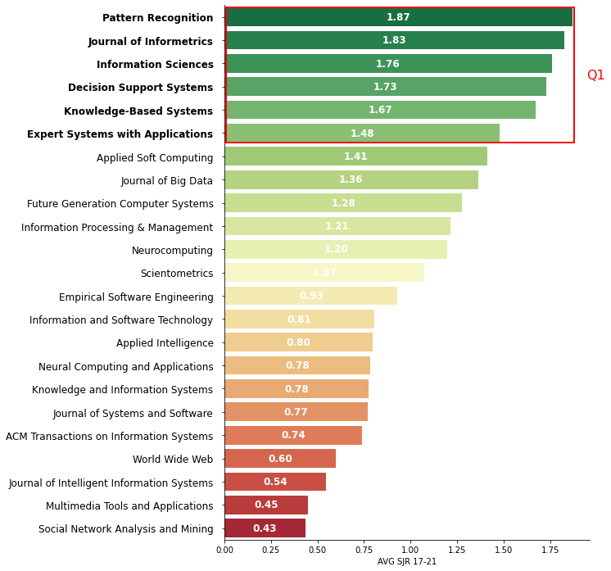
Venue selection process
Candidates are filtered based on values tied to selected quality metrics:
Scimago Journal & Country Rank (SJR(2)) score
Computing Research and Education Association of Australasia (CORE) rankings
GII-GRIN-SCIE (GGS) rankings
Final venues are obtained by retaining:
25% of best scoring journals
All conferences with an “A” rating
(Final) Results:
6 journals
10 conferences

Slide 7

Search strategy
Query used in the venue selection is refined by means of a proximity operator:
…and used to gather the primary studies
Proximity constraint is set to 20 terms
“The average length of sentences in scientific writing is only about 12-17 words” - Griffies et al. (2013)
Examples of captured sentences:
”Topics can be more readily interpretable when they are assigned semantically meaningful labels” - Hosseiny Marani et al., 2022
“Various methods have been proposed to assign concise labels to topics to improve interpretability” - Zosa et al., 2022
“An interpretable topic is one that can be easily labeled. How easily a topic could be labeled . . .” - Doogan and Buntine, 2021
Notes:
Mention why the query is split in two parts

Slide 8
(Initial) Study selection
An initial set of 937 documents is collected
Using the proximity constraint, 424 primary studies are kept
201 conference and 223 journal papers
Inclusion\exclusion criteria are applied by means of manual inspection
Only studies actively applying topic labeling techniques are kept
Secondary & tertiary studies are filtered out
…
A core selection of 55 papers is obtained
Represents the first set of studies included in the Review
Is used as a starting point for the snowballing activities

Slide 9

Snowballing activities
Core collection is used to extend the scope of the review by extracting:
References (backward snowballing)
Citations (forward snowballing)
This additional work is filtered via the query used for the initial collection
…and the inclusion/exclusion criteria
B.S.
Initial collection
F.S.
References
Citations
738
55
1147
160
58
23
358

Slide 10
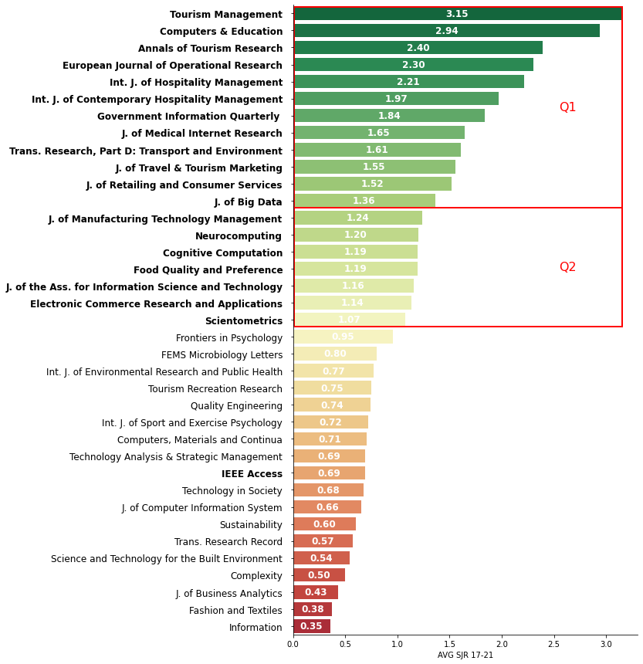
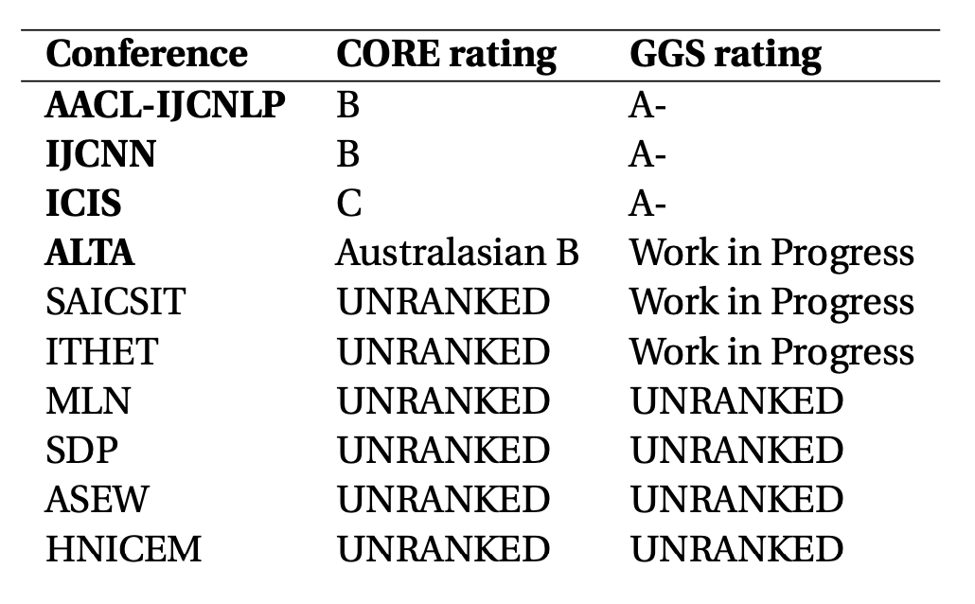
Snowballing activities
Quality of the snowballing studies needs to be taken into account
For B.S., properties of the core collection are expected to carry over to the referenced work
For F.S., no a-priori assumption of quality can be made for the gathered citations
Solution Exploit the metrics used in the venue selecion process
SJR(2) score for journals
Avg score of 1 and above
…and one cherrypicked venue (IEEE Access)
CORE/GGS ranking for conferences
Additionally, check for predatory venues
Notes:
19 journals (and 24 studies)
+1 additional journal (2 studies)
4 conferences (4 studies)

Slide 11
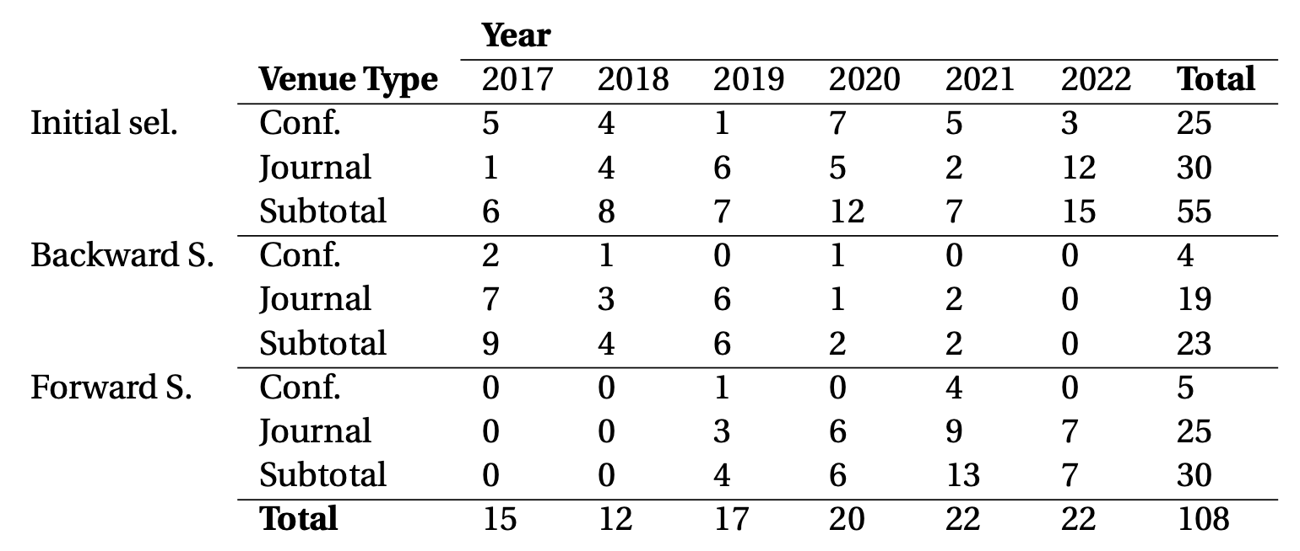
(Final) Study selection
A selection of 108 papers is obtained
B.S.
Initial collection
F.S.
References
Citations
23
55
30

Slide 12
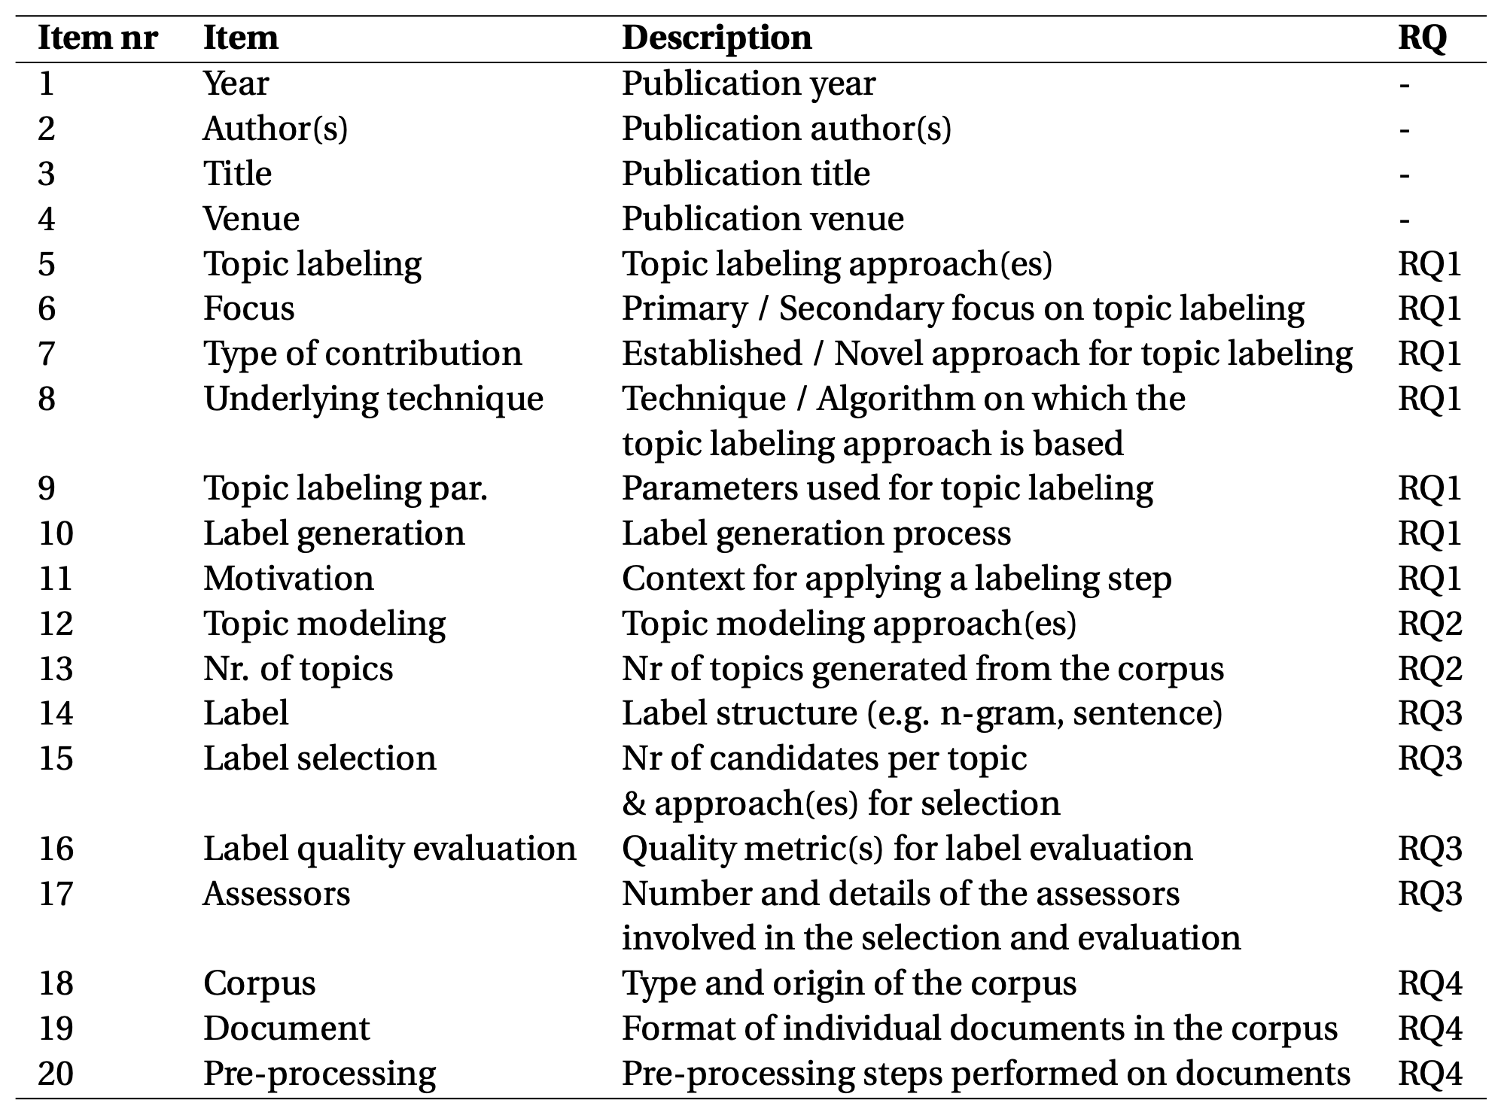
Data items
Data collection is centered around a data extraction form
Establishes which information is relevant for the review (what to look for in primary studies)
Made up of 20 data items
Ties each group of items to a specific RQ
(with the exception of items 1-4)
A version of this form is manually populated for each of the included (108) papers

Slide 13
Structure of the analysis and synthesis
Collected data is analysed in order to provide:
A synthesis of the evidence found in the primary studies
Conducted following the defined data items
Drawing comparisons between methodologies, contents and findings
Ultimately used to address the posed research questions
A description of the identified research gaps
Highlighting what is missing or lackluster
Selected insights from individual studies
Identified on the basis of the accessibility of the documents…
… and the reproducibility of the described methodology
Offered to provide guidance to prospective researchers

Slide 14
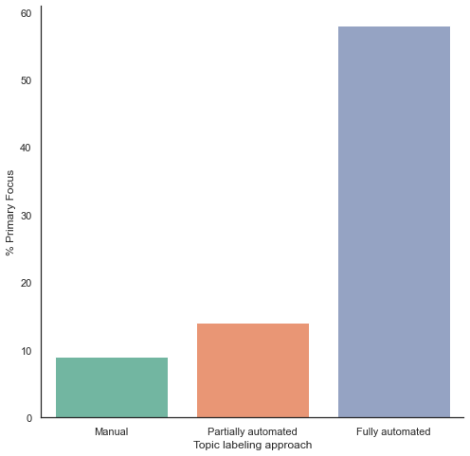
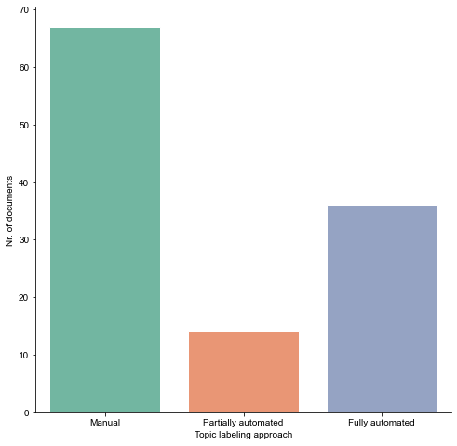
RQ1 – Topic labeling approaches

Slide 15
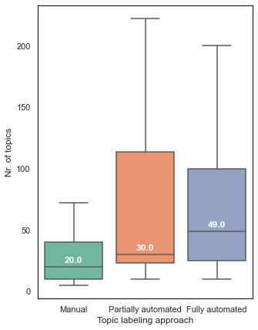
RQ2 – Underlying topic modeling approaches

Slide 16
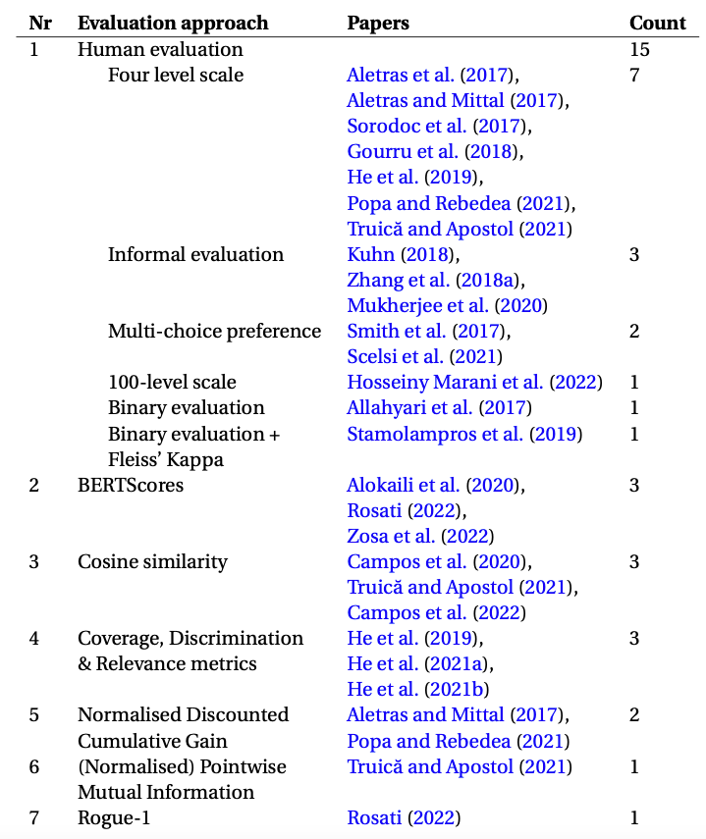
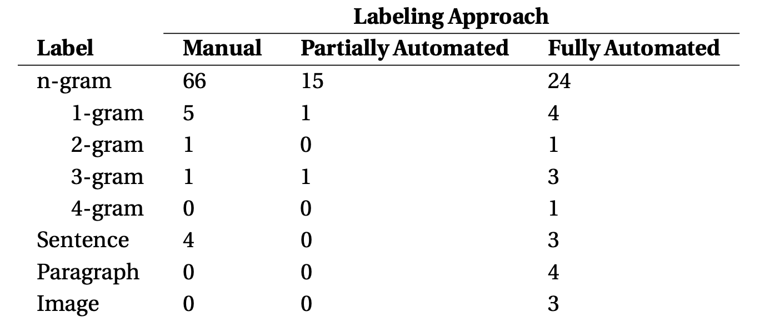
RQ3 – Label structures

Slide 17
RQ4 – Categories of corpora

Slide 18
Research gap 1 -

Slide 19
Additional Slides

Slide 20
Summary of methodological contributions

Slide 21
SLRs vs SMSs

Slide 22
SEGRESS

Slide 23
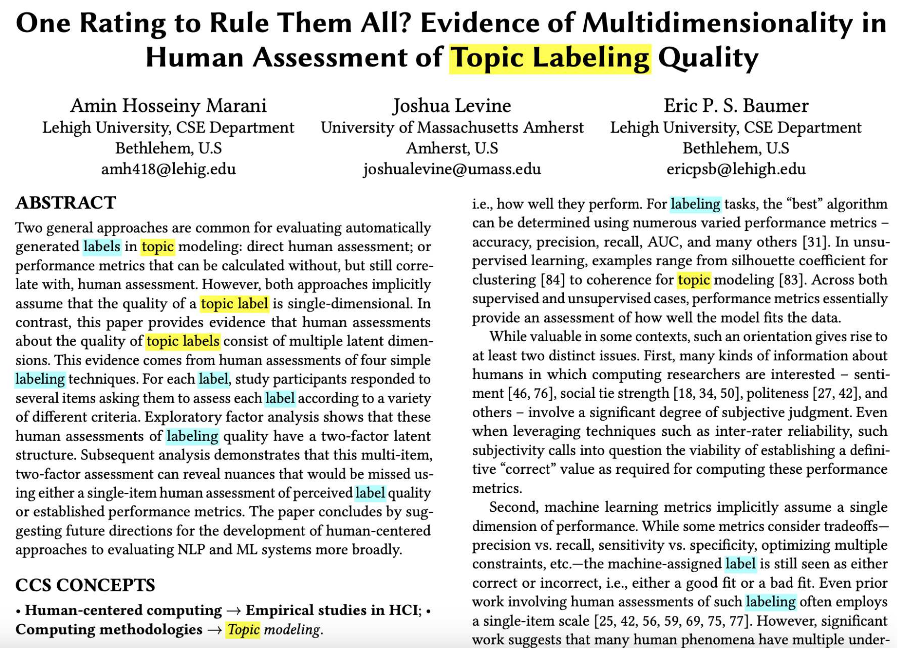

Data collection process

Slide 24
Guidelines for identifying gaps

Slide 25
Future work - Literature networks

