Slide 1
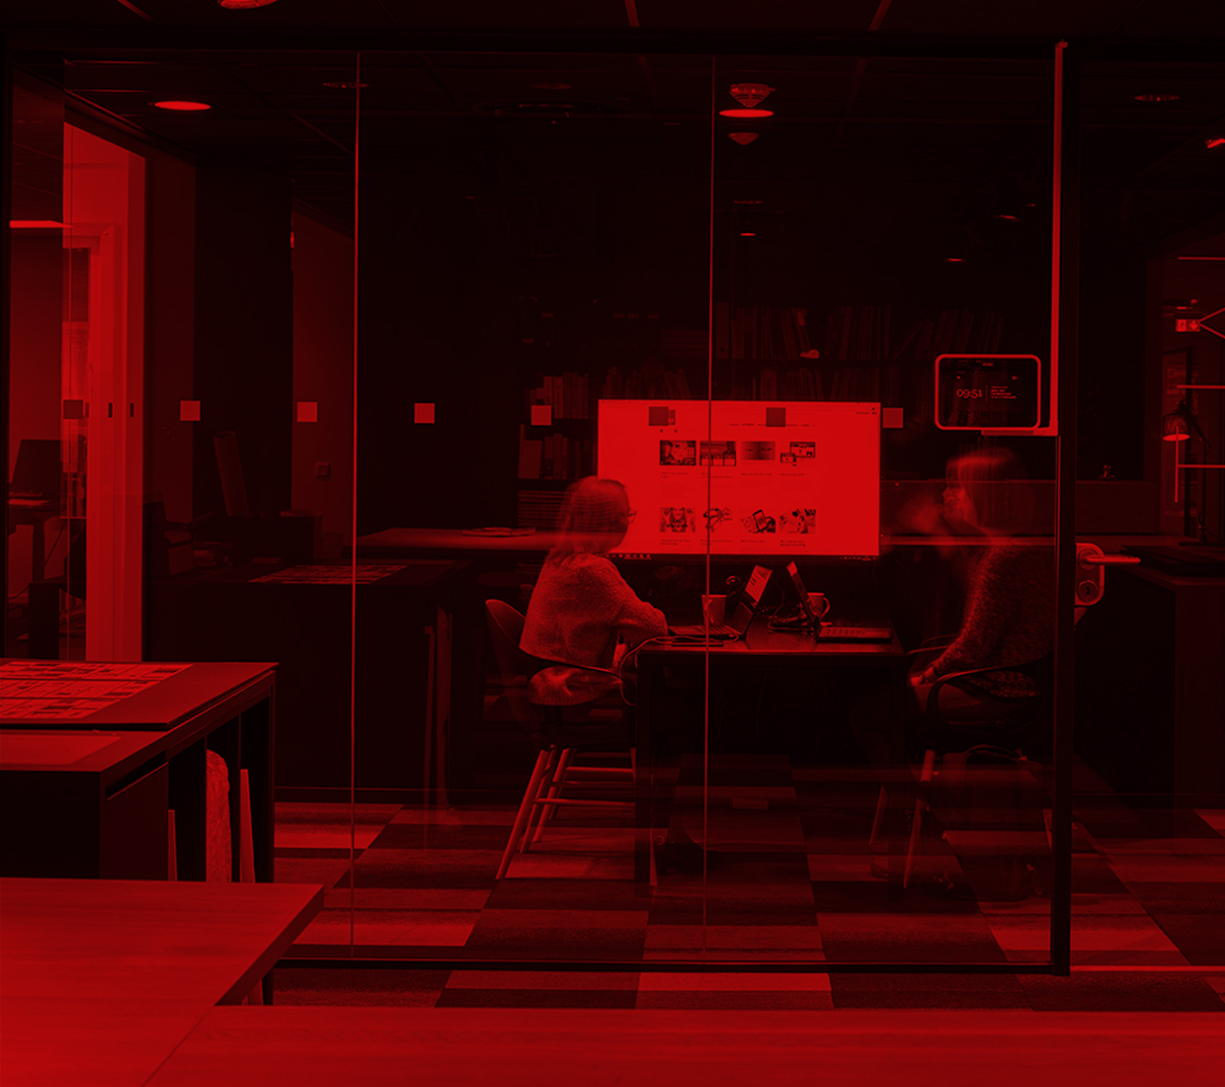
Cyber Assistant
hackathon islandsbanki Itera 2018

Slide 2

Why

Slide 3

Islandsbanki is family bank
Kids are our future
Kids like robots

Slide 4
Islandsbanki is innovative company
Robotics is innovation
Robots are fun

Slide 5
Cyber Assistant will Help to
Engage people
Make people closer to technologies
Increase sales

Slide 6
What

Slide 7
What

Slide 8
Demo

Slide 9
What

Slide 10

What

Slide 11
What Next

Slide 12
Questions

Slide 13


