Slide 1
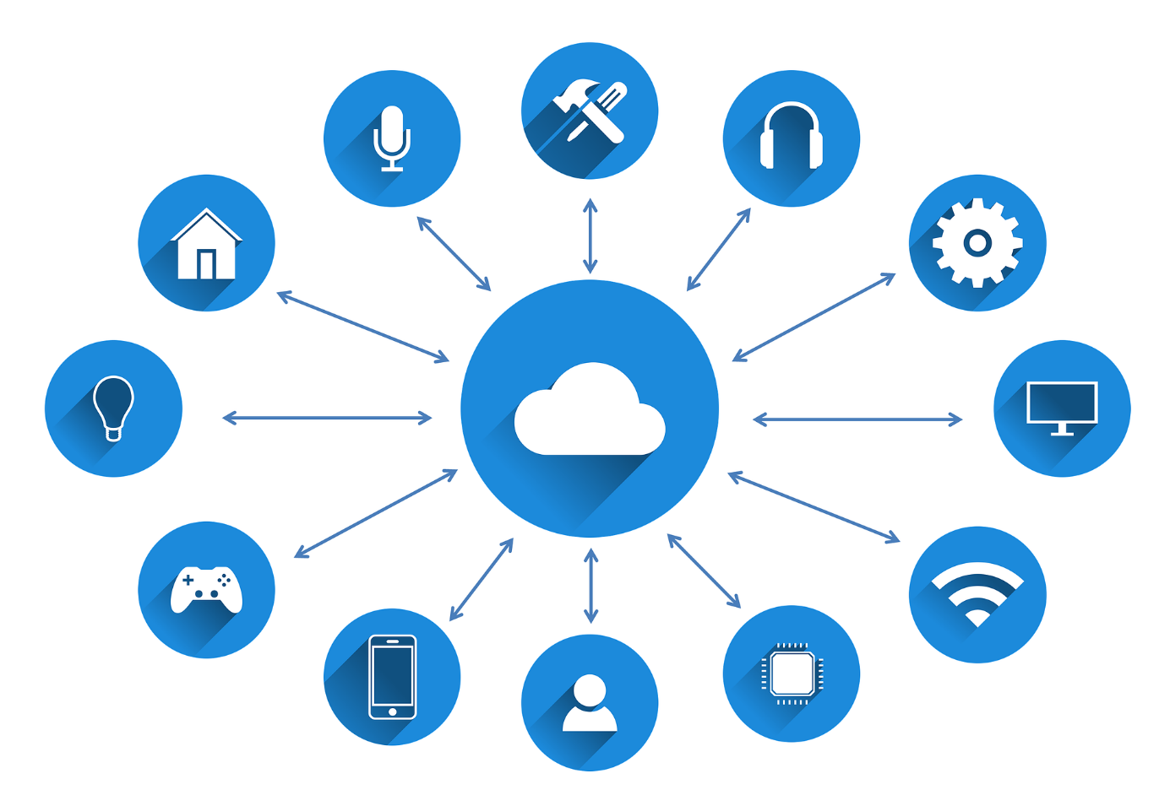
Smart Home Security

Slide 2
Smart Home Security
A few numbers

Slide 3
Smart Home Security
A few numbers
2018: 4.5 billion records exposed

Slide 4
Smart Home Security
A few numbers
2018: 4.5 billion records exposed
2019: 2.7 billion identity records
consisting of 774 million email addresses and 21 million passwords posted on the web for sale

Slide 5
Smart Home Security
A few numbers
What to improve ?
2018: 4.5 billion records exposed
2019: 2.7 billion identity records
consisting of 774 million email addresses and 21 million passwords posted on the web for sale

Slide 6
Smart Home Security
A few numbers
What to improve ?
2018: 4.5 billion records exposed
International security standard
2019: 2.7 billion identity records
consisting of 774 million email addresses and 21 million passwords posted on the web for sale

Slide 7
Smart Home Security
A few numbers
What to improve ?
2018: 4.5 billion records exposed
International security standard
2019: 2.7 billion identity records
consisting of 774 million email addresses and 21 million passwords posted on the web for sale
Smart things should be independently tested for security

Slide 8
Smart Home Security
A few numbers
What to improve ?
2018: 4.5 billion records exposed
International security standard
2019: 2.7 billion identity records
consisting of 774 million email addresses and 21 million passwords posted on the web for sale
Smart things should be independently tested for security
Educate users to choose secured passwords

