Slide 1
Learning Javascript
Group Members:
Shreeja Dangol
Yan Volis
Professor:
Yitzchak Novick
Touro College

Slide 2
About Website
Built as an example to demonstrate the potential of Javascript and Dom scripting.
Help beginners to learn and enhance the web development skills using javascript.
Demos of codes on how all the functionality of webpage have been implemented are available.
Besides, it is a piece of fun world!!!
- Put away your boredom by
*Playing Games
*Listening to Music
*Check your tech IQ
*Get ready for up coming holidays.

Slide 3
Javascript Essentials

Slide 4
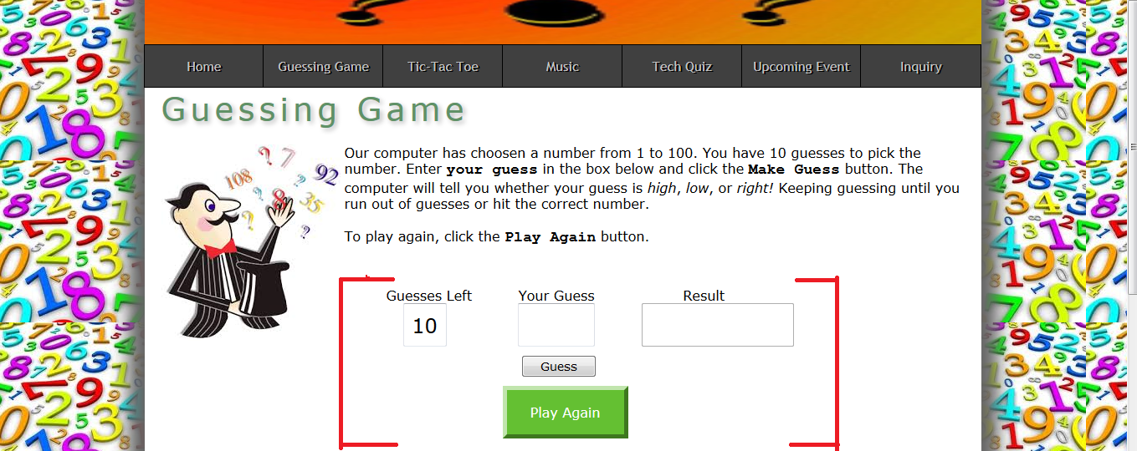

Slide 5
Implemented Javascript concepts for Guessing Game Page
window object and its onlod event.
Create and call of function with no parameters and no return.
random and floor method of Math object.
Create and call of function with one parameter and a return.
method of the document object – getElementById(id).
value property of the text box object.
Method focus() of textbox object.
button object and its onclick event.
if statements with compound conditional expression.
Validation using isNaN() and expression.
Common methods of window object – alert(message), parseFloat(string).

Slide 6
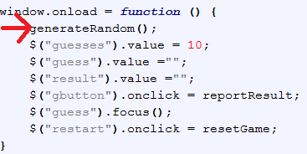

When the window loads……
window object and its onload event
Create and call of function with no parameters and no return
random and floor method of Math object

Slide 7
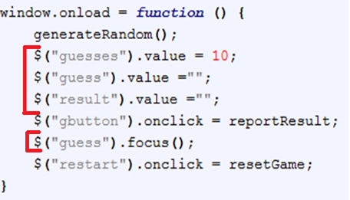

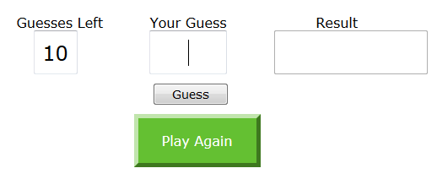
When the window loads…..
Create and call of function with one parameter and a return.
method of the document object – getElementById(id).
value property of the text box object.
Method focus() of text box object.

Slide 8
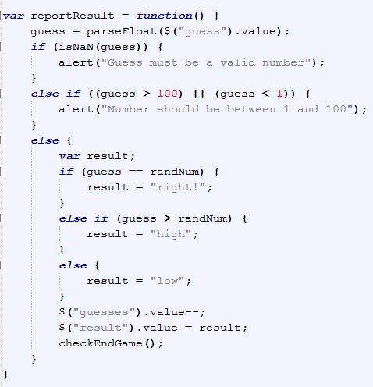
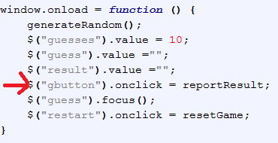
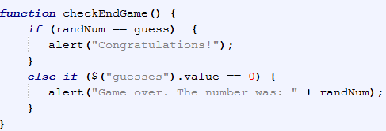
When guess button is clicked….
button object and its onclick event.
if statements with compound conditional expression.
Validation using isNaN() and expression.
Common methods of window object – alert(message), parseFloat(string).

Slide 9
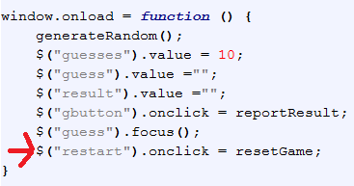
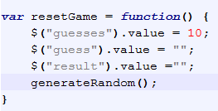
When PlayAgain button is clicked..

Slide 10
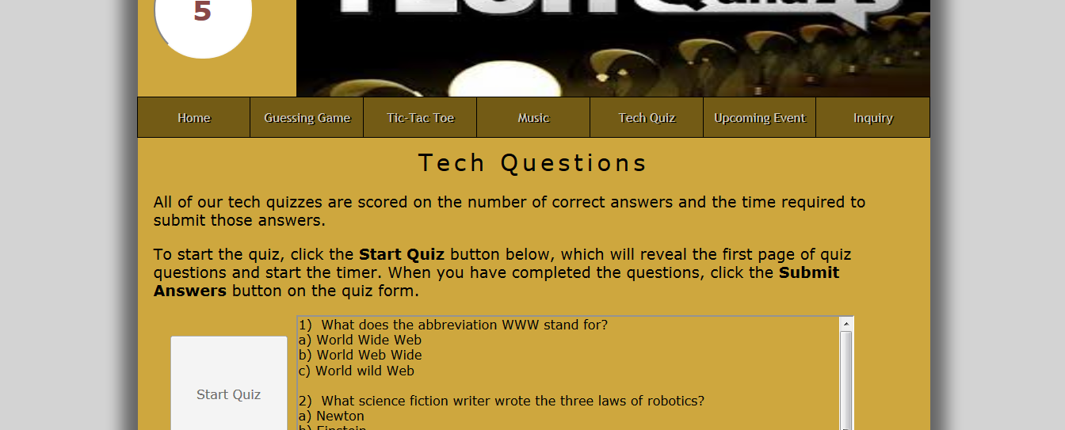

Slide 11
Implemented Javascript concepts for Tech Quiz Page
Form reset() method
Create and call a function with both with and without parameter and return
For Loop
Form Elements collection
Form length property
Form element disabled property
Two methods for working with timer that calls a function repeatedly
– setInterval(function, intervalTime)
– clearInterval(timer)
Visibility property of an element
Create and use of Array and array of Array
Random and round method of Math object
While loop
Use of button, text box and text area

Slide 12
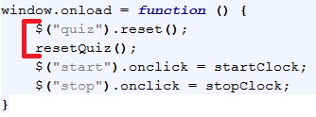
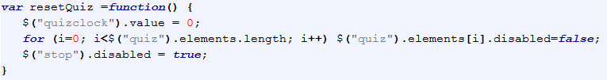
When the window loads..
Form reset() method
Create and call a function with both with and without parameter and return
For Loop
Form Elements collection
Form length property
Form element disabled property

Slide 13
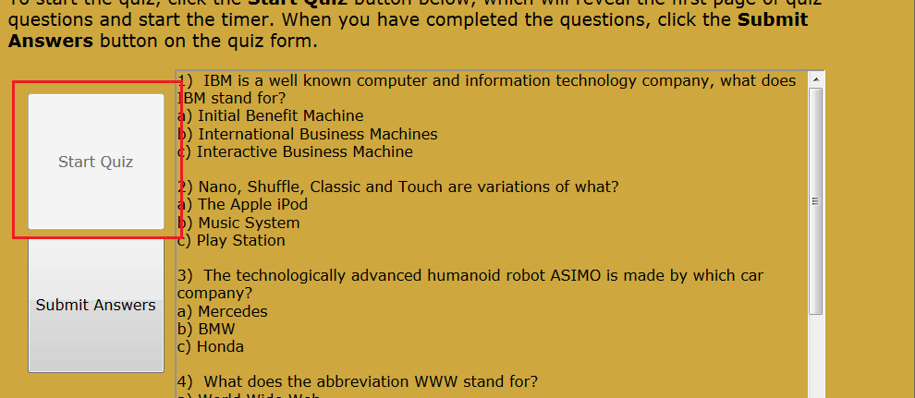
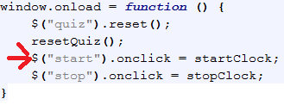
When start button is clicked….
Two methods for working with timer that calls a function repeatedly
– setInterval(function, intervalTime)
– clearInterval(timer)
Visibility property of an element
Create and use of Array and array of Array
Random and round method of Math object
While loop

Slide 14
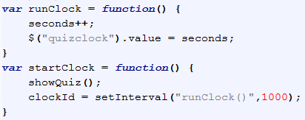
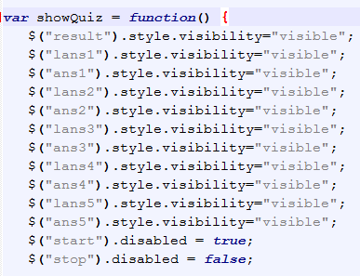

Slide 15
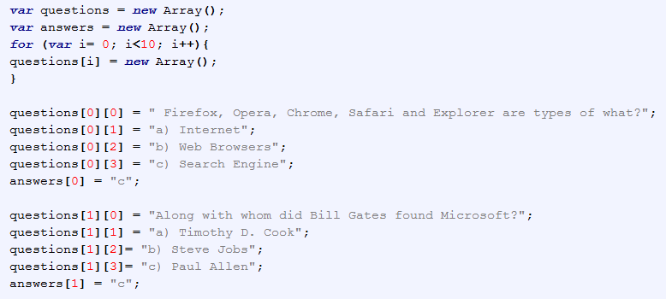
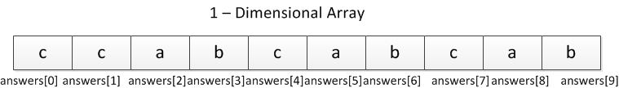

Slide 16
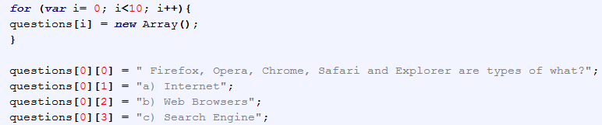
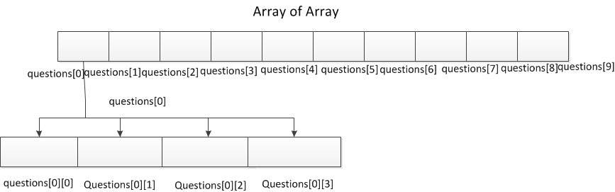

Slide 17
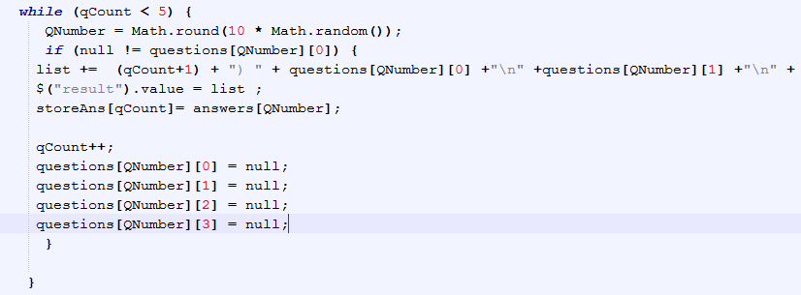

Slide 18
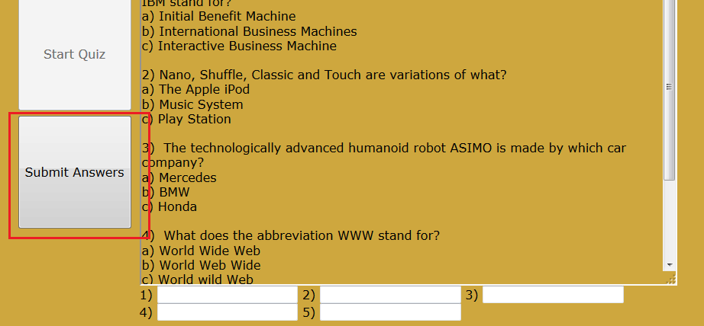
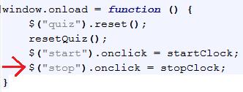
When submit button is clicked..

Slide 19
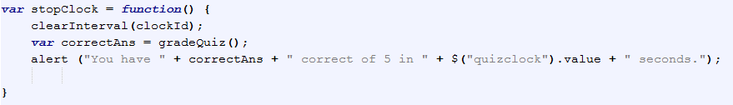
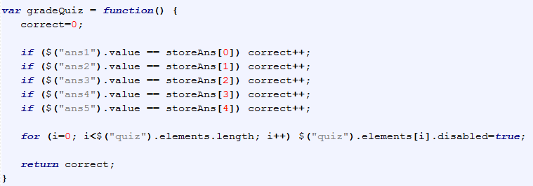

Slide 20
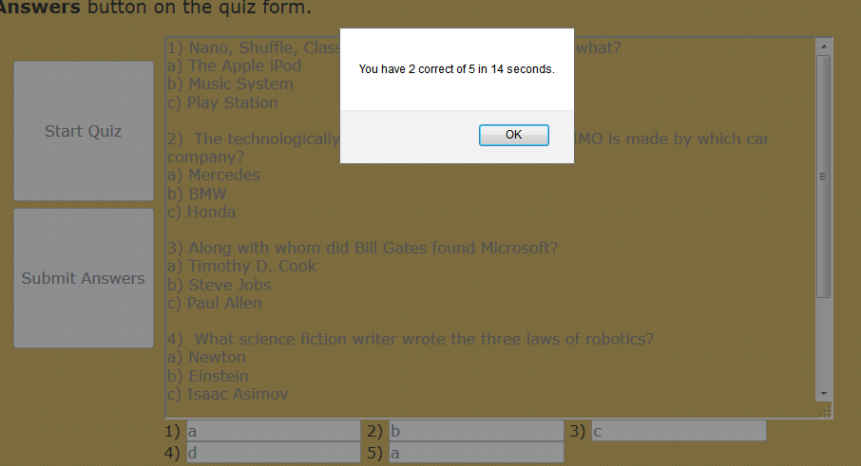

Slide 21
DOM Scripting and Manipulation

Slide 22
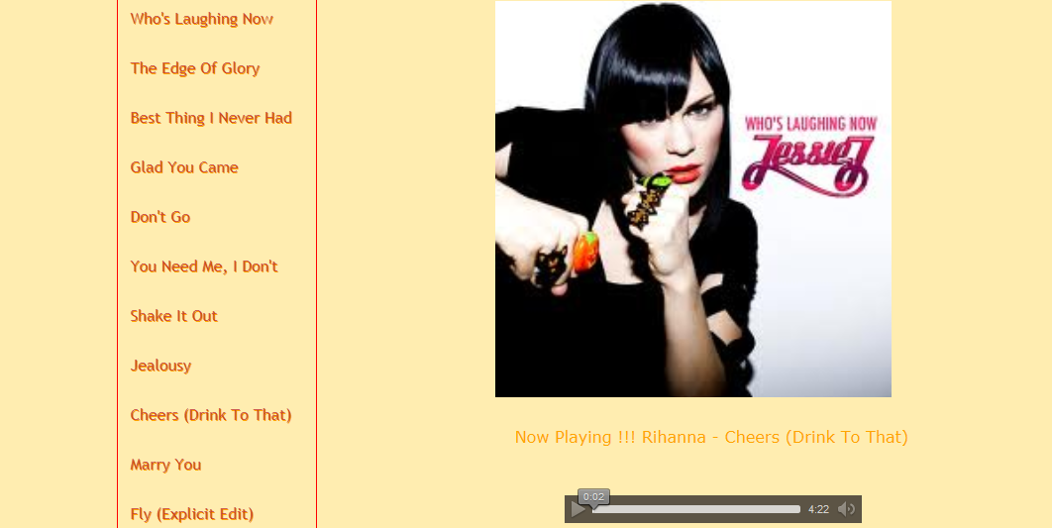

Slide 23
Implemented Javascript concepts for Music Page
Common properties of Node interface – nodeType
- nodeName
- nodeValue
- firstchild
Methods of the Document interface – getElementByTagName (tagname)
– getElementById(elementId)
Method of the Element interface – hasAttribute(name)
Property of the HTMLElement interface - .title
Property of the HTMLAnchorElement interface - .href
Property of the HTMLImageElement interface - .src
window.event property for IE
Preload the musics using Image object
setInterval (function,intervalTimer) and clearInterval(timer)
Create and call a constructor that takes one parameter which is an object
Validation of nodes

Slide 24
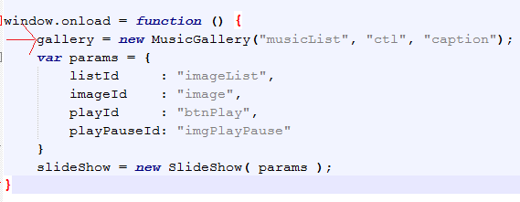
When window loads…

Slide 25
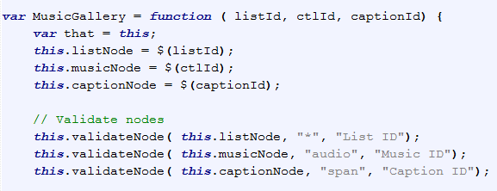
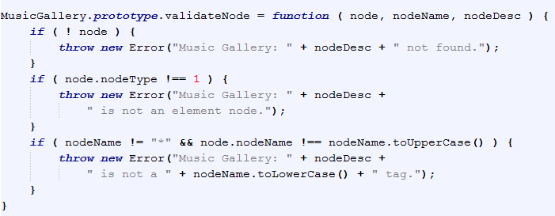

Slide 26
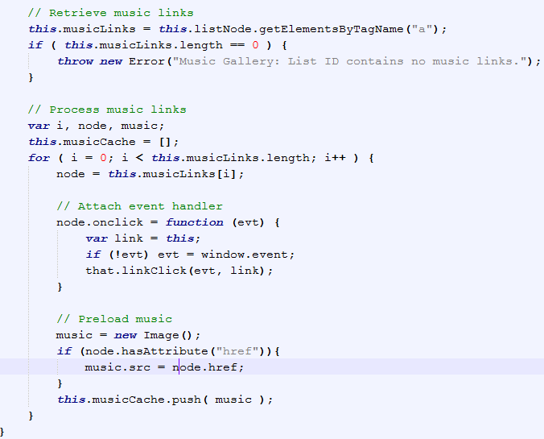

Slide 27
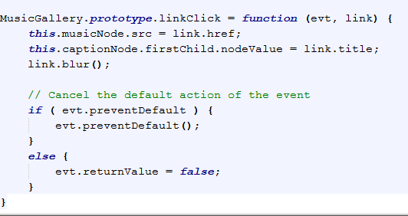

Slide 28
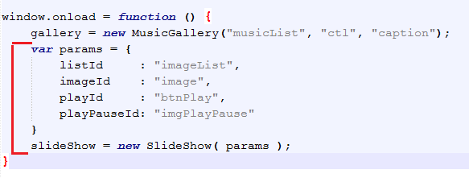
For image slide show…
Creates an object named params with four properties that store the ids of four elements.
The params object is passed to the constructor.

Slide 29
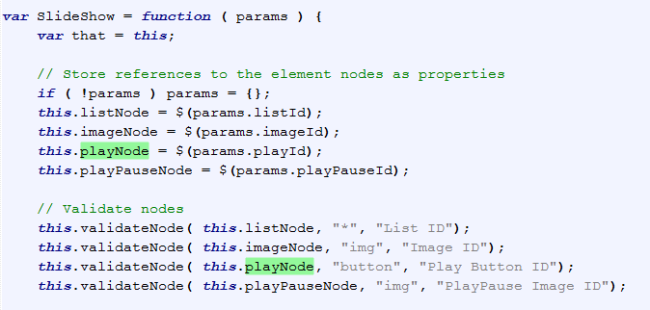
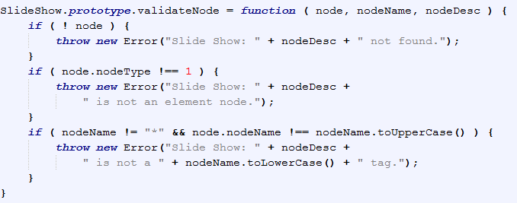

Slide 30
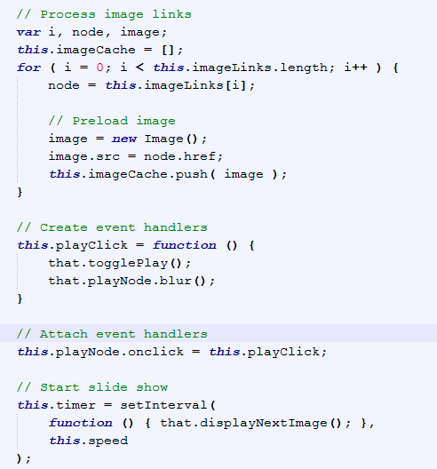

Slide 31
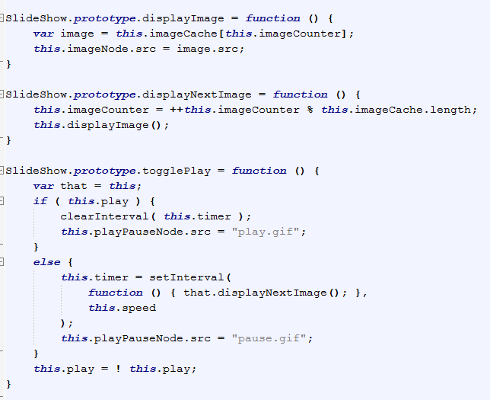

Slide 32
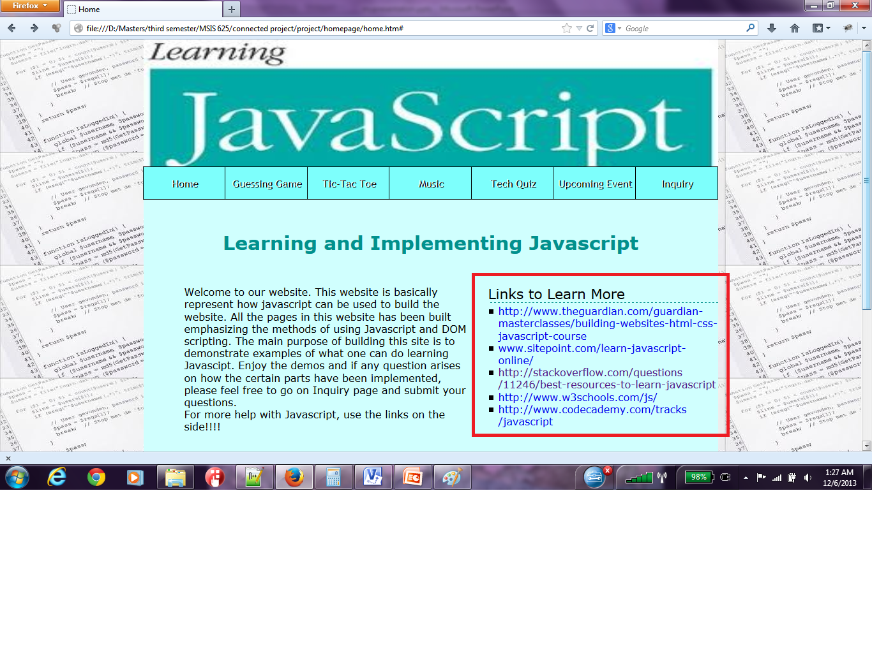

Slide 33
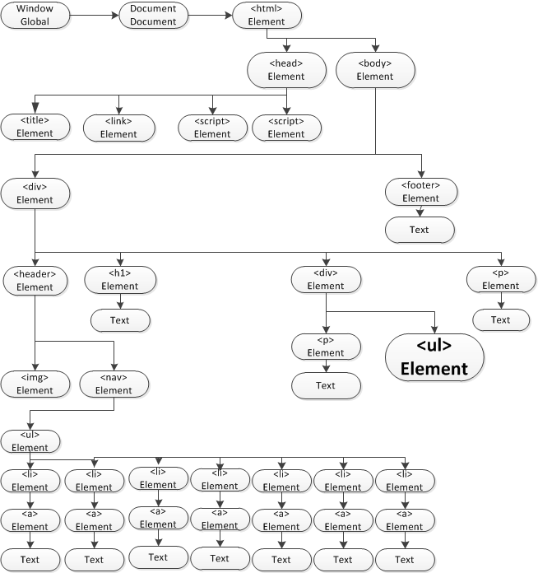
The Dom for Home Page

Slide 34
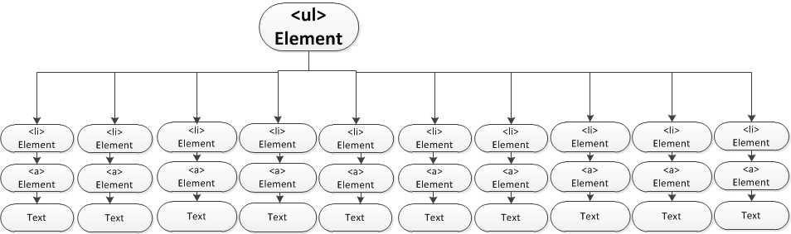

Slide 35
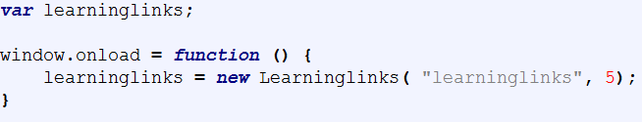
When the window loads
Creates Learninglinks object
Two parameters are passed
Id of UL element and
value of linkCount

Slide 36
Five major tasks done in Learninglinks Constructor
Validation - number of arguments for the method
- of nodes
- of linkCount
Remove LI nodes from UL node and store them in an array
Append 5 LI nodes to the UL node
Define and attach the event handlers to the events
Call play method to display 5 links in the very beginning which calls showNext method to roll up the links

Slide 37
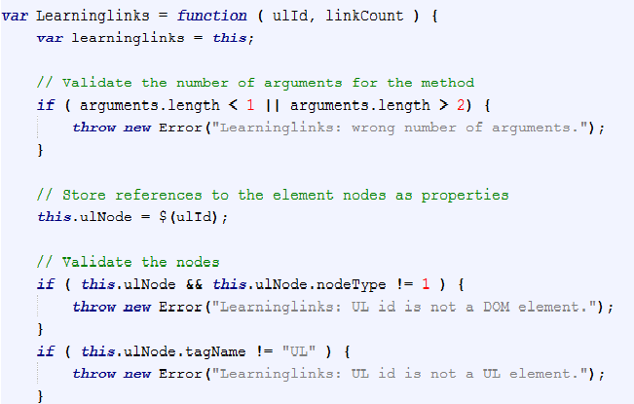
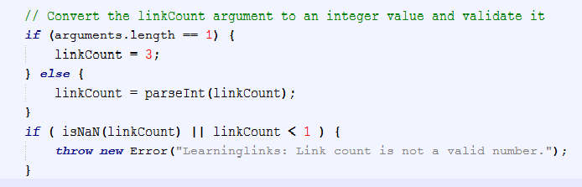
Validation

Slide 38
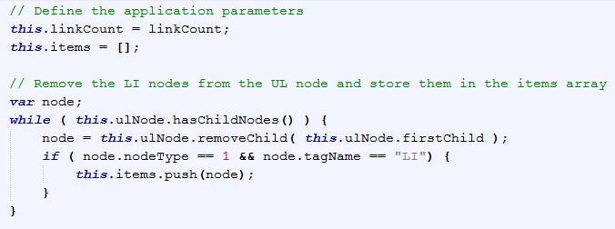
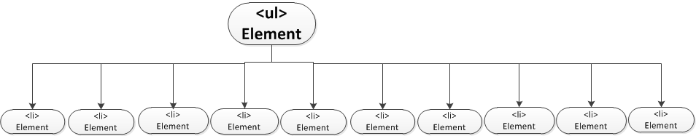
Remove LI nodes from UL node
Array Item[]

Slide 39
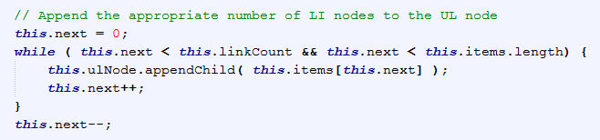
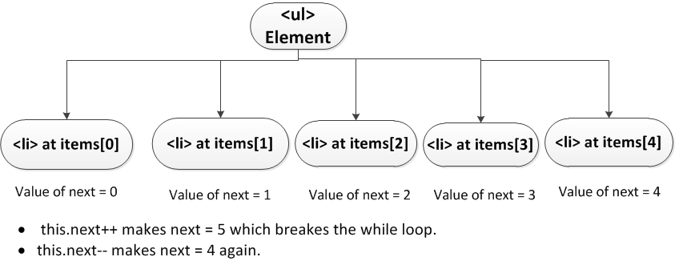
Append 5 LI nodes to the UL node

Slide 40
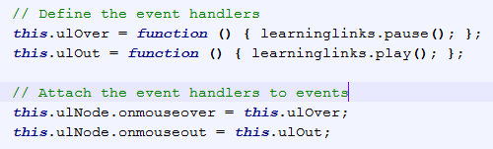
Define and attach event handlers

Slide 41
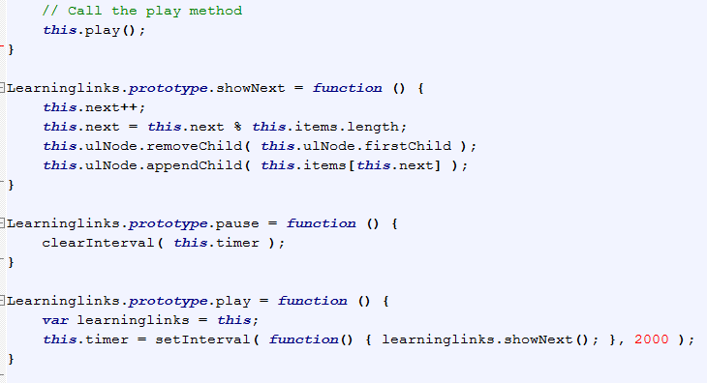
Roll up the links

Slide 42
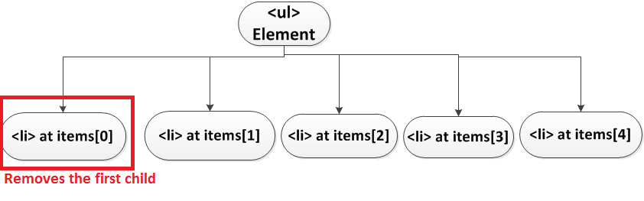


Slide 43


Slide 44
Implemented JavaScript concepts for Holidays page
Date object and its methods.
Getting and setting year, date time.
Changing the date
setTimeout method
setInterval method
Use of input boxes
Interaction with Document Object Model
Window onload property
Shorthand notation for if/else cases
Math.floor method

Slide 45

The built in script on holidays.htm page….
Creates dates for today, and 5 major holidays
Fills in input boxes with corresponding dates
Calls external javascript function to calculate time left between today and the coming holiday

Slide 46

Function showDateTime
Takes a date passed into it and returns the date in a text string formatted as:
mm/dd/yyyy at hh:mm:ss am or pm
Uses if/else cases to decide if time is am or pm

Slide 47

Function changeYear
Checks if holiday already passed this year
If holiday passed, sets the holiday year to next year to properly calculate time till then

Slide 48

Countdown function
Calculates time from now till holiday in milliseconds
Does the proper math to convert the result to days, hours, minutes, seconds
Assembles all results in to a string for output

