Slide 1
BUSINESS PROJECT OF HBFC BANK
BHARATH J

Slide 2
TASK-1 the percentage of bank’s customers who have availed Personal Loans?
Approach used : I used pivot table to make easy to handle the data.
Step 1: clicked-> insert button on the top of the window and selected the pivot table icon , and clicked on the new location.
Step 2: just selected the personal loan and dragged that loan to the rows field and again personal loan dragged into the value field and selected into ->counts .
Output:
Only 9.60% of the people availed for the personal loan from the bank.

Slide 3
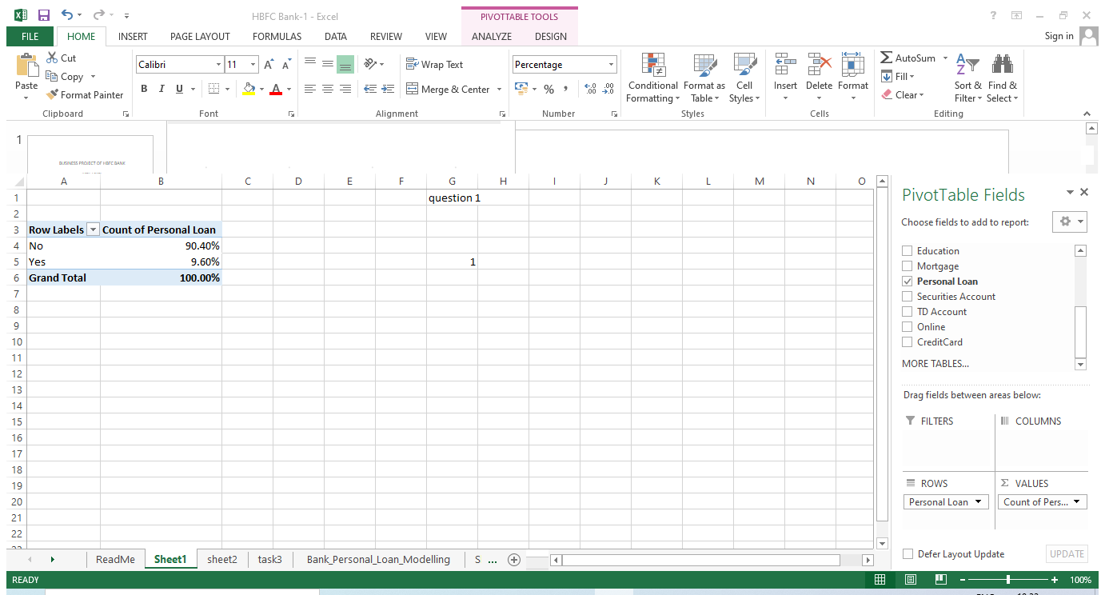

Slide 4
Task-2 Generate a table with min, max, median & average for all numeric variables (age, experience, income, family members, CCAvg, Mortgage).
Approach used: I have created pivot table using data set
Step 1: clicked-> insert button on the top of the window and selected the pivot table icon , and clicked on the new location.
And dragged all the age, experience, income, family members, CCAvg, Mortgage to the values field and dragged values to the column field .
The selected field changed the field setting into minimum values . The selected field changed the field setting into maximum values.
The selected field changed the field setting into average values as well after got the all the values copied and mentioned below table with the given name of AGE, EXPERIENCE ,FAMILY MEMBERS,INCOME,MORTAGE,CC AVG.
For median used formula =MEDIAN(Bank_Personal_Loan_Modelling!B:B) get the output.
OUTPUT:

Slide 5
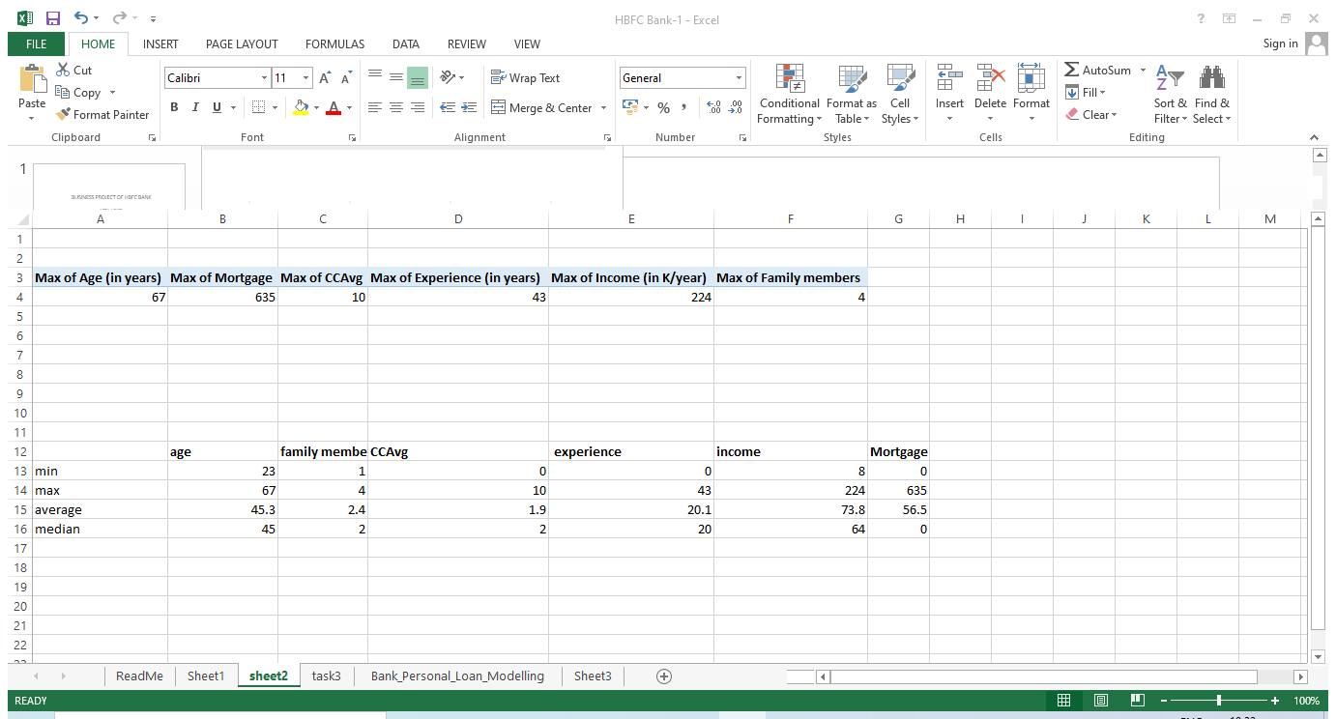

Slide 6
TASK-3 Created a new categorical variable for Experience using 4 categories – 0 to 10 years 11 to 20 years 21 to 30 years and 30+ years. Plot a bar graph for this new categorical variable
Approach used: From data set copied experience data to the new sheet and used formula of if method to display the range of the experience . =IF(A2<=10,"0 to 10years",IF(A2<=20,"11 t0 20 years",IF(A2<=30,"21 to 30years","30+years")))
Selected the whole data and created the-> pivot table to create the pivot chart and dragged range in years data to the row field and experience got dragged to the values and changed the field settings to the count for the clear and detailed chart.
OUTPUT:

Slide 7
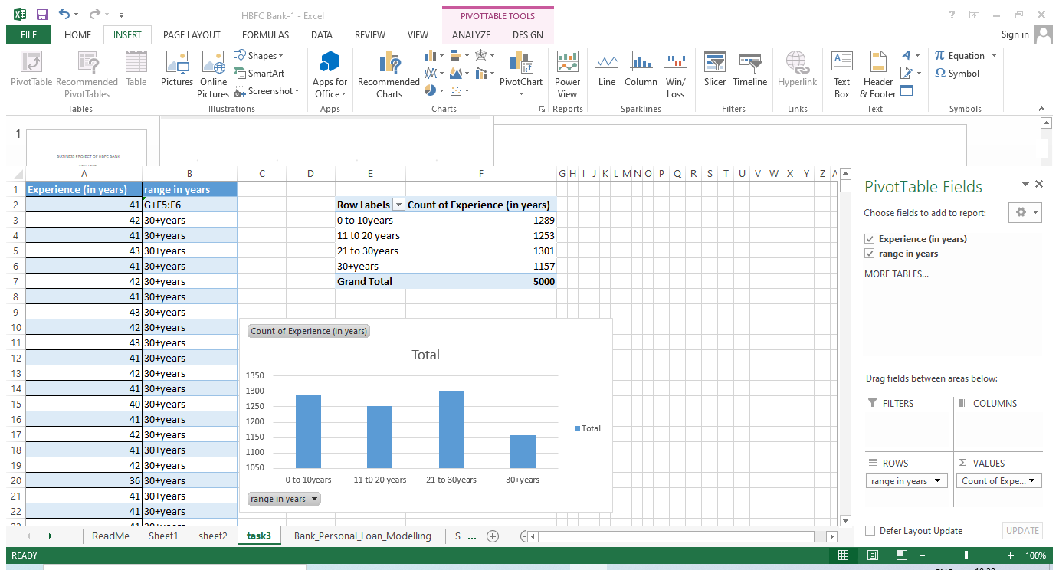

Slide 8
TASK-4 a scatter plot of the Age and the Experience variable
Approach used: From data set copied AGE & EXPERIENCE data to the new sheet .
Selected the two data which is AGE & EXPERIENCE and clicked the insert button .
After clicking the insert button-> selected the scatter plot chart .
OUTPUT:

Slide 9
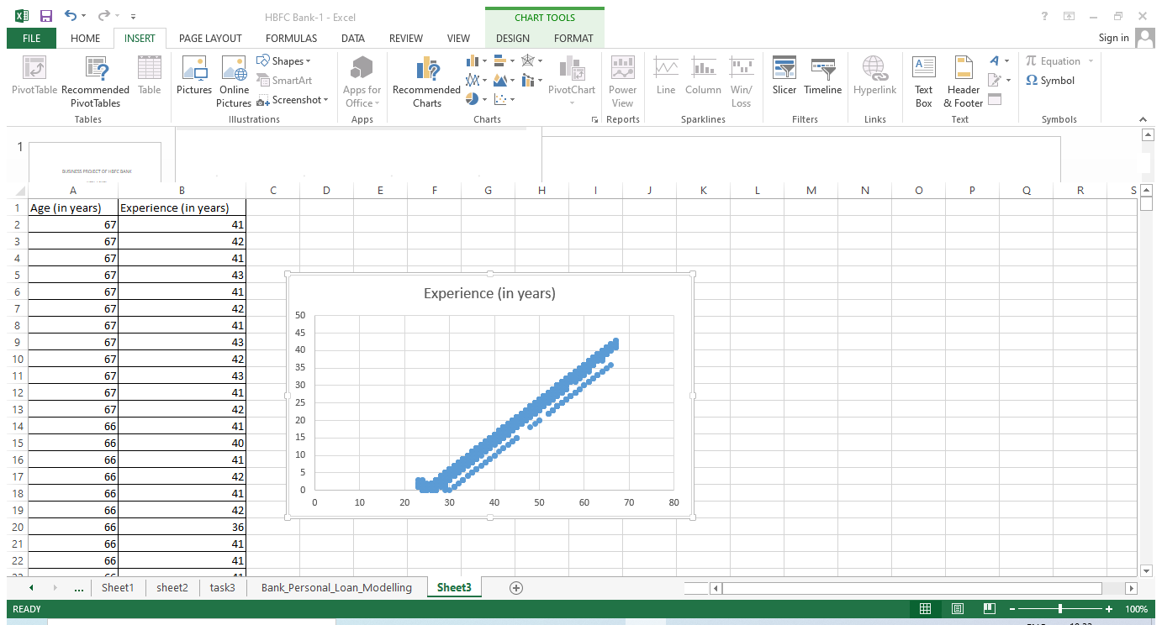

Slide 10
TASK-5 the top 3 areas (ZIP Codes) where the bank’s customers are located.
Approach used :
Step 1: clicked-> insert button on the top of the window and selected the pivot table icon , and clicked on the new location.
Dragged the zip code into the rows and dragged customer ID into the values as well.
Then sorted the ID values to largest to smallest and got the output of the top 3 ranks of zip code.
OUTPUT:

Slide 11
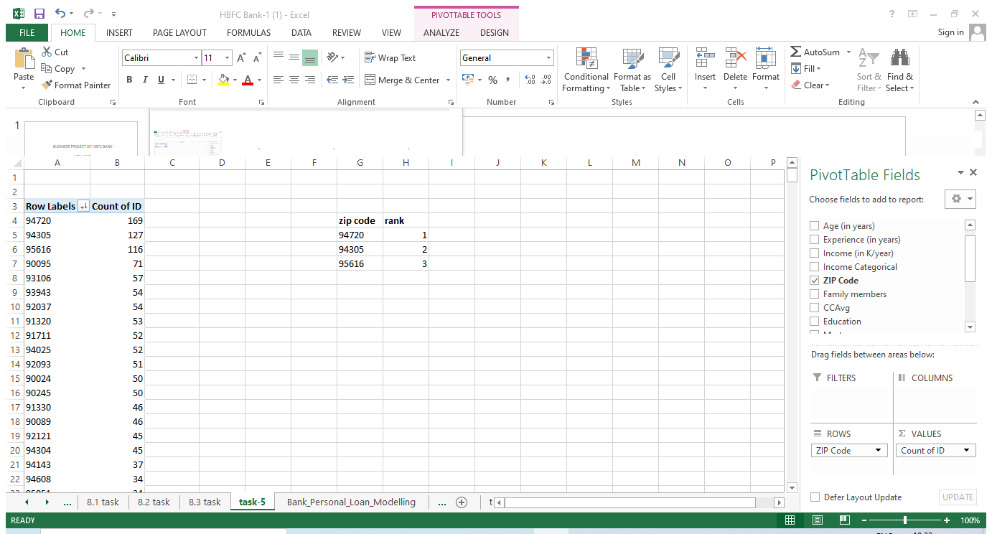

Slide 12
TASK-6 How many customers have a combination of Fixed Deposits and Credit Cards but not Personal Loan?
Approach used :
Step 1: clicked-> insert button on the top of the window and selected the pivot table icon , and clicked on the new location.
Selected and dragged Fixed Deposits and Credit Cards but not Personal Loan to the filters field and dragged the count of id to the value field and changed the field setting to the count of the ID.
In filters marked the fixed Deposits and credit cards as YES, and personal loan marked as NO .
Got the count of the COMBINATION of Fixed Deposits and Credit Cards count as 147.
OUTPUT:

Slide 13
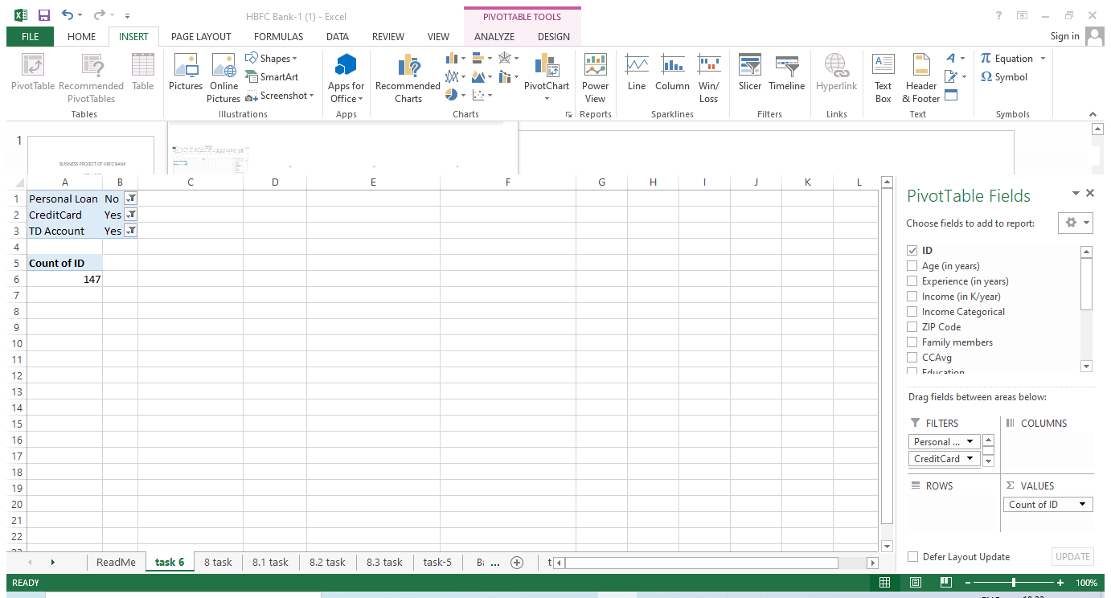

Slide 14
TASK-7 the median income of the customers who have availed personal loans and compare it with the median income of those customers who have not availed personal loans
Approach used :
Step1: selected the personal loan ->marked YES using filter and copied the personal loan data , and copied the income data to the new sheet as well.
And then calculated the median of the income which is marked yes .
Used formula =MEDIAN(B:B)
Step2: Then repeated the same but this time selected the personal loan ->marked NO using filter and copied the personal loan data , and copied the income data to the new sheet .
And then calculated the median of the income which is marked NO .
Used formula =MEDIAN(F:F).
OUTPUT:

Slide 15
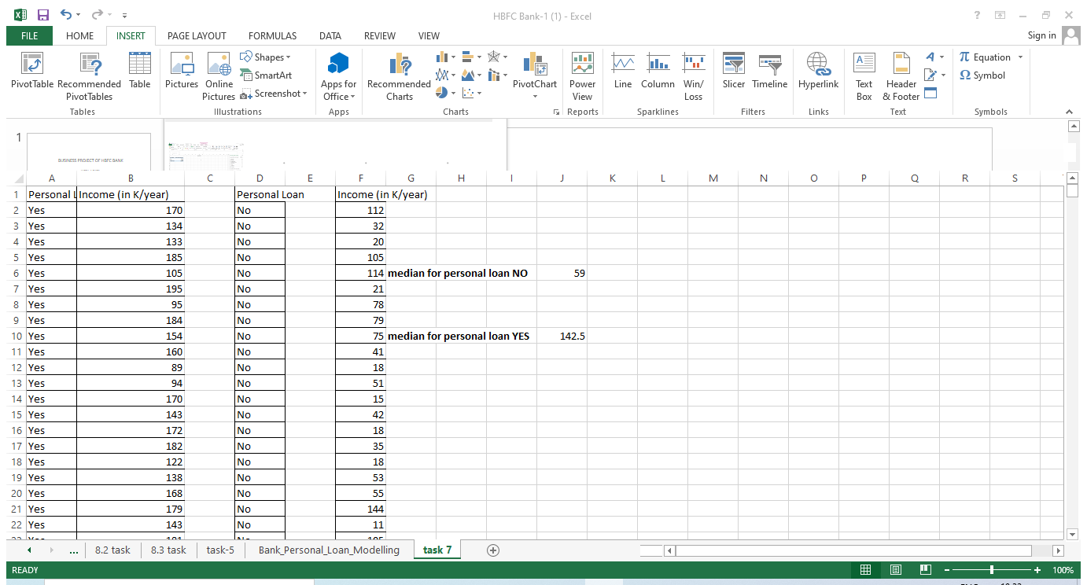

Slide 16
TASK-8 Create 4 separate Pivot Tables. Summarise your data by percentages. Education vs Personal Loan TD Account vs Personal Loan Online vs Personal Loan Income_Category vs Personal Loan
Approach used : clicked-> insert button on the top of the window and selected the pivot table icon , and clicked on the new location.
The pivot table got created and selected and dragged the education into the Row field and dragged the personal loan into the value field and column field as well . And changed the field settings to the percentage.
Step2 : again clicked-> insert button on the top of the window and selected the pivot table icon , and clicked on the new location.
The pivot table got created and selected and dragged the TD Account into the Row field and dragged the personal loan into the value field and column field as well . And changed the field settings to the percentage.

Slide 17
Step3:
again clicked-> insert button on the top of the window and selected the pivot table icon , and clicked on the new location.
The pivot table got created and selected and dragged the Online into the Row field and dragged the personal loan into the value field and column field as well . And changed the field settings to the percentage.
Step4:clicked-> insert button on the top of the window and selected the pivot table icon , and clicked on the new location.
The pivot table got created and selected and dragged the Income_Category into the Row field and dragged the personal loan into the value field and column field as well . And changed the field settings to the percentage.
OUTPUT:

Slide 18
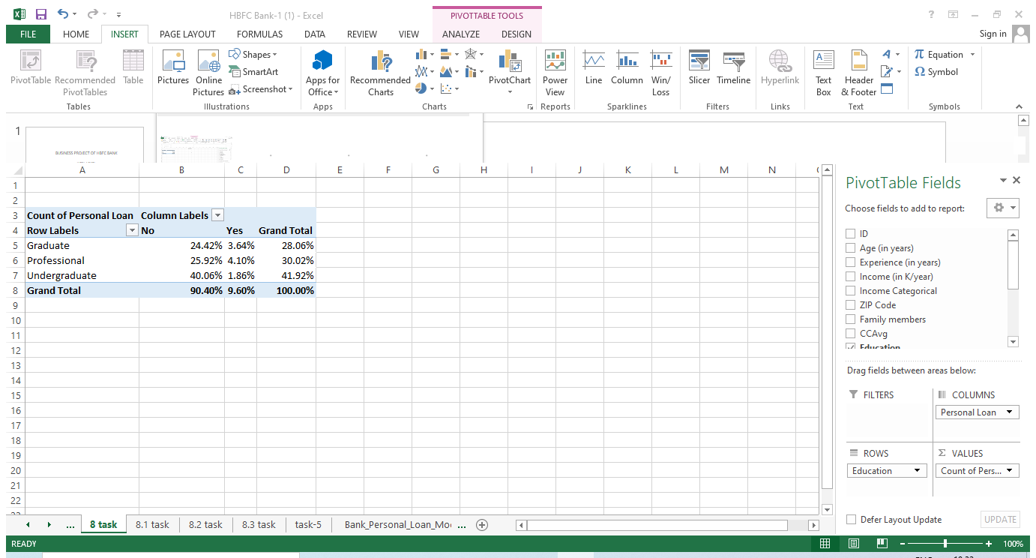

Slide 19
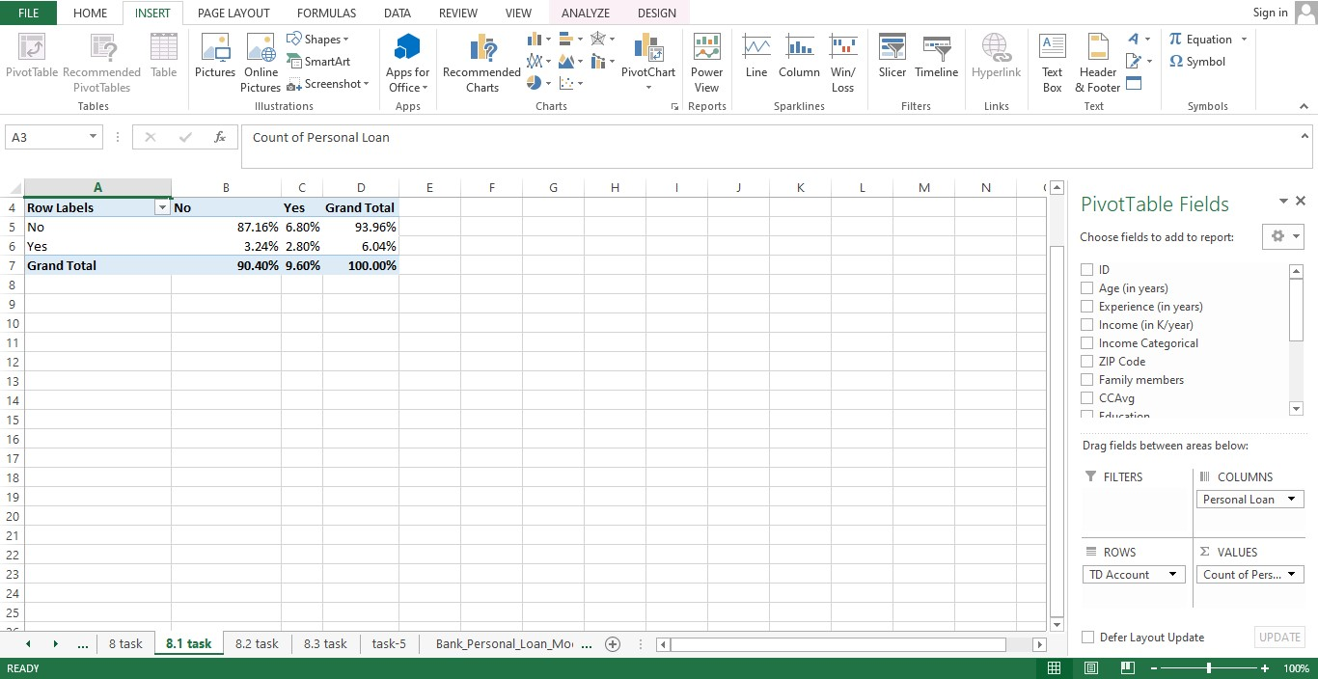

Slide 20
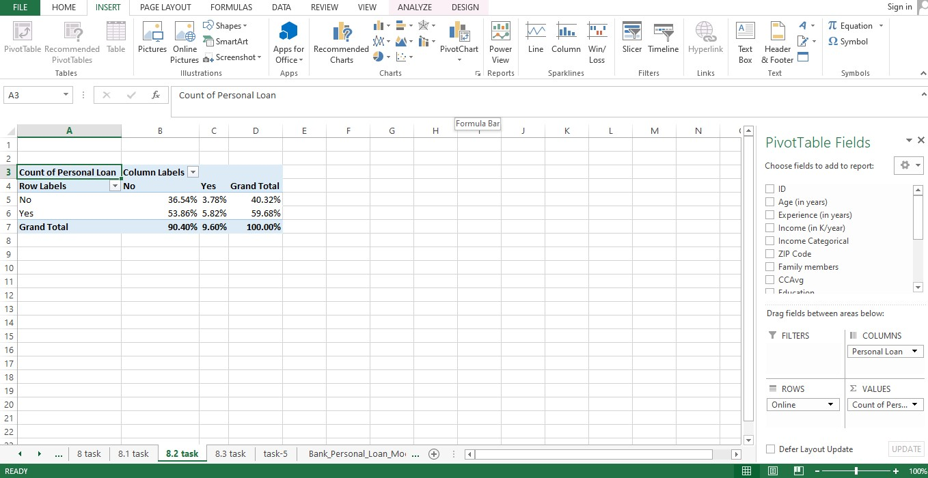

Slide 21
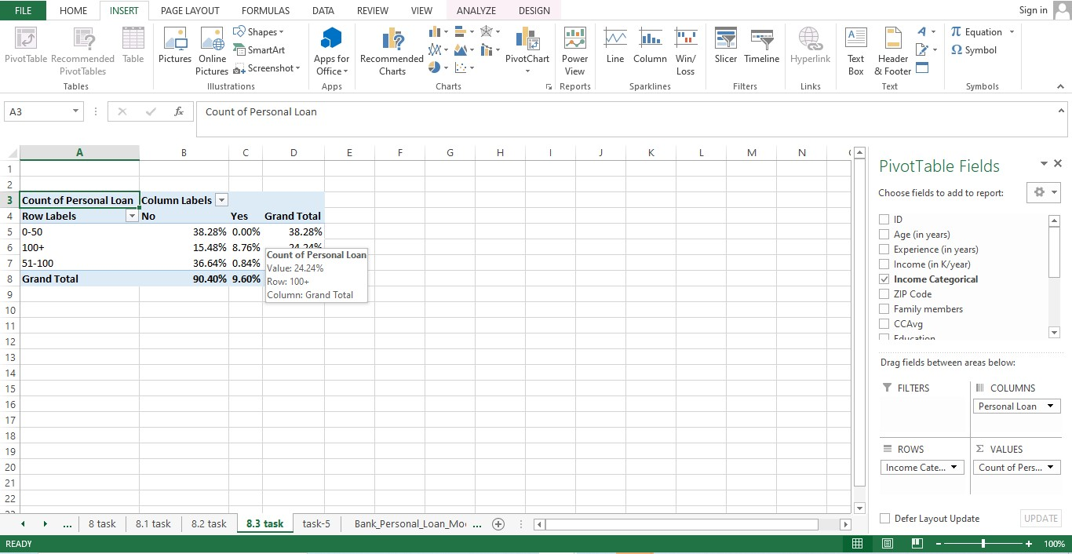

Slide 22
TASK-9 Analyse the Pivot tables created in the previous question and state any anomaly that you observe. Which categorical variables appear most important for your further study if you want to analyse which customers are most likely to take personal loans.
Approach : Based on the pivot tables created in the previous question, one anomaly that stands out is that the "Marital Status" category has a significant number of missing values, which may impact the accuracy of the analysis.
In terms of categorical variables that appear most important for further study to analyze which customers are most likely to take personal loans and why, "Education Level", "Employment Type", and "Income Category" are crucial. These variables may provide insights into the relationship between education, employment, income, and the likelihood of taking a personal loan. Additionally, "Loan Term" and "Interest Rate" could also be relevant, as they may impact customers' decisions to take personal loans.
In simple words, to understand which customers are more likely to take personal loans and why, we need to further investigate variables such as education level, employment type, income category, loan term, and interest rate, as they may provide valuable insights into customers' loan decision-making process. Additionally, addressing the issue of missing values in the "Marital Status" category is crucial for accurate analysis.

Slide 23
TASK-10 In the last campaign, bank reached out to 5000 customers out of which 480 customers accepted the personal loan offer. The bank incurred a huge cost in running a marketing campaign to reach out to so many customers. This is where you as a strategic business consultant step in. You are tasked to optimise the cost of this campaign by identifying the correct target base.
Approach :As a strategic business consultant, I would suggest implementing a data-driven approach to optimize the cost of the campaign for HBFC bank. Based on the analysis, the bank should identify key factors that are positively correlated with customer acceptance of personal loan offers, such as income level, employment type, loan term, and interest rate. By leveraging this information, the bank can narrow down the target customer base and focus on customers who are more likely to accept the offer, reducing marketing costs while maintaining a high acceptance rate. Additionally, conducting further research and analysis on customer preferences and behaviors can help refine the targeting strategy for maximum cost-effectiveness.

