Slide 1
Network Monitoring and Alert System
Bhavesh Chaudhary
Date: 2024-07-13

Slide 2
Introduction
Overview of the Project
Purpose: To monitor network devices and send alerts when devices go down or come back online.
Importance of Network Monitoring
Ensures network reliability and uptime.
Helps in early detection of network issues.
Reduces downtime and improves productivity.
Objectives of the Project
Automate the monitoring of network devices.
Send timely alerts to relevant stakeholders.
Log downtime and provide weekly reports.

Slide 3
Project Description
Description of the project and Its Functionality
designed to monitor the connectivity of network devices.
Uses an Excel file to store device details (name, IP address, email recipients).
How it Monitors Network Devices
It continuously pings the devices to check their connectivity status.
Tracks the status (up or down) of each device.
Alert Mechanism and Email Notifications
Sends email alerts when a device goes down or comes back online.
Customizable email content to provide detailed information.

Slide 4
Which devices compatible
In this project all network devices are included.
ISP lines
Firewall
Router
Switches
Access Points
Servers
Security Compliances
CCTV cameras
Gateway load balancing
Storage devices
Workstations and many more devices which is worked on network bases.

Slide 5
Benefits
Advantages of Using the Script
Automated network monitoring and alerting.
Timely detection of network issues.
Reduced downtime and improved network reliability.
How It Helps in Maintaining Network Stability
Early detection and resolution of network issues.
Continuous monitoring ensures high network uptime.

Slide 6
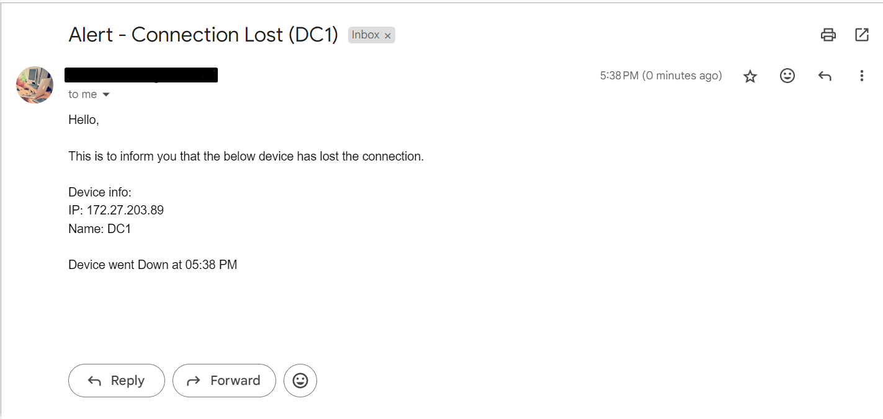
Demo
When device went down

Slide 7
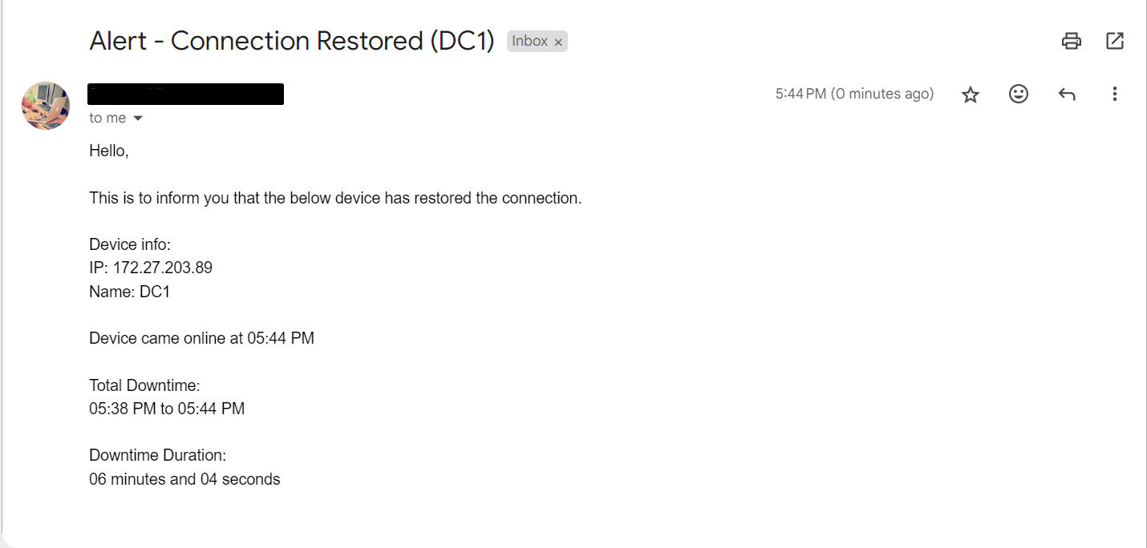
Demo
When device come back online

Slide 8
Q&A
Open the floor for questions from the audience.

