Slide 1
DawaiHaq
The Most Valuable Thing Is Your Health

Slide 2

AGENDA
Creating a network between patients, doctors and chemists and hence, making things easier for all of them. For instance, keeping medical records efficiently, creating paperless solution across nation.

Slide 3
About
01
Paperless
02
Biometric
03
Appointment
04
Selfcare
05
Data Privacy
06
Updates

Slide 4

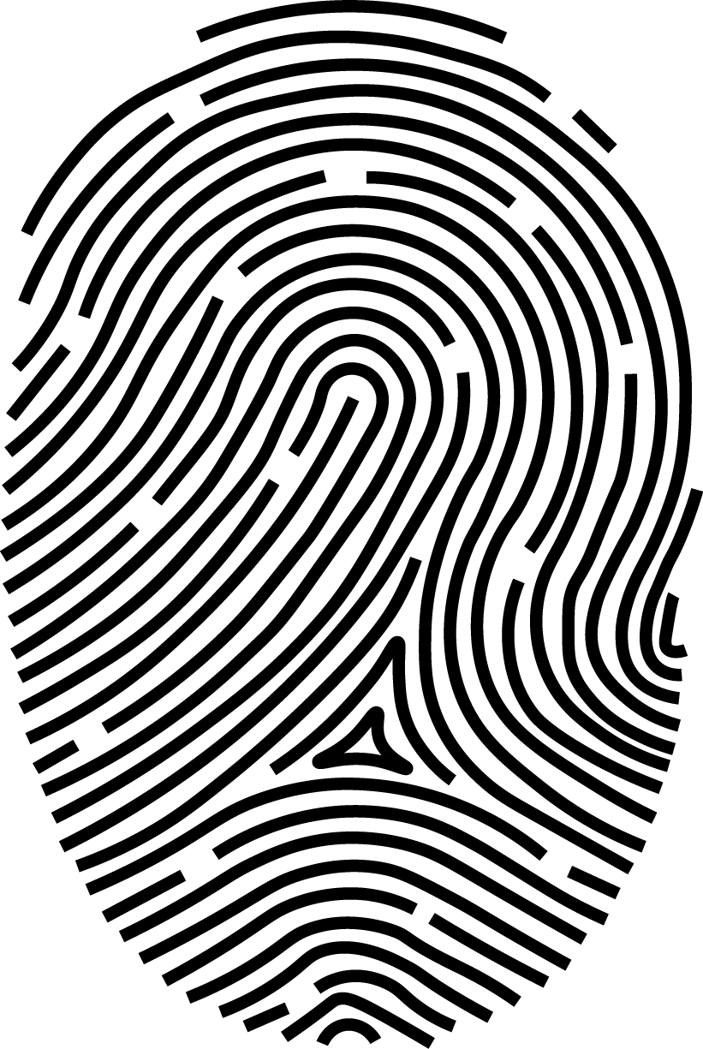




The Problem DAWAIHAQ Solve
Paperless
Biometric
Appointment
Updates
Providing a paperless database/record management system to the users which makes it easier to manage and access medical history of a patient
Immediate access to patient’s details like Blood group and diseases in an instance using biometric authentication during an emergency.
For your first visit to hospital, registration and appointment with doctor is made simpler. All you have to do is verify yourself using ID, and view all your recent and previous appointments .
We keep the patients profile up to date for ease . Appointments and Prescription data is updated as per the visits .
Patient privacy is your right to decide when, how, and to what extent others may access your health information. Patient privacy maintains confidentiality and only shares PHI with those who need it to provide or improve medical care.
In healthcare, self-care is any necessary human regulatory function which is under individual control, deliberate and self-initiated.
Data Privacy
SelfCare

Slide 5
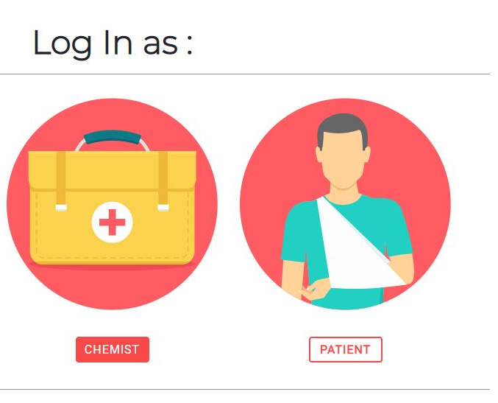
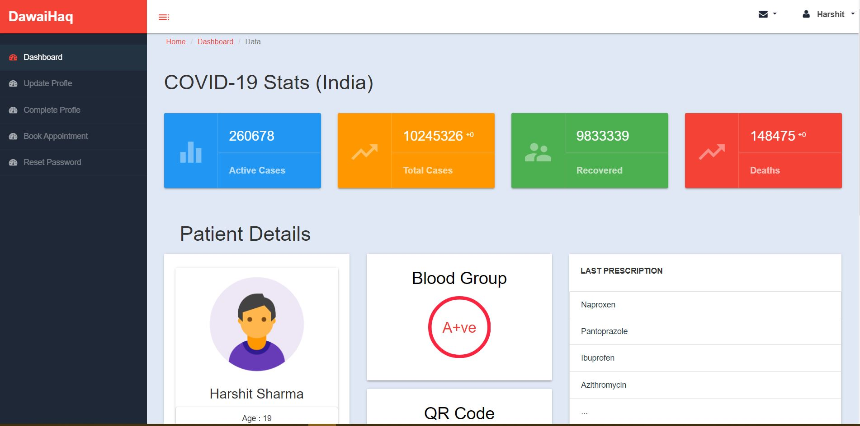
Patient’s Profile
Patient can check his/her profile by signing in as patient and a unique QR code on his/her dashboard. This page will provide complete info of the patient and his medical history which can be accessed anytime.

Slide 6
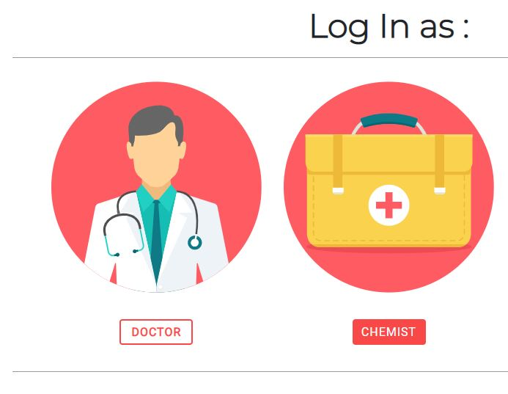
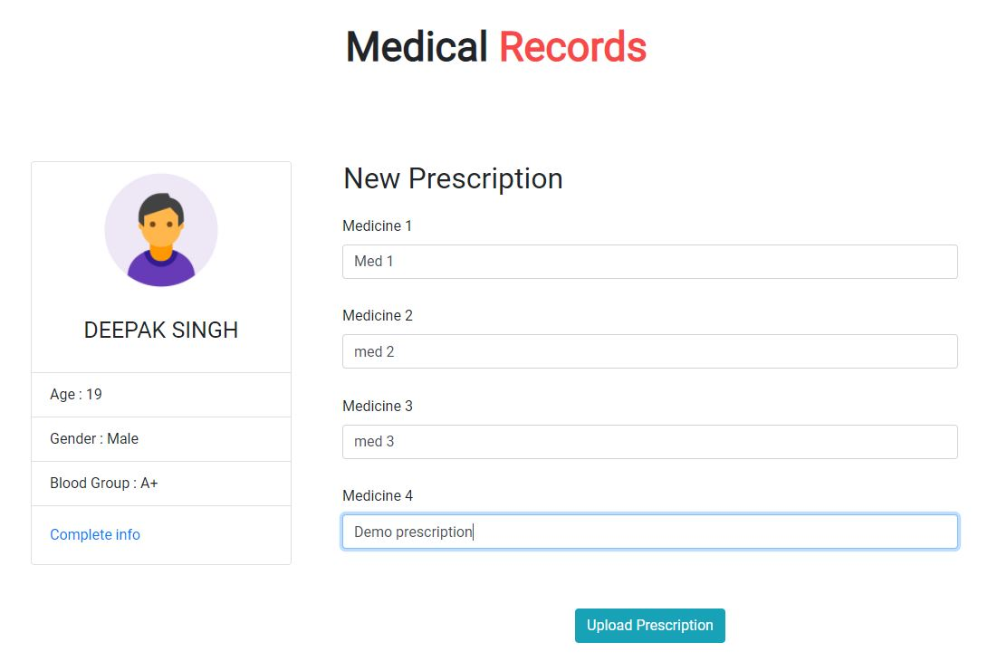
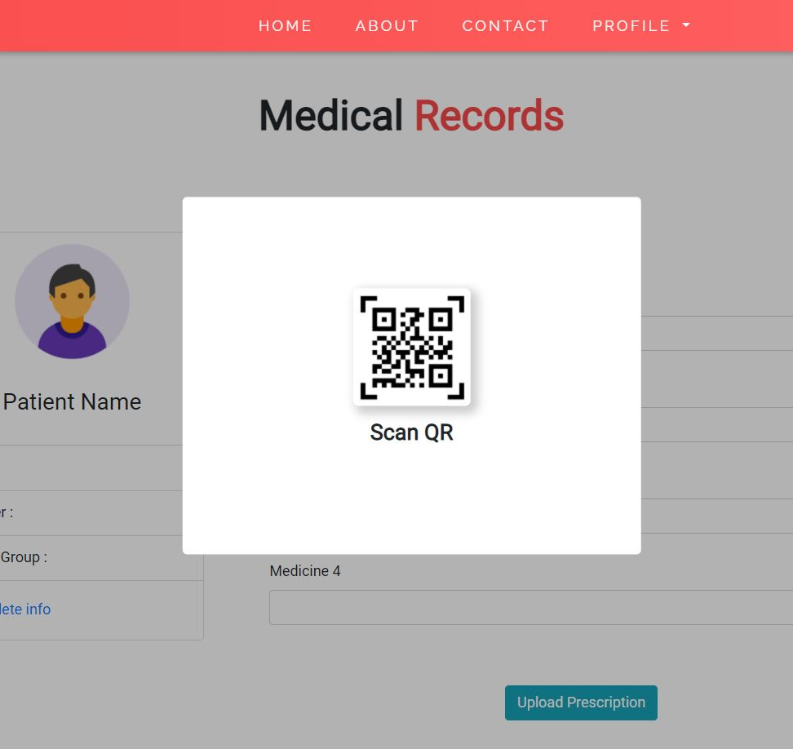
Doctor’s Page
This page provide the doctor access to patient's info and ability to write a new prescription for the patient . (Patient's QR Code needs to be provided to access this page)

Slide 7
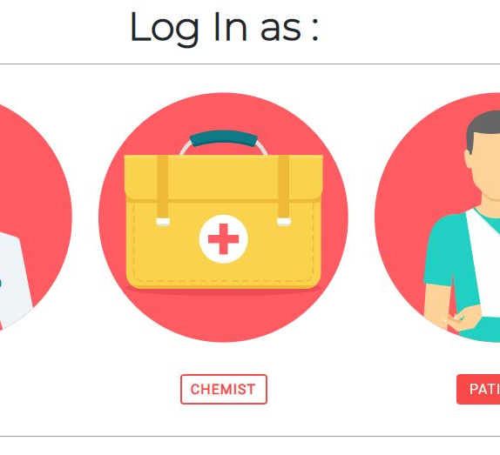
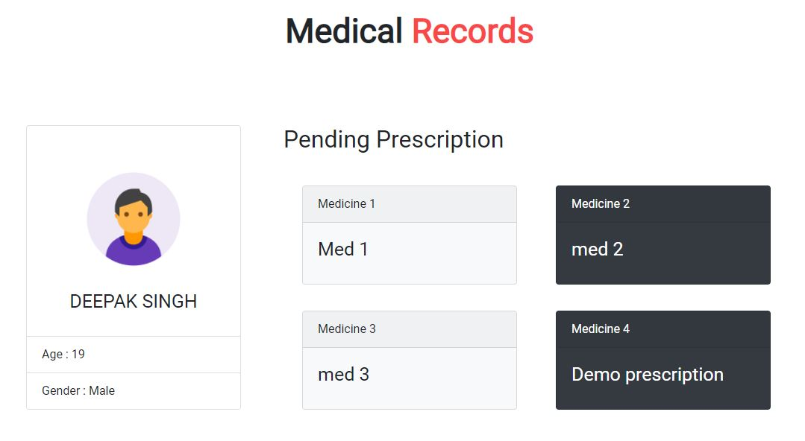
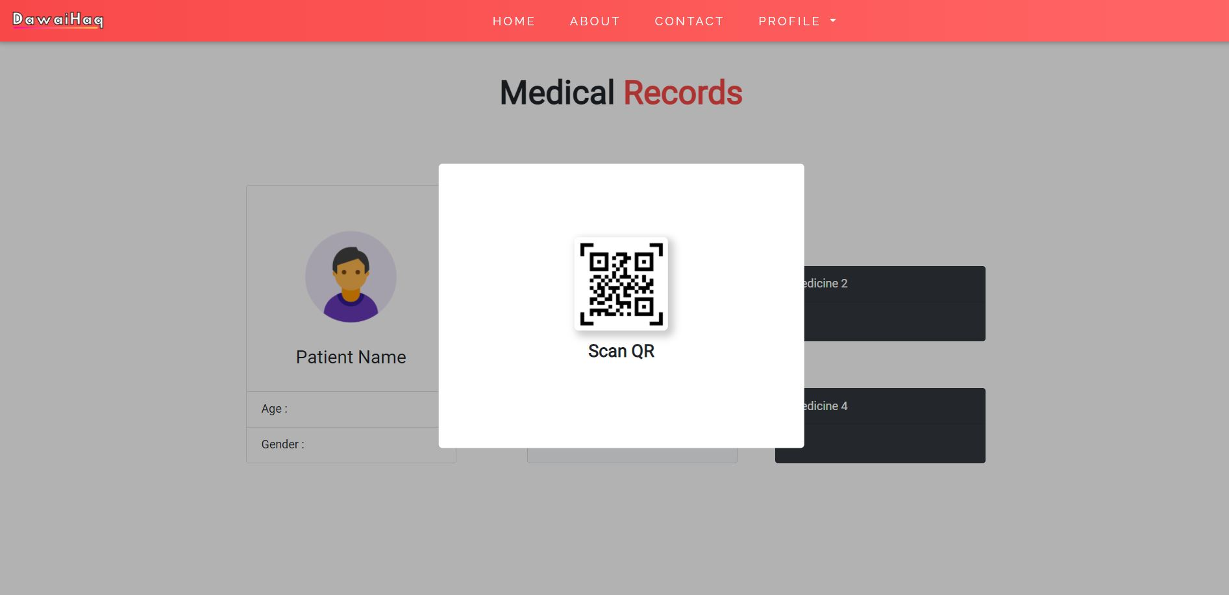
Chemist’s Page
This page provide the chemist access to patient's name ad age and the latest prescription given to the patient . (Patient's QR Code needs to be provided to access this page)

Slide 8
Future Plans
Connecting, Chemists, Doctors and Patients altogether.
Making things easier for doctors, patients & chemists.
Least discrepancy of the harmful drugs/medicines.
Regular updates to patients regarding their health.
Suggestions for better maintaining health.
Creating a network for better future.

Slide 9
The Problem DAWAIHAQ Solve
India doesn't have a centralized database system for medical records of individuals residing in the country. People have to rely on stacks of files for keeping record of their medical history.
As a sector that strives to establish a healthy world, digitalization or the paperless operations system in healthcare industry is a necessity than a need. Currently, there is very less transparency or flow of information between chemists & doctors which results in discrepancies and misuse of drugs, and eventually leads to various malpractices.
Using the centralized database, this problem can be tackled by making the prescription digital and link to the patient's unique ID and later connecting all of this with the Aadhar Card for Biometric Authentication. Healthcare biometrics allow users to access applications and patient data quickly - clinicians simply touch a fingerprint scanner and get instant access to the records they need on any workstation and this can help during emergencies/which require instant treatments.
In healthcare, self-care is any necessary human regulatory function which is under individual control, deliberate and self-initiated. We keep the patients profile up to date for ease . Appointments and Prescription data is updated as per the visits. Our primary focus would be the civil/government hospitals because they have a potential target audience that need this system primarily.

Slide 10


OUR TEAM
Harshit Sharma
Bhavika Malhotra

Slide 11
Thank You

