Slide 1
Identifying Notable Objects from Spitzer Enhanced Imaging Astronomical Observations
IBhojwani, AlexanderTyan, Sun-Kev, tamos
June 1, 2018
CMSC 12300
The University of Chicago
Notes:
Kevin

Slide 2
Goals
Identify and locate notable objects (outliers) within the sky
Define an area of interest around that object
Narrow down search area for manual analysis
Notes:
Kevin
- A whole lot of data without any good way of parsing through it all
- Currently and unsolved problem
- And so, we have the following goals...

Slide 3
Approach
Excess infrared light could mean:
Young Stellar Objects
Active Galactic Nucleii
Colliding Galaxies
Notes:
Kevin
- Young Stellar Objects: stars in early stages of evolution, protostars and pre main sequence stars. (For reference, our Sun is a main sequence star) -> infrared light means a younger star
- Active Galactic Nucleii - region at center of galaxy that has much higher than normal luminosity

Slide 4
Hypotheses: Young Stellar Objects
Notable objects can be identified as extrema in terms of infrared light
Some notable objects are grouped into interesting structures
Notes:
Kevin

Slide 5
Data
NASA/IPAC Infrared Science Archive:
Wide-field Infrared Survey Explorer (WISE)
Identifies objects, and readings on the energies they emit
800m objects (records), 815 GB
Contains:
Location (right ascension, declination)
Movement
Colour
Readings across a number of bands
Notes:
Ishaan

Slide 6
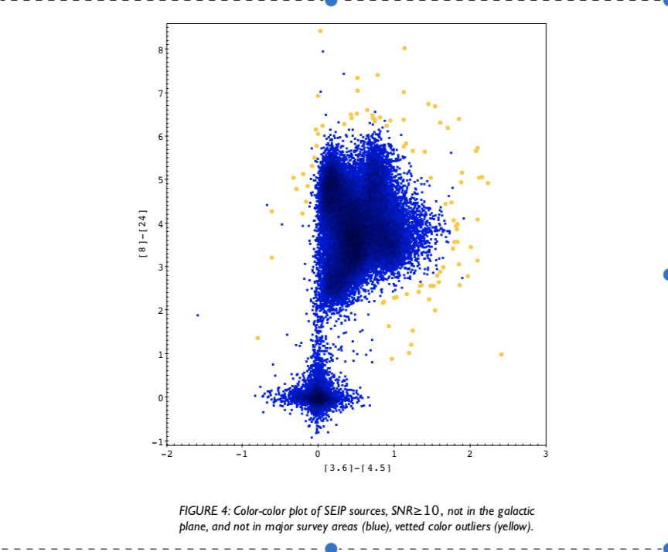
Unexpected Colour Interesting Object
Source: Gorjian et al.
Notes:
Ishaan

Slide 7
Algorithm I

Slide 8
Algorithm I, Step 1: Preprocessing with K-Means Classification
Canned K-Means (Dataproc Pending)
Split points into two groups, ~ N within each
Notes:
Ishaan

Slide 9
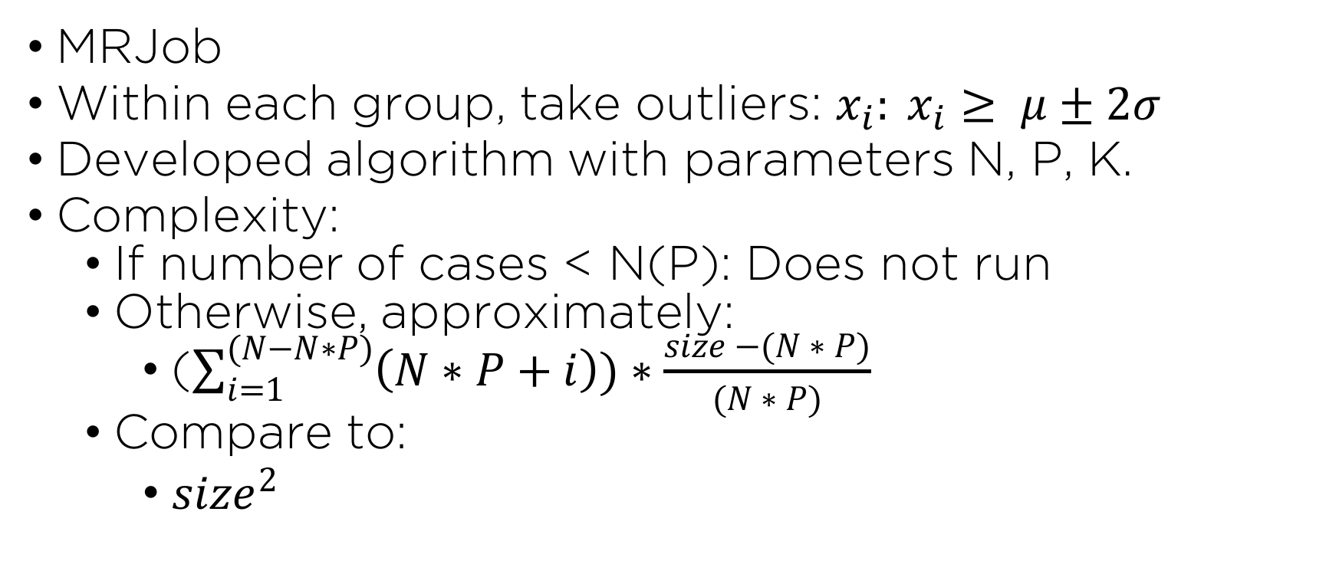
Algorithm I, Step 2: Outliers as Nodes, Distances as Edges
MRJob
Within each group, take outliers: $x_{i}: x_{i}≥ μ±2σ$
Developed algorithm with parameters N, P, K.
Complexity:
If number of cases < N(P): Does not run
Otherwise, approximately:
($\sum_{i=1}^{(N−N∗P)}{\left(N∗P+i\right))∗\frac{size −(N ∗ P)}{(N ∗ P)}}$
Compare to:
${size}^{2}$
Notes:
Tyler

Slide 10
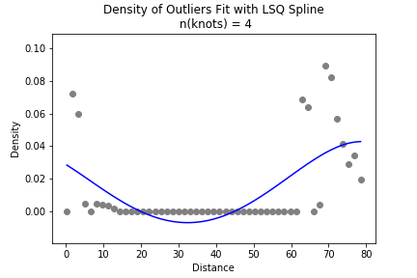
Algorithm I: Distance Density with Fitted Spline
Notes:
Tyler

Slide 11
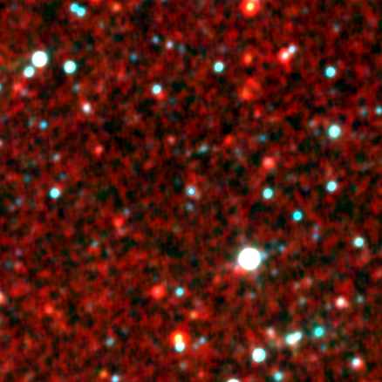
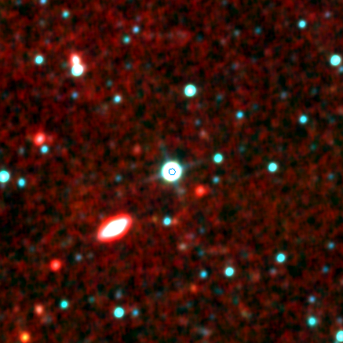
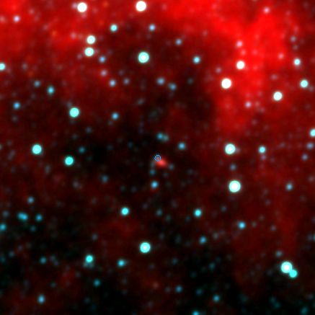
Algorithm I: Results
Notes:
Tyler

Slide 12
Algorithm II

Slide 13
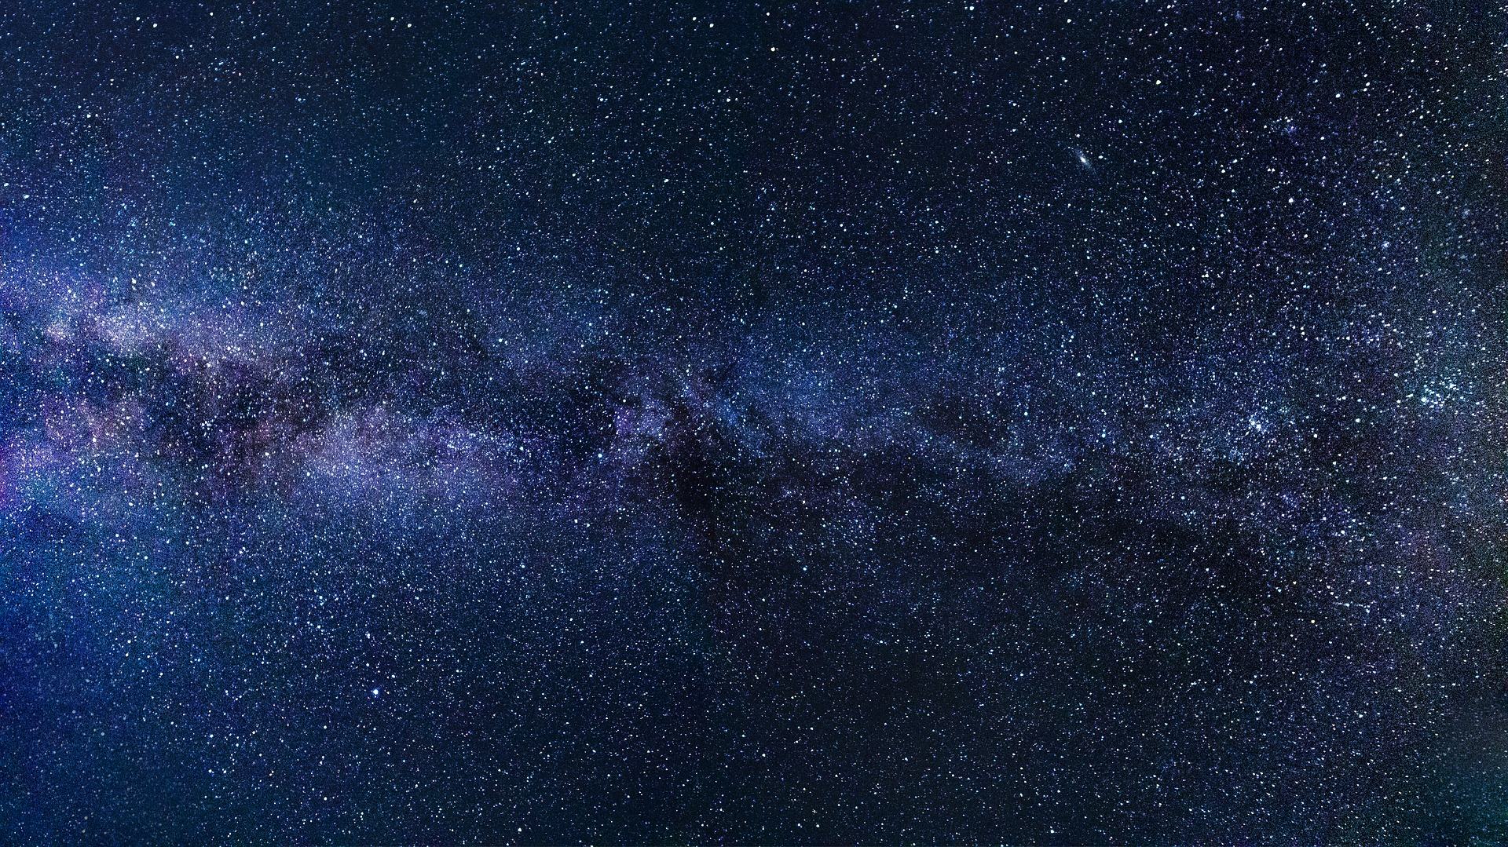
Algorithm II (MapReduce)
Step 1: Split Sky (Dataproc Implementation in Progress)
Create grids of the entire sky
Create graphs of each grid
Notes:
Sasha

Slide 14
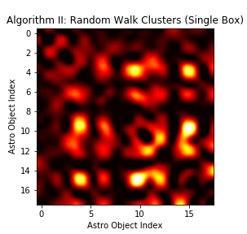
Algorithm II (MapReduce)
Step 1: Split Sky (Dataproc Implementation in Progress)
Create grids of the entire sky
Create graphs of each grid
Step 2: Random Walk
(Dataproc in Progress)
Step 3: Find Probabilistic Clusters (Coding In Progress)
Notes:
Sasha

Slide 15
Runtime Comparison
Algorithm I
Algorithm II (RandomWalk)
Local:
85 min. 51 sec.
365,601 rows
Dataproc:
8 min. 44 sec.
25 workers with n1-standard-4 specs
358,169 rows
Local:
16 min. 9 sec.
365,601 rows
Dataproc:
In Progress
Notes:
Tyler

Slide 16
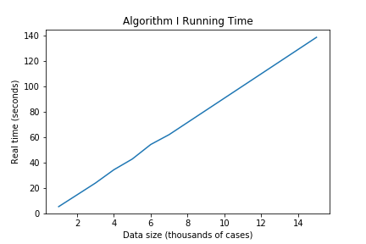
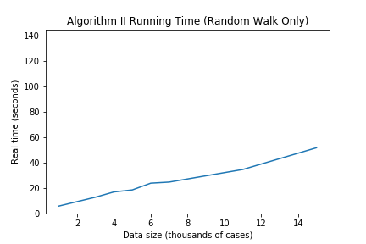
Runtime Comparison
Algorithm I
Algorithm II (RandomWalk)
Notes:
Tyler
Extrapolate Algorithm I Runtimes: for 800 mil rows -> ~2054.7 hours
Extrapolate Algorithm I Runtimes: for 800 mil rows -> ~767.2 hours

Slide 17
Challenges
Problems:
Graph algorithms without all data in memory (sky is too large)
Complexity too great for a fully connected graph
Solutions:
Running random sample (Algorithm I)
Grids and streaming processing (Algorithm II)
Notes:
Tyler

Slide 19
Algorithm 1 Implementation
Initialize a node list (Map 1)
for each object: (Map 1)
add the object to our node list
if the node list is too large: remove nodes at random until the list is size N(P):
If the node list is sufficently full (size N(P)):
yield the object's id and distance to each node
For each object (Reduce 1)
take K edges (the closest K)

Slide 20
Algorithm 1 Implementation (Cont'd)
For each object (Map 2)
Create a density function of distances from the object
Fit a spline function along this density curve
Find the first saddle point in this spline, usually a local minimum
If the first saddle point is less than 1 return the object and its saddle point

Slide 21
Algorithm 2 Implementation
Grids:
r x c grids -> bite-sized chunks
Output key: grid id

Slide 22
Algorithm 2 Implementation (Cont'd)
Random Walk
Fully connected graphs w/ distance$^{-1}$ as edge weight
Random walks on graph -> gradient of re-visit frequency

Slide 23
Algorithm 2 Implementation (Cont'd)
Watershed Algorithm:
Segmentation of the "image" - i.e, gradient

Slide 24
Code: https://github.com/ibhojwani/seip_big_data

