Slide 1
Identifying Notable Objects from Spitzer Enhanced Imaging Astronomical Observations
IBhojwani, AlexanderTyan, Sun-Kev, tamos
June 1, 2018
CMSC 12300
The University of Chicago

Slide 2
Goals
Identify notable objects (outliers)
Locate notable objects within the sky
Define an area of interest around that object

Slide 3
Approach
Excess infrared light could mean:
Young Stellar Objects
Active Galactic Nucleii
Colliding Galaxies

Slide 4
Hypotheses: Young Stellar Objects
Notable objects can be identified as extrema in terms of infrared light
Some notable objects are grouped into interesting structures

Slide 5
Data
NASA/IPAC Infrared Science Archive
Wide-field Infrared Survey Explorer (WISE)
Identifies objects, and readings on the energies they emit
800m objects (records), 815 GB
Contains:
Location (right ascension, declination)
Movement
Colour
Readings across a number of bands

Slide 6
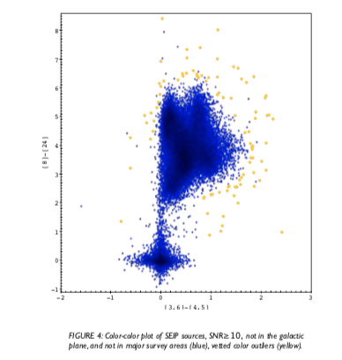
Unexpected Colour Interesting Object
Source: Gorjian et al.

Slide 7
Data
NASA/IPAC Infrared Science Archive
Wide-field Infrared Survey Explorer (WISE)
Identifies objects, and readings on the energies they emit
800m objects (records), 815 GB
Contains:
Location (right ascension, declination)
Movement
Colour
Readings across a number of bands

