Slide 1
Identifying Notable Objects from Spitzer Enhanced Imaging Astronomical Observations
IBhojwani, AlexanderTyan, Sun-Kev, tamos
June 1, 2018
CMSC 12300
The University of Chicago

Slide 2
Goals
Identify notable objects (outliers)
Locate notable objects within the sky
Define an area of interest around that object

Slide 3
Approach
Excess infrared light could mean:
Young Stellar Objects
Active Galactic Nucleii
Colliding Galaxies

Slide 4
Hypotheses: Young Stellar Objects
Notable objects can be identified as extrema in terms of infrared light
Some notable objects are grouped into interesting structures

Slide 5
Data
NASA/IPAC Infrared Science Archive
Wide-field Infrared Survey Explorer (WISE)
Identifies objects, and readings on the energies they emit
800m objects (records), 815 GB
Contains:
Location (right ascension, declination)
Movement
Colour
Readings across a number of bands

Slide 6
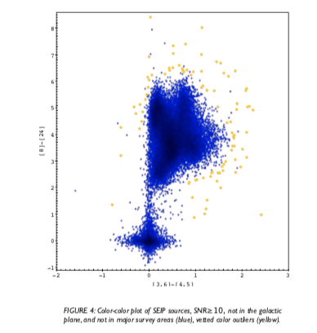
Unexpected Colour Interesting Object
Source: Gorjian et al.

Slide 7

Preprocessing with K-Means Classification
Canned K-Means in Spark
Split points into two groups, ~ N w/in themselves
Within each group, take outliers: $x_{i}: x_{i}≥ μ±2σ$

Slide 8
Algorithm 1: Outliers as Nodes, Distances as Edges
Developed algorithm with parameters N, P, K.
Complexity:
If number of cases < N(P): Does not run
Otherwise, approximately:
Insert BIG equation here
Compare to:
Insert size square equation

Slide 9
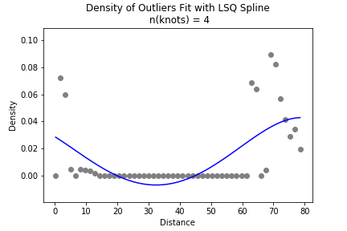
Algorithm 1: Distance Density with Fitted Spline
Algorithm 1 Details

Slide 10
Algorithm 2: Split Sky, Random Walk, Watershed
Algorithm 1 Details

Slide 11
Algorithm 2: Part I: Split Sky
Create grids of the entire sky
Create graphs of each grid

Slide 12
Algorithm 2: Part II: Random Walk
Random walks on graph to produce gradient

Slide 13
Algorithm 2: Part III: Watershed
Watershed algorithm to define dividing lines on gradient

Slide 14
Approaches and Tools
Spark (clustering)
MapReduce (mrjob)

Slide 15
Runtime examples
look how slow it would be without parallelism
look how fast it would be

Slide 16
Challenges
Problem: Graph algorithms without all data in memory; complexity too great for a fully connected graph
Solution: Running random sample (Algorithm 1)
Problem: Entire sky too large for Algorithm 2
Solution: Grids and streaming processing

Slide 17
Results

Slide 18
Results

Slide 19
Results

Slide 20
Algorithm 1 Implementation
Initialize a node list (Map 1)
for each object: (Map 1)
add the object to our node list
if the node list is too large: remove nodes at random until the list is size N(P):
If the node list is sufficently full (size N(P)):
yield the object's id and distance to each node
For each object (Reduce 1)
take K edges (the closest K)

Slide 21
Algorithm 1 Implementation (Cont'd)
For each object (Map 2)
Create a density function of distances from the object
Fit a spline function along this density curve
Find the first saddle point in this spline, usually a local minimum
If the first saddle point is less than 1 return the object and its saddle point

Slide 22
Algorithm 1 Runtime
8 min. 44 sec.
25 workers with n1-standard-4 specs
358,169 rows

Slide 23
Algorithm 2 Implementation
Grids:
r x c grids -> bite-sized chunks
Output key: grid id

Slide 24
Algorithm 2 Implementation (Cont'd)
Random Walk
Fully connected graphs w/ distance$^{-1}$ as edge weight
Random walks on graph -> gradient of re-visit frequency

Slide 25
Algorithm 2 Implementation (Cont'd)
Watershed Algorithm:
Segmentation of the "image" - i.e, gradient

Slide 26
Code: https://github.com/ibhojwani/seip_big_data

