Slide 1
Selenium overview
Yingying Xiong
2018/09/28

Slide 2
Agenda
What’s Selenium?
How Selenium works?
Set Up: Installation
Write a Selenium Test Script
Conclusion

Slide 3
What Is Selenium?
a free (open source) automated testing suite for web applications
composed of multiple software tools:
Webdriver is the real industry automation testing tool.
Selenium IDE
Selenium Webdriver

Slide 4
How selenium works?
make direct calls to the browser using each browser’s native support for automation
Drive The Browser Directly
Programming Languages Supported by WebDriver: Java / Python / Ruby / PHP / Perl / .Net

Slide 5
第二次回来的时候退出演示
Commands in Python
Selenium
Web Browser

Slide 6
Set up: installation
Install Python
Install a Python IDE, i.e. Pycharm
Install Selenium Python Bindings Package for WebDriver
Install ChromeDriver, FirefoxDriver(geckodriver)

Slide 7
Write A test script
find_element_by_...(“…”)
find_element_by_id
find_element_by_name
find_element_by_xpath
find_element_by_link_text
find_element_by_partial_link_text
find_element_by_tag_name
find_element_by_class_name
find_element_by_css_selector

Slide 8
Example – HTML Element
讲完这一张，退出演示怎么找那两个复制
<select class="form-control select optional" name= "search_proxy[record_type]" id="search_proxy_record_type">
find_element_by_class_name(“form-control select optional”)
find_element_by_name("search_proxy[record_type]")
find_element_by_id("search_proxy_record_type")
<h1>Welcome</h1>
heading1 = driver.find_element_by_tag_name('h1’)

Slide 9
Write A Test Script
Importing this library, you can access the classes:
Webdriver.Chrome
Webdriver.Firefox
Webdriver.IE
Wedriver.PhantomJS
…

Slide 10
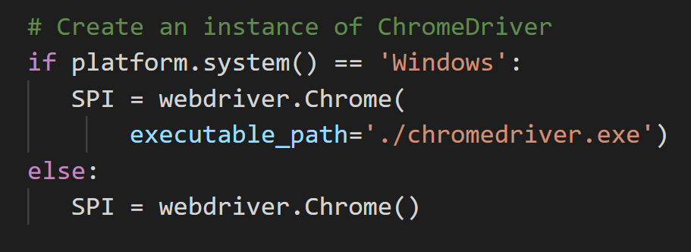
Write A Test Script

Slide 11
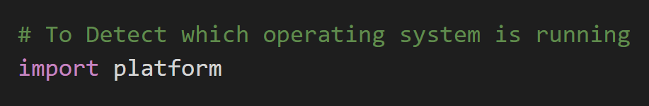
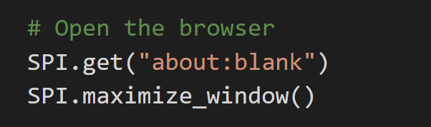
Write A Test Script

Slide 12
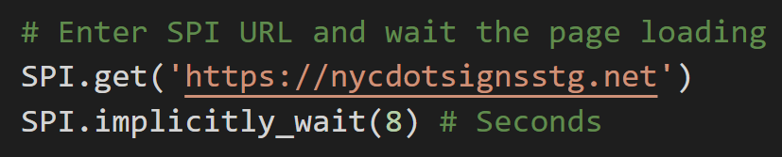
Implicit Wait:
An implicit wait tells WebDriver to poll the DOM(Document Object Model) for a certain amount of time when trying to find any element (or elements) not immediately available.
Explicit wait:
makes WebDriver wait for a certain condition to occur before proceeding further with execution

Slide 13
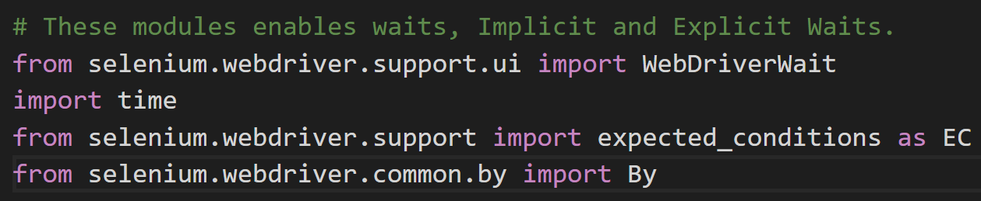
Write A Test Script

Slide 14
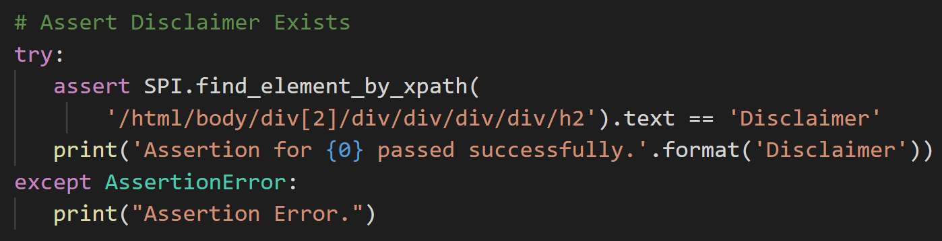
Write A Test Script

Slide 15
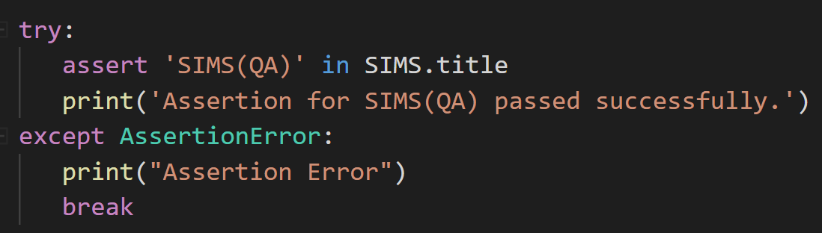
Asserttion
<head>
<title>SIMS(QA)</title>
</head>

Slide 16
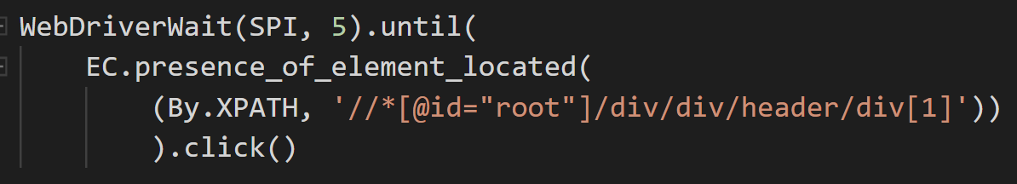
Write A Test Script
Explicit Wait, accompanied by Expected Condition (EC)

Slide 17
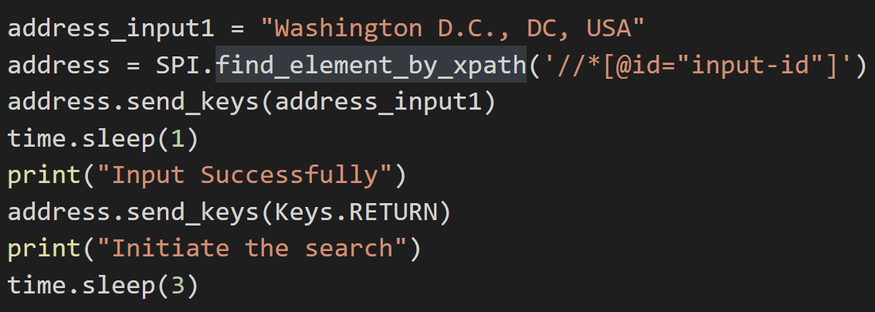
Write A Test Script

Slide 18
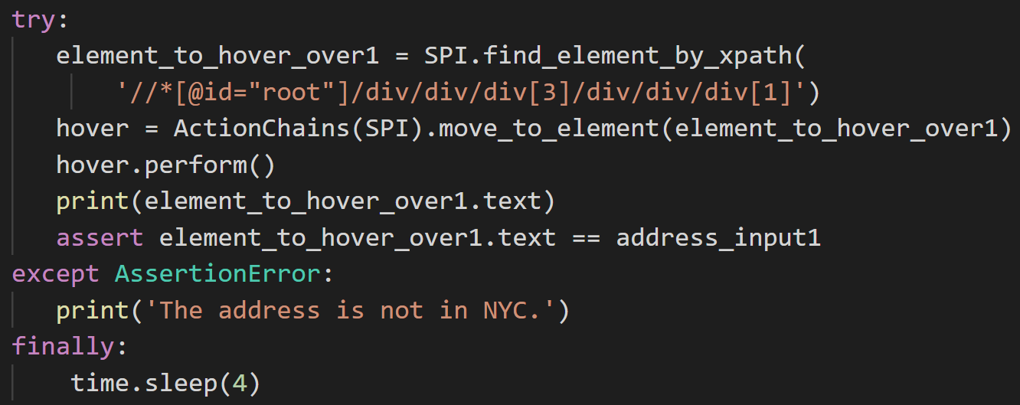
Write A Test Script

Slide 19
Write A Test Script
Mind Mapping
HTML Elements
Actions
Analyze Behavior
Find Element
Python Libraries / Modules
Workaround
Notes:
“find the element” means find the HTML elements, and “interact with the pages”, more specifically, is to interact with the HTML elements

Slide 20
Conclusion
Selenium Webdriver imitates a person to interact with the browser and webpages. So, it can do many testing.
The programming language is easy to learn and there’re many libraries and modules to use.
It doesn’t work well in testing about map, or to say, it’s hard to code a program about map actions.
And the coding person has to be careful and patient.

Slide 21
Demo (Add: link to the sims.py in DOT computer)

Slide 22
Thank You

Slide 23
Selenium IDe
Selenium webdriver
an integrated development environment for Selenium scripts
allows you to record, edit, and debug tests
implemented as a Firefox extension
a web automation framework that allows you to execute your tests
provide a programming interface
automate the web browser (Automation is giving commands to a browser.
back

Slide 24
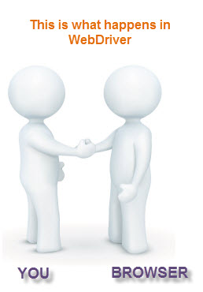



Slide 25
Xpath
XPath is a major element in the XSLT standard. It can be used to navigate through elements and attributes in an XML document.
Source 1: https://www.w3schools.com/xml/xpath_intro.asp
XPath is the language used for locating nodes in an XML document. As HTML can be an implementation of XML (XHTML), Selenium users can leverage this powerful language to target elements in their web applications. XPath extends beyond (as well as supporting) the simple methods of locating by id or name attributes, and opens up all sorts of new possibilities such as locating the third checkbox on the page.
Source 2: https://selenium-python.readthedocs.io/locating-elements.html

Slide 26
CSS Selector
In CSS, selectors are patterns used to select the element(s) you want to style.

Slide 27
It’s an interface.
An interface is a reference type, similar to a class, that can contain only constants, method signatures, default methods, static methods, and nested types. Method bodies exist only for default methods and static methods. Interfaces cannot be instantiated—they can only be implemented by classes or extended by other interfaces.

