Slide 1
MINI crawler
TAN

Slide 2
Webpage Analyze
1 Wikipedia (static)
2 US news (dynamic with url pagination)
3 Startclass (dynamic with button pagination)

Slide 3
Webpage Analyze - cont'd
1 Analyze all those 3 different kind of webpages
Async pages (dynamic stuff)
Static pages (Wikipedia)
Next page with urls
Next page with page buttons
2 Come up with a Mini-Crawler to cover all (actually almost all webpages)
3 Feature Engineering
4 Summary

Slide 4
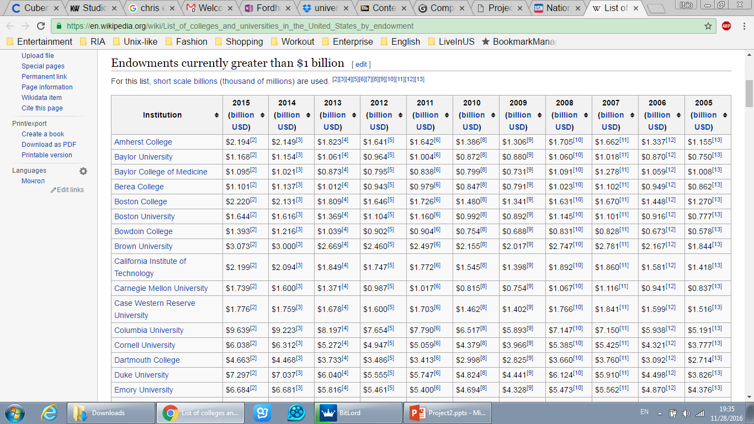
Webpage Analyze - cont'd
Static page
Only one page

Slide 5
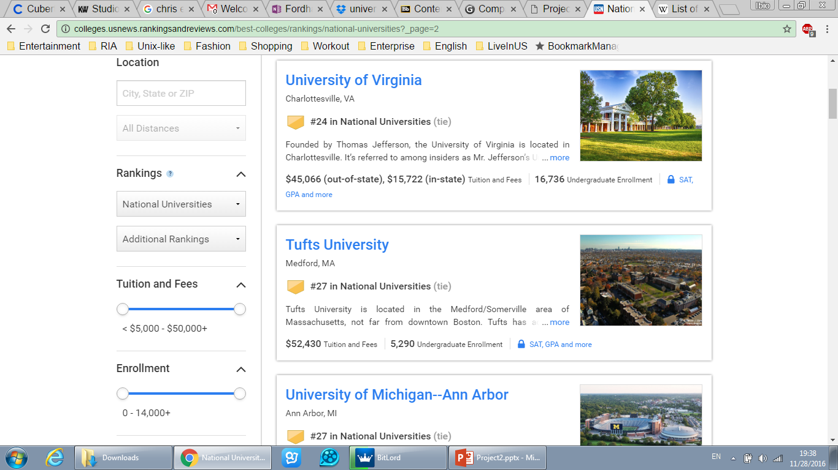
Webpage Analyze - cont'd
Dynamic page
Change url to next page

Slide 6
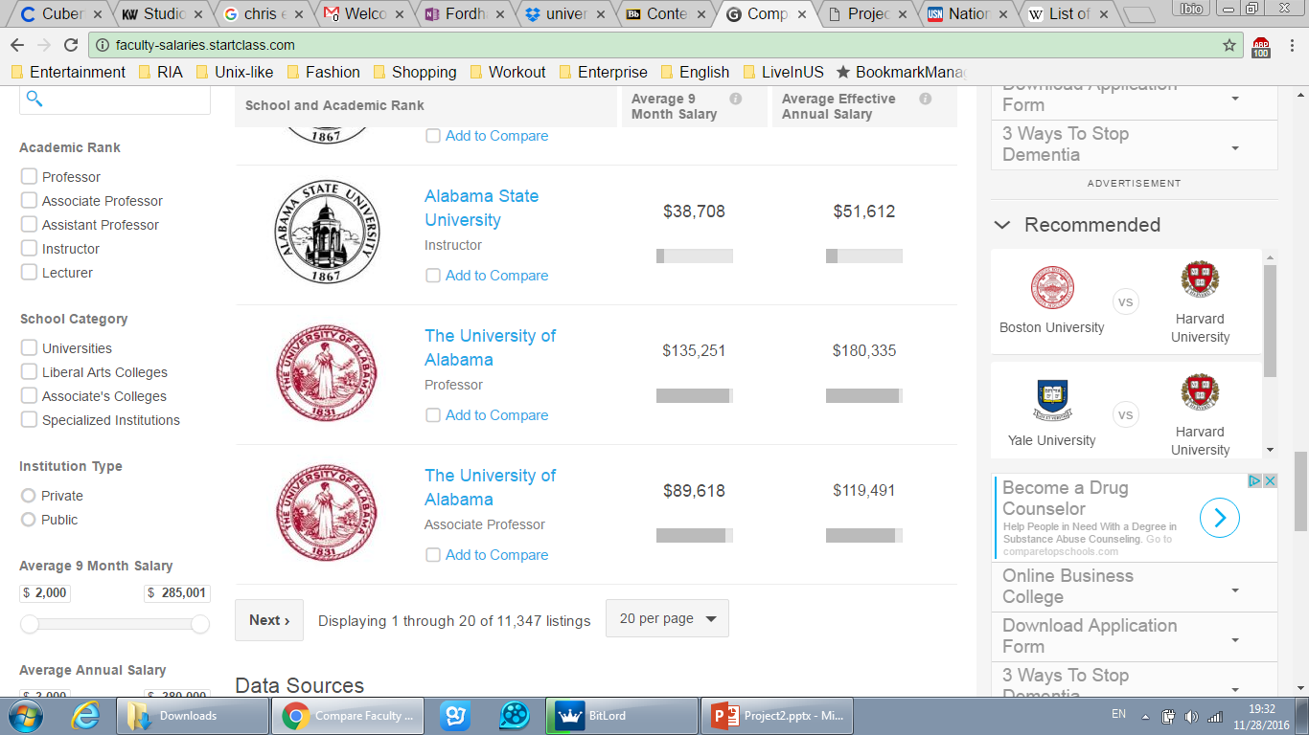
Webpage Analyze - cont'd
Dynamic page
Click it for the next page

Slide 7
MINI Crawler
Spider
crawl
getTotalKeys (leave it to sub class)
getCurrentPage (leave it to sub class)
gotoNextPage (leave it to sub class)
saveCurrentIndex
saveContentToWorkbook
Provider
load
getContent (leave it to different kernel)
navigate (leave it to different kernel)
quit

Slide 8
MINI Crawler - cont'd
1 Support “pause-rerun”
(Use ‘pickle’ to save current index in the local for re-running feature)
2 Differences between this and Scrapy
It can set different driver-kernels (PhantomJS, Firefox etc.)
Can simply use Requestor to fetch static pages, speed up the whole process
Easy to inherit (the core part code is from last project, you even did not change it )
Meet different needs (it can also do the project 1 job)

Slide 9
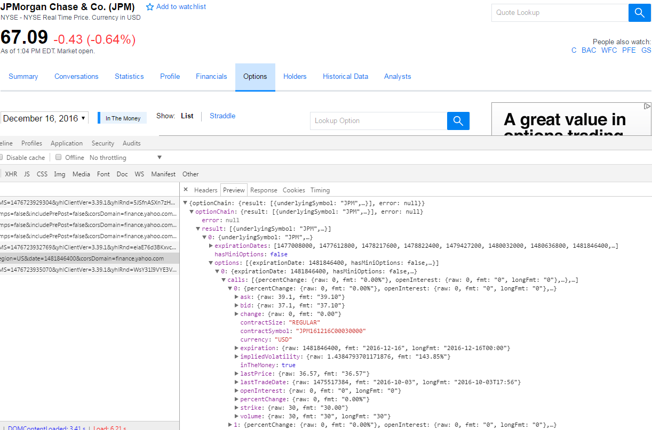
MINI Crawler - cont'd
Definitely can do this as well

Slide 10
Suppoer multiple different kernels
Only needs to have those TWO methods in subclass

