Slide 1
Intro to Git/Github
Pamela Camejo
Millennium Institute for Integrative Biology
https://github.com/ibioChile

Slide 2
Github
Platform for version control collaboration.
Largest web-based repository hosting service.
File or code sharing service.
Allows for code collaboration with anyone online.
https://github.com

Slide 3
2. How to use Github.
Create repository. A repository is the most basic element of GitHub. They're easiest to imagine as a project's folder. A repository contains all of the project files (including documentation), and stores each file's revision history. Repositories can have multiple collaborators and can be either public or private.
Fork (optional)/Branch.
Change/Add files.
Commit.
Create pull request.
Merge (owner of repository).
https://www.edureka.co/blog/how-to-use-github/

Slide 4
1. Install git
Linux (Debian)
$ sudo apt-get install git
Linux (Fedora)
$ sudo yum install git
Mac
https://git-scm.com/download/mac
Windows
https://git-scm.com/download/win

Slide 5
What is git?
Git is a version control system.
System that keeps records of your changes.
Allows for collaborative development.
Allows to know who made the changes and when.
Allows to revert any changes and go back to a previous state.
Recommended:
https://product.hubspot.com/blog/git-and-github-tutorial-for-beginners

Slide 6
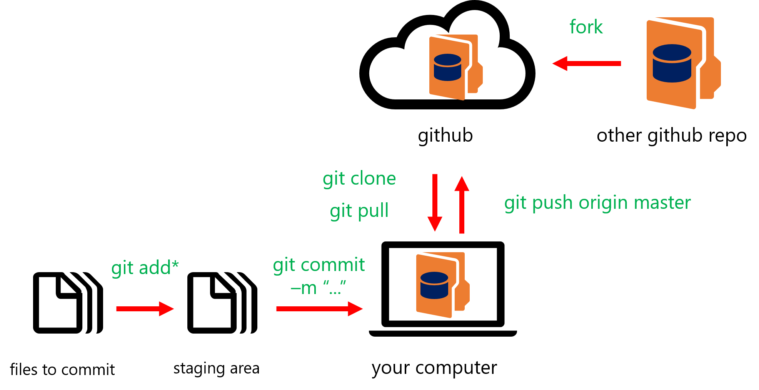
How does git work?
Snapshot
Notes:
Moverse a otra branch:
git checkout ‘branch’

