Slide 1
Modern Portfolio Theory
Visual Analytics
Ibis Prevedello

Slide 2
Outline
Introduction
Software Presentation
Principal Component Analysis (PCA)
Risk Return
History Graph
Dollar Cost Averaging (DCA)
Conclusion
Further Improvements

Slide 3
Introduction
Portfolio allocation strategy
Created by Harry Markowitz in 1952
Nobel prize winner for this strategy
Defines a risk return graph to help investors choosing a good allocation

Slide 4
Software Presentation
Dataset
S&P 500 stock data – Kaggle
Alpha Vantage API
Software parts
Principle Component Analysis (PCA)
Risk Return
History Graph
Dollar Cost Averaging

Slide 5
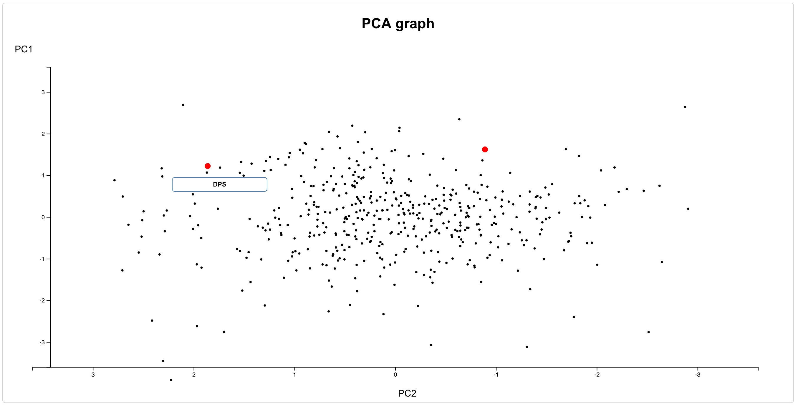
Software Presentation – Principal Component Analysis (PCA)
Used on correlation matrix of annual return of the S&P 500.
Goal of having companies with similar performance near each other

Slide 6
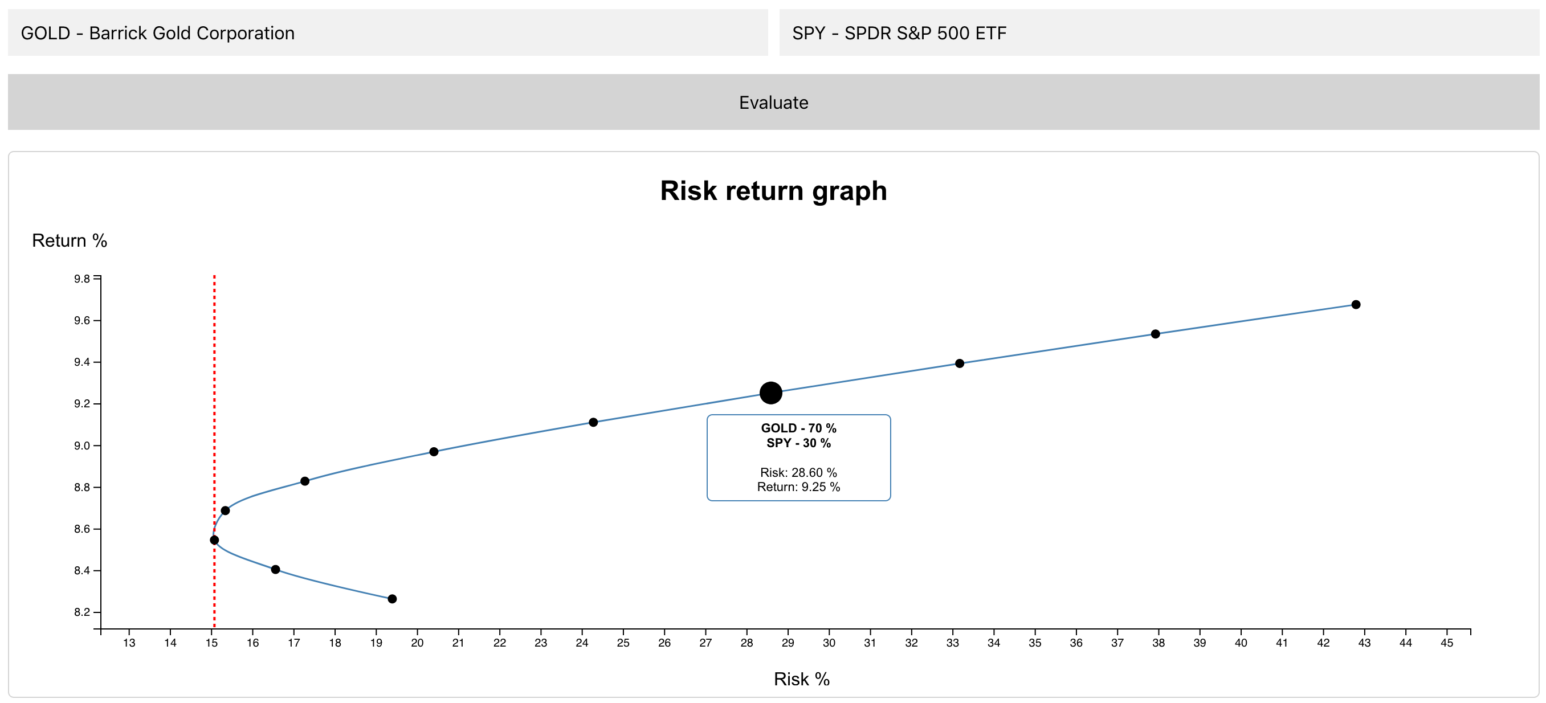
Software Presentation – Risk Return
Shows the risk return graph described by the Modern Portfolio Theory
Line in red represents the Efficient Frontier
Helps the user to define how much return he can expect given a risk

Slide 7
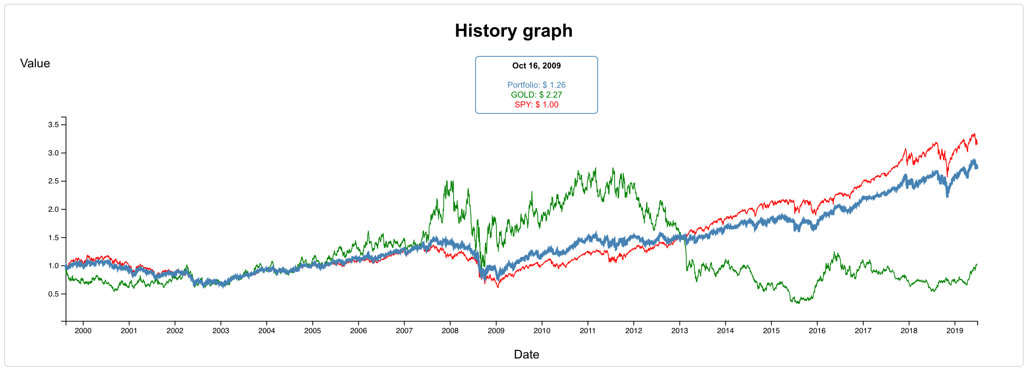
Software Presentation – History Graph
Shows the evolution of 1 dollar invested in both assets as well as the portfolio performance

Slide 8
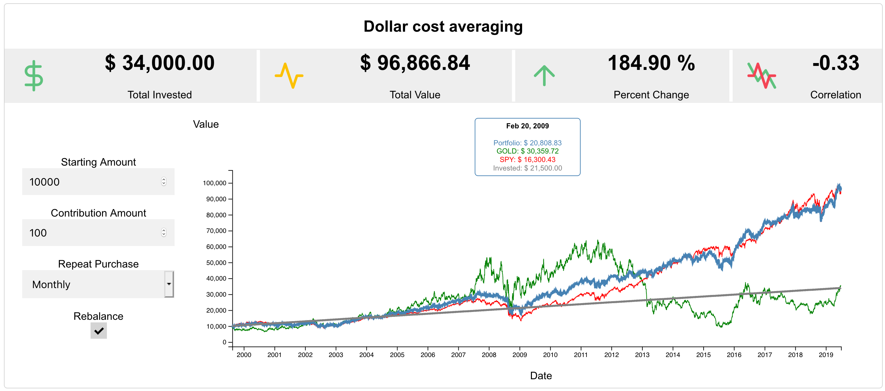
Software Presentation – Dollar Cost Averaging
Strategy to reduce volatility impact on a portfolio
Simulates how a frequent contribution would effect the overall portfolio performance
Give the user some variables to simulate the performance of a theoretical portfolio and shows some indicators

Slide 9

Conclusion
Inspired by the book "All About Asset Allocation" by Richard A. Ferry
Show how an easy strategy and tool can help people on choosing assets to invest
Show how Dollar Cost Averaging is one of the best approaches to outperform the market for long term investors

Slide 10
Further Improvements
Plot more then two assets for the risk return graph
Pay for the API in order to have more request
Calculate PCA to optimize portfolio, eliminating assets that are less relevant for diversification

Slide 11
Questions?

