Slide 1
noSQL 1
Peter Rodgers

Slide 2
Lecture Outline
What is noSQL?
Two noSQL DBMS
Key-Value Stores
Wide Column Store

Slide 3
Limitations of Relational Databases
Can be too rigid
Relational databases have a fixed schema, many DB applications do not
Not all applications are a good fit for the relational structure of tables and base data types
Relational DBs provide a lot of correctness guarantees
These come at a performance cost

Slide 4
What is noSQL?
not only SQL
Any non-relational persistent storage system
Common traits of noSQL systems:
Often lack ACID transactions, or have limited form
Uses different or more specialized underlying data structures
Often designed for the demands of distributed big data
Replication and redundancy possibly at both a distributed level and between records

Slide 5
Types of noSQL
Today, we look at:
Key-Value Stores
Wide Column (Row) Stores
But there are many more types of noSQL, for example:
Document Stores
Object-Oriented Databases
Graph Databases
Search Based
Triple (and Quad) Stores

Slide 6
Why noSQL?
The majority of databases in use at present are relational, using SQL:
http://db-engines.com/en/ranking
Similar project https://dbdb.io/
The database of databases

Slide 7
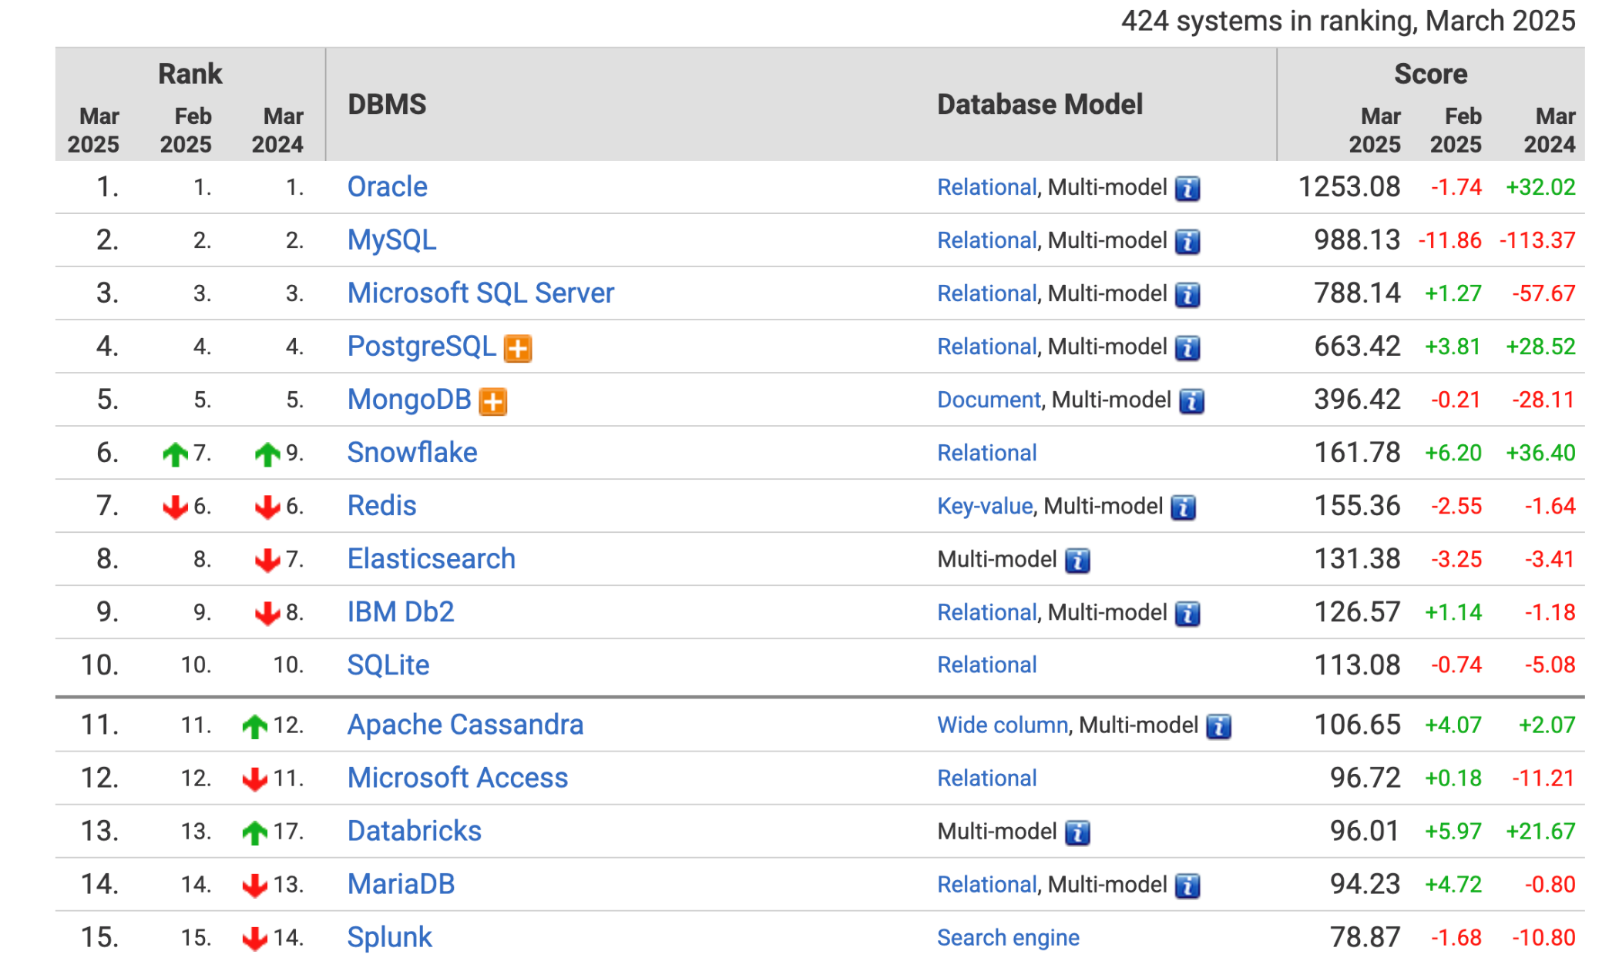
DB Engines March 2025

Slide 8
Relational Databases and SQL are not always the best choice (1/2)
Data is not always regular and structured
Up-front design may not match incremental software development approach
noSQL database often allow choice between implicit and explicit schemas
Consistency requirements can slow down transactions significantly
especially when data is distributed between machines
Flip side: weaker consistency can lead to bugs and more complex application code

Slide 9
Relational Databases and SQL are not always the best choice (2/2)
Join operations can be slow on large datasets
Using SQL with other languages can result in “impedance mismatch”
Going between native language and relational model may require complex code
Possibly causes poor performance
noSQL databases are often closer to “just another library”
e.g. operates like a hashmap/dictionary

Slide 10





Key-Value Stores

Slide 11
Key-Value Stores
Data is in pairs <key,value>. E.g.
user:name:345 = Wilhelm
Keys typically have some implicit structure
Perhaps the simplest form of storage
Like a persistent Java HashMaps
If you know the key, you can get the value
Atomic operations prevent concurrent write
key
value

Slide 12
Example: Redis
REmote DIctionary Server
All data in memory (i.e. database is entirely in RAM), with periodic disk syncing
Speeds up read and write access considerably
Other key-value stores have disk swapping, and so can store much more data
Partitioning over multiple machines is one solution to RAM limits

Slide 13
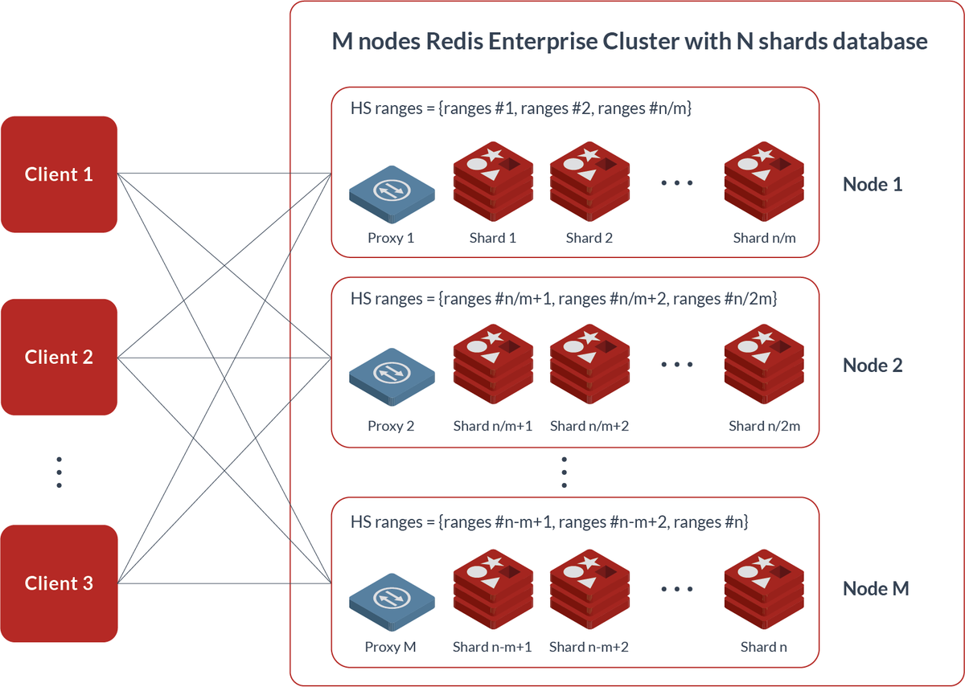
Example: Redis
Master-replica distribution of databases
Key ranges are distributed over machines
And may have replicas to compensate when master fails
https://redis.io/docs/manual/scaling/
https://redis.com/redis-enterprise/technology/linear-scaling-redis-enterprise/

Slide 14
Example: Redis
Bindings to various other languages
C++, .Net, Java, Erlang, Python, …
Various data types for values
including basic data types
collections such as
Lists
Sets
Hashsets

Slide 15
Redis Operations
No transactions as we know them, only command queues
No rollback etc because it has run-time overhead
Example of some simple operations:
SET account 36 – key is account, value is 36
GET account – returns the value for the key
someKeys = KEYS(id*) – returns the keys starting with id
Atomic operations, such as adding values or appending strings. Example: INCR account – add one to the account

Slide 16
Redis Atomic Operations
Why atomic operations? Because of concurrent access
There is manual optimistic locking support
Not using atomic operations:
Client A reads count as 10
Client B reads count as 10
Client A increments 10 and sets count to 11
Client B increments 10 and sets count to 11
Client A update is lost
With atomic operations
Client A increments count with atomic op, it is now 11
Client B increments count with atomic op, it is now 12
Client A update is retained
REDIS has support for Atomic and Isolated command groups (they call them transactions)
MULTI starts a transaction
Subsequent commands are queued
All commands are executed with EXEC, giving all-or-nothing and isolation

Slide 17
Datasets with Redis
Datasets can be stored in various ways. For example, information about people
SET user:name:1000 "Andy Cee"
SET user:email:1000 "a.cee@eg.com"
Retrieve all user data with
user1000Keys = KEYS(user:*:1000)
then iterate through the keys in user1000Keys using application code

Slide 18
Datasets with Redis
Datasets can be stored in various ways. For example, information about people
SET user:name:1000 "Andy Cee"
SET user:email:1000 "a.cee@eg.com"
Alternatively, with a hashset
HSET user:1000 name "Andy Cee"
HSET user:1000 email "a.cee@eg.com"
Retrieved with
HGETALL user:1000

Slide 19
Quick Exercise
Assume we store data like this:
SET user:email:1000 "a.cee@eg.com"
user1000Keys = KEYS(user:*:1000)
Write SET commands to add data for user 1001
Name: Jill Jefferies
Email: j.j@email.com
SET user:name:1001 "Jill Jefferies"
SET user:email:1001 "j.j@email.com"
Write a command to get the keys of all users in the database
userKeys = KEYS(user:*)

Slide 20





Wide Column Stores

Slide 21
Wide Column Stores (1)
Like SQL, tables are the main means of storage
But differ significantly
The first column of each table is a key
Each row can have a different set of columns
Rows, columns, or elements are often time-stamped to provide a temporal functionality

Slide 22
Wide Column Stores (2)
Schema can be implicit
No support for JOIN operation
Distributed, asynchronous replication
No need to update all duplicates at once
Original implementation was Google BigTable
e.g. used for GMail

Slide 23
Cassandra Overview
Claims to be the best performing noSQL database
Apple installation has over 100 PetaBytes of data (PetaByte: 10¹⁵ bytes, 1000 TeraBytes)
https://news.apache.org/foundation/entry/the-apache-cassandra-project-releases
Architecture designed for distribution
Peer-to-peer (contrast to master-replica)
improving scalability by adding nodes is relatively easy
single cluster with up to 1000 nodes, i.e., machines
Any column can be indexed

Slide 24
Cassandra Overview
No native locking supported
Changes logged at each node
Tuneable consistency
number of nodes required to respond to change can be modified
Optimized hard disc access
Avoids overwrites, so allowing sequential I/O
Supports Java, Python, Go, C++, …
Hadoop integration, so supports MapReduce

Slide 25
Cassandra Architecture
Cassandra usually runs over a cluster of machines
A cluster is a container for a single keyspace
A keyspace is the outermost container for data
Keyspace attributes
Replication factor
Number of nodes storing the same row
The keyspace contains the column families (similar to tables)
Keyspace
Column Family 1
Column Family 2
…
Machine 1
Machine 2
…
Machine n

Slide 26
Cassandra Architecture
Column family is similar to a relational table, but with some differences
Columns do not have to be defined by a schema
Schema can be explicit or implicit
Columns can be added or removed as required
Rows do not need to have all columns
Each column family is sorted on one column
Column families can contain other column families
This is nesting, so “tables” can contain “tables”

Slide 27
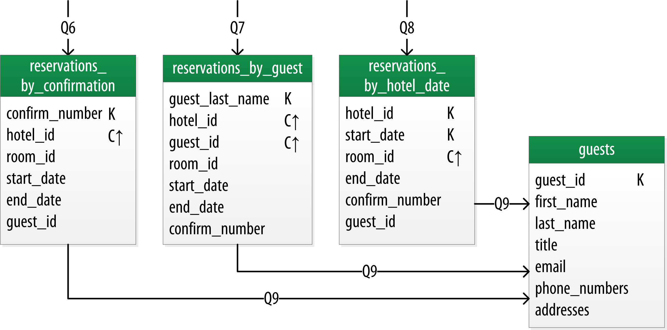
Cassandra Example
Data often stored in denormalized form, i.e. with redundancy
Most accesses read or add data, virtually no updates/modification
No joins: must retrieve guest details manually in application code
https://cassandra.apache.org/doc/latest/cassandra/data_modeling/data_modeling_logical.html

Slide 28
Quick Quiz
Is Cassandra an appropriate storage engine for
a small stand-alone employee database, where the server is not network connected to ensure security?
Answer: No. Small amount of structured data, a relational DB will do a fine job.

Slide 29
Quick Quiz
Is Cassandra an appropriate storage engine for
a fitness app, with many users and support for various sports, for which a wide range of different measures may be tracked.
Answer: Yes. Cassandra could be a good choice, especially with its implicit schema approach, column families, and optional column support.

Slide 30
Wrap Up

Slide 31
Summary
noSQL: not only SQL
noSQL increases redundancy to enable horizontal scaling
Distributed over multiple machines for performance
Trades performance for possible increase inconsistencies
Generally, they reduce structure, leaving decisions about redundancy and consistency down to the database designer/implementer
SQL installations remain the predominant database
There are different noSQL architectures
All with their pros and cons

