Slide 1

Lecture 6 Relational Model(2)
COMP5001: Database Systems
Peter Rodgers (p.j.rodgers@kent.ac.uk)
Kemi Ademoye(k.ademoye@kent.ac.uk)
Vanessa Bonthuys (v.bonthuys@kent.ac.uk)
Acknowledgements: Many thanks to Stefan Marr & Peter Rodgers for lecture notes from previous ears.

Slide 2
Assessment 1: Class Exercises
Reminder
Started this week
Solve assignments in class. If needed, finish after class.
Next week: worksheets are marked in-class

Slide 3
Today's lecture:
Relational Languages
Relational algebra operations:
Restrict
Project
Union
Intersection
Difference
Cartesian product
Join
Notes:
How to form queries in relational algebra using 5 basic operations and 3 more that can be expressed in terms of the 5 basic operations
Relational completeness

Slide 4

Join at vevox.app
ID:
109-856-825
https://kentuni.display.vevox.com#/present/698147/6G2GAFFWXQMM3JBGLPLD - Q1, 2, 3 & 4

Slide 5

Why bother with the theory?
Someone asks: “What is the address of Kate?”
sid | FirstName | LastName | Gender | Address | Phone
S1 | Kate | Adams | F | 1 High St | …561
S2 | John | Smith | M | 2 Station Rd | …642
S3 | Kate | Johns | F | 5 Church Rd | …546
S4 | Fred | Taylor | M | 10 Park St | …656
What was the problem with this question?
Natural Language is Ambiguous!
Need a little more precision
5
Notes:
SQL Select first name, last name, address from students where first name Kate

Slide 6
Looking at SQL
SELECT FirstName, Address FROM Students WHERE FirstName = 'Kate';
Students
Steps:
Find all the rows with Kate – RESTRICT operation
Only choose the first name and address column – PROJECT operation
sid | FirstName | LastName | Gender | Address | Phone
S1 | Kate | Adams | F | 1 High St | …561
S2 | John | Smith | M | 2 Station Rd | …642
S3 | Kate | Johns | F | 5 Church Rd | …546
S4 | Fred | Taylor | M | 10 Park St | …656

Slide 7
Looking at SQL (2)
SELECT FirstName, Address FROM Students WHERE FirstName = 'Kate';
StudentKate
Steps:
Find all the rows with Kate – RESTRICT operation
Only choose the first name and address columns – PROJECT operation
sid | FirstName | LastName | Gender | Address | Phone
S1 | Kate | Adams | F | 1 High St | …561
S3 | Kate | Johns | F | 5 Church Rd | …546
ResultKate
FirstName | Address
Kate | 1 High St
Kate | 5 Church Rd
StudentKate = RESTRICT Student WHERE FirstName = ‘Kate’;
ResultKate = PROJECT StudentKate OVER FirstName, Address;

Slide 8
Queries in relational algebra(1)
Query languages allows manipulation and retrieval of data from a database
Relational model supports simple, powerful queries
Strong formal foundation based on logic
Allows for much optimisation
Very useful for representing execution plans

Slide 9
Queries in relational algebra(2)
To respond to a user query, several operations may have to be performed, the example used Restrict and Project – in a few slides
Relational algebra is a procedural language
query is evaluated in the order specified
Complex queries are evaluated by
Nesting operations to create a relational expression, or
Applying operations one at a time and creating temporary tables

Slide 10
Queries in relational algebra(3)
There may be more than one way to process a complex query
The most efficient one is preferable
query optimization it to be covered later
SQL is essentially built on relational algebra

Slide 11
Relational Languages
Relational algebra
Relational Calculus

Slide 12
Relational Languages:
The table model comprises of:
Structural definitions
Integrity rules
Data manipulation
Two major languages proposed by Codd to deal with data manipulation
Relational algebra
Relational calculus (not covered in this module)

Slide 13
Relational Algebra vs.
Relational Calculus
SIMILARITIES
Formal, theoretical based on mathematical principles, non-user-friendly languages
Formal, theoretical (BASE ON MATH PRINCPLES), non-user-friendly languages
Used as basis for Data Manipulation Languages for relational database
Used to define operations to manipulate tables
Equivalent in terms of expressive power
DIFFERENCES
Relational Algebra | Relational calculus
Is procedural | Is declarative
Specifies how to achieve results | Specifies what is to be achieved
List all staff with a salary greater than £10,000. σ_{salary > 10000} (Staff) | To find details of all staff earning more than £10,000: {S | Staff(S) ∧ S.salary > 10000}
Notes:
Procedural – knowing how a particular thing can be accomplished, the steps how to do it
Declarative – gives the control to information along with the knowledge, what to execute, defines the program logic, not the detailed control flow
SQL (Structured Query Language) is a declarative query language and is the industry standard for relational databases.
** for those interested, more information in the textbook Connolly, T. and Begg, C. (2014). Database Systems: A Practical Approach to Design, Implementation, and Management, 6th Edition. Pearson

Slide 14
Relational Algebra (1) revision
Is a theoretical language
Provides a collection of operations used to manipulate tables
Is implementable
Basis for SQL query execution
Operations may be
Unary – One table
Binary – Two tables
It’s a very basic programming language!
Notes:
1 - The relational algebra is a theoretical language with operations that work on one or more tables to define another table without changing the original table(s). Thus, both the operands and the results are tables, and so the output from one
2 - The theory of programming languages is usually divided into syntax, semantics, and pragmatics. It is clear that for practical purposes, pragmatic problems are the most important. Consequently, most of the efforts in programming languages have been spent in this field. However, no theory of pragmatics has been developed as yet. Theoretical considerations have up to now mainly been concerned with syntax. Operation can become the input to another operation.

Slide 15
Relational Algebra (2) facts
Relational algebra operations work on one(unary) or more tables(binary), to define another table without changing the original tables
Both operands and results are tables, so output from one operation become input to another operation.
Allows expressions to be nested, just as in arithmetic.
Operations produce only tables based on elements of the input tables, this property is called closure
Notes:
In relational databases, closure is the process of finding the set of attributes that can be functionally determined from a given set of attributes. It's used to check if a set of attributes is a candidate key or a superkey

Slide 16
Relational Algebra (3) operations 5 + 2
Five basic operations which perform most of the data retrieval operation:
Restrict (Unary operator)
Projection (Unary operator)
Cartesian product
Union
Set Difference
Another two operations which can be expressed in terms of the basic operations:
Join
Intersection
Notes:
Cartesian product – cross product of table A + B is a set of rows where every row is the concatenation of a row from A and a row from B
All possible pairs

Slide 17
Join ⋈
Equi-Join
Natural Join
Outer Join
Relational Algebra symbols
Relational algebra operations symbols we use:
Restrict σ
Project Π
Union ∪
Intersection ∩
Difference –
Cartesian product X
The “bowtie” character in Unicode. (useful for assessments and notes)
Notes:
Unicode name – Join; Unicode Number – U+2A1D; HTML Code - &#10781; CSS Code - \2A1D: from https://symbl.cc/en/2A1D/

Slide 18
Relational Algebra
The Basic relational algebra operations

Slide 19
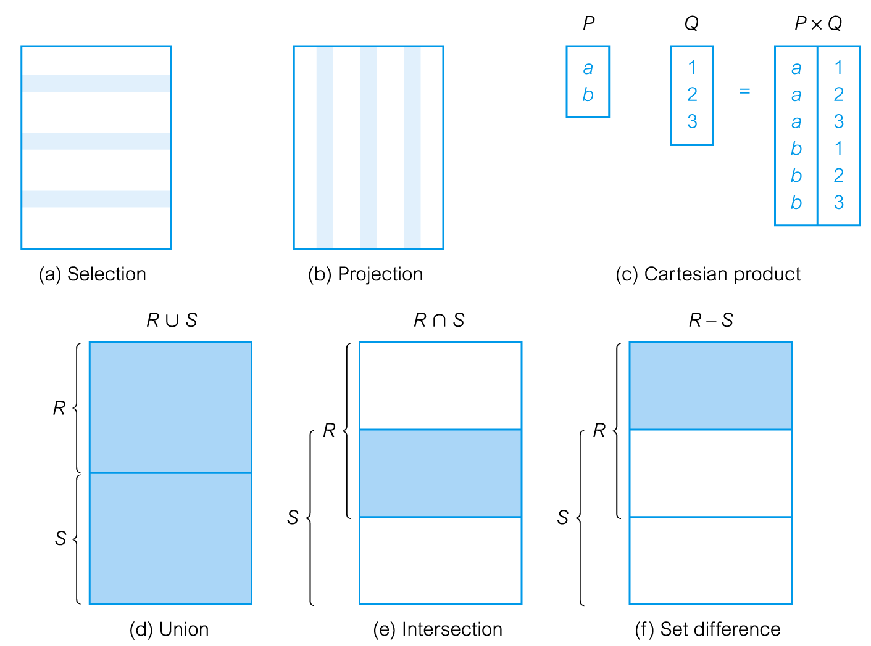
A visual interpretation summary
Restrict
Connolly, T. and Begg, C. (2014). Database Systems: A Practical Approach to Design, Implementation, and Management, 6th Edition Pearson Education © 2014
Notes:
Will refer back to these
Restrict involves queries on tuples(rows)
Projection involves queries on attributes(columns)
Cartesian product takes sets and produce a set with the specified selections
Union includes all the rows from the selected tables(tables)
Intersection will define the sets of all the rows(tuples) that are both in R and S
Set difference selects the rows that are in R but not in S

Slide 20
Student ( sid, name, gender )
Registration ( sid, cid, mark )
Example from lecture 1:
Two tables: Student and Registration in a university student database
Columns
Table
Registration
Relationship
Registered on
sid | cid | mark
S1 | C1 | 65
S1 | C2 | 45
S2 | C2 | 80
S2 | C4 | 60
S3 | C1 | 50
S3 | C2 | 75
S4 | C3 | 70
Student
sid | name | gender
S1 | Kate | F
S2 | John | M
S3 | Kate | F
S4 | Fred | M
Rows
(S1, Kate, F) …
Notes:
Please note when talking about a relation vs relationship – relation is the table, relationship is the one-to-one or one-to-many relationship between tables
What will be the relation between the two tables – sid
The sid will be how we express the table
Student ( sid, name, gender )
Registration ( sid, cid, mark )

Slide 21

Restrict operation (1)
MaleStudent ← σ _{(Gender=‘M’)} ( Student )
Defines a table, T2 (MaleStudent), that contains only those rows from the Student table, T1, where the column Gender is ‘M’
Restrict
Notes:
In-depth look at restrict
Defines a table (new table - MaleStudent) that is formed and contains only those tuples(rows) from the Student table where the attribute(columns) identified as Gender is ‘M’ will be selected when it satisfy the specified condition - predicate

Slide 22
Example – Restrict
MaleStudent ← σ _{(Gender=‘M’)} ( Student )
Student
MaleStudent
sid | name | gender
S1 | Kate | F
S2 | John | M
S3 | Kate | F
S4 | Fred | M
S5 | Dan | O
SID | Name | Gender
S2 | John | M
S4 | Fred | M
Restrict
The table MaleStudent (T2) is formed by selecting all rows from Student table (T1) where the column Gender is ‘M’ is predicate, i.e. condition

Slide 23
Restrict operation (2)
Restrict use the σ (sigma) symbol
We call this a Unary operator, as it works on a single table
Defines horizontal subset of a table (row) as per image
T2 ← σ _{(condition/predicate)} ( T1 )
table T2 is formed by selecting all rows from table T1 that satisfy the predicate, i.e. condition
Alternatively:
T2 = RESTRICT T1 WHERE condition
the results – left, operation on right produce the results on the left
Restrict

Slide 24
Restrict operation (3.1)
Comparison operators (<cmpOp>) are:
<, >, <=, >=, =, ≠
<colName> <cmpOp> [<colName>|<const>]
[<colName>|<const>] means either colName or const
--> we can compare to another column or a constant

Slide 25
Restrict operation (3.2)
e.g. Mark > = 40 (students who reached the pass mark)
Passed ← σ _{(Mark>=40)} ( Registration )
Registration
sid | cid | mark
S1 | C1 | 75
S1 | C2 | 40
S2 | C2 | 80
S2 | C4 | 60
S2 | C5 | 35
S3 | C1 | 50
S3 | C2 | 75
S4 | C1 | 39
S4 | C3 | 70
S4 | C5 | 30
Passed
sid | cid | mark
S1 | C1 | 75
S1 | C2 | 40
S2 | C2 | 80
S2 | C4 | 60
S3 | C1 | 50
S3 | C2 | 75
S4 | C3 | 70
Notes:
Predicate – 40 or above, greater than and equal too

Slide 26
Restrict operation (3.3) SQL
e.g. Mark > = 40
SELECT * FROM Registration WHERE mark >= 40
Registration
sid | cid | mark
S1 | C1 | 65
S1 | C2 | 40
S2 | C2 | 80
S2 | C4 | 60
S2 | C5 | 35
S3 | C1 | 50
S3 | C2 | 75
S4 | C1 | 39
S4 | C3 | 70
S4 | C5 | 30
Passed
sid | cid | mark
S1 | C1 | 65
S1 | C2 | 40
S2 | C2 | 80
S2 | C4 | 60
S3 | C1 | 50
S3 | C2 | 75
S4 | C3 | 70
Notes:
Predicate – 40 or above, greater than and equal too
* - wildcard, selects all in the table

Slide 27
Restrict operation (4.1)
Predicate (condition) can be composed using logical operators to connect two or more predicates:
⋀ (AND) ⋁ (OR) ~ (NOT)
e.g. cid = ‘C2’ ⋀ Mark >= 70 (all taking C2 with a distinction)
C2distinction ← σ _{(cid = ‘C2’ ^ Mark >= 70)} ( Registration )
Notes:
Connect
Referring back to the main tables
Predicate is a condition expression the evaluates to a Boolean value, either true or false

Slide 28
Restrict (Select) operation (4.2)
e.g. cid = ‘C2’ ⋀ Mark >= 70 (all taking C2 with a distinction)
C2distinction ← σ _{(cid = ‘C2’ ^ Mark >= 70)} ( Registration )
Registration
C2distinction
sid | cid | mark
S1 | C1 | 75
S1 | C2 | 45
S2 | C2 | 80
S2 | C4 | 60
S3 | C1 | 50
S3 | C2 | 75
S4 | C3 | 70
sid | cid | mark
S2 | C2 | 80
S3 | C2 | 75
Notes:
Connect
Referring back to the main tables

Slide 29
Restrict (Select) operation (4.3) SQL
e.g. cid = ‘C2’ ⋀ Mark >= 70 (all taking C2 with a distinction)
SELECT * FROM Registration WHERE cid = ‘C2' AND mark >= 70
Registration
C2distinction
sid | cid | mark
S1 | C1 | 75
S1 | C2 | 45
S2 | C2 | 80
S2 | C4 | 60
S3 | C1 | 50
S3 | C2 | 75
S4 | C3 | 70
sid | cid | mark
S2 | C2 | 80
S3 | C2 | 75
Notes:
Connect
Referring back to the main tables

Slide 30

Project operation(1)
Π _{Name, Gender} ( Student )
Student
sid | name | gender
S1 | Kate | F
S2 | John | M
S3 | Kate | F
S4 | Fred | M
S5 | Dan | O
sid | name | gender
S1 | Kate | F
S2 | John | M
S3 | Kate | F
S4 | Fred | M
S5 | Dan | O
Name | Gender
Kate | F
John | M
Fred | M
Dan | O
All duplicate rows have been removed from the table
SQL: SELECT DISTINCT _{Name, Gender} FROM Student;

Slide 31
Project operation (2)
Project use the Π (pi) symbol
We call this a Unary operator, as it works on a single table
Defines vertical partitioning of a table (column)
T2 ← Π col₁, col₂, ..., col_{n} ( T1 )
table T2 is formed by selecting the specified columns from table T1
All duplicate rows are eliminated, T2 contains same or fewer number of rows in T1
Alternatively:
T2 = PROJECT T1 OVER col₁, col₂, …, col_{n}
Notes:
columns chosen selected in operation

Slide 32
Project operation(3) SQL
SELECT DISTINCT _{Name, Gender} FROM Student;
sid | name | gender
S1 | Kate | F
S2 | John | M
S3 | Kate | F
S4 | Fred | M
S5 | Dan | O
sid | name | gender
S1 | Kate | F
S2 | John | M
S3 | Kate | F
S4 | Fred | M
S5 | Dan | O
Name | Gender
Kate | F
John | M
Fred | M
Dan | O
All duplicate rows have been removed from the table

Slide 33
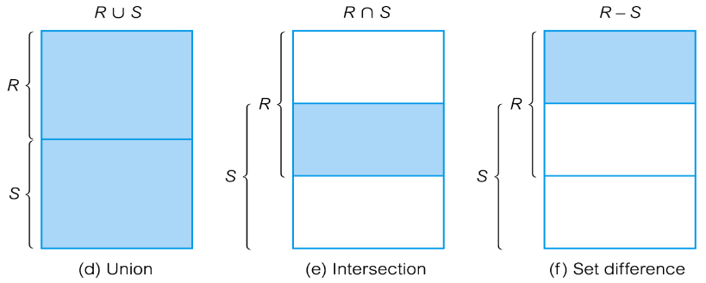
Set operations
Three types of standard set operations
Union ∪
Intersection ∩
Difference -
All three set operations
Are binary
Can only be applied to union compatible tables
∪ Removes all duplicate rows
∩ Returns rows that appears in both tables
- Returns the rows that are in one and not in the other table

Slide 34
Union compatibility(1)
Student
PartStudent
sid | name | gender | entry | birthdate
S1 | Kate | F | 2019 | 05-01-2000
S2 | John | M | 2022 | 31-08-2000
S3 | Kate | F | 2020 | 28-02-2001
S4 | Fred | M | 2022 | 14-03-2000
sid | name | gender | parttime
PS1 | John | M | 25%
PS2 | Anne | F | 50%
Can tables be made compatible?
Notes:
Different types - different domains

Slide 35
Union compatibility(1.1)
Student
PartStudent
sid | name | gender | entry | birthdate
S1 | Kate | F | 2019 | 05-01-2000
S2 | John | M | 2022 | 31-08-2000
S3 | Kate | F | 2020 | 28-02-2001
S4 | Fred | M | 2022 | 14-03-2000
sid | name | gender | parttime
PS1 | John | M | 25%
PS2 | Anne | F | 50%
Π _{sid, name, gender} ( PartStudent )
Π _{sid, name, gender} ( Student )
Project operations are often used to provide union compatible tables

Slide 36
Union compatibility(1.2)
Student
PartStudent
sid | name | gender | entry | birthdate
S1 | Kate | F | 2019 | 05-01-2000
S2 | John | M | 2022 | 31-08-2000
S3 | Kate | F | 2020 | 28-02-2001
S4 | Fred | M | 2022 | 14-03-2000
sid | name | gender | parttime
PS1 | John | M | 25%
PS2 | Anne | F | 50%
Π _{sid, name, gender} ( PartStudent )
Π _{sid, name, gender} ( Student )
Project operations are often used to provide union compatible tables
i.e. two tables are union compatible if they have the same number of columns and each pair of the corresponding columns have the same domain
Notes:
Part time student

Slide 37
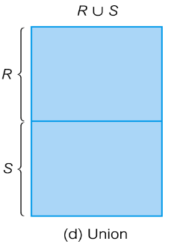
Union compatibility(1.3)
Student
PartStudent
sid | name | gender | entry | birthdate
S1 | Kate | F | 2019 | 05-01-2000
S2 | John | M | 2022 | 31-08-2000
S3 | Kate | F | 2020 | 28-02-2001
S4 | Fred | M | 2022 | 14-03-2000
sid | name | gender | parttime
PS1 | John | M | 25%
PS2 | Anne | F | 50%
Π _{sid, name, gender} ( PartStudent )
Π _{sid, name, gender} ( Student )
i.e. two tables are union compatible if they have the same number of columns and each pair of the corresponding columns have the same domain
Notes:
Part time students

Slide 38
Union(1.1)
Union ∪
Union combines two tables
e.g. T ← R ∪ S
Table T is formed by combining all rows of R, or S, or both R and S
R and S are union compatible
All duplicate rows are eliminated so that the result table T is valid
Alternatively,
T = R UNION S
What could union be useful for?
Notes:
Rules for using the union operator

Slide 39
Union (1.2)
Student
PartStudent
sid | name | gender | entry | birthdate
S1 | Kate | F | 2019 | 05-01-2000
S2 | John | M | 2022 | 31-08-2000
S3 | Kate | F | 2020 | 28-02-2001
S4 | Fred | M | 2022 | 14-03-2000
sid | name | gender | parttime
PS1 | John | M | 25%
PS2 | Anne | F | 50%
Π _{sid, name, gender} ( PartStudent )
AllStudent
Π _{sid, name, gender} ( Student )
sid | name | gender
S1 | Kate | F
S2 | John | M
S3 | Kate | F
S4 | Fred | M
PS1 | John | M
PS2 | Anne | F
AllStudent ← Π _{sid, name, gender} ( Student ) ∪ Π _{sid, name, gender} ( PartStudent )
The table AllStudent is formed by adding rows from tables Student and PartStudent once they are union compatible with the same number of columns and each pair of the corresponding columns have the same domain
Notes:
Part time student Student  PtStudent

Slide 40
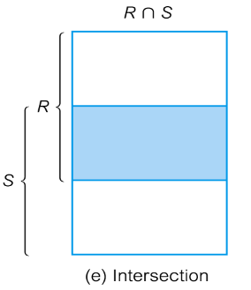
Intersection operation(1)
Intersection ∩
e.g. T ← R ∩ S
table T contains all rows which are in both tables R and S
R and S must be union compatible
All duplicate rows are eliminated so that the result table T is valid
Alternatively,
T = R INTERSECT S

Slide 41
Intersection operation(2)
Student
PartStudent
sid | name | gender | entry | birthdate
S1 | Kate | F | 2019 | 05-01-2000
S2 | John | M | 2022 | 31-08-2000
S3 | Kate | F | 2020 | 28-02-2001
S4 | Fred | M | 2022 | 14-03-2000
sid | name | gender | parttime
PS1 | John | M | 25%
PS2 | Anne | F | 50%
( Π_{Name}(Student) ) ∩ ( Π_{Name}(PartStudent) )
OR
( PROJECT Student OVER Name ) INTERSECT ( PROJECT PartStudent OVER Name )
Notes:
Part time student

Slide 42
Intersection operation(3)
Student
PartStudent
sid | name | gender | entry | birthdate
S1 | Kate | F | 2019 | 05-01-2000
S2 | John | M | 2022 | 31-08-2000
S3 | Kate | F | 2020 | 28-02-2001
S4 | Fred | M | 2022 | 14-03-2000
sid | name | gender | parttime
PS1 | John | M | 25%
PS2 | Anne | F | 50%
CommonName
CommonName ← Student ∩ PartStudent
name
John
( Π_{Name}(Student) ) ∩ ( Π_{Name}(PartStudent) )
i.e. two tables are union compatible if they have the same number of columns and each pair of the corresponding columns have the same domain
Notes:
Part time student

Slide 43
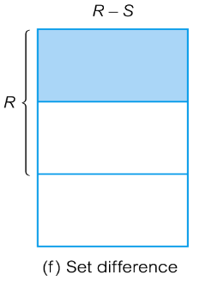
Difference operation(1)
Difference –
e.g. T ← R – S
table T contains all rows which are in table R but not in S
table 1(R) and table 2(S) must be union compatible
All duplicate rows are eliminated so that the result table 3 (T) is valid
Alternatively,
T = R DIFFERENCE S

Slide 44
Difference operation(2)
Student
PartStudent
sid | name | gender | entry | birthdate
S1 | Kate | F | 2019 | 05-01-2000
S2 | John | M | 2022 | 31-08-2000
S3 | Kate | F | 2020 | 28-02-2001
S4 | Fred | M | 2022 | 14-03-2000
sid | name | gender | parttime
PS1 | John | M | 25%
PS2 | Anne | F | 50%
( Π_{Name}(Student) ) – ( Π_{Name}(PartStudent) )
OR
( PROJECT Student OVER Name ) DIFFERENCE ( PROJECT PartStudent OVER Name )

Slide 45
Difference operation(3)
Student
PartStudent
sid | name | gender | entry | birthdate
S1 | Kate | F | 2019 | 05-01-2000
S2 | John | M | 2022 | 31-08-2000
S3 | Kate | F | 2020 | 28-02-2001
S4 | Fred | M | 2022 | 14-03-2000
sid | name | gender | parttime
PS1 | John | M | 25%
PS2 | Anne | F | 50%
DiffName
name
Kate
Fred
DiffName ← Student – PartStudent
( Π_{Name}(Student) ) – ( Π_{Name}(PartStudent) )
i.e. two tables are union compatible if they have the same number of columns and each pair of the corresponding columns have the same domain

Slide 46
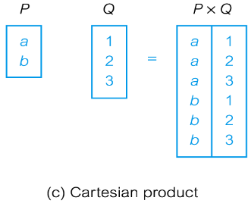
Cartesian product(1)
CARTESIAN PRODUCT X
Multiplies two tables
Defines a table that is the concatenation of every row of table P with every row with table Q
e.g.
PQ ← P X Q
Table PQ contains all rows which are the concatenation of every row of P with every row of Q

Slide 47
Cartesian product(2)
Columns with the same name in P and Q must be prefixed with the table name to maintain the uniqueness of column names within PQ
table | No. of rows | No. of columns
P | S (2) | M (1)
Q | T (3) | N (1)
PQ | S * T (= 6) | M + N (= 2)
Notes:
Connolly, T. and Begg, C. (2014). Database Systems: A Practical Approach to Design, Implementation, and Management, 6th Edition. Pearson

Slide 48
Cartesian product operation(1)
Example task:
List students’ ID and name together with their course IDs and marks.
Possible solution in 3 steps:
Cartesian product of Student and Registration
Select those rows where
Student.SID = Registration.SID
Project the columns as specified

Slide 49
Cartesian product operation(2)
TASK: List students’ ID and name together with their course IDs and marks.
Student ( sid, name, gender )
Registration ( sid, cid, mark )
Registration
sid | cid | mark
S1 | C1 | 65
S1 | C2 | 45
S2 | C2 | 80
S2 | C4 | 60
S3 | C1 | 50
S3 | C2 | 75
S4 | C3 | 70
Student
sid | name | gender
S1 | Kate | F
S2 | John | M
S3 | Kate | F
S4 | Fred | M

Slide 50
Cartesian product operation(3)
TASK: List students’ ID and name together with their course IDs and marks.
STEP 1:
A ← Student X Registration
Cartesian product
A ( S.SID, Name, Gender, R.SID, CID, Mark )
Registration
sid | cid | mark
S1 | C1 | 65
S1 | C2 | 45
S2 | C2 | 80
S2 | C4 | 60
S3 | C1 | 50
S3 | C2 | 75
S4 | C3 | 70
Student
sid | name | gender
S1 | Kate | F
S2 | John | M
S3 | Kate | F
S4 | Fred | M

Slide 51
Cartesian product operation(4.1)
TASK: List students’ ID and name together with their course IDs and marks.
STEP 1:
A ← Student X Registration
Cartesian product
A ( S.SID, Name, Gender, R.SID, CID, Mark )
A
S.SID | Name | Gender | R.SID | CID | Mark
S1 | Kate | F | S1 | C1 | 65
S1 | Kate | F | S1 | C2 | 45
S1 | Kate | F | S2 | C2 | 80
S1 | Kate | F | S2 | C4 | 60
S1 | Kate | F | S3 | C1 | 50
S1 | Kate | F | S3 | C2 | 75
S1 | Kate | F | S4 | C3 | 70
S2 | John | M | S1 | C1 | 65
… | … | … | … | … | …
S – Student R – Registration

Slide 52
Cartesian product operation(4.2)
TASK: List students’ ID and name together with their course IDs and marks.
STEP 2:
B ← σ _{(Student.SID=Registration.SID)} ( A )
Select
B ( S.SID, Name, Gender, R.SID, CID, Mark )
B
S.SID | Name | Gender | R.SID | CID | Mark
S1 | Kate | F | S1 | C1 | 65
S1 | Kate | F | S1 | C2 | 45
S2 | John | M | S2 | C2 | 80
S2 | John | M | S2 | C4 | 60
S3 | Kate | F | S3 | C1 | 50
S3 | Kate | F | S3 | C2 | 75
S4 | Fred | M | S4 | C3 | 70

Slide 53
Cartesian product operation(5)
TASK: List students’ ID and name together with their course IDs and marks.
STEP 3: Project the columns as specified
Project
C ← Π _{SID, Name, CID, Mark} ( B )
C ( SID, Name, CID, Mark )
C
SID | Name | CID | Mark
S1 | Kate | C1 | 65
S1 | Kate | C2 | 45
S2 | John | C2 | 80
S2 | John | C4 | 60
S3 | Kate | C1 | 50
S3 | Kate | C2 | 75
S4 | Fred | C3 | 70
All duplicate rows have been removed from the table columns we are interested in

Slide 54
Cartesian product and Join
Cartesian product and Restrict can be reduced to a single operation called a Join
Join is a derivative of Cartesian product

Slide 55
Visual summary of operations
Numbers just for simplicity, other domains (e.g. names, address) work the same
CARTESIAN PRODUCT
a
b
c
x
y
a
a
b
b
c
c
x
y
x
y
x
y
NATURAL JOIN
N
M
a
b
b
c
a
b
c
a1
b1
b1
c1
a1
b1
c1
a2
b1
b2
c2
a2
b1
c1
a3
b2
b3
c3
a3
b2
c2
P
Q

Slide 56
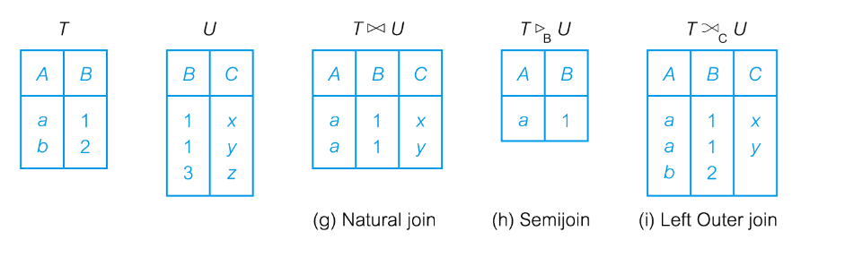
Joins
We will be looking at:
Equi-Join
Natural join
Outer Join
Left Outer Join
Right Outer Join
Full Outer Join
Notes:
More information regarding this in the textbook:

Slide 57
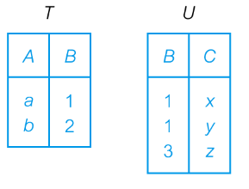
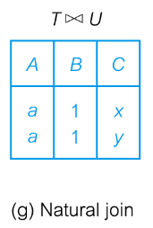
Join operation(1)
Join symbol to use
Combines two tables to form a new one
e.g. TU ← T U
Is a derivative of Cartesian product where all elements satisfy the condition p
Very important/useful relational operation
The columns involved in a join condition p must have the same domain
Alternatively,
TU = T JOIN U ON condition
condition
p
Notes:
Condition – matching attributes/column

Slide 58
Join operation(2)
JOIN operation can be written in terms of Restrict and Cartesian product operations, i.e.
T1 T2 = σ _{p} ( T1 X T2 )
p
The result of a join may be empty if no row satisfies the condition

Slide 59
Equi-join operation(1)
Condition of Equi-Join contains only equality comparisons
e.g.
Student Registration
S.SID=R.SID
Registration
sid | cid | mark
S1 | C1 | 65
S1 | C2 | 45
S2 | C2 | 80
S2 | C4 | 60
S3 | C1 | 50
S3 | C2 | 75
S4 | C3 | 70
Student
sid | name | gender
S1 | Kate | F
S2 | John | M
S3 | Kate | F
S4 | Fred | M

Slide 60
Equi-join operation(2)
Condition of Equi-Join contains only equality comparisons
e.g.
Student Registration
S.SID=R.SID
S.SID | Name | Gender | R.SID | CID | Mark
S1 | Kate | F | S1 | C1 | 65
S1 | Kate | F | S1 | C2 | 45
S2 | John | M | S2 | C2 | 80
S2 | John | M | S2 | C4 | 60
S3 | Kate | F | S3 | C1 | 50
S3 | Kate | F | S3 | C2 | 75
S4 | Fred | M | S4 | C3 | 70
S.SID | Name | Gender | R.SID | CID | Mark
S1 | Kate | F | S1 | C1 | 65
S1 | Kate | F | S1 | C2 | 45
S2 | John | M | S2 | C2 | 80
S2 | John | M | S2 | C4 | 60
S3 | Kate | F | S3 | C1 | 50
S3 | Kate | F | S3 | C2 | 75
S4 | Fred | M | S4 | C3 | 70
S – Student R – Registration
Note the redundant SID column
60

Slide 61
Natural join operation (1)
Natural Join
e.g.
TU is an Equi-Join of the two tables T and U over a set of common columns Z
The common duplicate columns are removed in the resulting table TU (implicit projection)
TU ← T U
Table | No. of rows | No. of columns
T | S | M
U | T | N
TU | Min(S, T) | M + N - K
Note: K is the number of common columns Z
Notes:
S.SID and R.SID are in the result because the equi join preserves them for the comparison

Slide 62
Natural join operation (2.2)
e.g.
OR
Student Registration
Student NATURAL JOIN Registration
Registration
sid | cid | mark
S1 | C1 | 65
S1 | C2 | 45
S2 | C2 | 80
S2 | C4 | 60
S3 | C1 | 50
S3 | C2 | 75
S4 | C3 | 70
Student
sid | name | gender
S1 | Kate | F
S2 | John | M
S3 | Kate | F
S4 | Fred | M

Slide 63
Natural join operation (2.3)
e.g.
OR
Student Registration
Only one SID
Student NATURAL JOIN Registration
SID | Name | Gender | CID | Mark
S1 | Kate | F | C1 | 65
S1 | Kate | F | C2 | 45
S2 | John | M | C2 | 80
S2 | John | M | C4 | 60
S3 | Kate | F | C1 | 50
S3 | Kate | F | C2 | 75
S4 | Fred | M | C3 | 70
Registration
sid | cid | mark
S1 | C1 | 65
S1 | C2 | 45
S2 | C2 | 80
S2 | C4 | 60
S3 | C1 | 50
S3 | C2 | 75
S4 | C3 | 70
Student
sid | name | gender
S1 | Kate | F
S2 | John | M
S3 | Kate | F
S4 | Fred | M

Slide 64

Natural join operation (3)
Exercise (after lecture):
Show the result tables of the following operations:
1)
Π _{SID, Name, CID, Mark} ( Student Registration )
2)
( Π_{SID, Name}(Student) ) ( Π_{SID,CID,Mark}(Registration) )

Slide 65
Outer Join operation(1)
To display rows in the result that do not have matching values in the join column, use Outer join
Problem with Natural Join
Rows not included when
join columns are null
or do not have matching rows in another table
This can cause loss of information
Outer Join
Avoids information loss
Includes unmatched rows in result table

Slide 66
Outer Join operation(2)
Types of Outer Join
Left Outer Join
Includes all rows from R1, even the unmatched ones
Missing values of rows from R2 are set to null
Right Outer Join
Includes all rows from R2, even the unmatched ones
Missing values of rows from R1 are set to null
Full Outer Join
Includes all rows from R1 and R2, even the unmatched ones
Missing values are set to null

Slide 67
Outer Join operation(3)
List all students including those who do not have a tutor yet
Foreign key
Primary key
Student
Staff
StdID | Name | Tutor |  | StaffNo | Name
1234 | Bloggs | S1 |  | S1 | Thompson
5678 | Smith | S3 |  | S2 | Blair
9012 | O’Neill | S1 |  | S3 | Short
7456 | Simpson | S4 |  | S4 | Straw
7890 | Jones | Null
Primary key
The column tutor in Student table is a foreign key referring to the primary key staffNo in Staff table

Slide 68
StudentTutor ( StdID, Student.Name, Tutor, Staff.Name)
Outer Join operation(4)
List all students including those who do not have a tutor yet
e.g. Left Outer Join Student and Staff
StudentTutor ← Student Staff
StudentTutor
StdID | Student.Name | Tutor | Staff.Name
1234 | Bloggs | S1 | Thompson
5678 | Smith | S3 | Short
9012 | O’Neill | S1 | Thompson
7456 | Simpson | S4 | Straw
7890 | Jones | Null | Null

Slide 69
Queries in relational algebra
To respond to a user query, several operations may have to be performed
Relational algebra is a procedural language
query is evaluated in the order specified
Complex queries are evaluated by
Nesting operations to create a relational expression, or
Applying operations one at a time and creating temporary relations
There may be more than one way to process a complex query
The most efficient one is preferable
query optimization is to be covered later in the module

Slide 70
Wrap up
Remember the homework tasks!

Slide 71
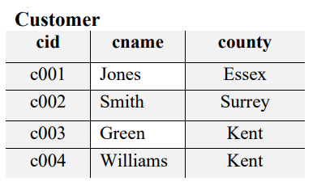
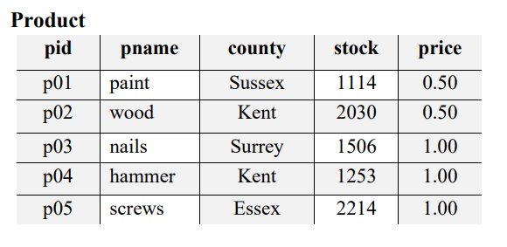
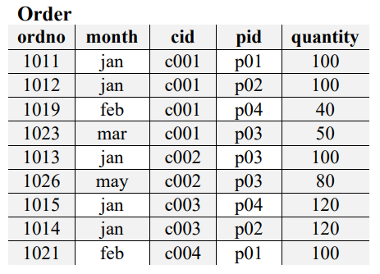
Class 1 – Relational Algebra
Tables – Customer, Product & Order:
Challenge Questions: Add a new table “Supplier” with a suitable primary key and a foreign key to product. Create a table with appropriate data for supplier name. Add a supplier for each product.

Slide 72
vevox.app
ID:
109-856-825
https://kentuni.display.vevox.com#/present/698147/6G2GAFFWXQMM3JBGLPLD

Slide 73
Summary
Relational model is a logical, formal data model concerned with data structure, data integrity and data manipulation based on math
A table is physically represented as a table, each row represents a group of related data values.
Two important integrity constraints are
Entity integrity
Referential integrity
Relational Algebra
foundation for data manipulation and therefore SQL
Notes:
From Lecture 2

Slide 74
Summary – symbols we use
Relational algebra operations:
Restrict (Select) σ
Project Π
Union ∪
Intersection ∩
Difference –
Cartesian product X
Equi-Join; Natural Join; Outer Join ⋈

Slide 75
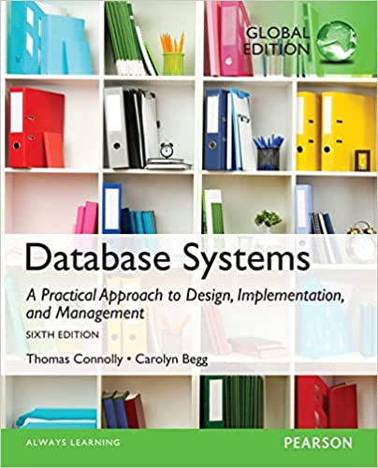
References
Connolly, T. and Begg, C. (2014). Database Systems: A Practical Approach to Design, Implementation, and Management, 6th Edition. Pearson.
Chapter 5

Slide 76
References
05-01-relational-algebra-1.mp4:
https://youtu.be/tii7xcFilOA?si=WfEt5UD70ogqIwRr
05-02-relational-algebra-2.mp4:
https://youtu.be/GkBf2dZAES0?si=trVZpKfF85OHI47k

