Slide 1
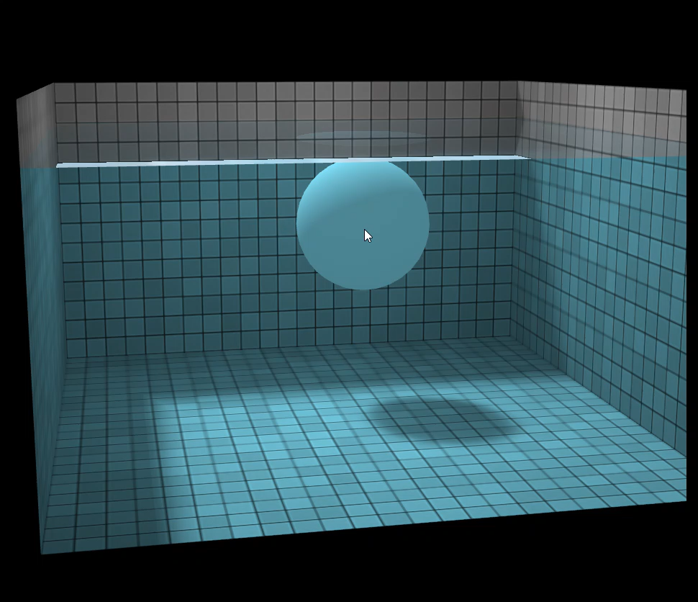
PROJECT CHECKPOINT
3D Fluid Simulation
Team: Race Conditions
Harish Eakambaram
Esteban Martinez
Ibraheem Moin
Akshat Mehta
PROJECT IMAGE
Insert a simulation still
or use this space during the live demo
01
Notes:
We are building a CPU/GPU lattice Boltzmann solver for channel flow around an obstacle. Today we will show the GPU foundation, what the tests establish, and the remaining work. Based on presentation_notes.md. Confirm teammate work outside this checkout before presenting overall team status.

Slide 2
GOAL
Original Goal
Simulate 3D fluid flow through a channel and around solid obstacles.
Visualize how the flow changes over time.
Experiment with fluids of varying viscosity as well as rendering results
Implement CPU and GPU versions and compare correctness and performance.
RACE CONDITIONS / ECE 379K / CHECKPOINT
02
Notes:
The final target is stable 3D channel flow around at least one obstacle. The proposal sets 0.5% mass and 1% CPU/GPU agreement targets. Metrics need definition, especially for inlet/outlet flux and near-zero velocity. Current source defaults: 16 by 16, D2Q9, density 1.10 at (8,8). Documented quantitative validation is the earlier 2 by 2 case.

Slide 3
CURRENT SCOPE
Current Progress
Built a 2D CUDA solver using the D2Q9 Lattice Boltzmann Method
Implemented initialization, collision, streaming, and periodic boundaries for a 16 x 16 grid
Added CSV output and animations, including a 16 × 16 disturbance demo.
Next: CPU reference, 3D extension, channel walls, and obstacles.
RACE CONDITIONS / ECE 379K / CHECKPOINT
02
Notes:
The final target is stable 3D channel flow around at least one obstacle. The proposal sets 0.5% mass and 1% CPU/GPU agreement targets. Metrics need definition, especially for inlet/outlet flux and near-zero velocity. Current source defaults: 16 by 16, D2Q9, density 1.10 at (8,8). Documented quantitative validation is the earlier 2 by 2 case.

Slide 4

Progress…
What Happens in One Timestep?
Read each cell’s populations
One GPU thread loads the nine D2Q9 values for its cell.
Calculate density and velocity
Sum the populations for density and their directional contributions for momentum
$$ρ=\sum_{i}{f_{i}}, u=\frac{\sum_{i}{f_{i}}c_{i}}{ρ}$$
Apply BGK collision
Compute the local equilibrium distribution and relax toward it
Stream into the next buffer
Each cell pulls incoming populations from its neighbors. Indices wrap at periodic boundaries.
Swap buffers and repeat
The newly streamed buffer becomes the current state. At selected steps, download results for checks and visualization
RACE CONDITIONS / ECE 379K / CHECKPOINT
03
Notes:
Each fixed cell stores nine populations. Density is their sum; velocity is directional momentum divided by density. Collision relaxes local populations to equilibrium. Streaming transports them to neighbors. Collision updates in place; streaming writes the second buffer; then pointers swap. CPU control and field extraction do not constitute a CPU reference solver.

Slide 5
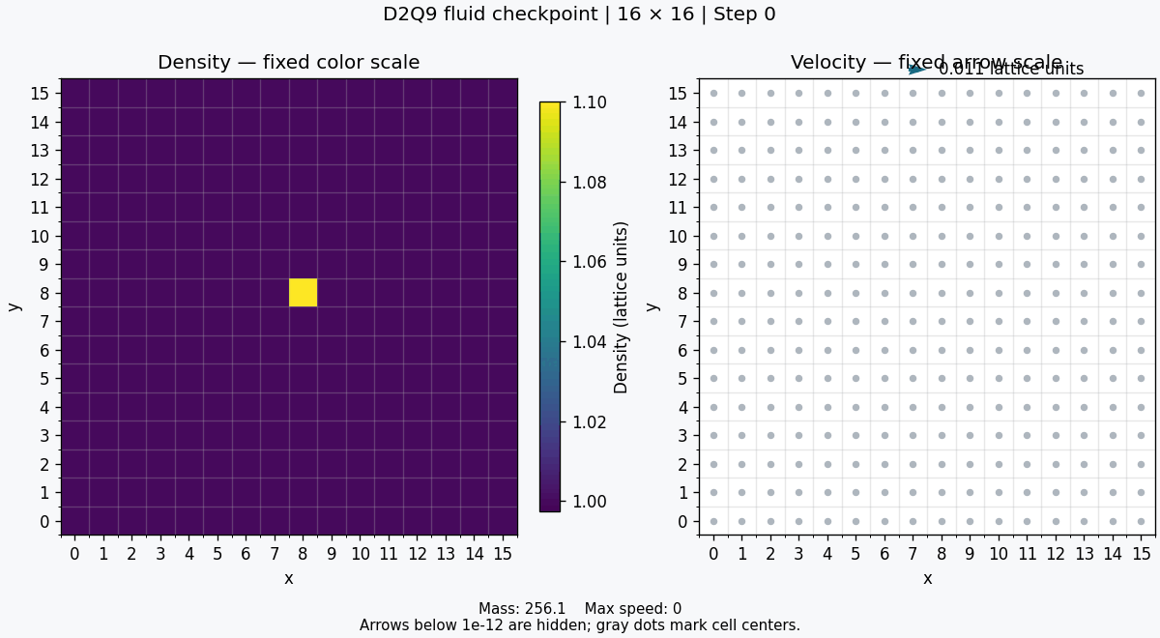
Demo
Demo: a density disturbance spreading
Start with fluid at rest and a small density increase in one cell.
Each timestep, the GPU applies collision and streaming across the 16 × 16 grid, spreading the disturbance.
After each step, the CPU reads back the populations, calculates each cell’s density and velocity, and saves them to CSV.
A Python visualizer turns each snapshot into a frame: color shows density; arrows show velocity direction and magnitude.
RACE CONDITIONS / ECE 379K / CHECKPOINT
05
Notes:
Insert results/disturbance.gif on the left and results/16x16/disturbance.gif on the right. The 2 by 2 case starts with density 1.01 at one cell and 1 elsewhere; total mass is 4.01 and final densities approach 1.0025. Opposite directions wrap to the same neighbor, leaving zero velocity. This symmetry limits what the example can show. The 16 by 16 GIF exists, but confirm its generating settings and retain its run log before quantitative claims. Current source settings alone do not verify the artifact. The 16 by 16 CSV was not present in the folder when checked.

Slide 6
Next Steps
Extending to 3D and Beyond
Extend the lattice
Move from D2Q9 to D3Q27, adding a z dimension and 3D population streaming.
Increase grid size gradually
Validate small 3D cases first, then scale to 64³ and 128³.
Add meaningful flow conditions
Introduce channel walls, an inlet/outlet, and a solid obstacle.
Add a CPU reference
Run identical cases on CPU and GPU to check that their results agree.
Measure and optimize
Profile GPU computation, transfers, and output separately to identify the main bottleneck.
Scale the output
Replace CSV with binary VTK snapshots saved at selected timesteps; use ParaView for slices and flow visualization.
RACE CONDITIONS / ECE 379K / CHECKPOINT
05
Notes:
Insert results/disturbance.gif on the left and results/16x16/disturbance.gif on the right. The 2 by 2 case starts with density 1.01 at one cell and 1 elsewhere; total mass is 4.01 and final densities approach 1.0025. Opposite directions wrap to the same neighbor, leaving zero velocity. This symmetry limits what the example can show. The 16 by 16 GIF exists, but confirm its generating settings and retain its run log before quantitative claims. Current source settings alone do not verify the artifact. The 16 by 16 CSV was not present in the folder when checked.

Slide 7
Potential Issues
Potential Issues as We Scale
Output and visualization:
We currently export GPU results as CSV through the CPU.
At larger 3D sizes, file size and output time could become a bottleneck.
We explored VTK binary formats and ParaView, and are considering a custom viewer for interactive controls and visualization.
GPU memory and bandwidth:
Larger grids store 19 or 27 populations per cell in two buffers. Memory capacity and data movement may limit performance. (Though that might not matter…)
Boundary correctness:
Walls, inlets/outlets, and obstacles need validation to avoid artificial mass gain or loss.
Validation and scope:
A convincing animation does not prove correct physics. CPU comparisons and reference-flow tests take priority over advanced rendering features.
RACE CONDITIONS / ECE 379K / CHECKPOINT
05
Notes:
Insert results/disturbance.gif on the left and results/16x16/disturbance.gif on the right. The 2 by 2 case starts with density 1.01 at one cell and 1 elsewhere; total mass is 4.01 and final densities approach 1.0025. Opposite directions wrap to the same neighbor, leaving zero velocity. This symmetry limits what the example can show. The 16 by 16 GIF exists, but confirm its generating settings and retain its run log before quantitative claims. Current source settings alone do not verify the artifact. The 16 by 16 CSV was not present in the folder when checked.

Slide 8
APPENDIX · SOURCES
Prior Art
Source | Takeaway for our project
Rinaldi et al. — 3D LBM on CUDA (2012) | Demonstrates a D3Q19 GPU solver. Highlights memory layout, combining update passes, and validating against a known flow.
Dan Schroeder’s Interactive LBM Demo | Shows how obstacles, velocity controls, tracers, and flow lines make fluid behavior easier to understand. Ideas for our interactive viewer.
ParaView Visualization Pipeline | Shows how slices, clipping, and streamlines reveal flow inside a 3D volume. A starting point for displaying our larger simulations.
RACE CONDITIONS / ECE 379K / CHECKPOINT
14
Notes:
Source outline: presentation_notes.md. Implementation status: work_done.md and src/. Artifacts: results/disturbance.csv and GIF; results/16x16/disturbance.gif. These external references are listed in the presentation notes.

Slide 9
PROPOSED SCHEDULE
The plan from here
When
Deliverable / completion gate
Nov 20
CPU reference and 3D 128 x 128 simulation done with matching results on basic tests.
Nov 24
Channel flow with walls, inlet and obstacle, plus correctness checks and visualization.
Nov 28
Finish Visualizer or Renderer Method with GPU outputs matching expectations
Nov 30
Final demo, performance graphs, and presentation ready
RACE CONDITIONS / ECE 379K / CHECKPOINT
08
Notes:
This is a proposed recovery plan, not confirmed commitments. Nov 11–14: 3 by 3 routing, 16 by 16 validation, CPU reference, uniform flow. Nov 15–19: choose the 3D lattice (notes tentatively propose D3Q19), start at 8-cubed to 32-cubed, test conservation and CPU/GPU agreement. Nov 20: scope gate. Nov 20–24: channel, obstacle, known reference flow, binary output and slices. Nov 25–28: 64-cubed/128-cubed benchmarks; 256-cubed only if correctness, time, and memory permit. Profile a bottleneck and evaluate one optimization. Nov 29–30: freeze and reproduce demo. Presentation Dec 1 or 3, date to confirm; report Dec 6.

Slide 10
DISCUSSION
Questions??
RACE CONDITIONS / ECE 379K / CHECKPOINT
12
Notes:
Clarify acceptable reference flow and CPU/GPU error norm; treatment of near-zero velocities; whether the 0.5% open-channel criterion is a flux-adjusted mass residual. Clarify separate CPU/GPU implementations versus concurrent CPU/GPU simulation, and OpenMP expectations. Ask whether a validated smaller 3D domain with scaling evidence can replace 256-cubed. Confirm the substantive 2D fallback, Vista GH200 instead of A100, AI disclosure, and final presentation date.

