Slide 1

StyleHub
A front-end clothes ordering experience — catalog, cart, checkout & accounts,
built with React 18, Vite, modern CSS3, semantic HTML5 & vanilla JavaScript.
COURSE
TEAM MEMBERS
25CSE0203 · B.E. CSE, 3rd Sem
#
NAME
ID
1
Karanvir Singh
2510990746
2
Harmanpreet Singh
2510991133
3
Gunvir Singh Ahluwalia
2510990841
4
Tushar Rattan
2510990838
REPOSITORY
SUBMITTED TO
Dr. Neha Sharma
GitHub · updated throughout the semester
Live product screenshots captured directly from our running site are used throughout this deck.
1

Slide 2
AGENDA
What we'll walk through
01
Project overview & problem it solves
02
Tech stack & modern Vite tooling
03
React catalog architecture & state hooks
04
Site map, system flow, live preview & conclusion
2

Slide 3
PROJECT OVERVIEW
A small, considered online wardrobe
Digital catalog
Detail & reviews
Six curated clothing products browsed in a responsive grid, dynamically filtered by collection and search via React.
Clicking a product opens a full gallery with star ratings and a live review form — anyone can rate and comment.
Bag & checkout
Accounts & wallet
A persistent shopping bag with quantities and totals, flowing into a validated delivery-details checkout form.
Sign up / log in, a StyleHub wallet balance, saved addresses and full order history — simulated with browser storage.
3

Slide 4
PROBLEM & OBJECTIVES
Why StyleHub — and what it had to do
THE PROBLEM
OUR OBJECTIVES
– Manual, message-based clothing orders are slow and easy to lose track of
– No single place to browse what's actually available before asking
– Customers can't see reviews or ratings before choosing a piece
– Order status and history live in scattered chats, not one account
– Give visitors a clean, fast catalog they can browse and filter visually
– Make selecting, reviewing and bagging an item take a few clicks
– Guide checkout with clear validation and a confirmed order summary
– Let returning customers manage address, wallet and past orders
4

Slide 5
TECH STACK
Built with core front-end fundamentals & React
React 18 & Vite
JavaScript (ES6+)
Component-based catalog architecture, declarative JSX UI, and Vite 6 development server with Hot Module Replacement (HMR).
Arrow functions, template literals, destructuring, DOM APIs, and bidirectional window.StyleHub interoperability bridge.
HTML5 & CSS3
Browser Storage
Semantic multi-page layout (header, nav, section, footer), CSS custom properties, responsive Flexbox & Grid styling.
Persistent localStorage + JSON for bag items, user accounts, wallet balance, saved addresses, and submitted reviews.
4 pages · index · about · account · checkout React catalog.jsx (142 lines) script.js & style.css
5

Slide 6
REACT INTEGRATION
Why React & Hybrid Architecture
Why React in StyleHub?
Hybrid Mount Pattern
• Replaced imperative DOM manipulation with declarative, reactive components.
• Solved catalog synchronization issues when adding real-time search & filters.
• Eliminates manual innerHTML generation previously written in script.js.
• Targeted integration: React mounts into #productGrid via createRoot().
• Retains lightweight multi-page architecture across about, account & checkout.
• Avoids unnecessary SPA complexity while maximizing catalog reactivity.
Two-Way Interop Bridge
Modern Tooling with Vite 6
• React calls window.StyleHub methods (openProductModal, addToCart, openCart).
• script.js can trigger window.StyleHub.refreshCatalog() on external changes.
• Zero disruption: existing localStorage, modal, and bag systems stay intact.
• React 18 + Vite pipeline with instant Hot Module Replacement (HMR).
• Transforms JSX components into optimized JavaScript for modern browsers.
• Repeatable scripts in package.json: npm run dev, build, and preview.
Hybrid Architecture: High-interaction catalog powered by React 18, coexisting cleanly with vanilla JS flows
6

Slide 7
REACT ARCHITECTURE
Components, Props & State Hooks
<ProductCatalog>
<ProductCard>
• Top-level container component managing search input and collection chips.
• Dynamically derives unique categories ('Tops', 'Bottoms', 'Sets') via Set.
• Renders responsive grid of ProductCard items with live item counter.
• Reusable UI card displaying image, badge, formatted price, and rating stars.
• Receives data via props: product, rating, reviewCount, onOpen, onAdd.
• Uses stopPropagation so card click (modal) and add-to-bag operate cleanly.
useState Hook
useMemo Hook
• search & collection: Track active text and category filters in ProductCatalog.
• quantity: Each ProductCard maintains its own isolated quantity state (1–99).
• Independent quantity states ensure updating one piece never affects others.
• Derives visibleProducts array by filtering against collection AND search text.
• Memoizes result: recalculates only when search, filter, or products change.
• Delivers sub-millisecond real-time search without redundant computations.
Clean Unidirectional Data Flow: State (search/filters) → useMemo → Props Down → Action Callbacks Up
7

Slide 8
SITE MAP
Four pages, one shared shell
index.html
about.html
Hero + React catalog grid (#productGrid), product modal, cart drawer — the main shopping surface
Brand story section, explaining the small, considered product range
account.html
checkout.html
Login / signup tabs, wallet top-up, saved address, order history
Order summary + delivery form with validation and payment method
Every page shares the same header, cart drawer and footer markup — index mounts React; other pages use shared script.js.
8

Slide 9
SYSTEM FLOW
From browsing to a placed order
1
2
3
4
5
Open catalog
View details
Add to bag
Checkout form
Order placed
React mounts ProductCatalog & renders dynamic ProductCard components from data
Clicking card triggers onOpen to display modal with gallery, rating & reviews
Local quantity state passed to onAdd; item saved to localStorage cart
Delivery details captured with live validation
Order saved to account history, bag cleared
Steps 3–5 persist through localStorage, so a refresh never loses the customer's bag or session.
9

Slide 10
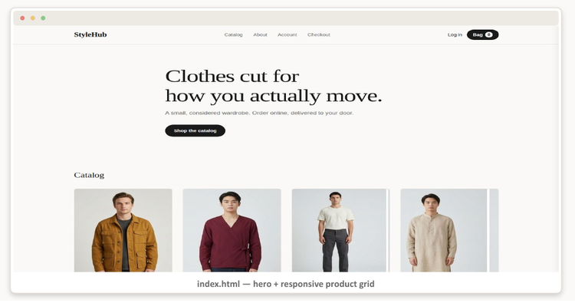
LIVE PREVIEW
Home & catalog grid
LIVE FROM OUR RUNNING SITE
index.html — hero + React-powered dynamic catalog with search & collection filtering
10

Slide 11
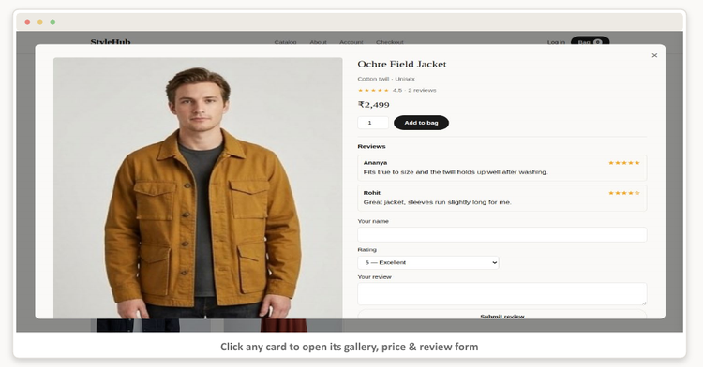
LIVE PREVIEW
Product detail, ratings & reviews
LIVE FROM OUR RUNNING SITE
Click any card to open its gallery, price & review form
11

Slide 12
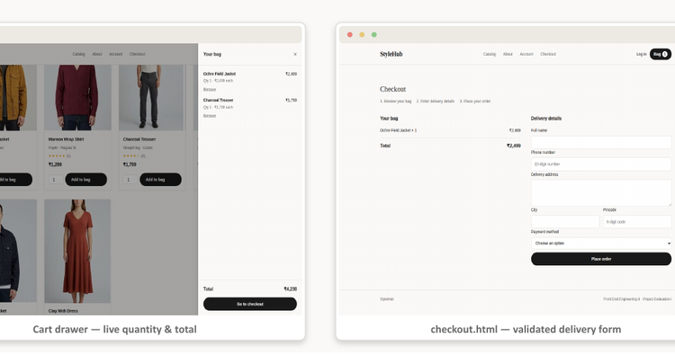
LIVE PREVIEW
Shopping bag & checkout
LIVE FROM OUR RUNNING SITE
Cart drawer — live quantity & total checkout.html — validated delivery form
12

Slide 13
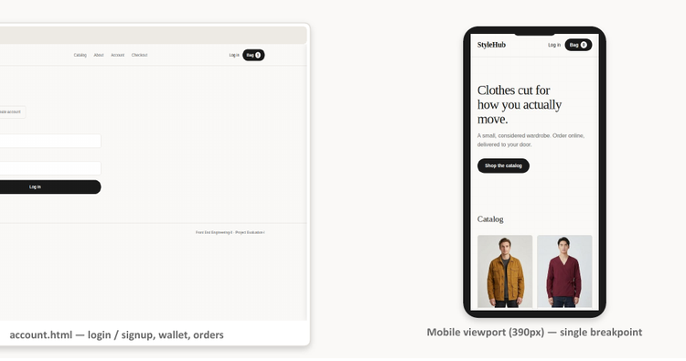
LIVE PREVIEW
Accounts & fully responsive layout
LIVE FROM OUR RUNNING SITE
account.html — login / signup, wallet, orders Mobile viewport (390px) — single breakpoint
13

Slide 14
CONCLUSION
StyleHub, and where it goes next
We set out to replace manual, message-based clothing orders with a clean front-end experience — combining a dynamic React 18 catalog with a multi-page HTML5, CSS3, and JavaScript storefront.
Full React SPA Migration
Real Backend & Database
Expand React components across all pages — migrating modal, cart drawer, and checkout to React Router and Context.
Move products, orders, and user accounts off localStorage onto a Node.js/Express server with MongoDB or PostgreSQL.
Real Authentication
Payments & Deployment
Implement JWT session tokens, bcrypt password hashing, and user profile management in place of simulated login.
Integrate Razorpay/Stripe payment gateway, automated CI/CD via GitHub Actions, and production deployment on Vercel.
Thank you
Questions & a live walkthrough welcome.
14

