Slide 1


Onboarding Automation – Content and document services use case IBM Cloud Pak for Business Automation a Technology Enablement Walkthrough Contacts: Thomas Yang Technology Enablement, Business Automation November 2021
Notes:
Welcome to the Technology Enablement walkthrough of the Onboarding Automation - Content and document services use case
As of the version deployed in November 2021

Slide 2
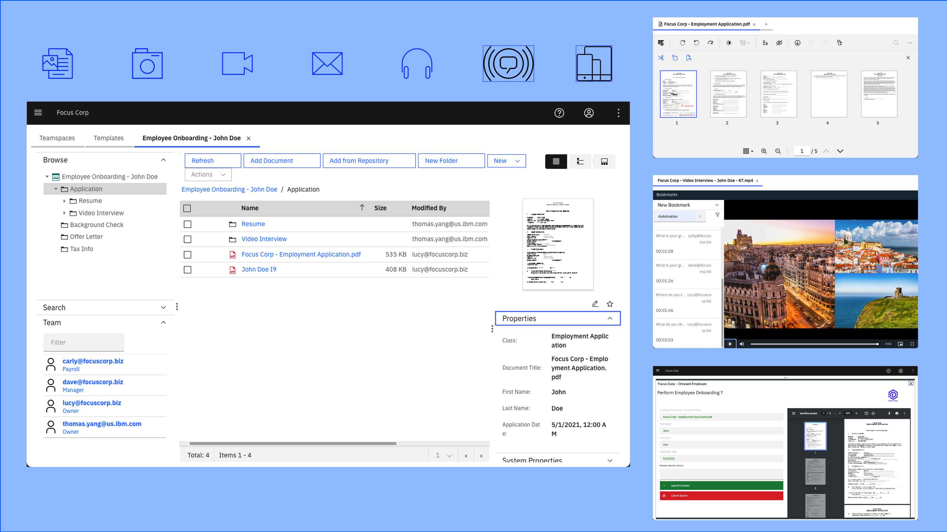
Onboarding Automation – Content and Document Processing use case
Use Case Overview: Focus Corp accelerates the use of unstructured content in an employee onboarding use case using teamspaces and secure external file sharing. You will assume the role of Lucy, an HR employee onboarding specialist at Focus Corp. Lucy’s objective is to improve Focus Corp’s process and ensure various onboarding requirements are met in a secure, structured, consistent and timely manner to onboard the new employees. Focus Corp must collaborate both internally and externally during the employee onboarding process as well as enforce structured and adhoc workflows.
Notes:
The use case scenario involves an employee onboarding process for a company called Focus Corp. The value of the content and document processing use case is demonstrated by providing a secure, structured, consistent and timely process to onboard new employees.

Slide 3
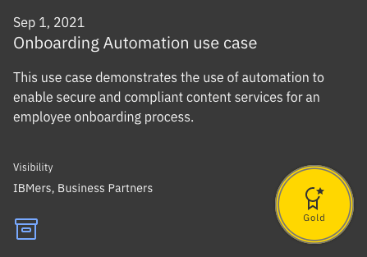
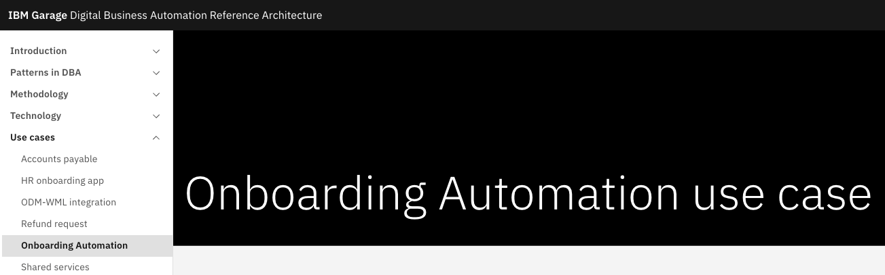
Onboarding Automation – Content and document processing use case
As of November 2021, the use case is available in the following locations:
IBM Technology Zone
Open source use case on github.com
Notes:
The Onboarding Automation – Content and document processing use case is currently available as a demo on the IBM Technology Zone –AND-
as an open source use case on GitHub.com with a complete Getting Started Lab and open source repository with all the code.

Slide 4
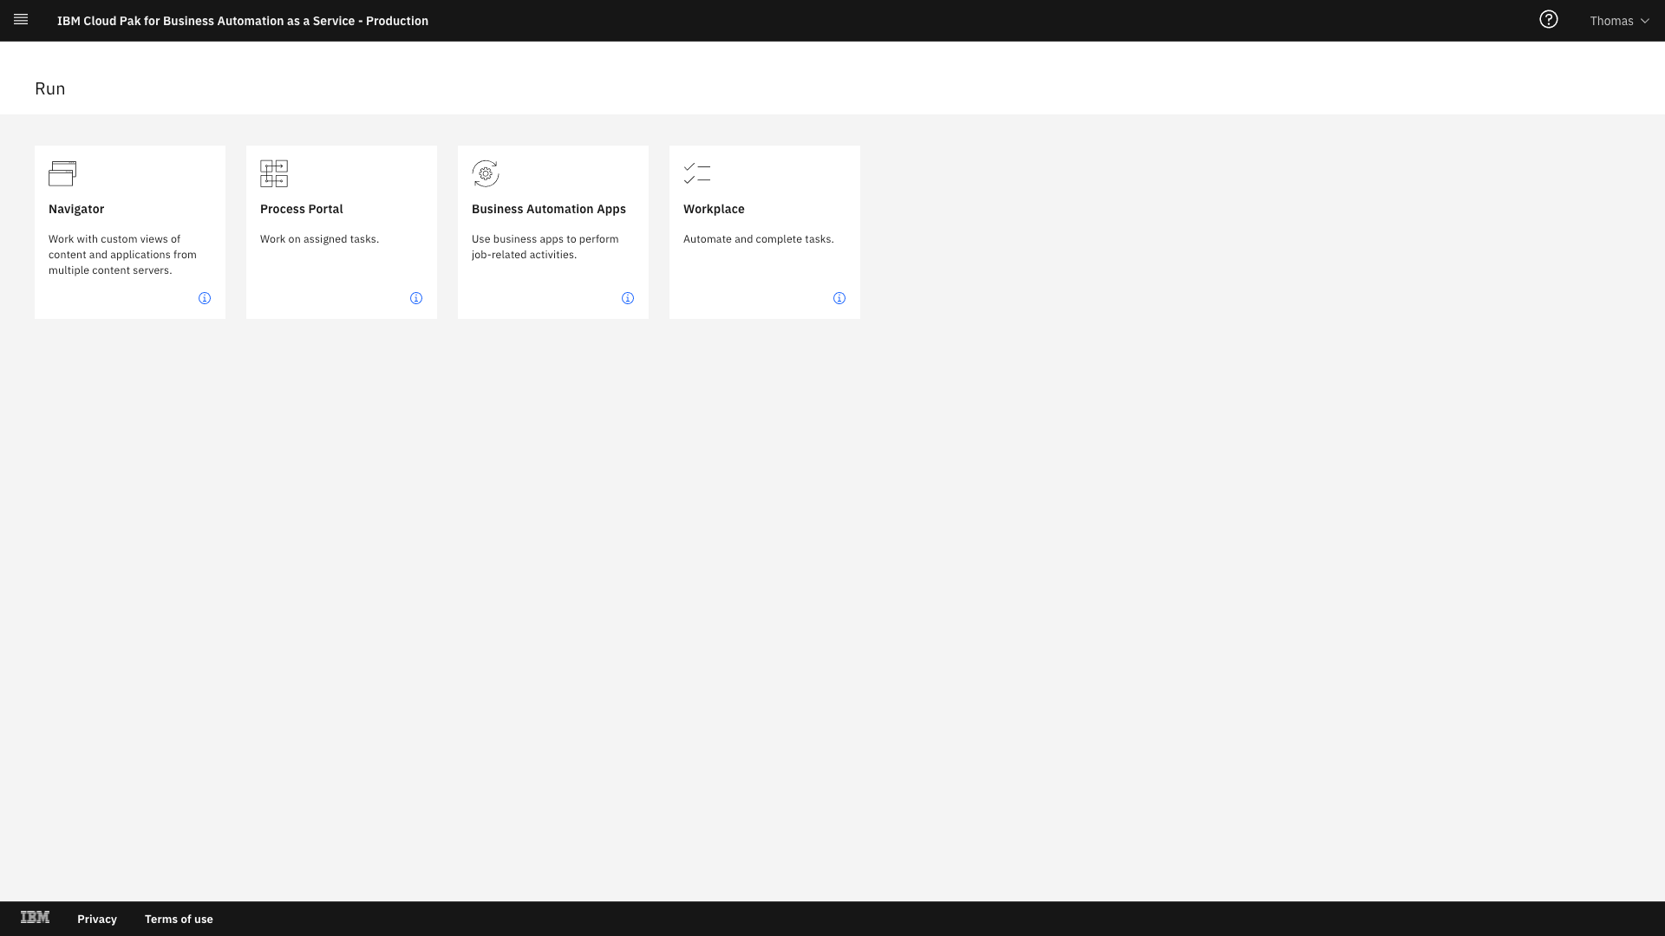
Notes:
Logging into the Cloud Pak for Business Automation as a Service SaaS portal, you will see the tiles you have access to
And these may vary depending on your own permissions.
Here on the left, we see we have access to a development environment and we also have access to a production environment.
Select the Production environment and then select Run on the left hand side menu which displays the end-user interfaces
We will use Business Automation Apps to access the demos interface which is built in Business Automation Studio
and here deployed to Business Automation Navigator’s Application Engine
This Navigator Desktop will provide access to one or more business applications that are used for demonstrations
Here, we see the business applications for Refund Request and Automation Onboarding.
Clicking on the Automation Onboarding tile will load the application directly in Navigator

Slide 5
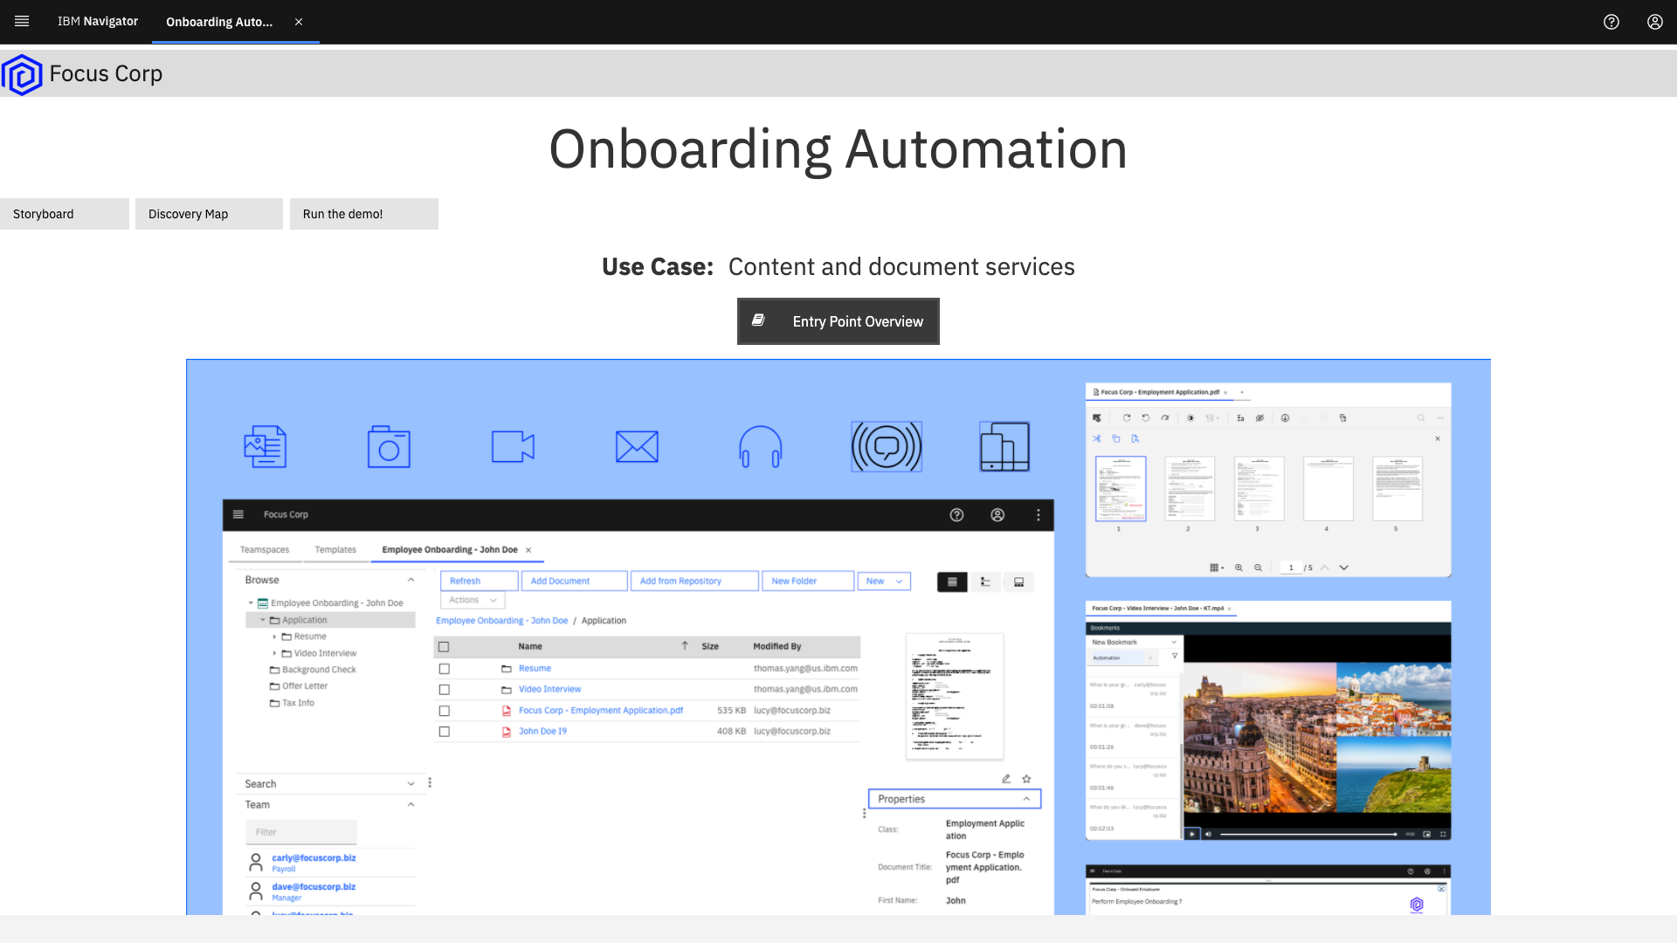
Notes:
Here we have the Storyboard where we can see a diagram of the use case along with a link to the user case overview which displays the overview along with a link to the Getting Started lab
We have Discovery Map that may be good for discussions about the use case
The Run the demo! Tab displays the two personas for the use case.
Select Lucy to start the demonstration

Slide 6
It’s your turn! Get started in the demo prep and script learning activity
Notes:
Once you are ready to execute the demo, please review the Your Learning plan for details on the Demo Prep and Script learning activity

Slide 7
Thank you
Contacts: Thomas Yang Technology Enablement, Business Automation
thomas.yang@us.ibm.com

Slide 9
Reference
Getting Started Lab:
https://ibm-cloud-architecture.github.io/refarch-dba/use-cases/onboarding-automation/
GitHub:
https://github.com/ibm-cloud-architecture/dba-onboarding-automation
Technology Zone:
https://techzone.ibm.com/collection/onboarding-automation
https://techzone.ibm.com/collection/business-automation-content-services-demos#tab-1
https://techzone.ibm.com/collection/cloud-pak-for-automation-activation-kit
Walkthrough:
Onboarding Automation:
Refund Request: https://ibm.seismic.com/Link/Content/DC31lKZNhtCkOzC_aAozXkKQ
https://ibm.seismic.com/app?ContentId=644a59df-6dd8-430a-b30b-f680a335e429#/contentmanager/main/1/c20c9996-a217-4689-bdc8-c826e827b8fd/LIST/title

Slide 11
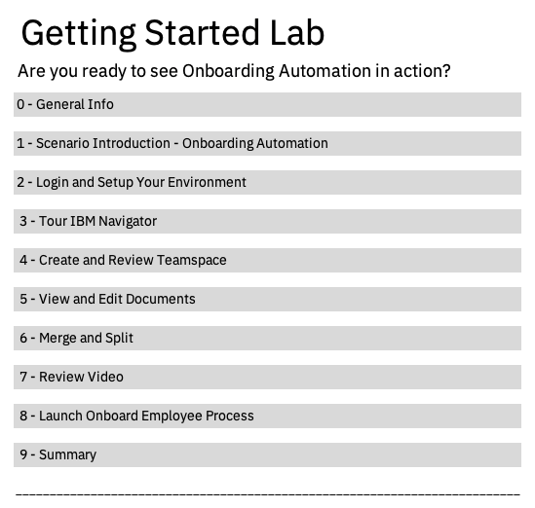
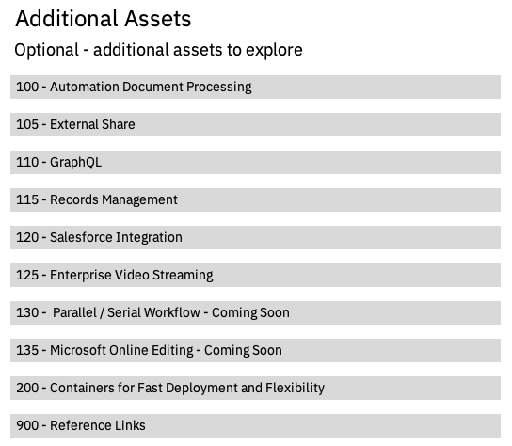
Guided Tour – Onboarding Automation
Notes:
Here's the flow of the Guided Tour along with the additional assets that are planned.
Based on your opportunity, consider incorporating additional assets into your demonstration

