Slide 1
Event Driven Architecture
Kafka Streams – Deeper Dive
Rick Osowski
Senior Technical Staff Member
Senior Solution Architect – IBM Cloud Garage Solution Engineering
osowski@us.ibm.com

Slide 2
Agenda
Recap
Streams & Tables
Partition Concerns
Stateless Transforms
Stateful Transforms
Windowing
Joins
Pros & Cons

Slide 3
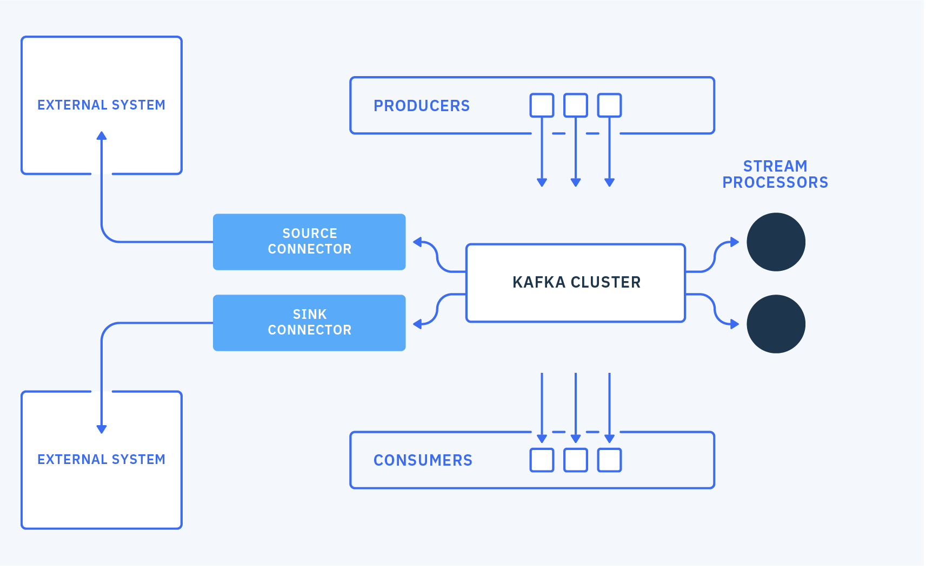

Slide 4
Kafka Streams
Client library for processing and analysing data stored in Kafka
Processing happens in the app
Supports per-record processing – no batching
Streaming DSL approach
my-input
FILTER
MAP
my-output
Notes:
Streams: unbounded flow of facts - key, value pairs, they can have types
Kafka Streams is an open source Java api
No separate processing cluster required – processing happens in your app
Supports per-record stream processing – no batching
Stateless processing, stateful processing, windowing
Elastic, highly scalable, fault-tolerant
Fully integrated with Kafka security
Supports exactly once semantics

Slide 5
Kafka Streams
Input topic
foo
red
bar
orange
foo
yellow
bingo
green
bingo
blue
bar
purple
KStream<String, String> source = builder.stream("inputTopic")
.filter((key,value) -> key.equals("bingo"))
.map((key,value) -> KeyValue.pair(key, value.toUpperCase()))
.to("outputTopic");
Output topic
bingo
GREEN
bingo
BLUE
Notes:
Example:
Kafka streams app can take input of one or more topics, and can output 0 or more topics.
e.g. take these records with foo, bar etc being keys and red, orange etc the values
We filter to find all records with a key of bingo
Then apply a map to uppercase the values
Then push the records onto the output topic
Can you guess what the records on the output topic will be?

Slide 6
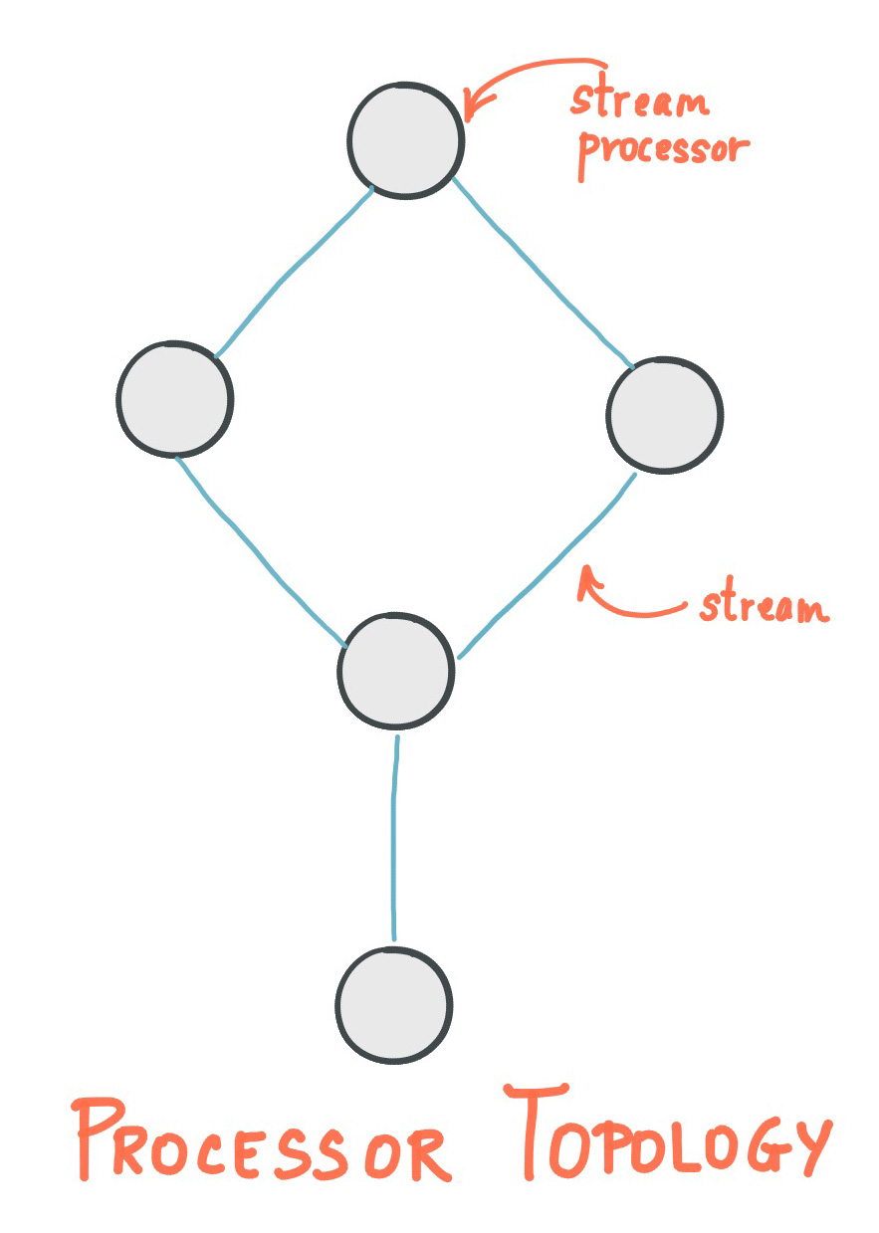
Topology
Build the processing logic
final StreamsBuilder builder = new StreamsBuilder();
//Create Actual Stream Processing pipeline
final KStream<Long, String> source = builder.stream(
INPUT_TOPIC,
Consumed.with(longSerde, stringSerde));
final KStream<String, Long> mapped = source
.map((key, value) -> new KeyValue<>(value, key));
mapped.to(OUTPUT_TOPIC, Produced.with(stringSerde, longSerde));

Slide 7
Streams & Tables
KStreams
Abstraction of an unending record stream
Immutable individual entries
Each data record is considered an isolated datum.
KTables
Abstraction of a changelog stream
Mutable individual entries
Each data record is considered a contextual update.
GlobalKTables are available to aggregate across partitions.
Notes:
STREAMS
A stream is a durable, partitioned sequence of immutable events. When a new event is added a stream, it's appended to the partition that its key belongs to. Streams are useful for modeling a historical sequence of activity. For example, you might use a stream to model a series of customer purchases or a sequence of readings from a sensor. Under the hood, streams are simply stored as Apache Kafka® topics with an enforced schema. You can create a stream from scratch or declare a stream on top of an existing Kafka topic. In both cases, you can specify a variety of configuration options.
TABLES
A table is a durable, partitioned collection that models change over time. It's the mutable counterpart to the immutable stream. By contrast to streams, which represent a historical sequence of events, tables represent what is true as of “now”. For example, you might model the locations that someone has lived at as a stream: first Miami, then New York, then London, and so forth. You can use a table to roll up this information and tell you where they live right now. Tables can also be used to materialize a view by incrementally aggregating a stream of events.
Tables work by leveraging the keys of each event. Keys are used to denote identity. If a sequence of events shares a key, the last event for a given key represents the most up-to-date information. Under the hood, uses Kafka’s notion of a compacted topic to make this work. Compaction is a process that periodically deletes all but the newest events for each key. For more information, see Log Compaction.

Slide 8



Example item-aggregator
OpenShift
item sale simulator
inventory consumer
item-aggregator
item-aggregator
Event Streams
0
1
2
3
0
1
2
3
0
1
2
3
items
item-aggregator-Item Sold Store
inventory
On-premise or Cloud Providers (IBM, AWS, GCP, Azure...)
https://github.com/ibm-cloud-architecture/refarch-eda-item-inventory

Slide 9
Item Aggregation
KTable<String,Inventory> inventory = builder.stream(itemSoldTopicName,
Consumed.with(Serdes.String(), itemSerde))
// use store name as key
.map((k,v) -> new KeyValue<>(v.storeName, v))
.groupByKey(Grouped.with(Serdes.String(),itemSerde))
// update the current stock for this store - item pair
// change the value type
.aggregate(
() -> new Inventory(), // initializer
(k , newItem, aggregate) -> aggregate.updateStockQuantity(k,newItem),
Materialized.<String,Inventory,KeyValueStore<Bytes,byte[]>>as(StoreInventoryAgent.STOCKS_STORE_NAME)
.withKeySerde(Serdes.String())
.withValueSerde(inventorySerde));

Slide 10
Co-partitioning
Certain joins, known as equi-joins, must have input data that is co-partitioned when joining.
What does this mean?
Input records with the same key from both sides of the join are presented to the stream processing task
Input topics must have the same number of partitions
Producing applications must all have the same partitioning strategy to ensure the same keys are delivered to the same partitions
Co-partitioning is not required when performing KTable-KTable Foreign-Key joins and Global KTable joins.
Notes:
Co-partitioning is not required when performing KTable-KTable Foreign-Key joins and Global KTable joins.

Slide 11
Repartitioning
Certain transforms allow the user to change the record’s key – either the value of the key, the type of the key, or both.
When this happens, Kafka Streams must perform a repartitioning, or an internal reshuffling of the input stream, to allocate individual records to new partitions of the output KStream or KTable.
If the type of a key is changed in a transform, the partitioning strategy can also be updated to map records to different partitions.
Repartitioning is transparent to the user much of the time but does incur a performance hit. This can be avoided by using value-changing operations only where possible.
Kafka Streams creates internal repartitioning topics for each repartitioning required, creating a long-term performance and resource concern.

Slide 12
Stateless Transforms
Transform | Supported on | Description
Branch | KStream -> KStream[] | Logically split a KStream & record to only one of N branches
Filter / Inverse Filter | KStream -> KStream KTable -> KTable | Evaluate a Boolean function to determine whether to retain record or not
FlatMap / FlatMapValues | KStream -> KStream | Process a single record to produce one or more records. Options include modifying keys, values, and types.
GroupByKey | KStream -> KGroupedStream | Groups records by the existing key
GroupBy | KStream -> KGStream KTable -> KGTable | Groups records by a new key, which can be a new key type. Can also support new value and value type.
Map / MapValues | KStream -> KStream | Process a single record and produces a single record. Options include modifying keys, values, and types.
Notes:
Source: https://kafka.apache.org/25/documentation/streams/developer-guide/dsl-api.html#stateless-transformations
“Stateless transformations do not require state for processing and they do not require a state store associated with the stream processor. Kafka 0.11.0 and later allows you to materialize the result from a stateless KTable transformation. This allows the result to be queried through interactive queries. To materialize a KTable, each of the below stateless operations can be augmented with an optional queryableStoreName argument”
Transforms omitted for brevity:
Cogroup
Merge

Slide 13
Stateless Transforms
Transform | Supported on | Description
Foreach | KStream -> void KTable -> void | Perform a stateless action on each record and terminate stream processing. Think side effects.
Peek | KStream -> KStream | Perform a states action on each record and return an unchanged stream. Think side effects.
SelectKey | KStream -> KStream | Assigns a new key, including support for a new key type, to each record.
Table to Stream | KTable -> KStream | Get the changelog stream of a table.
Stream to Table | KStream -> KTable | Convert event stream into a table. Also known as a changelog stream.
To | KStream -> void | Write the records to a Kafka topic and end processing.
Through | KStream -> KStream KTable -> KTable | Write the records to a Kafka topic and create a new stream/table from that topic to continue processing.
Notes:
Source: https://kafka.apache.org/25/documentation/streams/developer-guide/dsl-api.html#stateless-transformations
“Stateless transformations do not require state for processing and they do not require a state store associated with the stream processor. Kafka 0.11.0 and later allows you to materialize the result from a stateless KTable transformation. This allows the result to be queried through interactive queries. To materialize a KTable, each of the below stateless operations can be augmented with an optional queryableStoreName argument”
Transforms omitted for brevity:
Cogroup
Merge

Slide 14
Stateful Transforms
Transform | Supported on | Description
Aggregate* | KGStream → KTable KGTable → KTable | Aggregate values of records by the grouped key. Resultant value type can be changed. Generalization of Reduce.
Reduce* | KGStream → KTable KGTable → KTable | Combines values of records by the grouped key. Resultant value type cannot be changed.
Count* | KGStream → KTable KGTable → KTable | Counts the number of records by the grouped key.
Transform | KStream→ KStream | Apply a Transformer to each record, allowing low-level Processor API integration for updating both keys and values.
TransformValues | KStream → KStream KTable → KTable | Apply a ValueTransformer to each record, allowing low-level Processor API integration for updating only values.
Inner Join | See next chart | Performs an INNER JOIN of the current stream with another stream.
Left Join | See next chart | Performs a LEFT JOIN of the current stream with another stream.
Outer Join | See next chart | Performs an OUTER JOIN of the current stream with another stream.
*Supports both rolling and windowed aggregation.
Notes:
Source: https://kafka.apache.org/25/documentation/streams/developer-guide/dsl-api.html#stateful-transformations
“Stateful transformations depend on state for processing inputs and producing outputs and require a state store associated with the stream processor. For example, in aggregating operations, a windowing state store is used to collect the latest aggregation results per window. In join operations, a windowing state store is used to collect all of the records received so far within the defined window boundary.”
Transforms omitted for brevity:
Cogroup
Merge

Slide 15
Joins
Join operands | Type | (INNER) JOIN | LEFT JOIN | OUTER JOIN
KStream-to-KStream | Windowed | Supported | Supported | Supported
KTable-to-KTable | Non-windowed | Supported | Supported | Supported
KTable-to-KTable Foreign-Key Join | Non-windowed | Supported | Supported | Not Supported
KStream-to-KTable | Non-windowed | Supported | Supported | Not Supported
KStream-to-GlobalKTable | Non-windowed | Supported | Supported | Not Supported
KTable-to-GlobalKTable | N/A | Not Supported | Not Supported | Not Supported
Windows
Hopping time window – fixed-sized, overlapping windows
Tumbling time window – fixed-sized, non-overlapping, gap-less windows
Sliding time windows – fixed-sized, overlapping windows that focus on record timestamps
Session windows – dynamically-sized, non-overlapping, data-based windows
Source: https://kafka.apache.org/25/documentation/streams/developer-guide/dsl-api.html#joining
Notes:
Hopping time windows are windows based on time intervals. They model fixed-sized, (possibly) overlapping windows. A hopping window is defined by two properties: the window’s size and its advance interval (aka “hop”). The advance interval specifies by how much a window moves forward relative to the previous one. For example, you can configure a hopping window with a size 5 minutes and an advance interval of 1 minute. Since hopping windows can overlap – and in general they do – a data record may belong to more than one such windows.
Tumbling time windows are a special case of hopping time windows and, like the latter, are windows based on time intervals. They model fixed-size, non-overlapping, gap-less windows. A tumbling window is defined by a single property: the window’s size. A tumbling window is a hopping window whose window size is equal to its advance interval. Since tumbling windows never overlap, a data record will belong to one and only one window.
Sliding windows are quite different from hopping and tumbling windows. In Kafka Streams, sliding windows are used only for join operations, and can be specified through the JoinWindows class. A sliding window models a fixed-size window that slides continuously over the time axis; here, two data records are said to be included in the same window if (in the case of symmetric windows) the difference of their timestamps is within the window size. Thus, sliding windows are not aligned to the epoch, but to the data record timestamps. In contrast to hopping and tumbling windows, the lower and upper window time interval bounds of sliding windows are both inclusive.
Session windows are used to aggregate key-based events into so-called sessions, the process of which is referred to as sessionization. Sessions represent a period of activity separated by a defined gap of inactivity (or “idleness”). Any events processed that fall within the inactivity gap of any existing sessions are merged into the existing sessions. If an event falls outside of the session gap, then a new session will be created.

Slide 16
Join Examples – KStream-KStream
Timestamp | Left (KStream) | Right (KStream) | (INNER) JOIN | LEFT JOIN | OUTER JOIN
1 | null
2 |  | null
3 | A |  |  | [A, null] | [A, null]
4 |  | a | [A, a] | [A, a] | [A, a]
5 | B |  | [B, a] | [B, a] | [B, a]
6 |  | b | [A, b], [B, b] | [A, b], [B, b] | [A, b], [B, b]
7 | null
8 |  | null
9 | C |  | [C, a], [C, b] | [C, a], [C, b] | [C, a], [C, b]
10 |  | c | [A, c], [B, c], [C, c] | [A, c], [B, c], [C, c] | [A, c], [B, c], [C, c]
11 |  | null
12 | null
13 |  | null
14 |  | d | [A, d], [B, d], [C, d] | [A, d], [B, d], [C, d] | [A, d], [B, d], [C, d]
15 | D |  | [D, a], [D, b], [D, c], [D, d] | [D, a], [D, b], [D, c], [D, d] | [D, a], [D, b], [D, c], [D, d]
Requirements:
Data must be co-partitioned
Causes repartitioning of the output stream if the stream itself or the joining stream were marked for repartitioning previously
By default, this join is a windowed-join, due to the unbounded nature of both input streams.
Notes:
https://kafka.apache.org/25/documentation/streams/developer-guide/dsl-api.html#kstream-ktable-join
Semantics of stream-stream joins: The semantics of the various stream-stream join variants are explained below. To improve the readability of the table, assume that (1) all records have the same key (and thus the key in the table is omitted), (2) all records belong to a single join window, and (3) all records are processed in timestamp order. The columns INNER JOIN, LEFT JOIN, and OUTER JOIN denote what is passed as arguments to the user-supplied ValueJoiner for the join, leftJoin, and outerJoin methods, respectively, whenever a new input record is received on either side of the join. An empty table cell denotes that the ValueJoiner is not called at all.

Slide 17
Join Examples – KTable-KTable Equi-Join
Timestamp | Left (KTable) | Right (KTable) | (INNER) JOIN | LEFT JOIN | OUTER JOIN
1 | null
2 |  | null
3 | A |  |  | [A, null] | [A, null]
4 |  | a | [A, a] | [A, a] | [A, a]
5 | B |  | [B, a] | [B, a] | [B, a]
6 |  | b | [B, b] | [B, b] | [B, b]
7 | null |  | null | null | [null, b]
8 |  | null |  |  | null
9 | C |  |  | [C, null] | [C, null]
10 |  | c | [C, c] | [C, c] | [C, c]
11 |  | null | null | [C, null] | [C, null]
12 | null |  |  | null | null
13 |  | null
14 |  | d |  |  | [null, d]
15 | D |  | [D, d] | [D, d] | [D, d]
Requirements:
Data must be co-partitioned
By default, this join is a non-windowed join.
Notes:
https://kafka.apache.org/25/documentation/streams/developer-guide/dsl-api.html#ktable-ktable-equi-join
Semantics of table-table equi-joins: The semantics of the various table-table equi-join variants are explained below. To improve the readability of the table, you can assume that (1) all records have the same key (and thus the key in the table is omitted) and that (2) all records are processed in timestamp order. The columns INNER JOIN, LEFT JOIN, and OUTER JOIN denote what is passed as arguments to the user-supplied ValueJoiner for the join, leftJoin, and outerJoin methods, respectively, whenever a new input record is received on either side of the join. An empty table cell denotes that the ValueJoiner is not called at all.

Slide 18
Join Examples – KTable-KTable FK Join
Record Offset | Left KTable (K, extracted-FK) | Right KTable (FK, VR) | (INNER) JOIN | LEFT JOIN
1 | (k,1) | (1,foo) | (k,1,foo) | (k,1,foo)
2 | (k,2) |  | (k,null) | (k,2,null)
3 | (k,3) |  | (k,null) | (k,3,null)
4 |  | (3,bar) | (k,3,bar) | (k,3,bar)
5 | (k,null) |  | (k,null) | (k,null,null)
6 | (k,1) |  | (k,1,foo) | (k,1,foo)
7 | (q,10) |  |  | (q,10,null)
8 | (r,10) |  |  | (r,10,null)
9 |  | (10,baz) |  | (q,10,baz), (r,10,baz)
By default, this join is a non-windowed join.
Notes:
https://kafka.apache.org/25/documentation/streams/developer-guide/dsl-api.html#ktable-ktable-fk-join
Semantics of table-table foreign-key joins: The semantics of the table-table foreign-key INNER and LEFT JOIN variants are demonstrated below. The key is shown alongside the value for each record. Records are processed in incrementing offset order. The columns INNER JOIN and LEFT JOIN denote what is passed as arguments to the user-supplied ValueJoiner for the join and leftJoin methods, respectively, whenever a new input record is received on either side of the join. An empty table cell denotes that the ValueJoiner is not called at all. For the purpose of this example, Function foreignKeyExtractor simply uses the left-value as the output.

Slide 19
Join Examples – KStream-KTable
Timestamp | Left (KStream) | Right (KTable) | (INNER) JOIN | LEFT JOIN
1 | null
2 |  | null
3 | A |  |  | [A, null]
4 |  | a
5 | B |  | [B, a] | [B, a]
6 |  | b
7 | null
8 |  | null
9 | C |  |  | [C, null]
10 |  | c
11 |  | null
12 | null
13 |  | null
14 |  | d
15 | D |  | [D, d] | [D, d]
Requirements:
Data must be co-partitioned
Causes repartitioning of the output stream if the stream itself was marked for repartitioning previously
By default, this join is a non-windowed join.
Notes:
https://kafka.apache.org/25/documentation/streams/developer-guide/dsl-api.html#kstream-ktable-join
Semantics of stream-table joins: The semantics of the various stream-table join variants are explained below. To improve the readability of the table we assume that (1) all records have the same key (and thus we omit the key in the table) and that (2) all records are processed in timestamp order. The columns INNER JOIN and LEFT JOIN denote what is passed as arguments to the user-supplied ValueJoiner for the join and leftJoin methods, respectively, whenever a new input record is received on either side of the join. An empty table cell denotes that the ValueJoiner is not called at all.

Slide 20

Stream tasks
Unit of parallel processing
app pod 1
application.id -> consumer group
0
1
2
3
...
stream task 1
stream task 2
0
1
2
3
...
app pod 2
0
1
2
3
...
stream task 3
Notes:
An application instance can be running zero, one, or multiple tasks during its lifecycle
Input partitions from topics/streams/tables are assigned 1:1 to these tasks for processing
Tasks are evenly distributed (by kafka) across application running instances
there are exactly as many stream tasks as there are input partitions
This partition-to-task assignment via stream tasks also means that data in a topic is being processed per partition.

Slide 21
Table are partitioned
KTable persisted on state-store
app pod 1
state stores are ‘materialized’ on local disk
stored remotely in Kafka to enable fault tolerance and elasticity
partitioned as state store instances and maintained by one stream task
shared-nothing approach
0
1
2
3
...
stream task 1
stream task 2
0
1
2
3
...
app pod 2
0
1
2
3
...
stream task 3
Notes:
tables need to additionally maintain their respective state in between events so that operations like aggregations (e.g., COUNT()) can work properly.
Every table has its own state store. Any operation on the table such as querying, inserting, or updating a row is carried out behind the scenes by a corresponding operation on the table’s state store.
These state stores are being materialized on local disk inside your application instances
each state store partition will be maintained by one and only one stream task

Slide 22
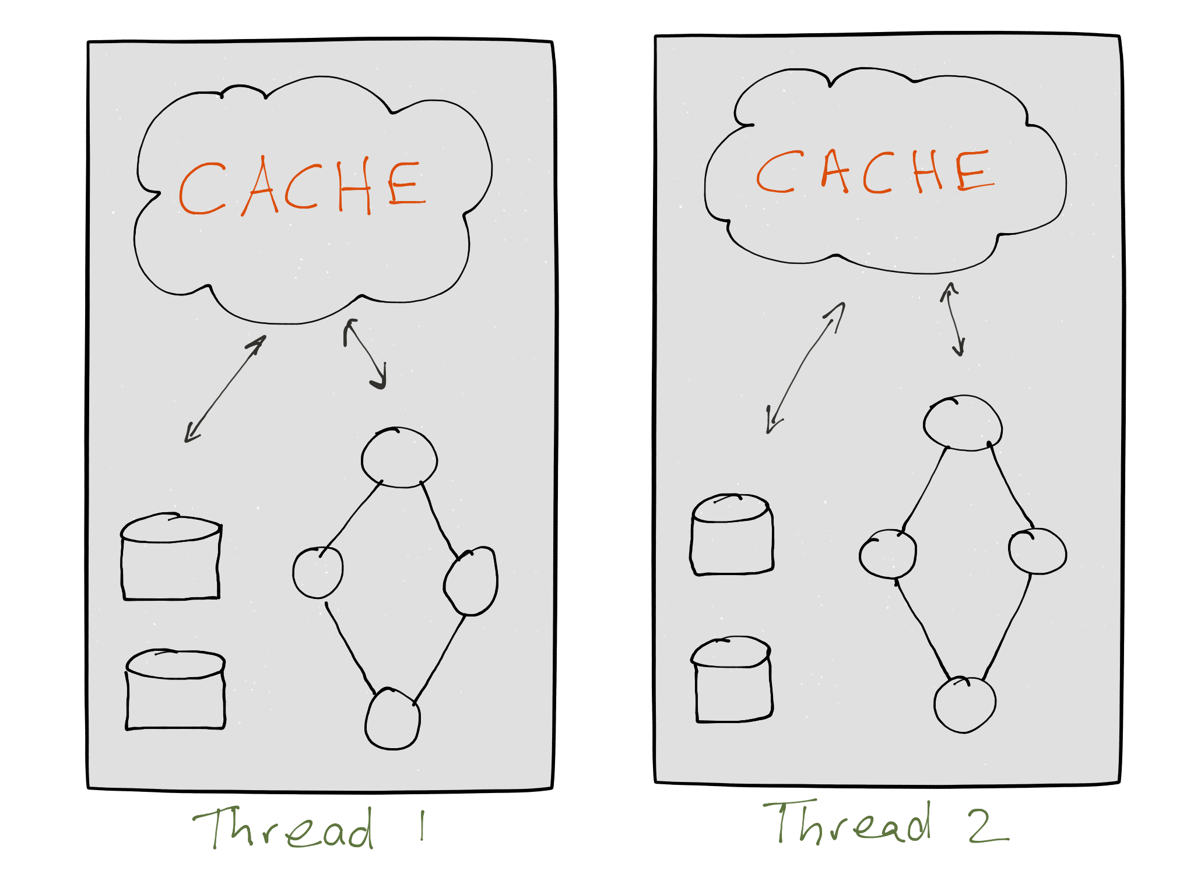
More on state store
Cache is using to improve read from state-store
Compacting of output records before they are written
Batching multiple records instead of sending each record individually to the state store
Reducing the number of records going to downstream processor
cache.max.bytes.buffering
commit.interval.ms
Notes:
Without cache on an aggregate operator, each records are produced:
The parentheses (()) denote changes, the left number is the new aggregate value and the right number is the old aggregate value: <A, (1, null)>, <A, (21, 1)>, <A, (321, 21)>
With caching the a single output record is emitted for key A that would likely be compacted in the cache, leading to a single output record of <A, (321, null)>

Slide 23
GlobalKTable
not partitioned
app pod 1
data is broadcasted to all tasks
Useful for global aggregates
0
1
2
3
...
stream task 1
stream task 2
0
1
2
3
...
app pod 2
0
1
2
3
...
stream task 3
Notes:
change stream is the source of truth for the respective table, and it is continuously and durably stored in a changelog topic

Slide 24
Fault Tolerance
KTable persists on state -stores
app pod 1
0
1
2
...
state store re ‘materialized’ on local disk
Also stored in kafka: every table has its own change log stream
change log topics are compacted
Rebuild table from change log
0
1
2
3
...
stream task 1
stream task 2
0
1
2
...
0
1
2
3
...
app pod 2
0
1
2
3
...
stream task 3
0
1
2
...
app pod 3
stream task 3
Notes:
tables need to additionally maintain their respective state in between events so that operations like aggregations (e.g., COUNT()) can work properly.
Every table has its own state store. Any operation on the table such as querying, inserting, or updating a row is carried out behind the scenes by a corresponding operation on the table’s state store.
These state stores are being materialized on local disk inside your application instances
each state store partition will be maintained by one and only one stream task

Slide 25
Scaling
Four partitions -> four stream tasks in two app instances
app pod 1
0
1
2
...
0
1
2
3
...
stream task 1
Adding 2 new instances to scale out
Task and table partitions will migrate to the new instances
stream task 2
0
1
2
...
0
1
2
3
...
0
1
2
3
...
app pod 2
0
1
2
...
stream task 3
0
1
2
3
...
stream task 4
0
1
2
...
app pod 3
app pod 4

Slide 26
Scaling
Task and table partitions will migrate to the new instances
app pod 1
0
1
2
...
0
1
2
3
...
stream task 1
0
1
2
...
compacted topic to reload quickly
0
1
2
3
...
app pod 2
stream task 3
0
1
2
3
...
app pod 3
0
1
2
...
stream task 4
app pod 4
0
1
2
...
0
1
2
3
...
stream task 2

Slide 27
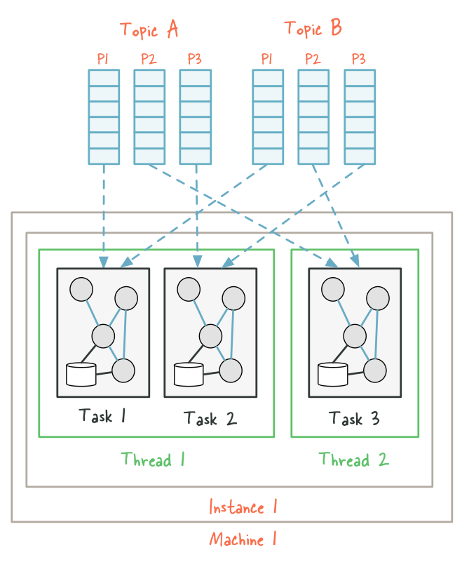
Another view with threading
Topology consumes from 2 topics
Each topic has 3 partitions
Start with max threads = 2
A thread runs two tasks
Each task executes a topology

Slide 28
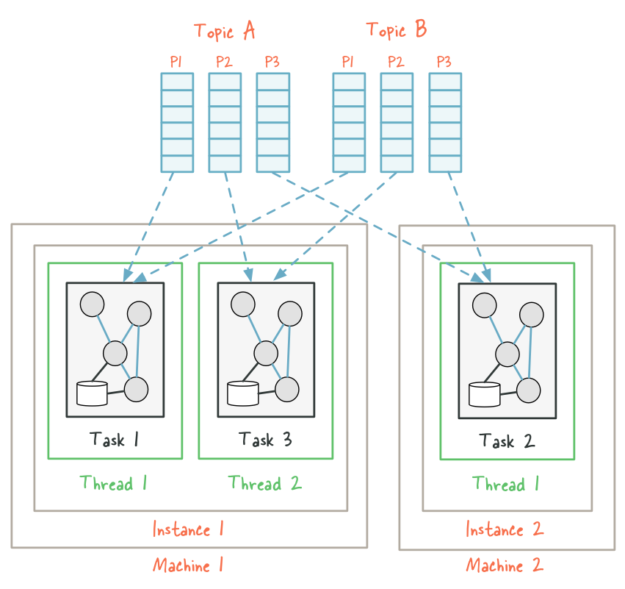
Another view with threading
Adding a new machine
A new thread instance2-thread1 is created
Input partitions are re-assigned

Slide 29
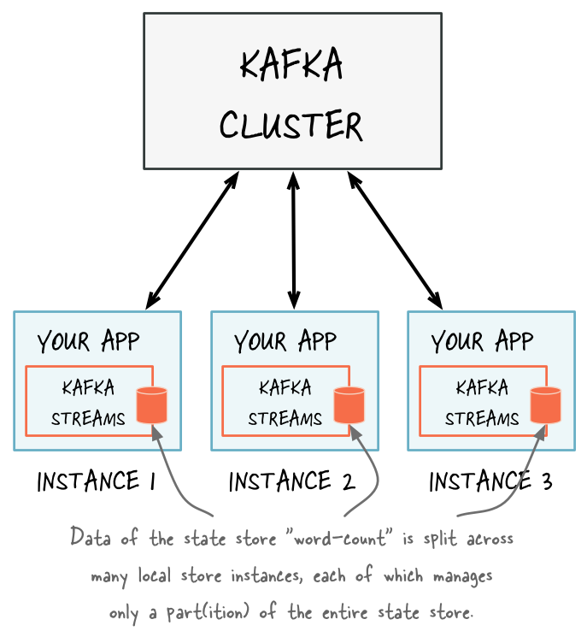
Interactive Queries
Full state of the application = split across many distributed instances across many state stores

Slide 30
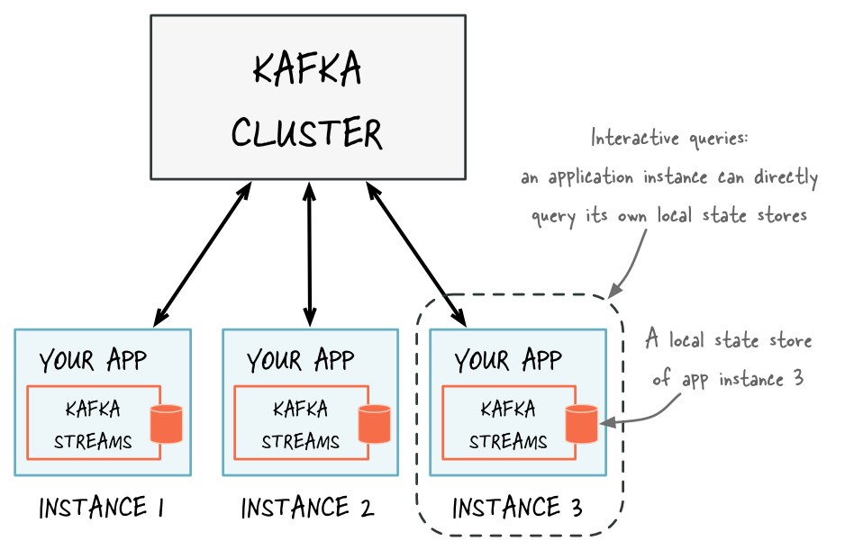
Interactive Queries
Query on local store
Store is accessed via Streams
Inventory result =
getInventoryStockStore().get(storeID);
StoreQueryParameters<ReadOnlyKeyValueStore<String,Inventory>> parameters =
StoreQueryParameters.fromNameAndType(
InventoryAggregate.INVENTORY_STORE_NAME,
QueryableStoreTypes.keyValueStore());
return streams.store(parameters);

Slide 31
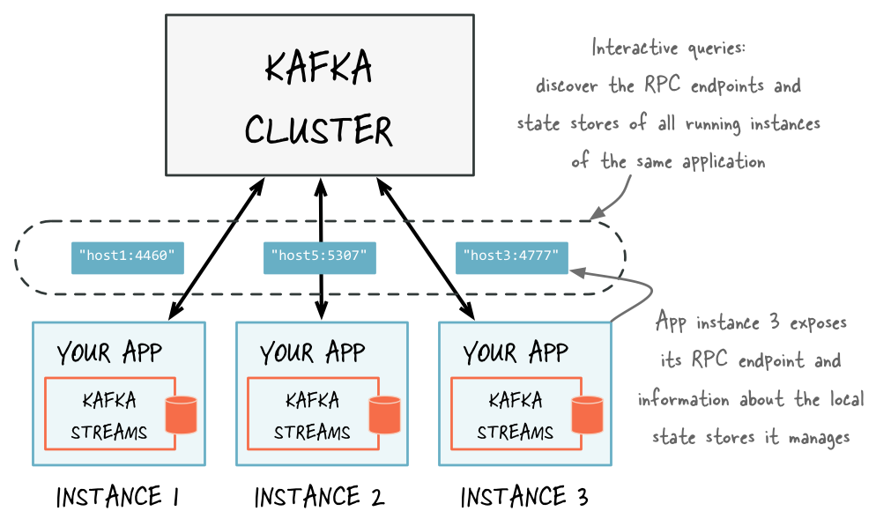
Interactive Queries
Expose API to access local store and use it when the result includes remote instance.
Each instance needs a unique DNS name define in application.server properties

Slide 32
Pros & Cons
Considerations to what does this all mean…
Pros
A lightweight client library provides a lot of processing power
Manual creation of streaming transforms helps to keep use cases small in scope
No additional middleware is required besides your app and Kafka
Simple connectivity to existing Kafka clusters.
Freely licensed OSS component of Apache Kafka.
Cons
Java (and Scala) only
Deeper Kafka experience is required
Ability to manually create abstracted transforms can quickly create performance hogs
Maintain integrations & environments via Dev teams.
No batch support

Slide 33
Questions?

