Slide 1








OpenShift Single Cluster
openshift-gitops
openshift-pipelines
Ibm-common-services
kc-solution-dev
kc-solution-staging
Cp4i Platform Navigator
Cp4i Platform Navigator
es-staging
k-dev
OpenShift Cluster
Ibm-common-services
Cp4i-prod
kc-solution-gitops
es-prod

Slide 2
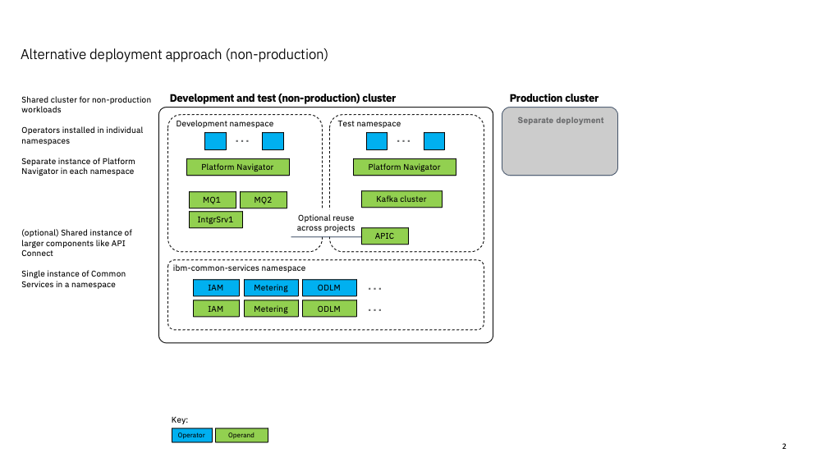

Slide 3
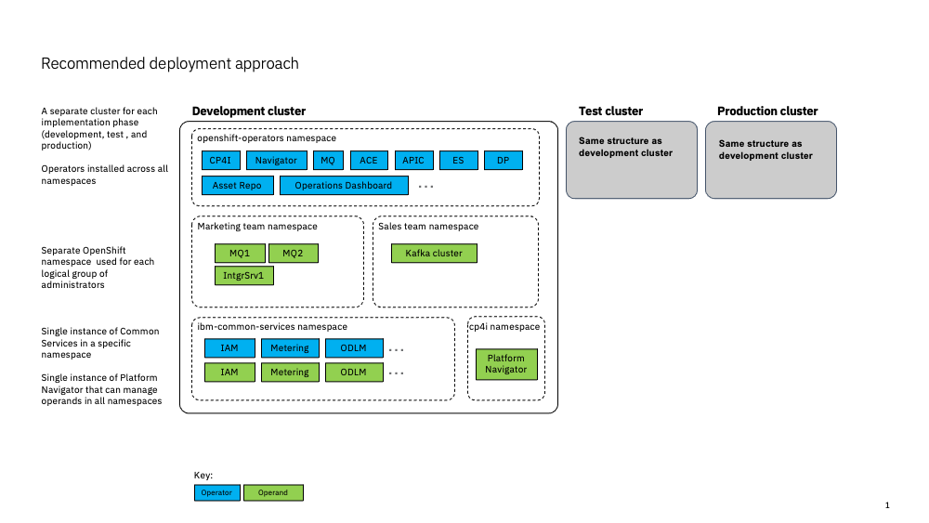

Slide 4
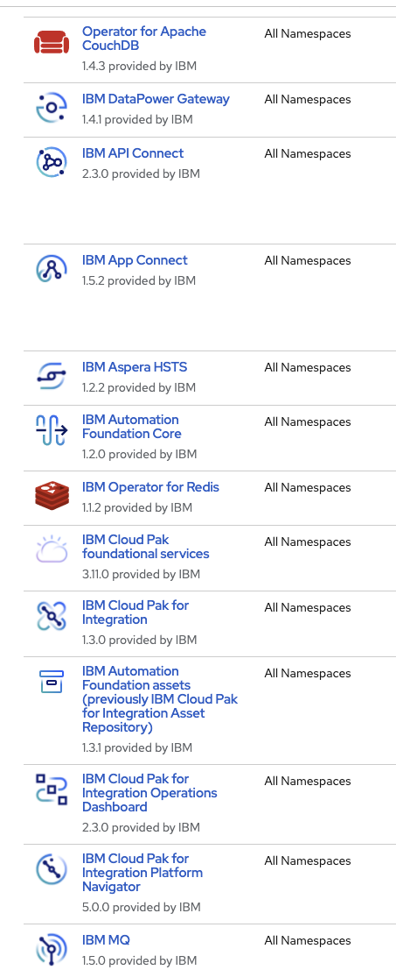
CP4I operators

Slide 6
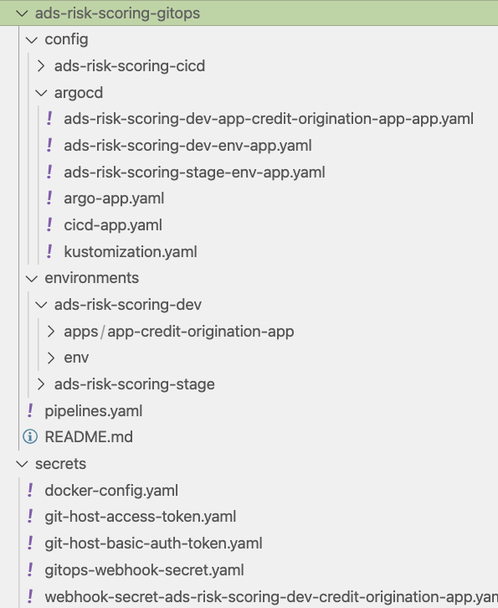
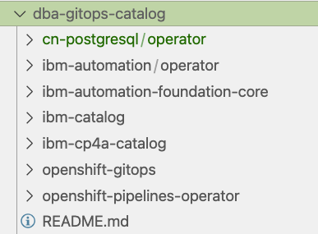
KAM for solution-gitops
Solution gitops defines how to deploy the services of this solution
But also the dependent products, or if the products are multi tenants
Then we can isolate the product deployment in an –infra repository?
-catalog can be used to define
Operators and multi tenant instances

Slide 7

bootstrap
Deploy OpenShift GitOps operator
Create ArgoCD projects and app of app for environment
Creates namespaces / projects for the IBM products
Create image catalog definitions
Create operators: pipelines, dependent ibm product operators
Create services: dependent IBM products, non IBM products
Create ci/cd tasks, pipelines, event listeners
Create app for app for solution
Bootstrap environment and ci/cd
Bootstrap solution apps deployment
SRE
ci-pipeline
Create first app images
Create local dev env.
Git push biz-app
Dev

Slide 8

Tekton
Specific
Reusable
PipelineRun
Pipeline
*
Task
*
PipelineResource
*
TriggerTemplate
gtihub
template
app service
webhook
*
imageRepository name for the app to build
EventListener
TriggerBinding
triggers
Map parameters from HTTP request message sent by git
so, they can be used in pipeline run
app service
webhook
Route
Interceptors
Secrets
Webhook-secret-key

