Slide 1





OpenShift Single Cluster
openshift-gitops
openshift-pipelines
kc-solution-dev
event-streams-staging
kc-solution-staging
event-streams-prod
kc-solution-gitops
mq-staging
mq-prod

Slide 2

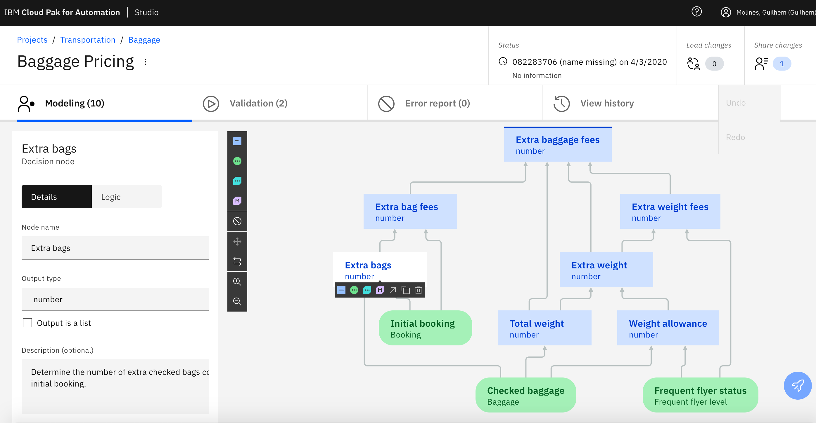


Staging Cluster
Production cluster
ADS Studio
ADS run time
0
Business
Analyst
1
3
Solution-gitops
Solution-ns
1
ADS run time
Biz App
1
Solution-cicd
cp4auto
app pipeline
ADS pipeline
Database
LDAP
2
Tools
Image registry
Artifactory
Common service
Dev
app service
ADS rules
Solution-gitops
2
Notes:
0- install cluster and needed minimum operator like GitOps one
1- bootstrap ArgoCD app of apps

Slide 3
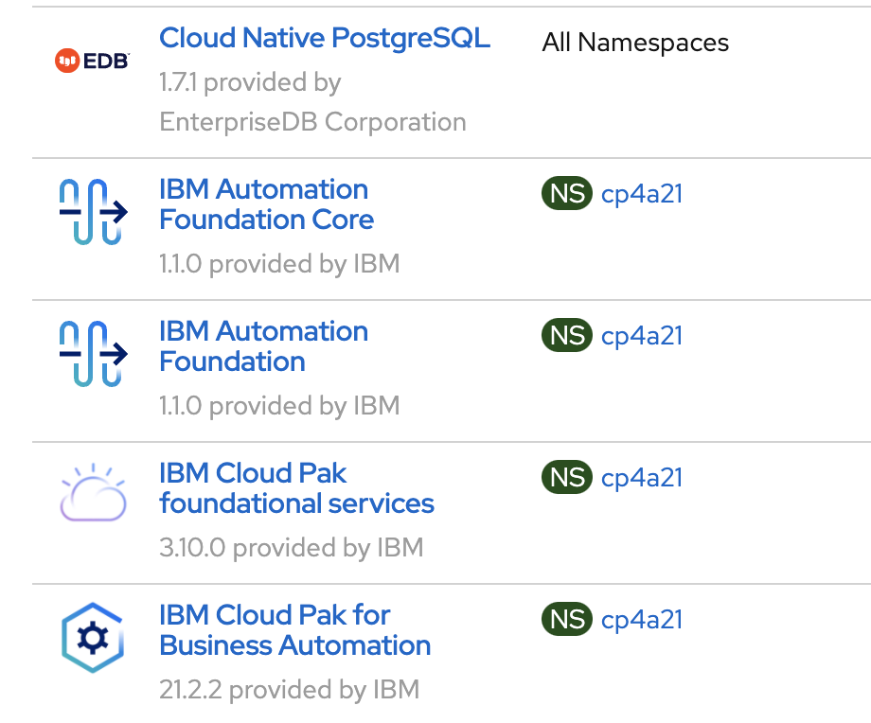
DBA Operators
Ibm-common-service
openshift-gitops
Openshift-pipelines
cp4a21
openldap
risk-scoring-solution-dev
risk-scoring-solution-staging
risk-scoring-solution-gitops

Slide 4
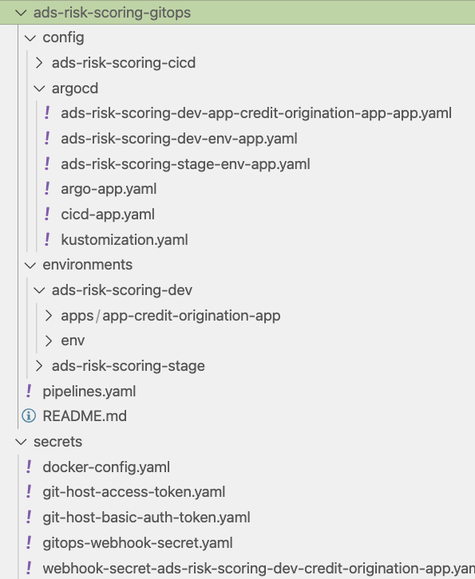
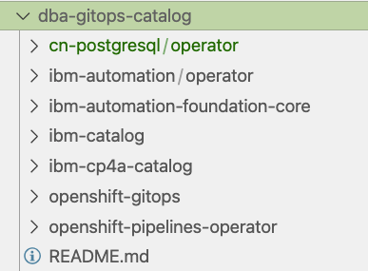
KAM for solution-gitops
Solution gitops defines how to deploy the services of this solution
But also the dependent products, or if the products are multi tenants
Then we can isolate the product deployment in an –infra repository?
-catalog can be used to define
Operators and multi tenant instances

Slide 5
bootstrap
Deploy OpenShift GitOps operator
Create ArgoCD projects and app of app for environment
Creates namespaces / projects for the IBM products
Create image catalog definitions
Create operators: pipelines, dependent ibm product operators
Create services: dependent IBM products, non IBM products
Create ci/cd tasks, pipelines, event listeners
Create app for app for solution
Bootstrap environment and ci/cd
Bootstrap solution apps deployment
SRE
ci-pipeline
Create first app images
Create local dev env.
Git push biz-app
Dev

Slide 6
Tekton
Specific
Reusable
PipelineRun
Pipeline
*
Task
*
PipelineResource
*
TriggerTemplate
gtihub
template
app service
webhook
*
imageRepository name for the app to build
EventListener
TriggerBinding
triggers
Map parameters from HTTP request message sent by git
so, they can be used in pipeline run
app service
webhook
Route
Interceptors
Secrets
Webhook-secret-key

Slide 7
Stging Cluster
Runtime cluster A
ADS Studio
Solution-gitops
Solution-ns
Business
Analyst
ADS run time
Biz App
Solution-cicd
Runtime cluster B
app pipeline
rules pipeline
Solution-ns
ADS run time
Biz App
app service
ADS rules
Solution-gitops

Slide 8
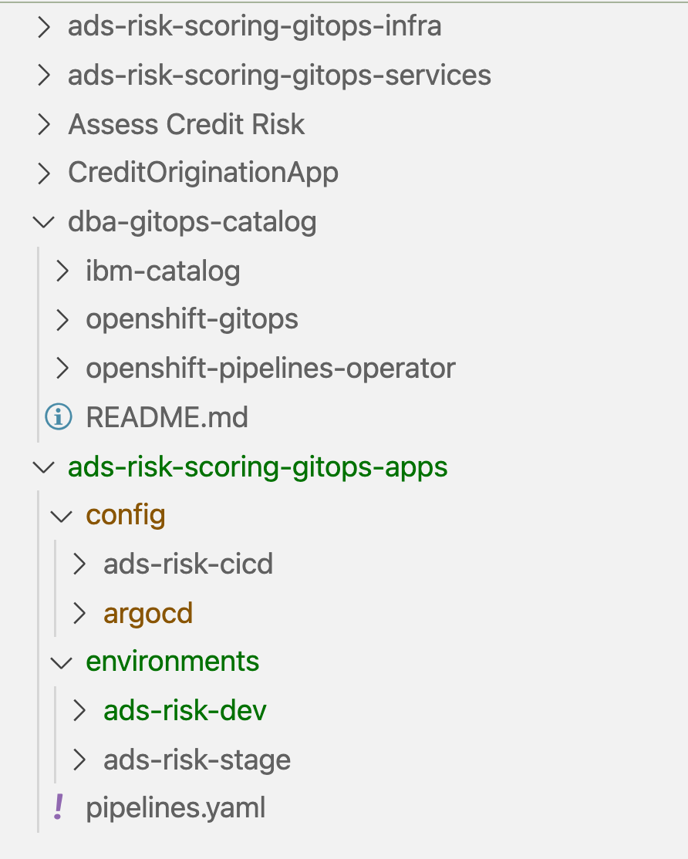
SRE
Multi-tenant component deployments & Operator
ADS service source code
Quarkus App client to ADS service
Different operator manifests: Openshift GitOps OpenShift pipelines
Bitnami Sealed secrets
Dev
gitops repository using KAM CLI
cicd pipelines - task
SRE
Notes:
Dev is setting up the pipeline

