Slide 1

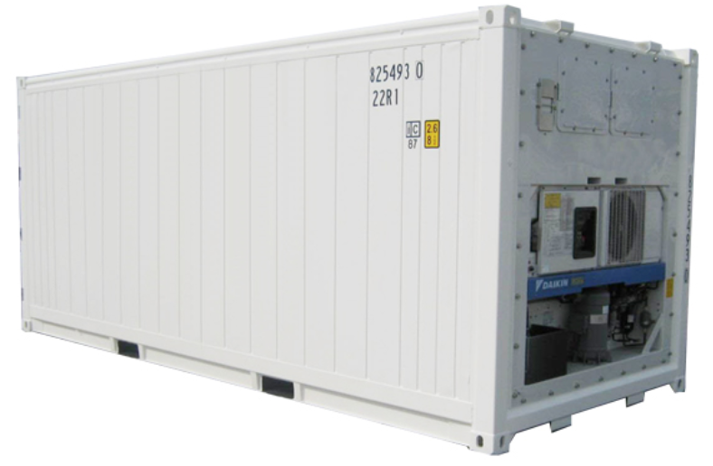





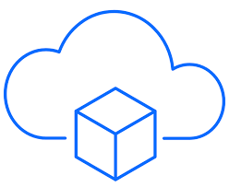




Architecture
Cloud native app
Data Ingestion
Event driven microservice
Event driven microservice
Change Data Capture
Data in motion
0
1
2
3
4
mqtt
HTTP
Connect
Data Storage
Real Time Analytics
Big Data Cluster
Streams Analytics
Kafka Streams
Python pickle model
Data Science

Slide 2
Architecture
Cloud native app
Data Ingestion
Container MS
Simulator MS
Data in motion
0
1
2
3
4
Data Storage
Real Time Analytics
Big Data Cluster
Scoring Agent
Pickle model
Data Science

Slide 3
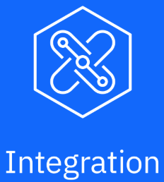

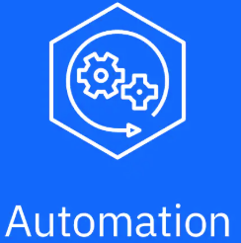
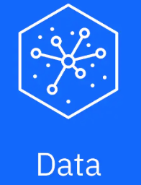

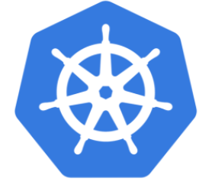
Cloud Pak Solution
Application
Reefer Simulator
Scoring Agent
BPM app
Container MS
Predictive service
IBM Cloud Services
Cloud Pak
Cloud Pak
MCM

Slide 4




Cloud Pak Approach Solution
Cluster
Application
IBM Cloud Services
Container MS
Reefer Simulator
Products
telemetries
Scoring MS
Data In Motion
Event Streams
BPM app
Collect / Organize/ Analyze
Data Virtualization
Anomaly Detection Notebook
Anomaly Detection Service

Slide 5
Cloud Pak Approach Solution
Cluster
Application
IBM Cloud Services
Container MS
Reefer Simulator
1
2
Products
telemetries
Scoring MS
6
5
7
Data In Motion
Event Streams
4
BPM app
3
12
Collect / Organize/ Analyze
Data Virtualization
Anomaly Detection Notebook
Anomaly Detection Service
11
8
9
10

Slide 6

Appsody
Developer’s Workstation
Cluster
2
Namespace
IDE
App Based on Stack
3
App Container
CLI
1
Appsody Repository
Image Repository
Stack
Stack
Stack
App Image
Notes:
Appsody has different components working together to simplify developing cloud native app deployable on Kubernetes.

Slide 7



CI
Project Git Repository
Git push
master branch
Webhook:
action dispatcher
Developer’s Workstation
IDE
App Based on Stack
Solution GitOps Repository
Git push
Modified yaml
With docker tag
Appsody test
CLI
docker push
Docker hub Repository
Notes:
Webhook helps to control the integration with other component of the development process: when an action is done on the github.com app, an avent is generated, webhook subscribe to such event to perform something like a HTTP POST to the specified URL. Webhooks can be used to update an external issue tracker, trigger CI builds, update a backup mirror, or even deploy to your production server

Slide 8

CD
Solution GitOps Repository
K8s Yaml files
Git push
Docker hub Repository
Developer’s Workstation
App Image
IDE
synch
Kubectl …
Cluster
ArgoCD
Eda-namespace
Notes:
Webhook helps to control the integration with other component of the development process: when an action is done on the github.com app, an avent is generated, webhook subscribe to such event to perform something like a HTTP POST to the specified URL. Webhooks can be used to update an external issue tracker, trigger CI builds, update a backup mirror, or even deploy to your production server

Slide 9
CD
Solution GitOps Repository
K8s Yaml files
Git push
Docker hub Repository
Developer’s Workstation
App Image
IDE
synch
Kubectl …
Cluster
Tekton pipelines
Eda-namespace
Notes:
Webhook helps to control the integration with other component of the development process: when an action is done on the github.com app, an avent is generated, webhook subscribe to such event to perform something like a HTTP POST to the specified URL. Webhooks can be used to update an external issue tracker, trigger CI builds, update a backup mirror, or even deploy to your production server

Slide 10

Reefer Container - HL
UI Web SPA
Submit order
Update Order
Accept Order
Get Submitted Orders
UI Web SPA
Search Voyages
Get Pending Orders
Manuf
Shipment Inc
Order Mgt MS
voyageEvt
Voyages
Mgt MS
Voyages
Order
Anomaly detection scoring
orderEvents
Containers
Problems
Event Backbone
voyages
Ships
orders
Store
Fleet / Ships
Simulator MS
Container Mgt MS
containers
Notes:
Map geographic
Multiple ships
Ship

Slide 11



ML runtime architecture
Curl …
2
Reefer Telemetry Agent
4
1
Anomaly Detection Scoring WML
Reefer Simulator
Kafka Producer
5
reeferTelemetries
3
0
1
2
3
4
5
6
7
0
1
2
3
4
6
7
8
containers
Reefer Container Manager
Reefer Maintenance Business Process
Notes:
What to consider:
-

Slide 12
ML runtime architecture
Curl …
2
4
Anomaly Detection Scoring
1
Reefer Simulator
Kafka Producer
reeferTelemetries
3
0
1
2
3
4
5
6
7
0
1
2
3
4
5
6
7
containers
Container Consumer
Reefer Maintenance Business Process
Notes:
What to consider:
-

Slide 13
Event Stream to long term Event Store for ML
Python
1
SimulatorTool
Machine Learning Environment
Pandas DF
Reefer telemetries
Long term persist stream
Reefers Inventory
Products
Python
SimulatorApp
0
1
2
3
4
5
reeferTelemetries
2

Slide 14
Event Stream As Event Store for ML
Python
ML Environment
Kafka Consumer
Simulator
Pandas DF
Reefers Inventory
Products
0
1
2
3
4
5
reeferTelemetries

