Slide 1


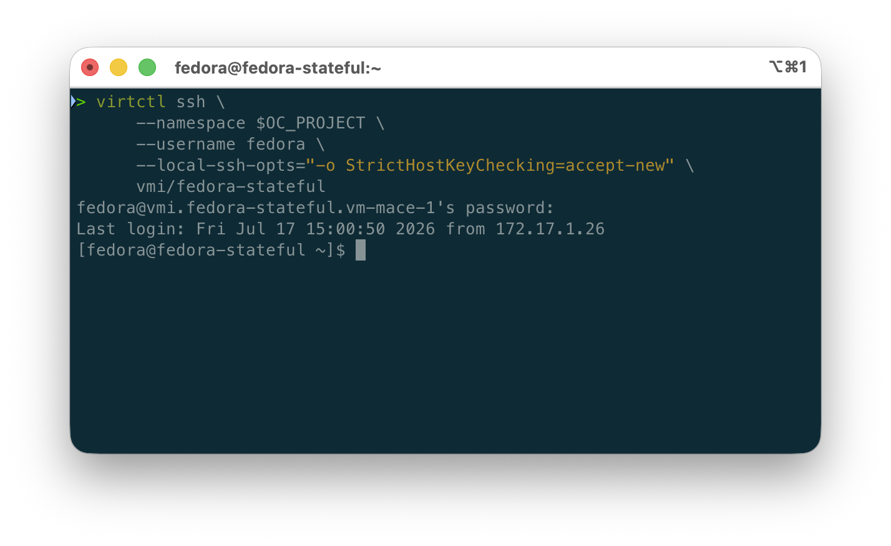

IBM Cloud Account
Developer Terminal
Region
Resource Group (RG)
ROVS
Red Hat OpenShift Virtualization Service
oc login
Project
VPC Load Balancer
Route
Internet
Service
Virtual Machine
Server
virtctl

