Slide 1

OMS Knowledge Assistant
IBM Supply Chain Assets
Ecosystem Engineering – SI Lab
Sustainability Software Squad
Deepa Manchikanti
Priya Vasudevan
Suja Mohandas
IBM Sterling Order Management Powered by watsonx.ai

Slide 2
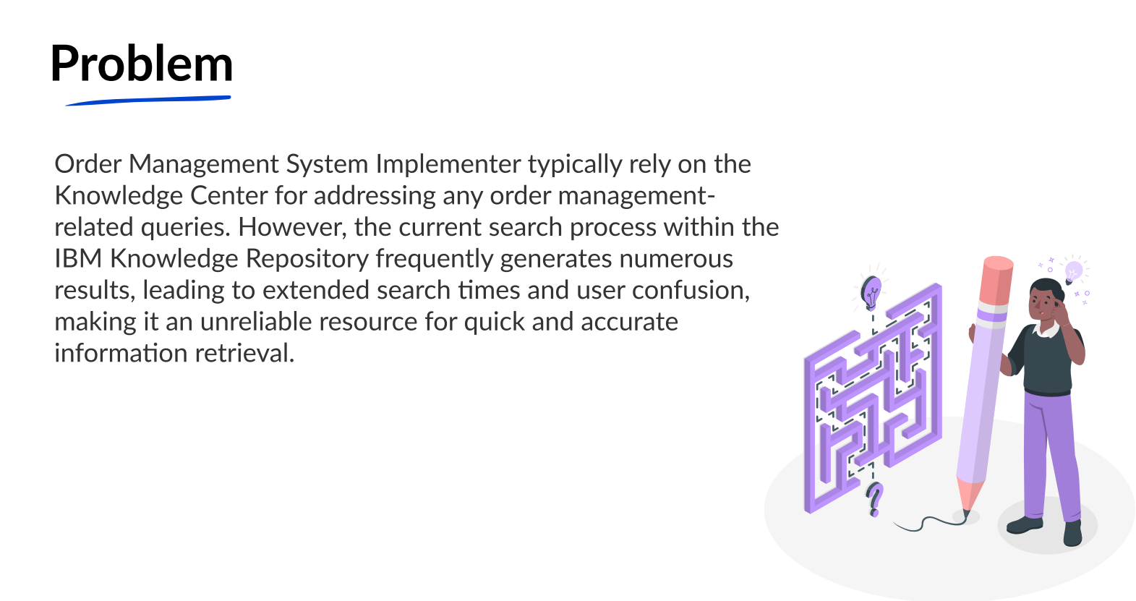

Slide 3
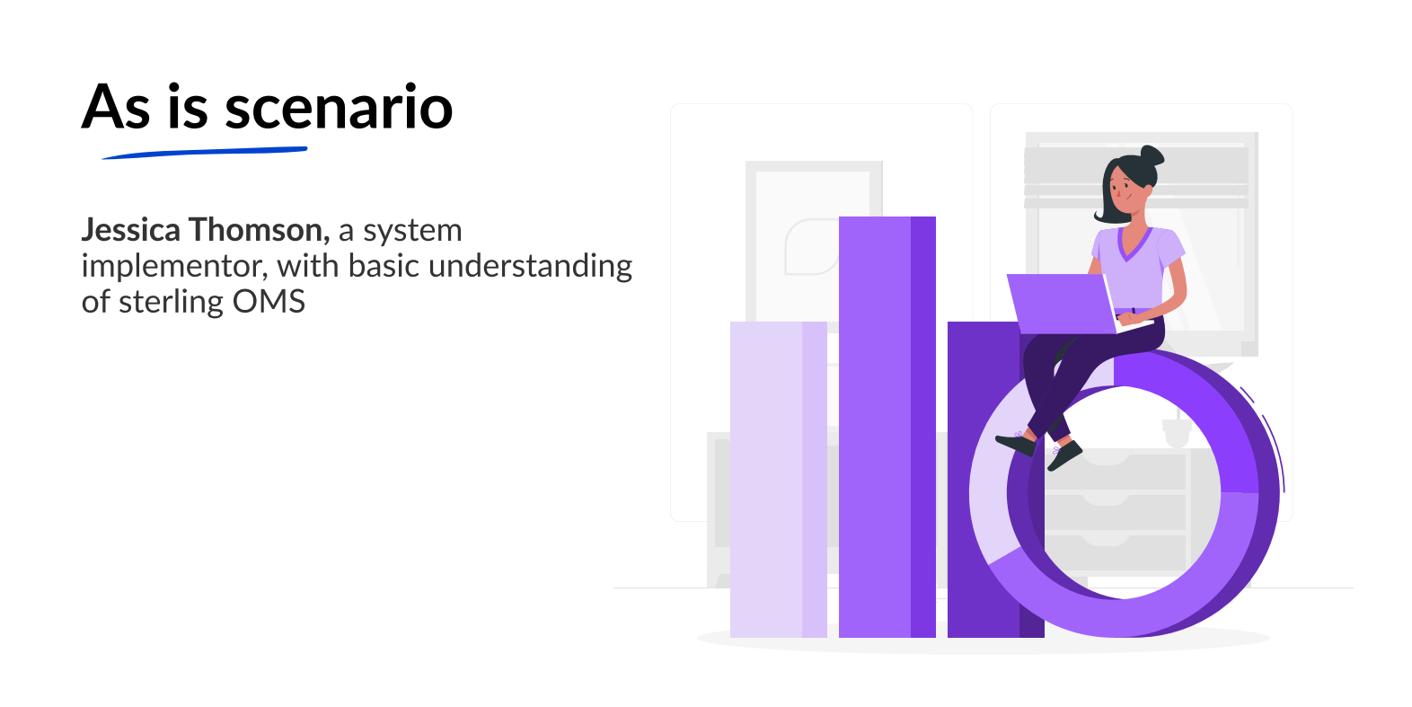

Slide 4
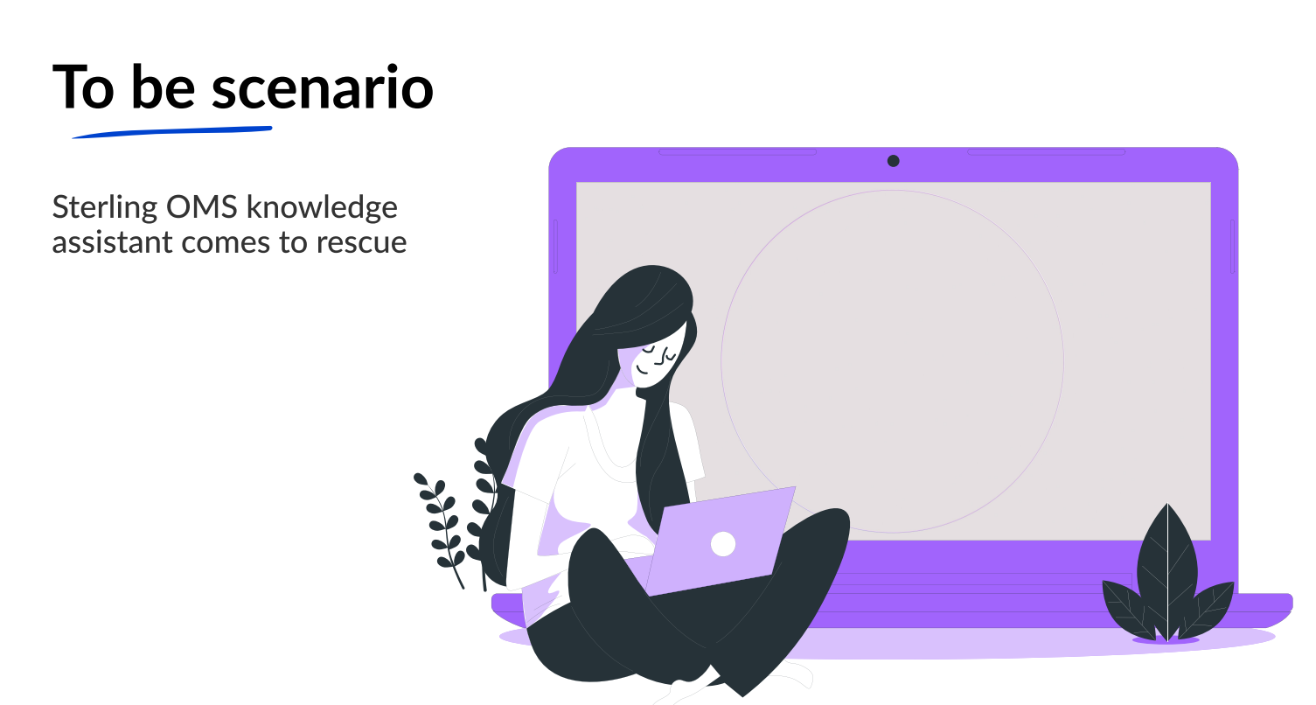
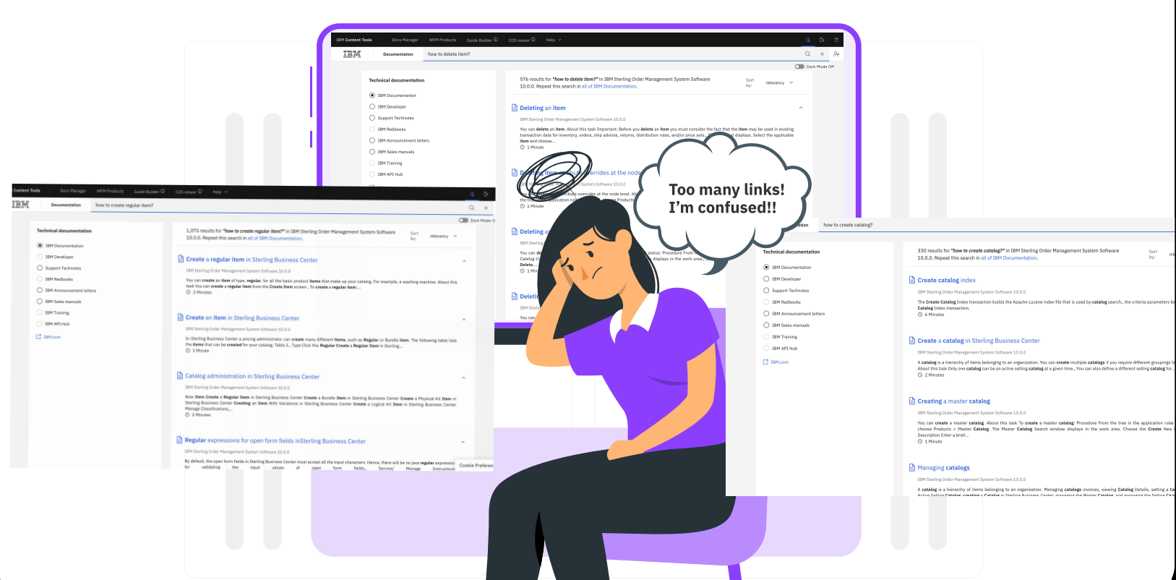
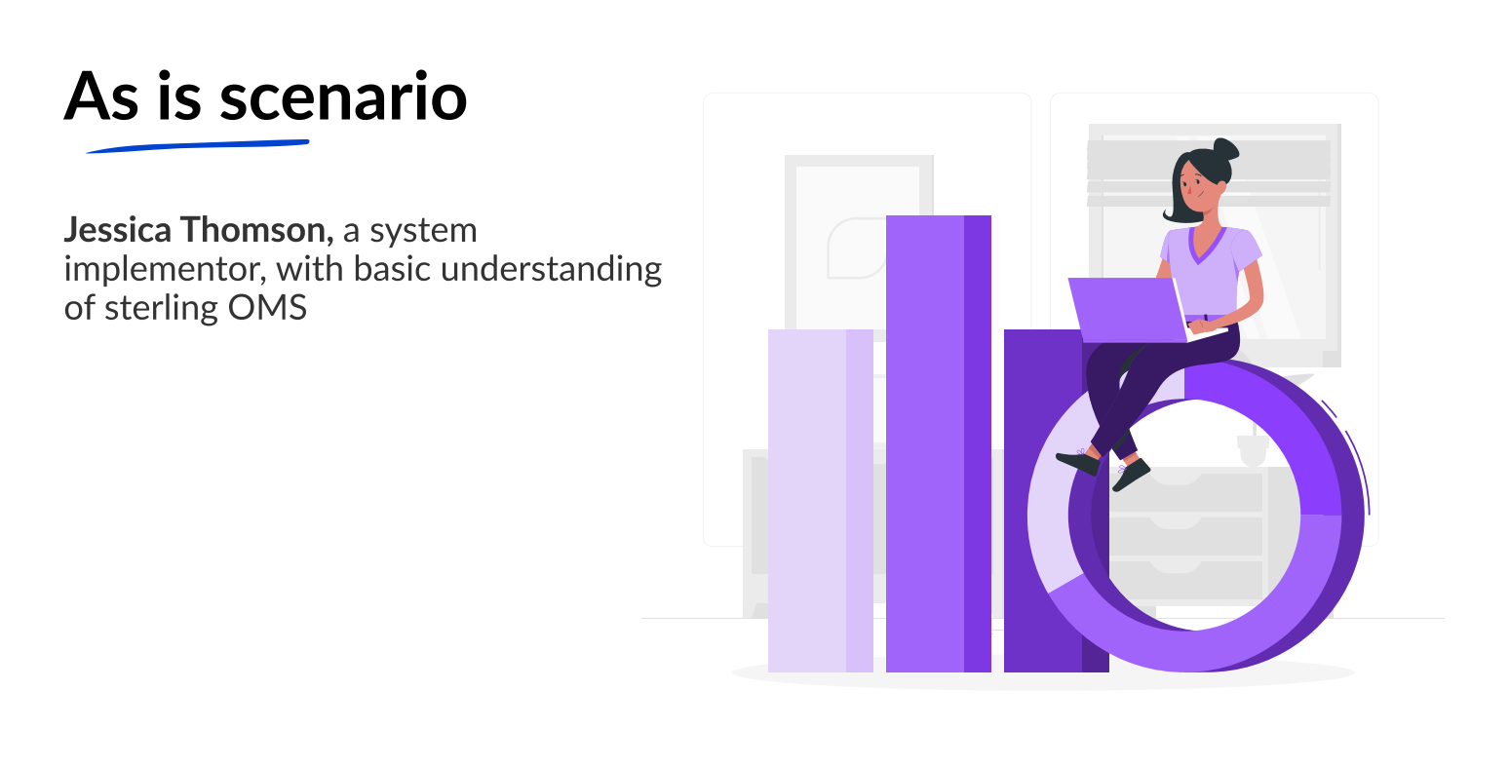

Slide 5
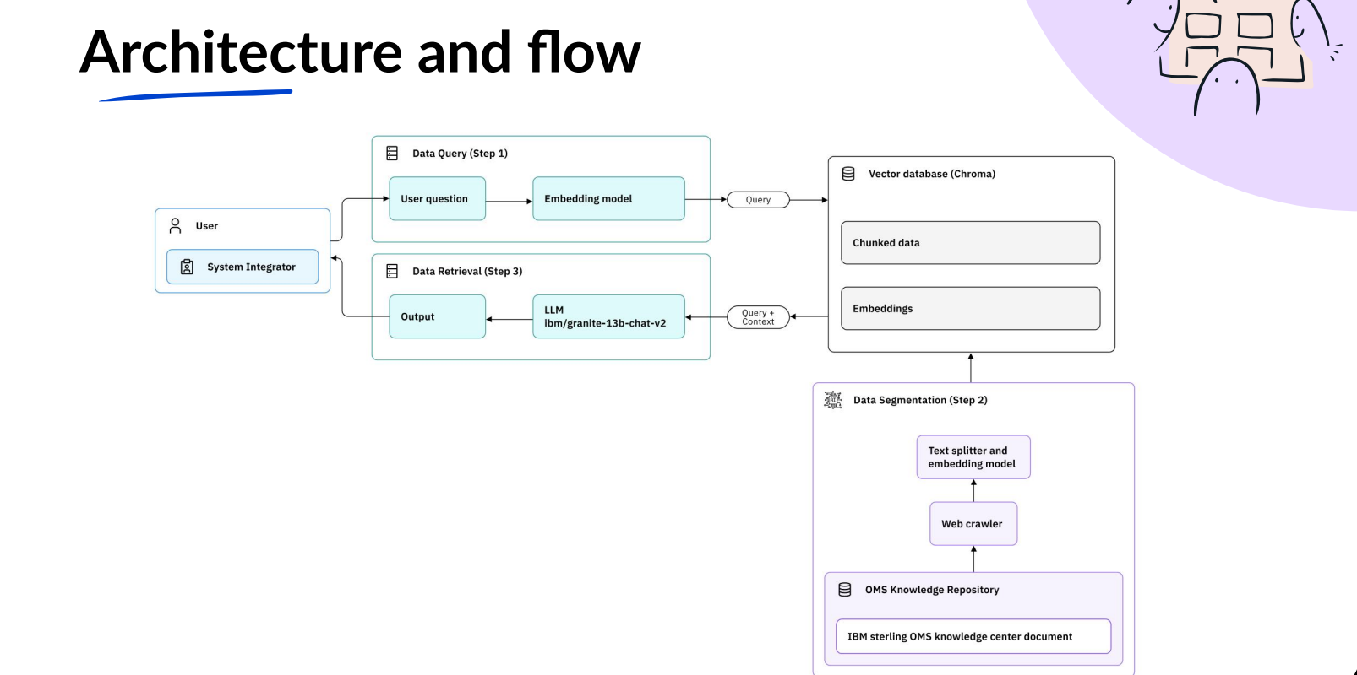

Slide 6
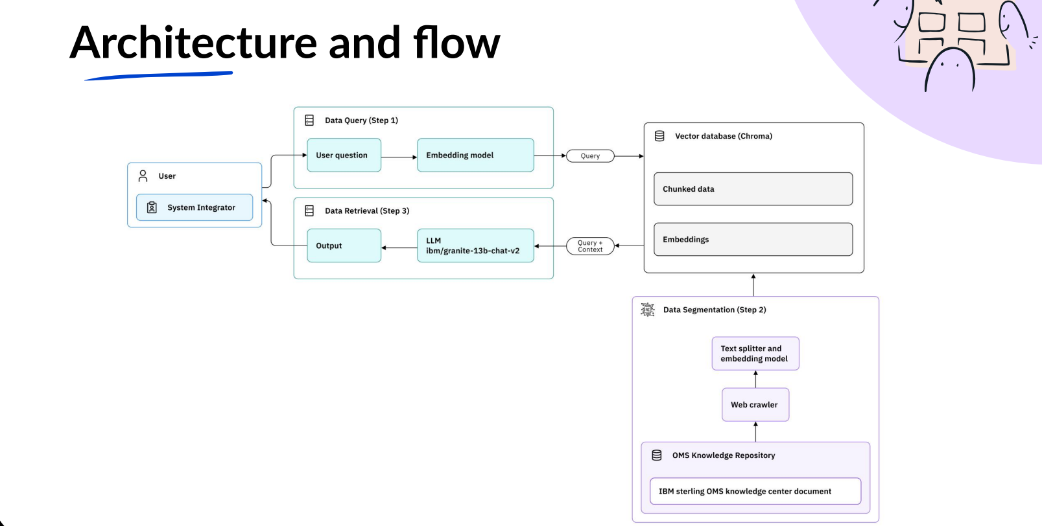
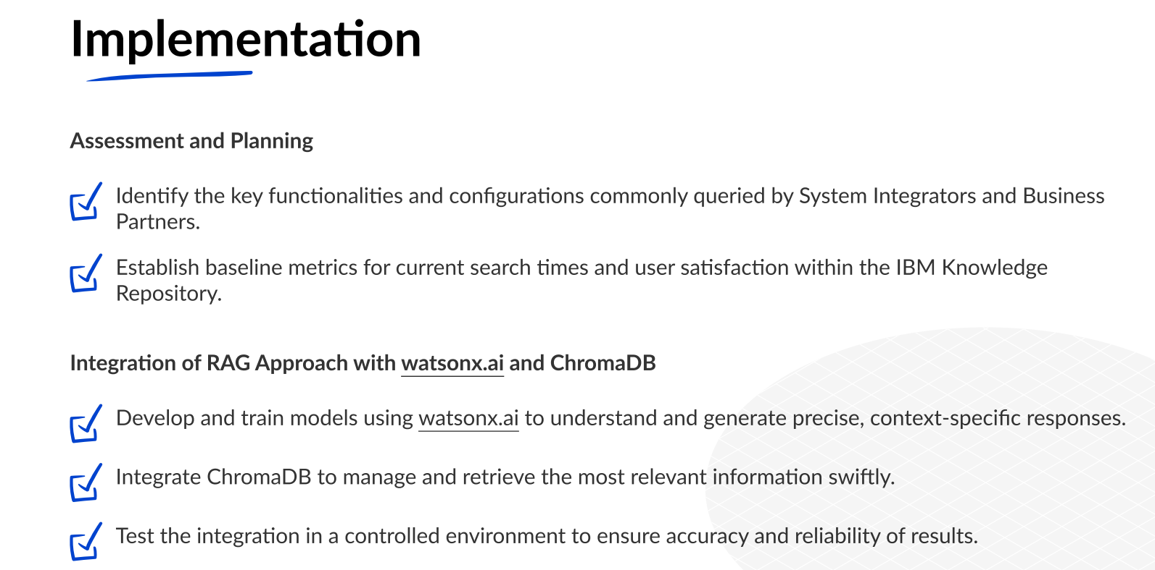

Slide 7
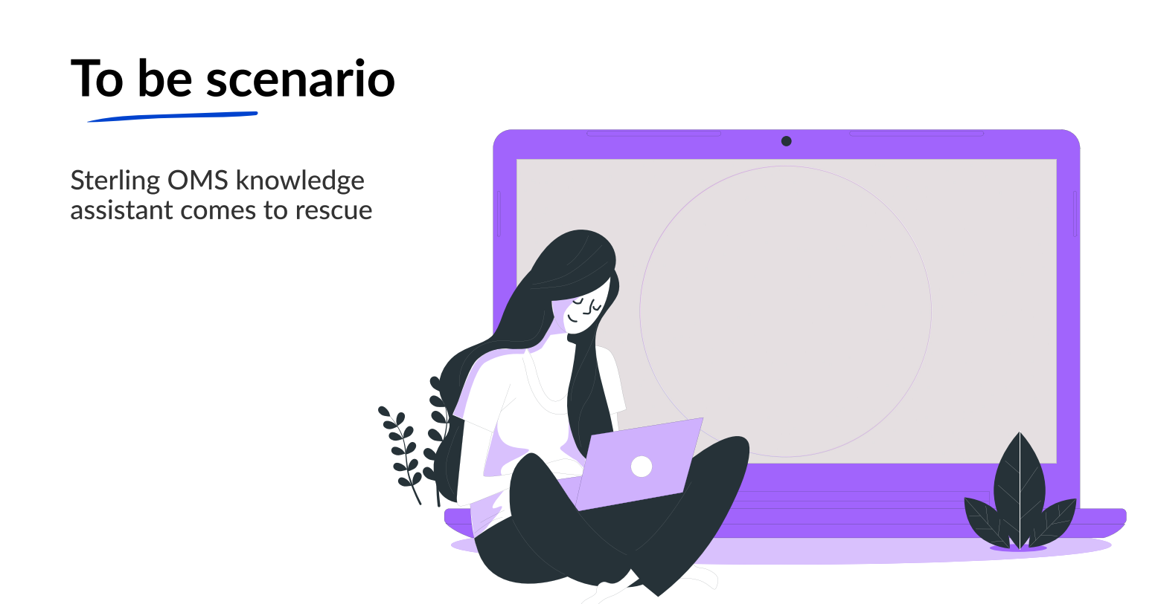

Slide 8
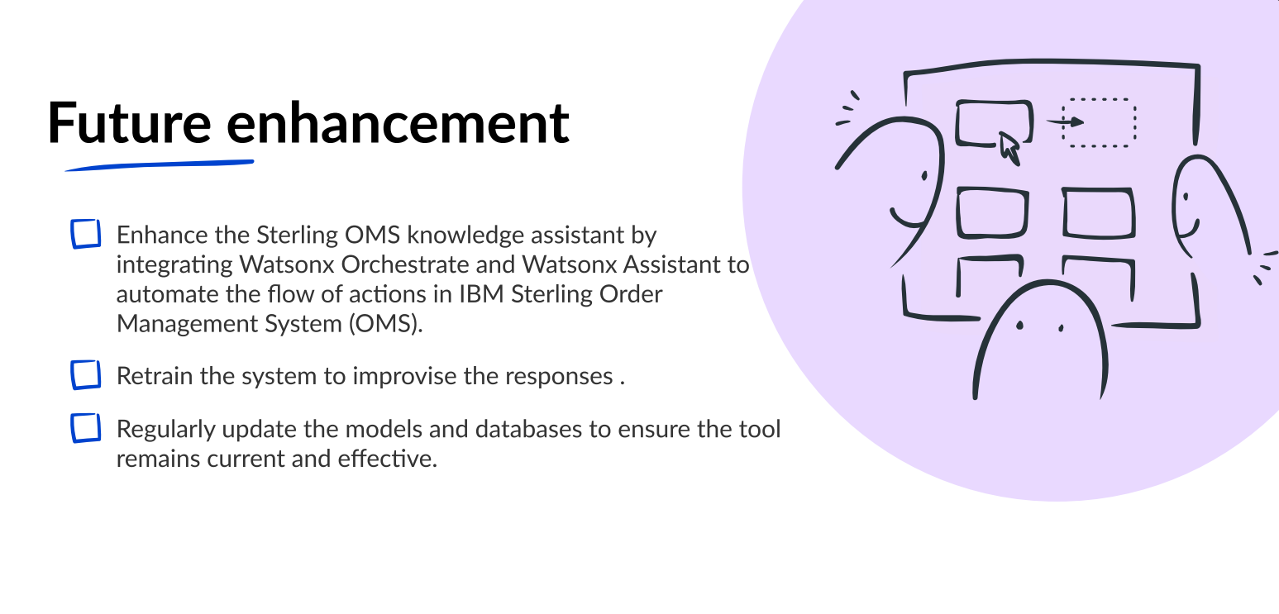

Slide 9
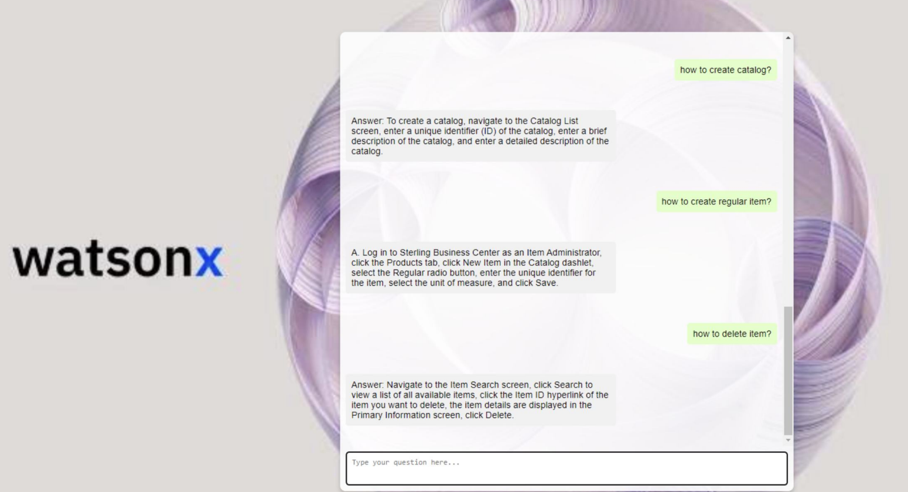

Supply Chain Intelligence Suite (SCIS)
Notes:
Clients can put AI to work with watsonx
Scale and accelerate the impact of AI with trusted data.
Train, tune and deploy AI across your business, leveraging critical, trusted data wherever it resides.
IBM watsonx is an exciting new IBM AI and data platform that represents five years of focused effort in the making. Recalling when Watson first started and competed on Jeopardy, it’s been nearly 13 years of work that has gotten IBM to this moment. And it's not just IBM, because IBM is integrating partners (like Hugging Face, where the targeted communities share open models) as part of this solution in AI for business, one model will not rule them all.

Slide 10


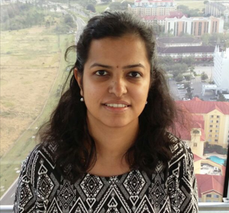
Deepa Manchikanti
Program Director,
WW Sustainability Squad Leader,
Ecosystem Engineering - SI Lab
dmanchik@in.ibm.com
OMS-Knowledge-Assistant
https://github.com/ibm-ecosystem-engineering/OMS-Knowledge-Assistant-watsonx.ai/tree/main
Sustainability Software Assets are available here in Seismic
https://ibm.seismic.com/Link/Content/DC6WhJ2pQR7XXG2BhXXTgW9pgpT3
Priya Vasudevan
Senior Technical Architect
Ecosystem Engineering - SI Lab
priya_vasudevan@in.ibm.com
Suja Mohandas
Technology Engineer
Ecosystem Engineering - SI Lab
sujamoha@in.ibm.com

