Slide 1
IBM Hackathon Team 1 Submission
Greg Hamilton, Mari Cieszynski, and Mike Nelson

Slide 2
Presentation Overview
Problem and background
Outline of our approach
Code workflow
Conclusions

Slide 3
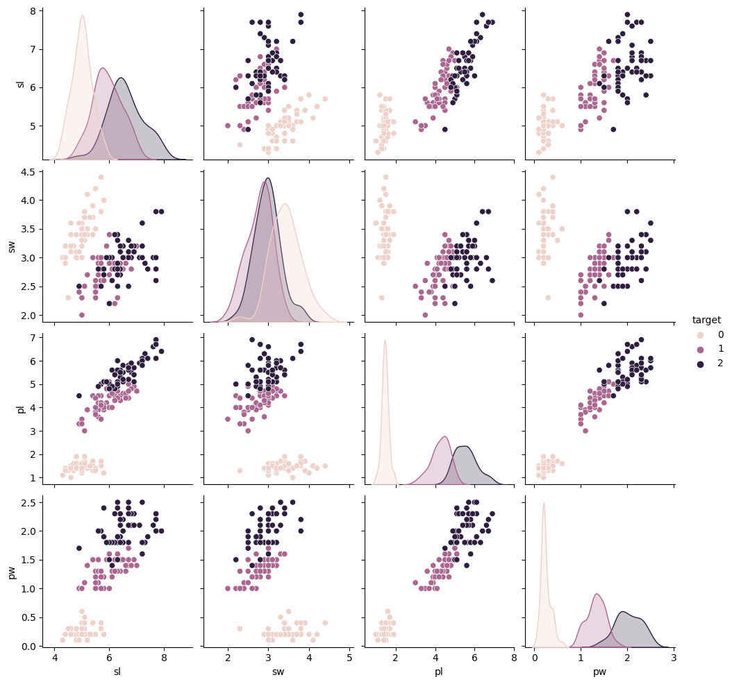
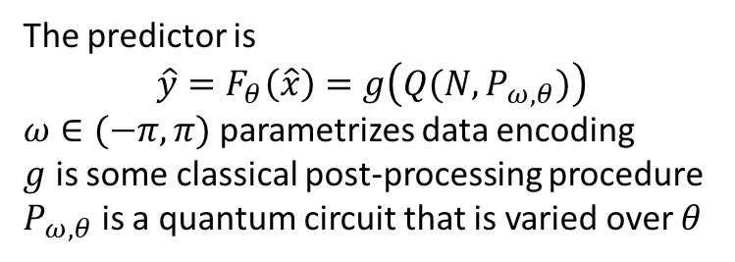
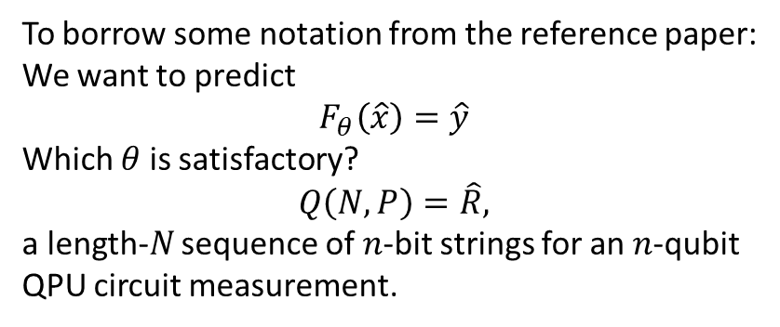
Problem and Background
We address the task of classifying the Iris Dataset on a QPU
This is a ternary classification problem, with two linearly non-separable classes.
We also apply a variational quantum algorithm.
To borrow some notation from the reference paper:
We want to predict
$$F_{θ}\left(\hat{x}\right)=\hat{y}$$
Which $θ$ is satisfactory?
$$Q\left(N,P\right)=\hat{R},$$
a length-$N$ sequence of $n$-bit strings for an $n$-qubit QPU circuit measurement.
The predictor is
$$\hat{y}=F_{θ}\left(\hat{x}\right)=g\left(Q(N,P_{ω,θ})\right)$$
$ω∈(−π,π)$ parametrizes data encoding
$g$ is some classical post-processing procedure
$P_{ω,θ}$ is a quantum circuit that is varied over $θ$

Slide 4
Outline of our approach
The solution to the task follows these main pieces:
Classical preprocessing
Data encoding strategy
Our circuit design
Association of the measurement outcome to data classes
Loss function and optimization

Slide 5
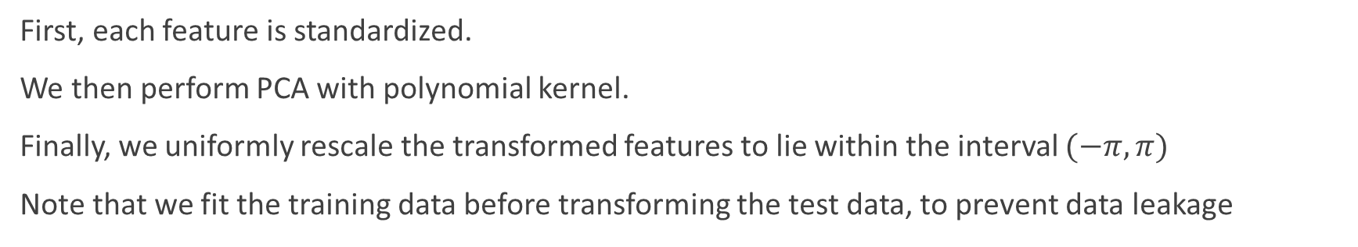
Preprocessing and encoding
First, each feature is standardized.
We then perform PCA with polynomial kernel.
Finally, we uniformly rescale the transformed features to lie within the interval $(−π,π)$
Note that we fit the training data before transforming the test data, to prevent data leakage

Slide 6
















Our circuit
Encoded features were re-uploaded
A total of ten variational parameters were used in gates
$$|0⟩$$
$$R_{x}(ω_{0})$$
$$R_{y}(θ_{0})$$
$$R_{Z}(ω_{1})$$
$$R_{x}(θ_{1})$$
$$R_{x}(ω_{2})$$
$$R_{z}(θ_{2})$$
$$R_{y}(ω_{3})$$
$$U_{1}=U\left(θ_{4},θ_{5},θ_{6}\right)$$
$$U_{2}=U(θ_{7},θ_{8},θ_{9})$$
$$R_{y}(θ_{3})$$
$$U_{1}$$
$$R_{x}(ω_{0})$$
$$R_{z}(ω_{1})$$
$$R_{x}(ω_{2})$$
$$R_{y}(ω_{3})$$
$$U_{2}$$
We followed Qiskit’s CircuitQNN and NeuralNetworkClassifier classes (with modification), optimized using COBYLA

Slide 7
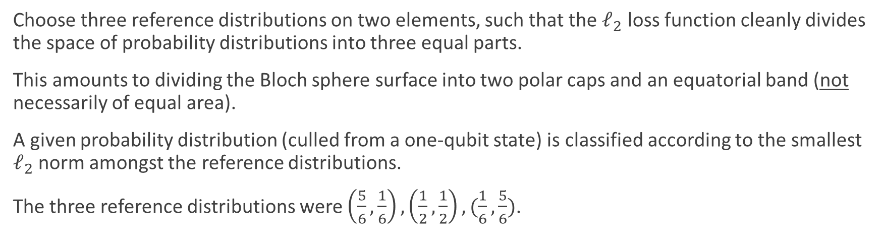
Quantum Circuit Classification
Choose three reference distributions on two elements, such that the $ℓ_{2}$ loss function cleanly divides the space of probability distributions into three equal parts.
This amounts to dividing the Bloch sphere surface into two polar caps and an equatorial band (not necessarily of equal area).
A given probability distribution (culled from a one-qubit state) is classified according to the smallest $ℓ_{2}$ norm amongst the reference distributions.
The three reference distributions were $\left(\frac{5}{6},\frac{1}{6}\right), \left(\frac{1}{2},\frac{1}{2}\right), (\frac{1}{6},\frac{5}{6})$.

Slide 8
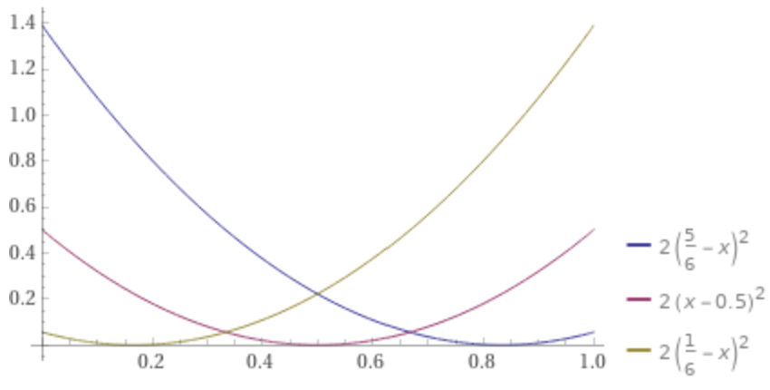






Quantum Circuit Classification
$$|0⟩$$
$$l_{2}$$
$$φ≈{70.53}^{∘}$$
$$|1⟩$$
$$φ≈{109.47}^{∘}$$
$$P(1)$$

Slide 9
Loss function, optimization, results
Using only one qubit, our approach achieved$74.00±.07 \%$ accuracy as measured through stratified five-fold cross-validation.

Slide 10
Some Qiskit workflow notes
Our code is written as a Jupyter notebook for the IBM Q Platform.
Results were run on classical simulators.
Portions of the code are adapted from Qiskit machine learning.
Notably, the neural network classifier class is modified slightly to fit our approach.

Slide 11
END

