Slide 1



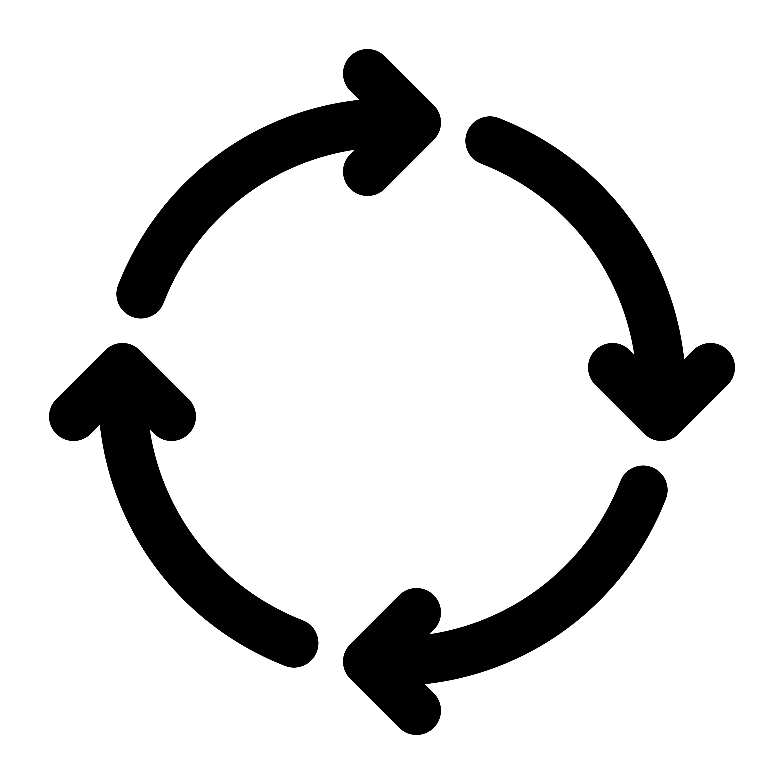




Firewall
pip download
Staging
Repository
Production
Repository
Package Repository
review
pip install
downloads.pyaitoolkit.ibm.net
sysadmin
sysadmin
dev/test
IBM Cloud
production
staging area

Slide 2

staging area
Firewall
Internal
Package Repository
Package Repository
sysadmin
pip download
review
fully reviewed
packages
built packages
vetting
dev/test
vetting
project source
Open source communities
production

Slide 3











contributors
Open Source
community repository
IBM Z Open Source
repository
IBM Toolkit
team
pypi.org
system administrators
downloads.pyaitoolkit.ibm.net

Slide 4
contributors
acme_widget
V2.4.13
Dependency Confusion
Open Source
community
repository
IBM Z OSS
repository
IBM Toolkit
team
acme_widget
V2.5.1
acme_widget
V2.4.13
acme_widget
V2.4.13
pypi.org
system administrators
downloads.pyaitoolkit.ibm.net
acme_widget
V2.5.1

Slide 5
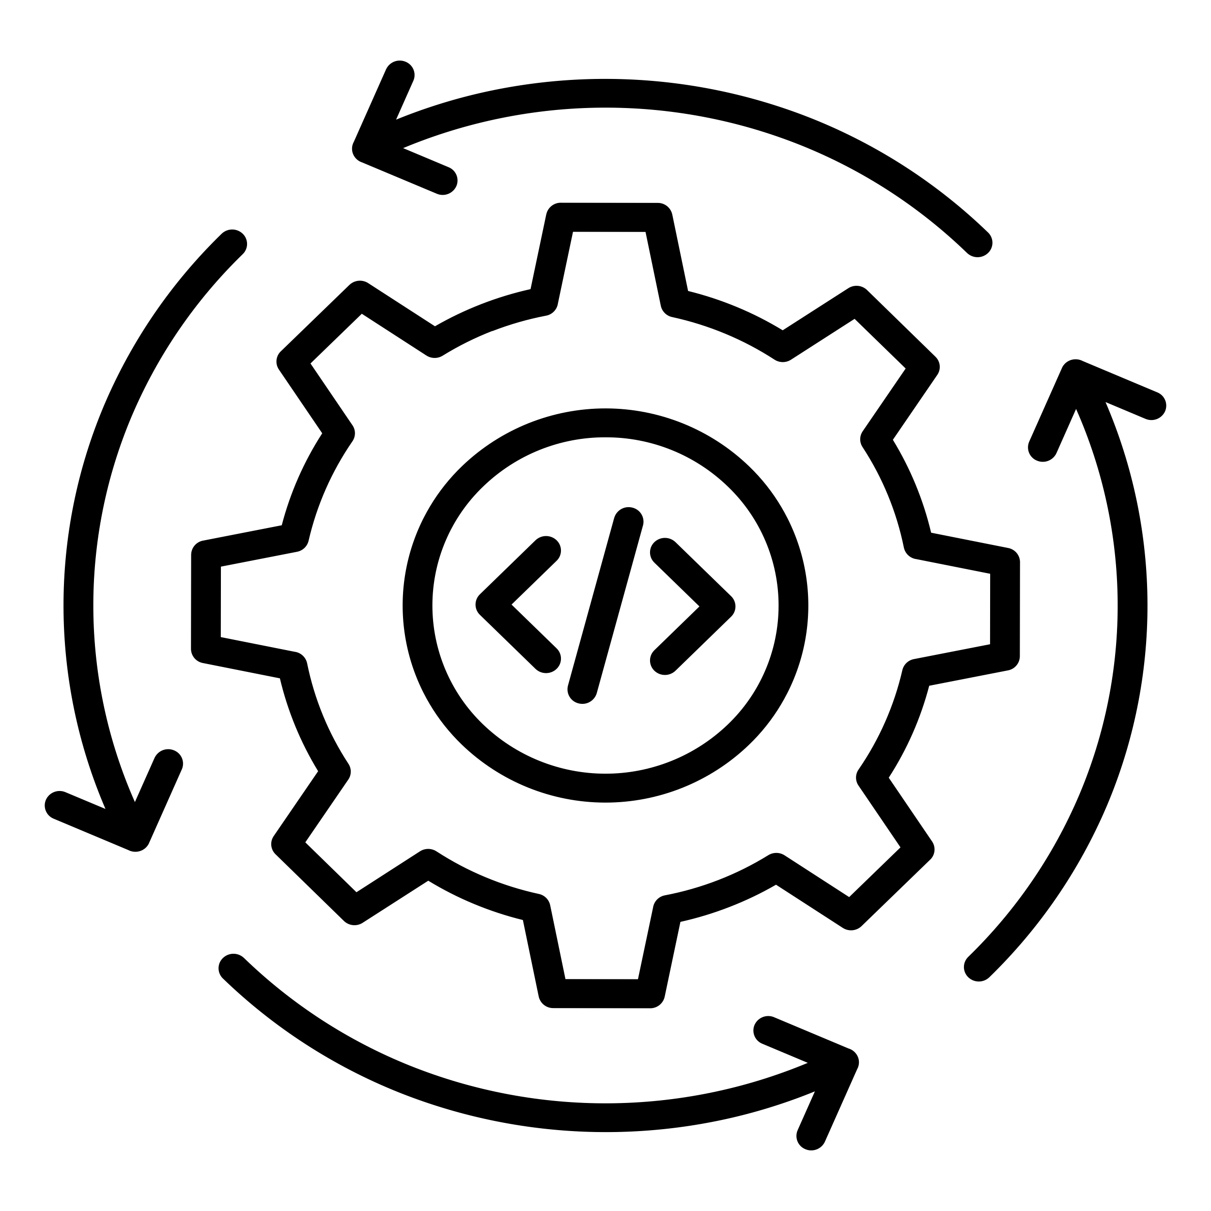
open source developers
upstream projects
The secure center
build,
test
production
deployment
automation, workflows
system administrators
delivery channel
cloud storage

Slide 6
pyaitoolkit_cp311_1.1.2_3_req.txt
Product name
Update number for
this Toolkit version
Python version
(3.11)
PyAIToolkit version
(1.1.2)

